Slide 2
Design Goals
Clarity
Interconnectivity
Modularity

Slide 3
Clarity
Visualizations designed to show one or two things
Simplicity makes relevant information obvious
Customisability removes extraneous data

Slide 4
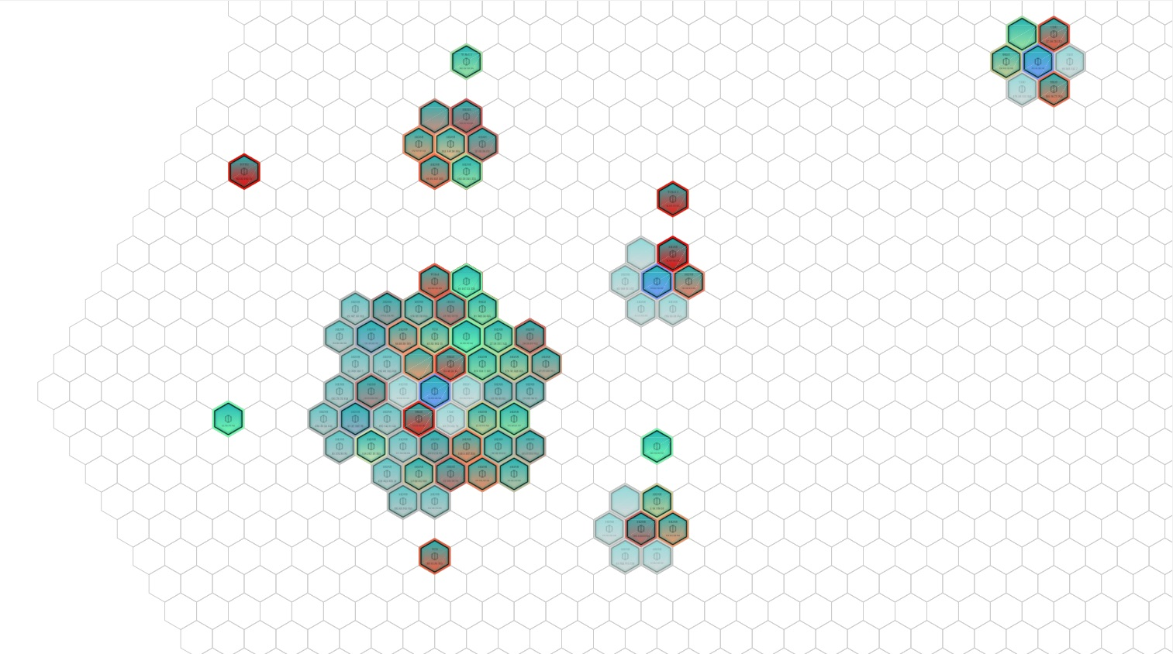
Notes:
ActivityGroups

Slide 5
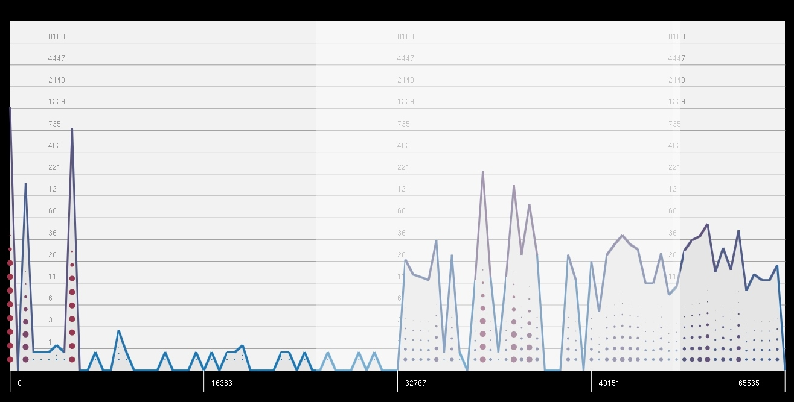
Notes:
AttributeDistribution

Slide 6
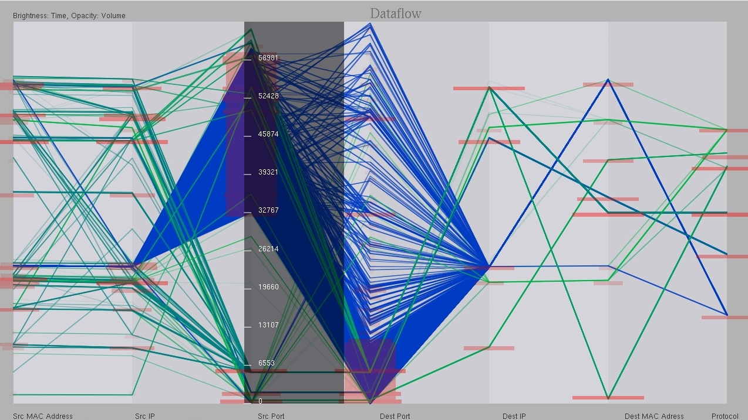
Notes:
DataFlow

Slide 7
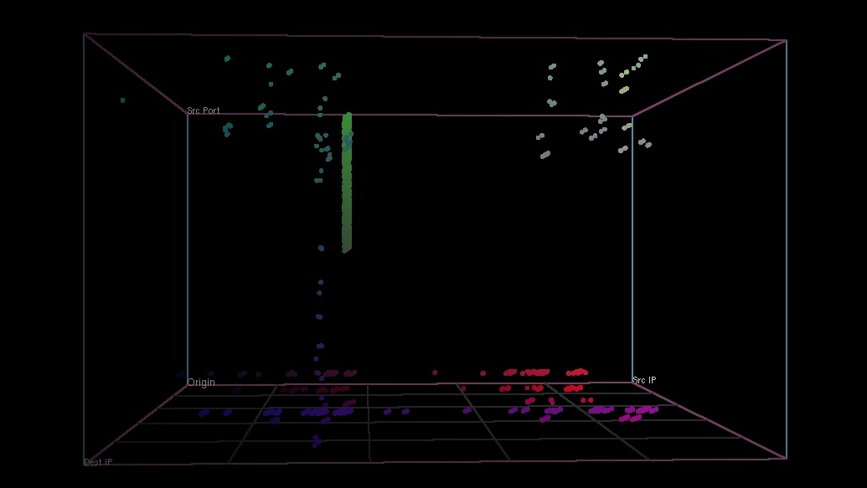
Notes:
SpinningCube

Slide 8
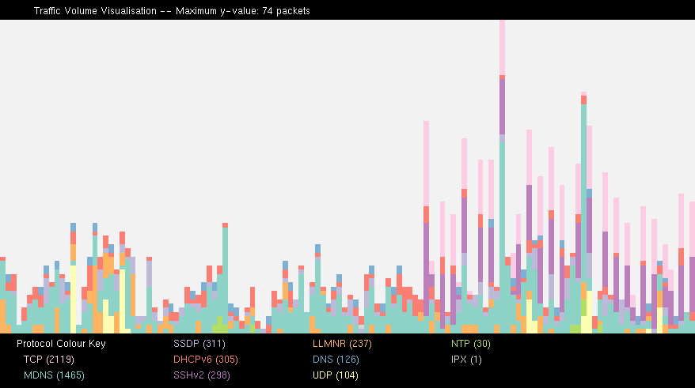
Notes:
TrafficVolume

Slide 9
Interconnectivity
Trade-off between clarity and depth
Data from one visualization can be explored in another
Use both hard and soft filters to focus on areas of interest

Slide 11
Modularity
Data Feeder
Data Controller
Hard Filters
Normalisers
Visualizations
Soft Filters
Painter

