Slide 1
组会汇报
2024/12/16

Slide 2
MCVCO: Multi-MEC Cooperative Vehicular Computation Offloading
Challenge:
The mobility of vehicles and the uneven spatial-temporal distribution of wireless infrastructures give rise to challenges such as frequent handoff and service interruption when vehicles traverse overlapping coverage areas of different MEC nodes. Moreover, the existing V2I communication architecture predominantly utilizes a single link model, which is susceptible to the fluctuating state of wireless channels.
Given the intricate nature of the edge network environment, characterized by diverse edge server configurations and constrained computation resources, sequential task offloading to these servers may result in resource congestion and imbalances.

Slide 3
Existing problem
It is widely acknowledged that the successful uploading of vehicle task data to the MEC nodes via a wireless network heavily relies on efficient data transmission. However, the majority of current research assumes stable channel conditions and constant communication bandwidth. The noise and fading of wireless channels and unknown characteristics of MEC-assisted vehicle network conditions may decrease the successful transmission probability and prolong the task completion delay. Therefore, multi-link cooperative data uploading is of vital importance to improve system performance under the changing channel state.
most existing works have designed offloading mechanisms according to the coarse-grained method, while the dependency and decomposability of the tasks are often neglected. However, a vehicular task can comprise multiple subtasks or threads

Slide 4
Main contribution
1)In view of the mobility of the vehicle and frequent topology change problem, we propose a heat-aware task offloading strategy. This method could effectively take advantage of the multi-link data uploading mechanism and improve the efficiency of task offloading by 39%.
2) A multi-MEC cooperative resource compensation algorithm based on fountain code is proposed. Employing resource compensation and collision detection, the algorithm could avoid data confusion caused by wireless network interference and outperforms 24% in data-collecting.
3) In order to achieve high efficiency of scheduling, a parallel transmission and execution based dynamic scheduling method is designed. Compared with the single process based algorithm, the proposed method can reduce 32% computation delay by fully utilizing the limited computing and transmission resources.

Slide 5
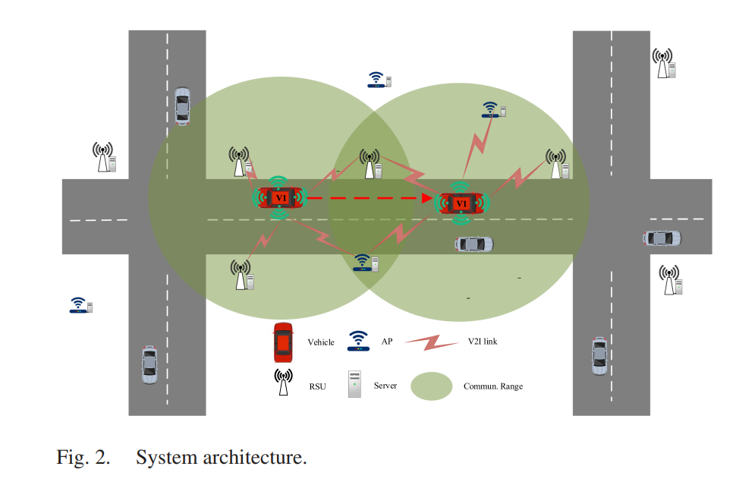
Network model

Slide 6
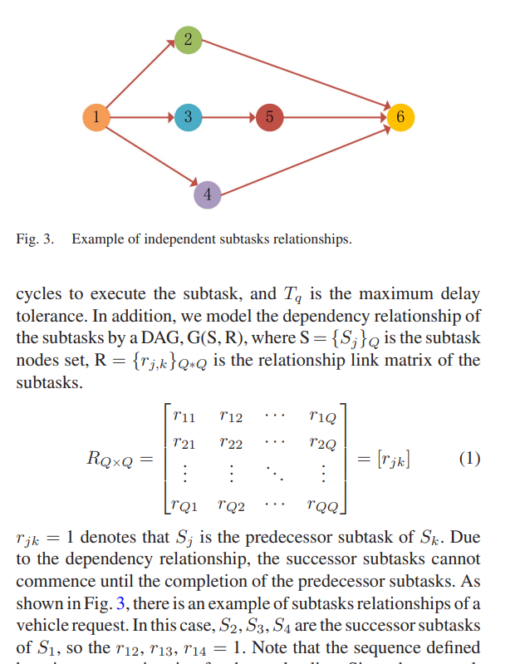
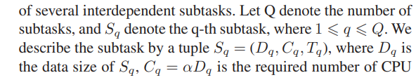
task model

Slide 7
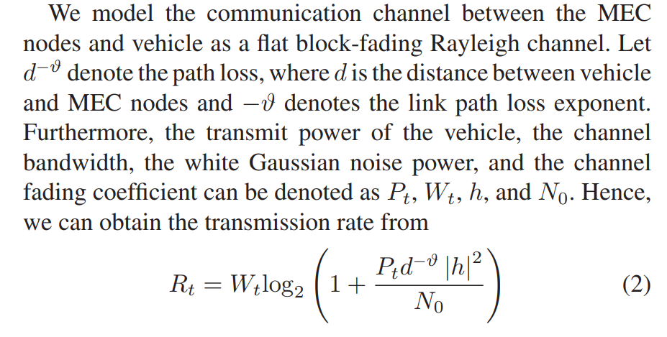
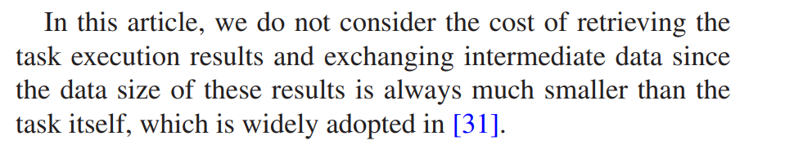
Communication model

Slide 8
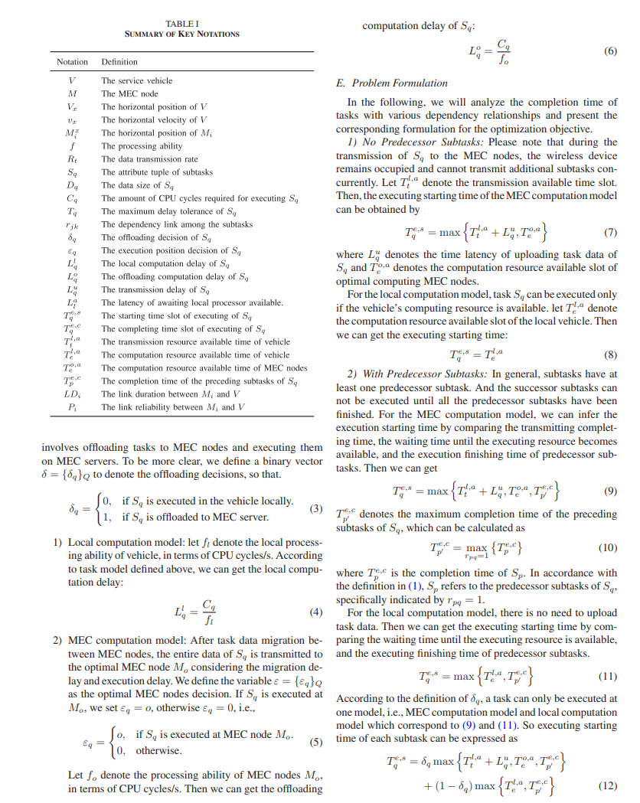
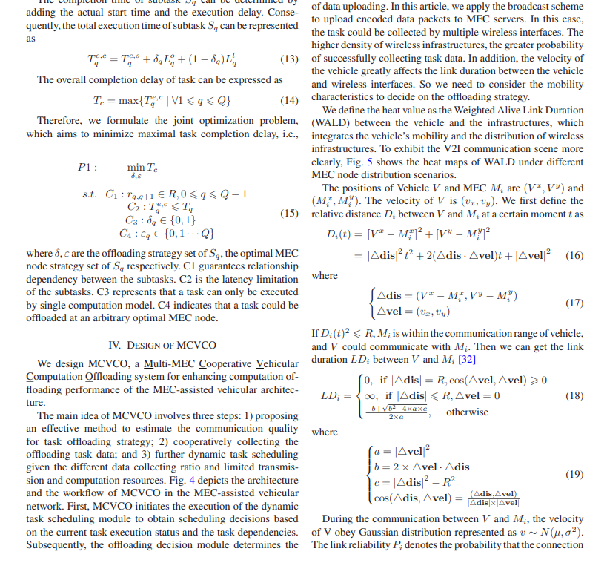

Slide 9
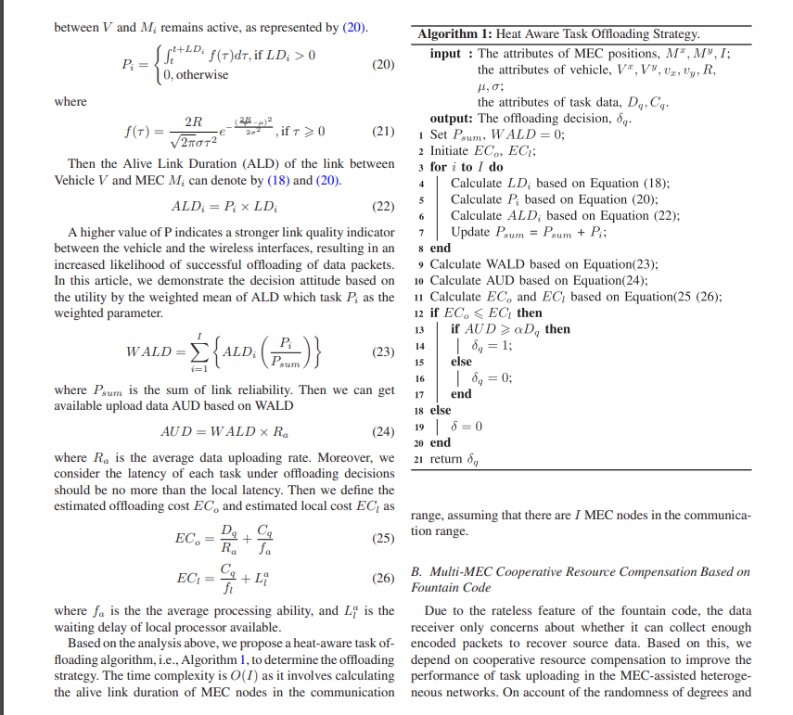

Slide 10
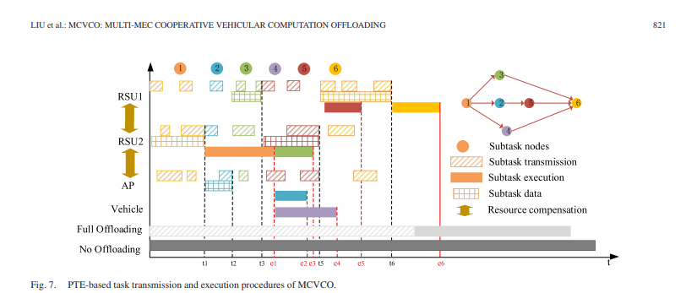
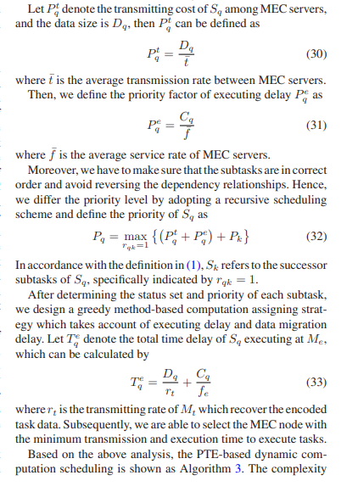

Slide 11
