Slide 1



Astrophotography Planner Business Intelligence Report
View in Power BI
Last data refresh:
7/25/2025 9:56:55 PM UTC
Downloaded at:
8/5/2025 9:31:25 PM UTC

Slide 2
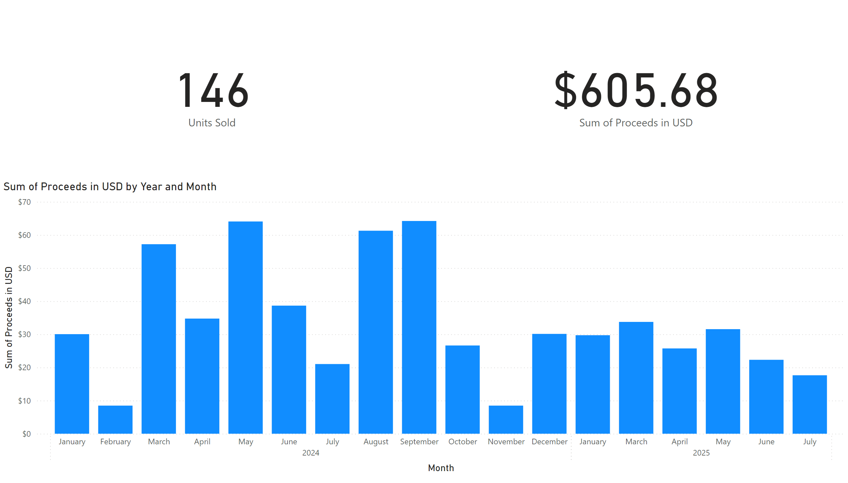
Proceeds
Notes:
dd
No alt text provided
clusteredColumnChart
No alt text provided
card
No alt text provided

Slide 3
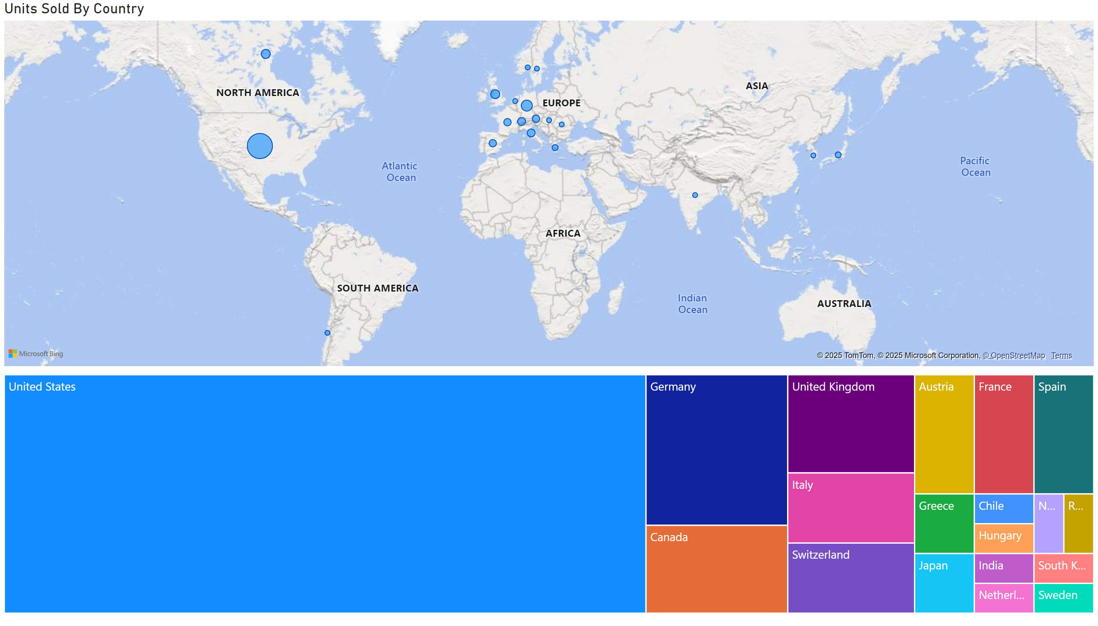
Regions
Notes:
Units Sold By Country
No alt text provided
Units Sold By Country
No alt text provided

Slide 4
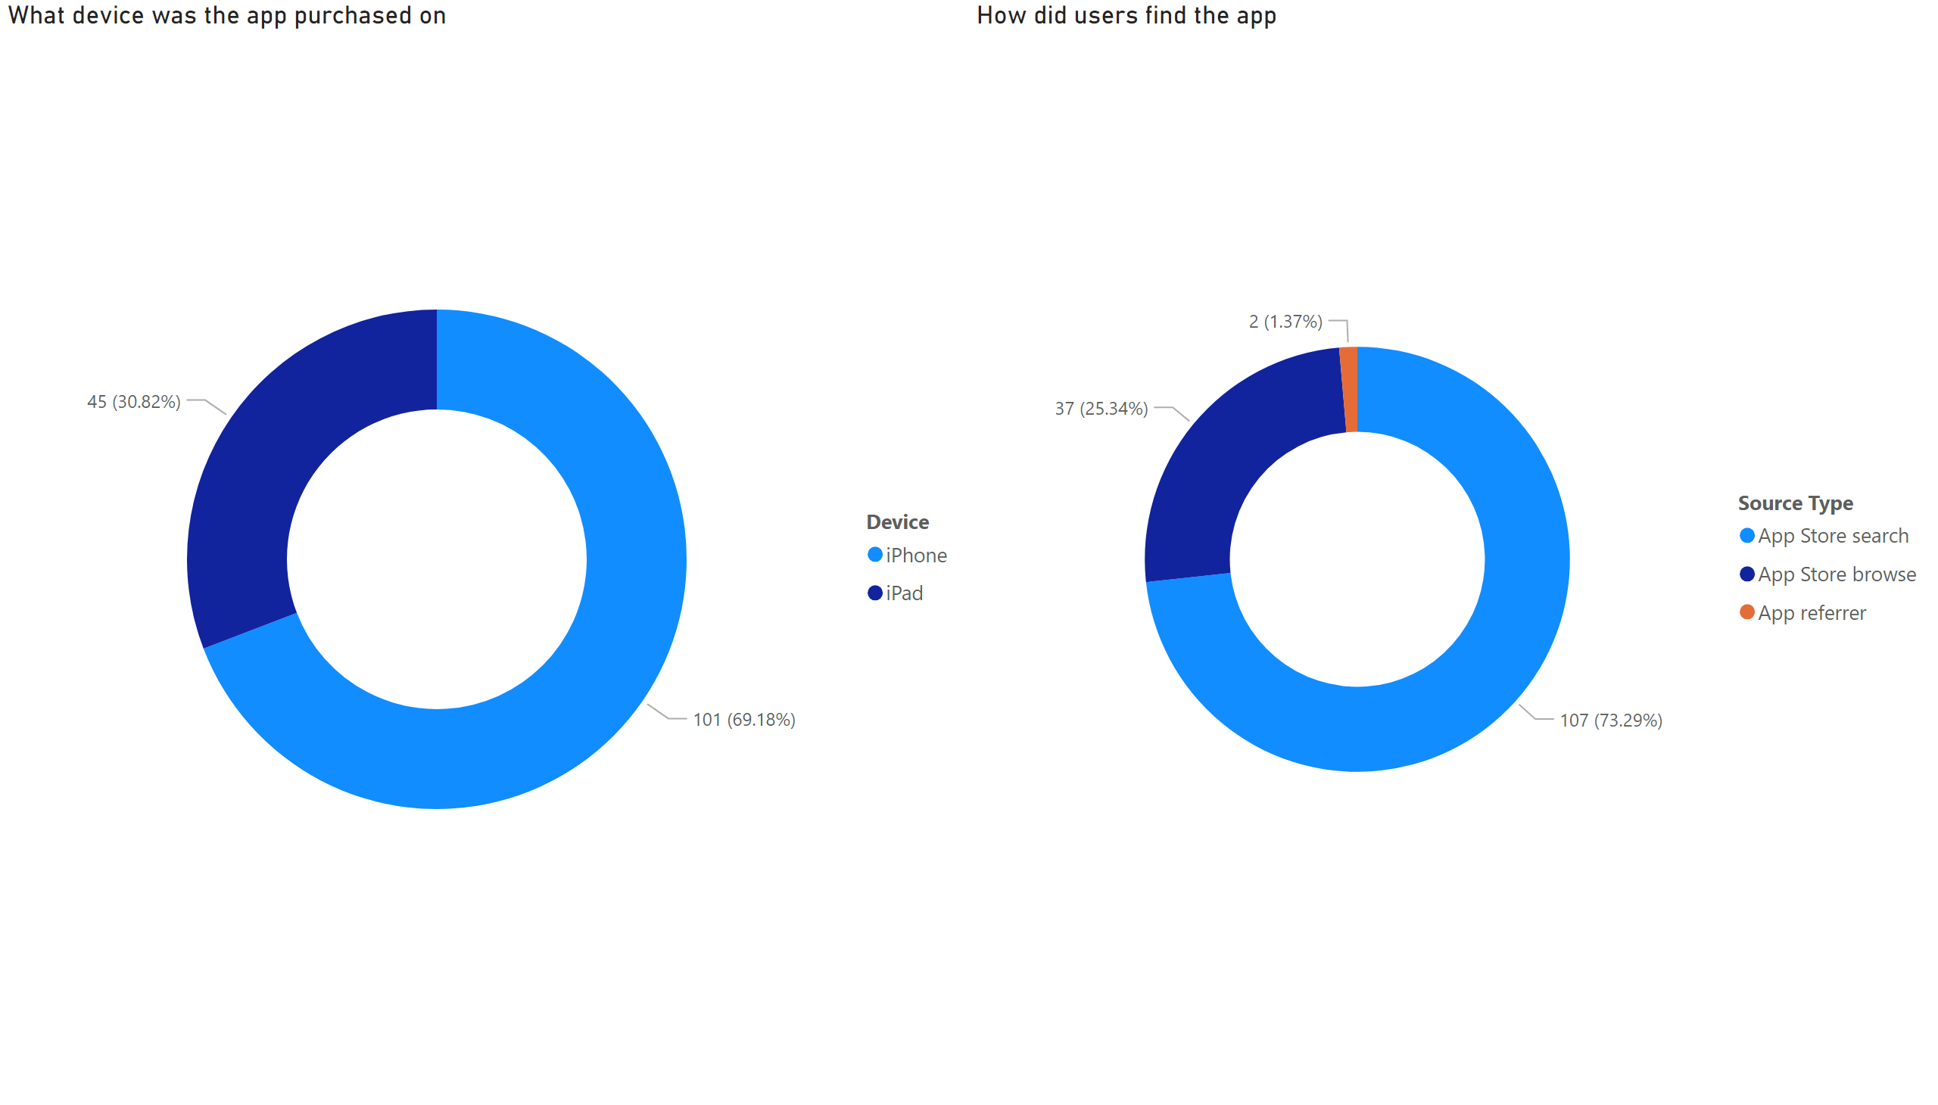
Other
Notes:
How did users find the app
No alt text provided
What device was the app purchased on
No alt text provided

