Slide 1
screentime
File created on: 7/12/25 10:58:36 PM CDT
Created by Ryan Sponzilli with Tableau

Slide 2
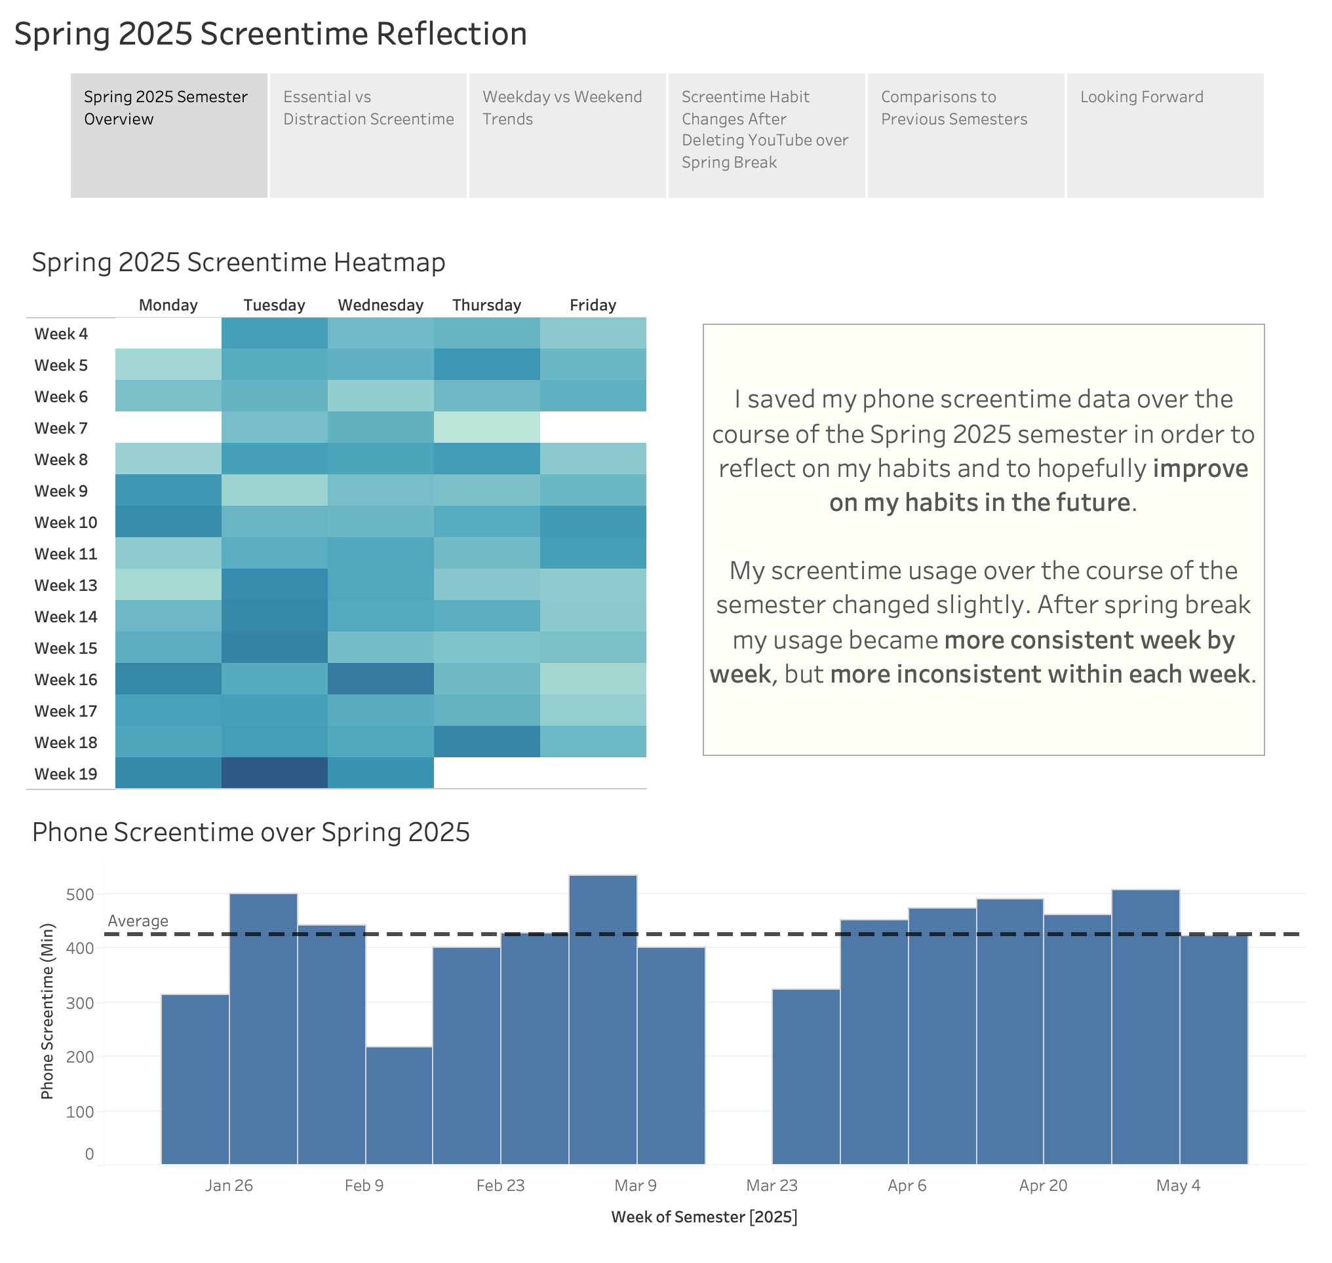

Slide 3
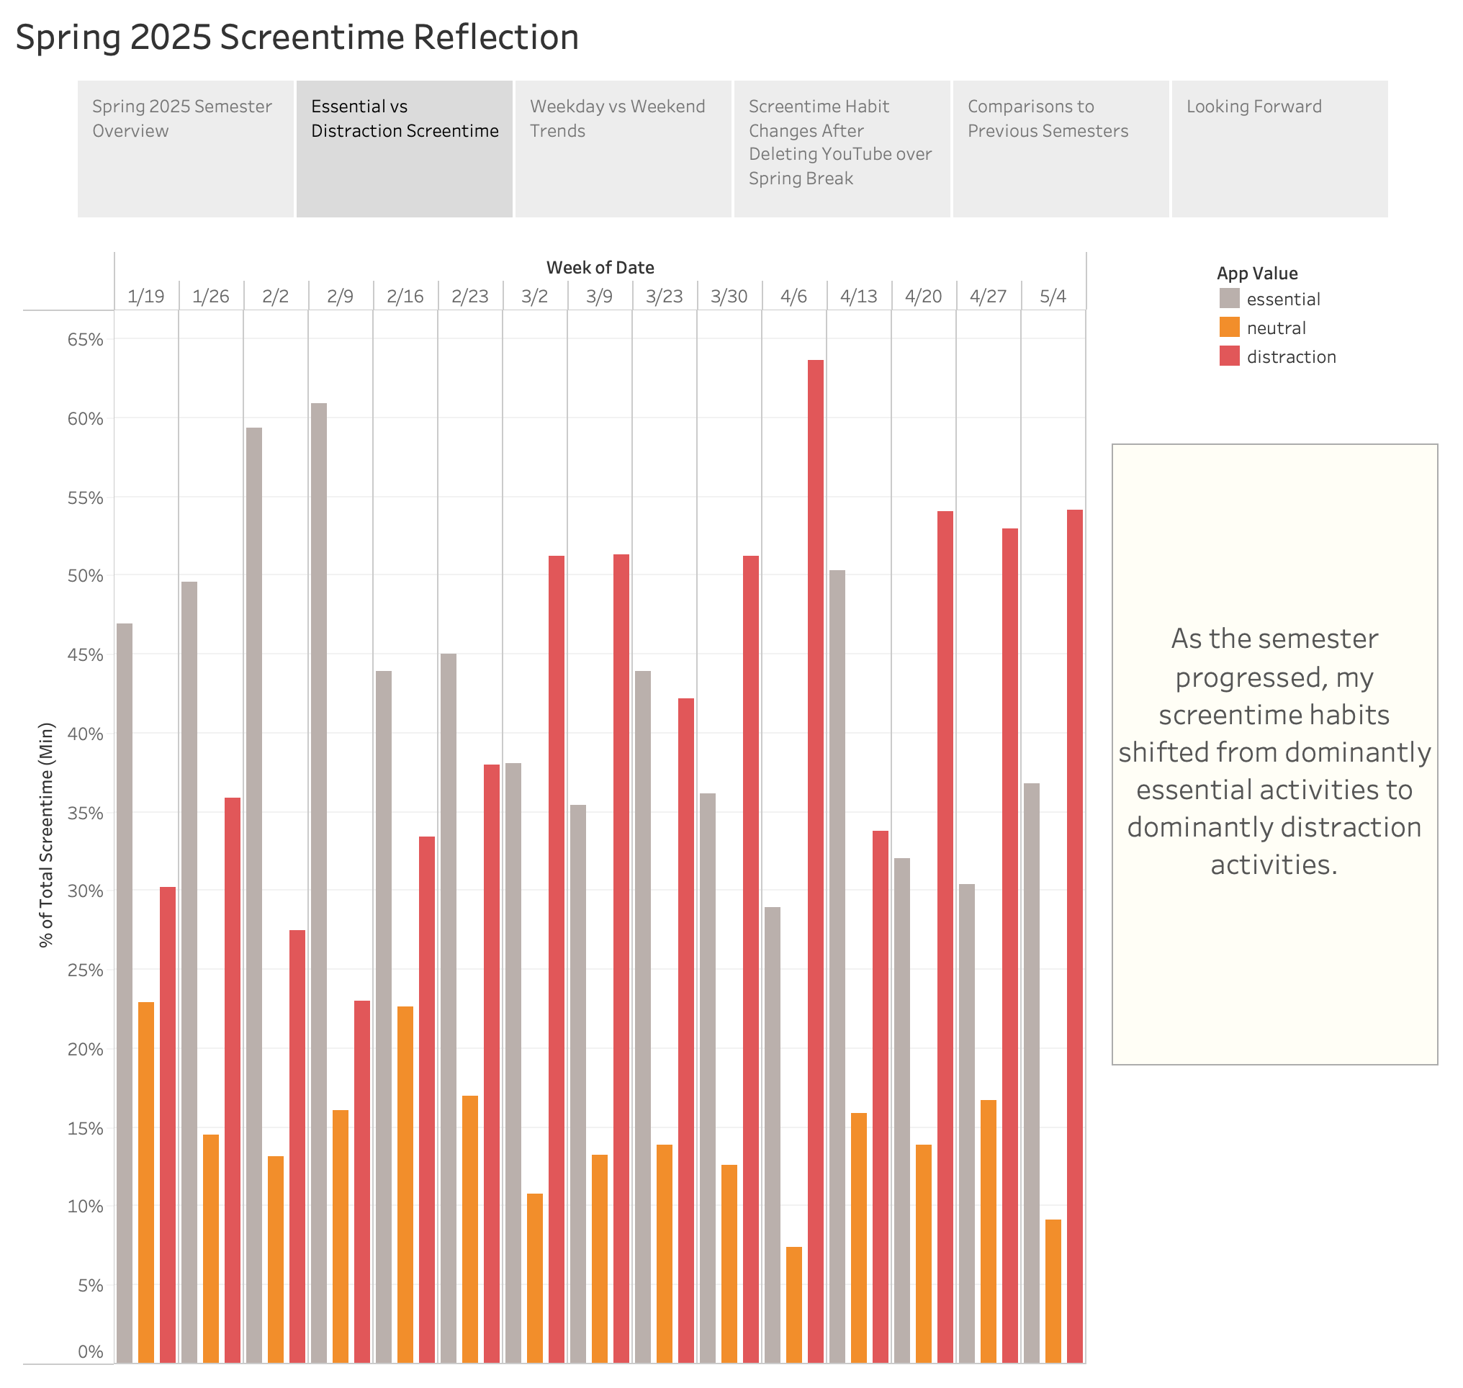

Slide 4
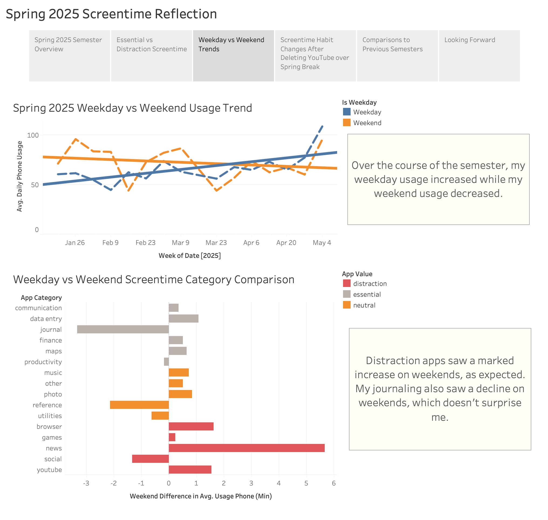

Slide 5
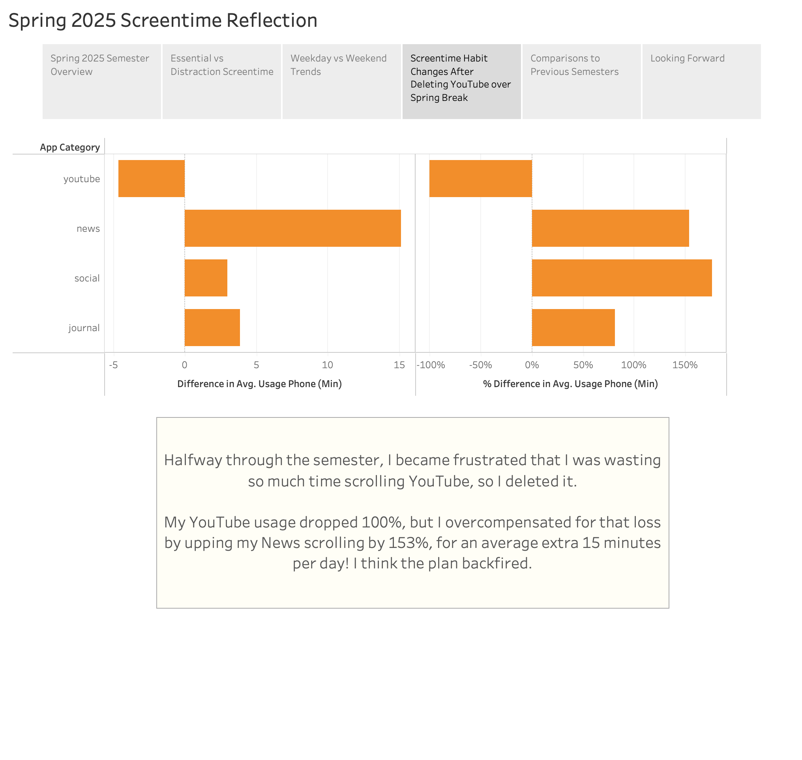

Slide 6
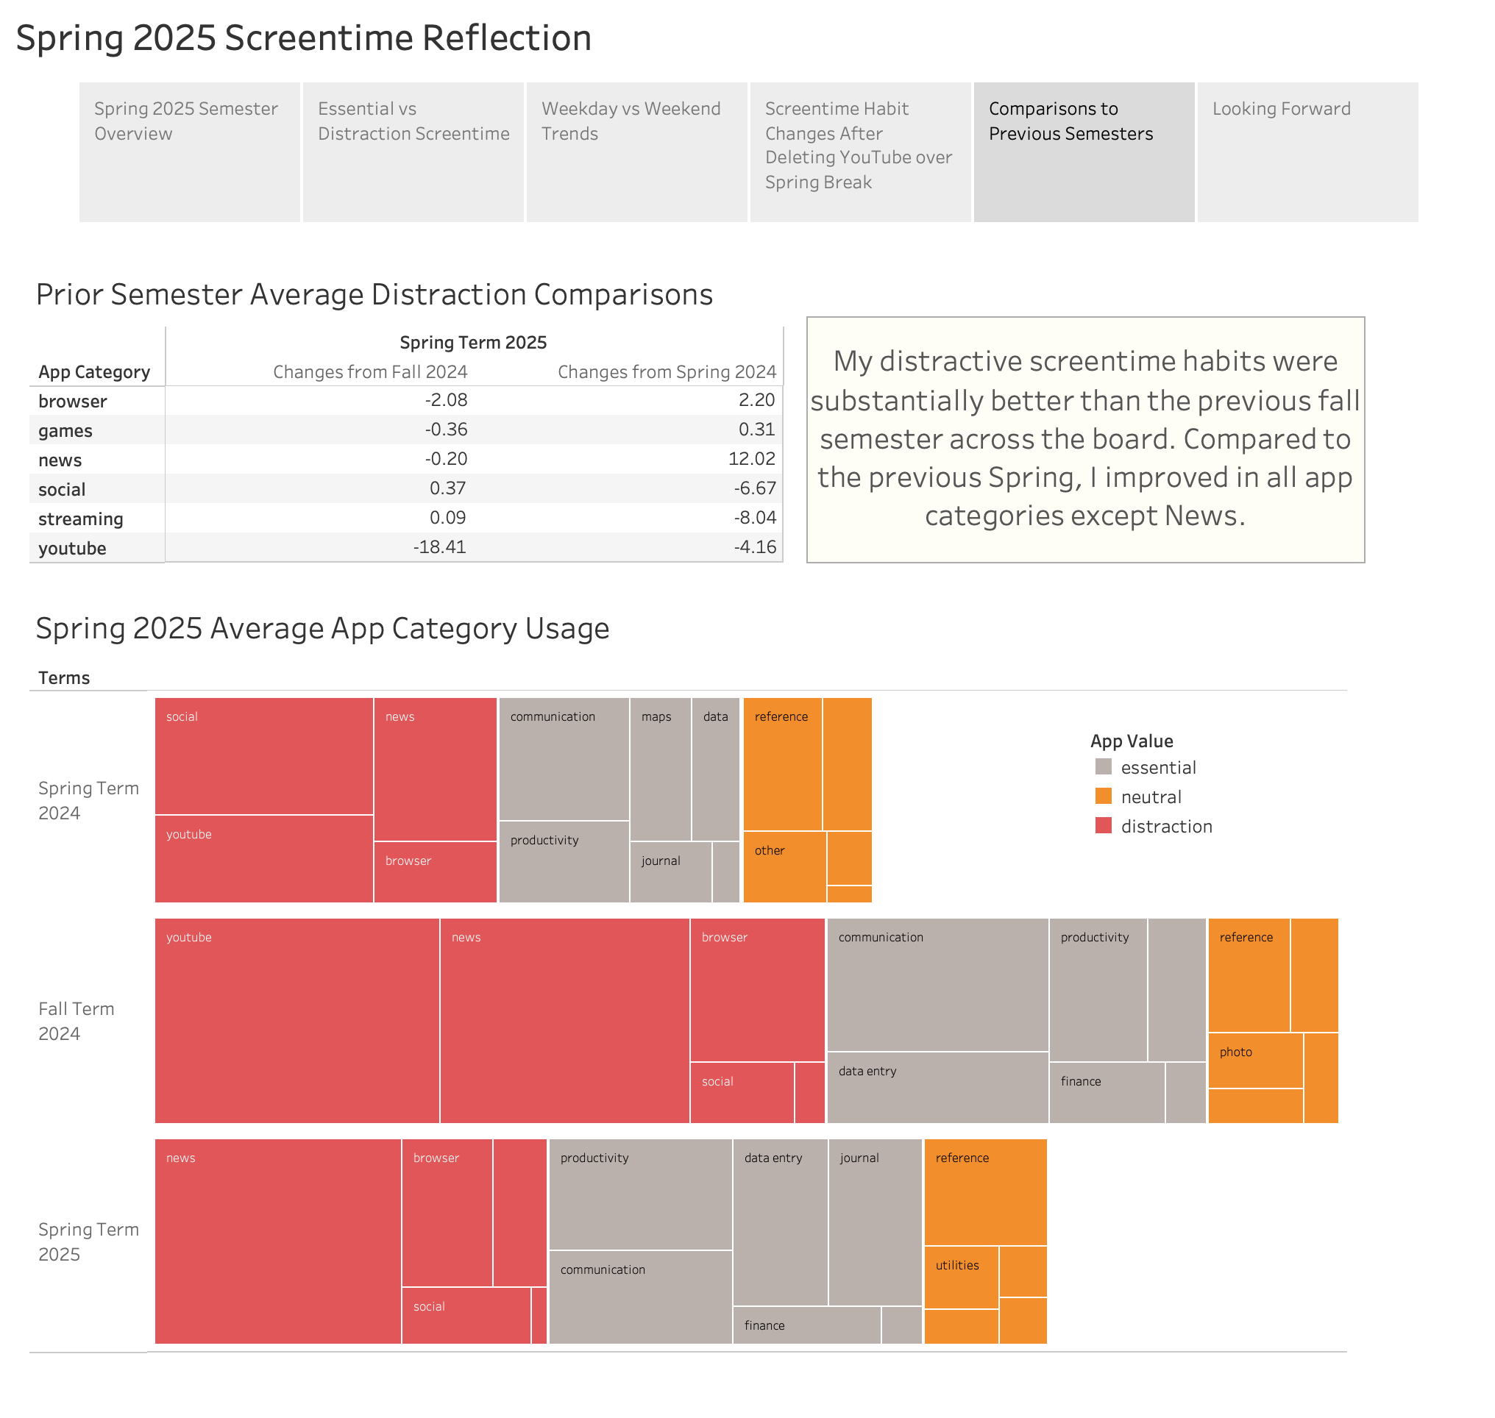

Slide 7
