Slide 1
Movie Website Project

Slide 2
The team and their roles
Tom Pohjola
- Database desing and implementation, REST-api initialization and implementation (authorization, CRUDS for account and favourites tables, flagging account for deletion and cancelling deletion, automatated deletetion of flagged accounts and cascading account data deletion, email format verification, api testing), client-side authorization (i.e. components/implementation for Logging in/out), account settings (changing password, email and account deletion), CSS-styling and REST-documentation, profile page and user icons ~ 83,5 hours of work as of 17/12
Timo Moilanen
Frontend UI design, responsiveness, frontend navigation bar components, external movie database API calls (fetching movie/series data), home page, movies/series pages, profile page, creating URL for sharing user favourite list, CRUDS for favourites table, database design, CSS-styling. ~53 hours of work as of 17/12
Eerik Pitkänen
Initialization of GitHub and maintenance of sprint, favourites and reviews components, searchbar-feature (SearchBar, SearchResult, SearchResultsList + external API calls for movie data), movie info page, react routers, contexts for favourites and reviews, database design. ~48,5 hours of work as of 14/12
(Kasper Leiviskä)
CRUDS for groups and group members tables, client-side implenentation of group page.

Slide 3
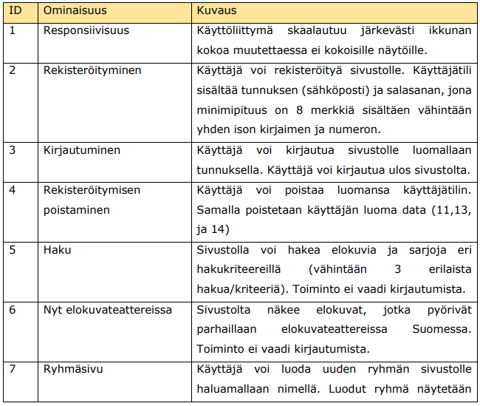
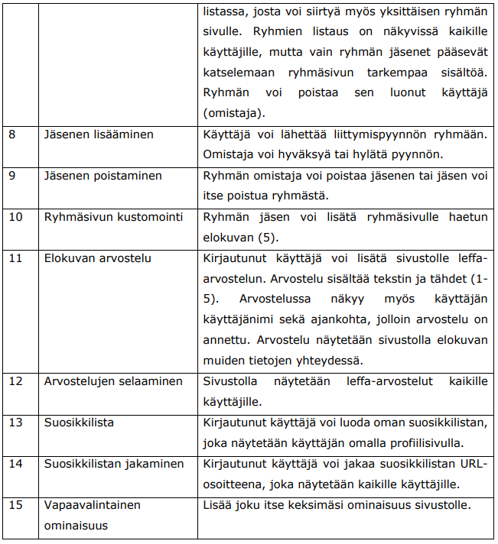
Lets talk about functionalities...

Slide 4
Thoughts about what each of us learned:
Tom
Improved undestanding of relational database design and what to consider when implementing one.
Additionally, a wide varioty of things about server-side coding such as proper user authorization, preventing common vulnerabilities and sanitizing user input for possibly malicious code injections, testing and learning to anticipate user behaviour for preventing unexpected outcomes and handling possible errors.
Timo
To plan and design an application using wireframe and database design. Fetching movie data and handling API calls. I also built responsive pages with navigation and improved the layout and styling using CSS.
Eerik
Learned planning and designing layout using wireframe. Fetching and handling API calls for both The Movie DataBase and own database. Syncing data between database and local. Styling using CSS. More Github use and now also Sprints. React components such as react-routes.

Slide 5
Thank you for listening!

