Slide 1

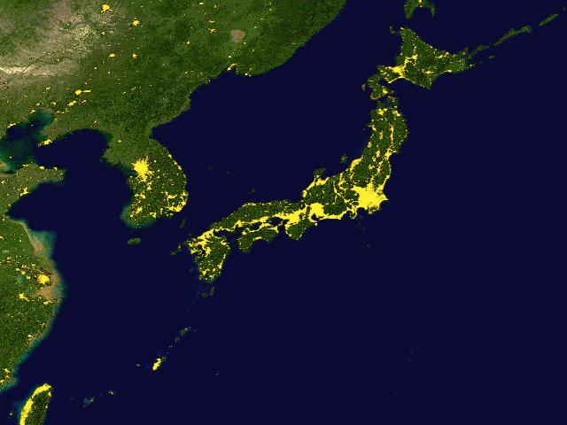
Segmental Brush Stroke Synthesis by Example
Ryoichi Ando and Reiji Tsuruno
Kyushu Univ, Japan.
Came from Here !
Notes:
Hello everyone. Thank you for coming to see our latest work titled Segmental Brush Stroke Synthesis by Example. My name is Ryoichi Ando and I came all the way from Japan. This is where I come from.

Slide 2

Background
Digital painting plays an important role
1. Education
2. Story telling
3. Production...
Segmental Brush Stroke Synthesis by Example - Ryoichi Ando
Notes:
Here I start with Introduction. Digital painting plays an important role in many ways. Children express themselves through the painting, designer tells his idea by sketching, matt painter paints photorealistic pictures which are used as a background of films. So the demands of digital painting is growing these days.

Slide 3

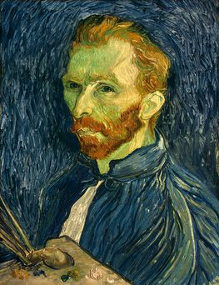
Background
Real paintings have complex visual features...
Segmental Brush Stroke Synthesis by Example - Ryoichi Ando
Notes:
In the real paintings they have complex visual features such as twisted hair movement, soft color changes, cracked pigment. And it is obvious that such detailed features make the painting look real and impressive...

Slide 4
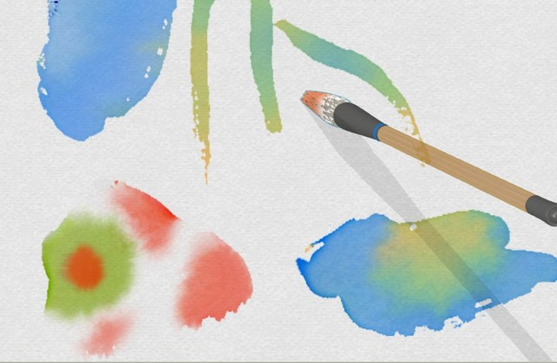
Background
Moxi [SG05]
Physical simulation is not a panacea
Segmental Brush Stroke Synthesis by Example - Ryoichi Ando
Notes:
The recent works have tried this using physical equations. For instance, Moxi, which is proposed by Nelson in 2005 combined numerical fluid simulation with deformable brushes to achieve realistic interaction of watercolor, sumie-paintings. However, (p) physical method is not a panacea. Because the method is carefully engineered to produce specific media. Additionally, it is often time consuming and slow when applied to high resolution.

Slide 5
Idea
Why not use images ?
Very easy to gather exemplar strokes !
Challenges
How to use images to generate new realistic strokes in realtime ?
- Use fast texture synthesis technique
Segmental Brush Stroke Synthesis by Example - Ryoichi Ando
Notes:
So we decided to take different approach, that is, to use numbers of captured images as an exemplar. You know, it is very easy to gather sample strokes of real brushes. So why not use them ? But here we face a challenge, that is, How to use those images to generate new stroke images ? In our approach, we employed a patch-based texture synthesis method. You know, texture synthesis can be used to extend regions, stitch images together. So it is natural to use this technique to achieve our goal.

Slide 6

Problem statement
Analyze
Exemplar
Synthesized
Segmental Brush Stroke Synthesis by Example - Ryoichi Ando
Notes:
Now we go into concrete workflow. Our conceptual problem is illustrated as follows. How to generate realistic brush image that well matches to the user’s movement of a brush, using exemplar knowledges. This is our problem.

Slide 7


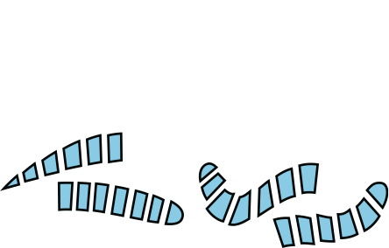
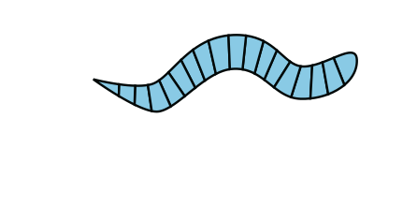
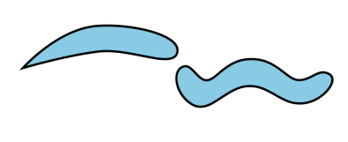
Approach
Exemplar Images
Synthesized
2
Stitching
1
Decomposition
Segmental Brush Stroke Synthesis by Example - Ryoichi Ando
Notes:
Our approach involve mainly two stages. The first stage is (p) Decomposition. Given a set of example strokes, we cut those strokes into the small pieces of rectangles. And for each piece we compute large dimensional feature vectors. The second stage is (p) Stitching. Given an input of user’s movement of brush, we stitch those pieces together to create new nice stokes.

Slide 8

Decomposition
1
Decompose using CDT
Segmental Brush Stroke Synthesis by Example - Ryoichi Ando
Notes:
Here’s a decomposition stage. To decompose give RGB strokes, we first calculate spine of the stroke and cut them along the spine. To do this, we have used Constrained Delaunay Triangulation method.

Slide 9

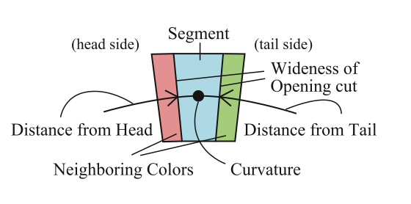

Decomposition
1
Compute Feature Vector
Segmental Brush Stroke Synthesis by Example - Ryoichi Ando
Notes:
After the decomposition, we compute a feature vector for each segment. The feature includes neighboring colors, curvature, distance from head, distance from tail and so on. Finally, these feature vectors are normalized.

Slide 10




Stitching
2
i
In such a way that
goes lower ...
energy
where
( similarity )
Segmental Brush Stroke Synthesis by Example - Ryoichi Ando
Notes:
At the stitching stage, we stitch those pieces along user’s input of path (p) to generate new nice stroke. (p), (p) in such a way that (p) sum of each energy function goes lower, where energy function denotes the similarity with neighboring segments.

Slide 11

Stitching
2
may be minimized using dynamic programming in time.
energy
- is still costly for realtime synthesis
curvature, etc..
neighboring colors, etc...
Segmental Brush Stroke Synthesis by Example - Ryoichi Ando
Notes:
The optimal solution is known to be computed efficiently in square order time using dynamic programming. But still, this is time consuming for realtime feedback. So, we adopt some approximated method to compute low energy combination. You know, energy function consists of two kinds of part: static term, and dynamic term. Static term means the energy depends on only its features such as curvature, positions and not by neighboring segments. The dynamic term depends on features of neighboring segments such as neighboring colors, and so on. So if we observe low energy for one segment, the static term should also have low energy value.

Slide 12


Stitching
2
1
Search ones with small static terms.
2
Choose the smallest one
- Not an optimal solution, but works fast in time.
Segmental Brush Stroke Synthesis by Example - Ryoichi Ando
Notes:
So we roughly choose segments of good combination as follows: First we gather segments which have low static energy value. Second, we choose the segment which has lowest dynamic energy value. This operation is repeated several times for each segment and we get approximated combination of final stroke. You know, it’s not an optimal solution, but it works fine and fast in a linear time.

Slide 13
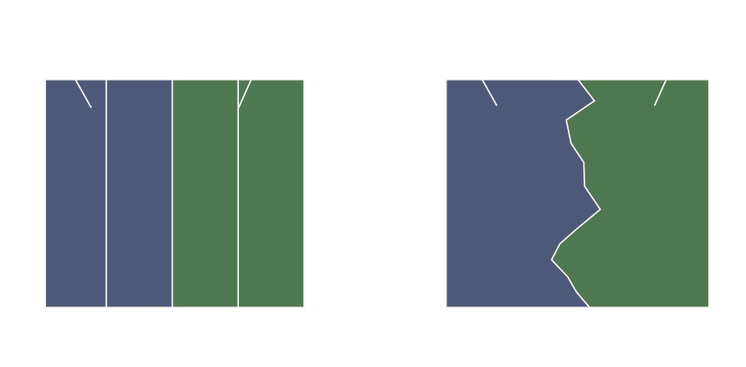
Stitching
2
Compute Min-cut
Segmental Brush Stroke Synthesis by Example - Ryoichi Ando
Notes:
But you know, some artifacts still remain around boarders. We improve this problem using min-cut method within an overlapping regions, just like a graphcut method. You may also use poisson composition to further remove this artifact, unfortunately, poisson blending is costly for realtime composition.

Slide 14
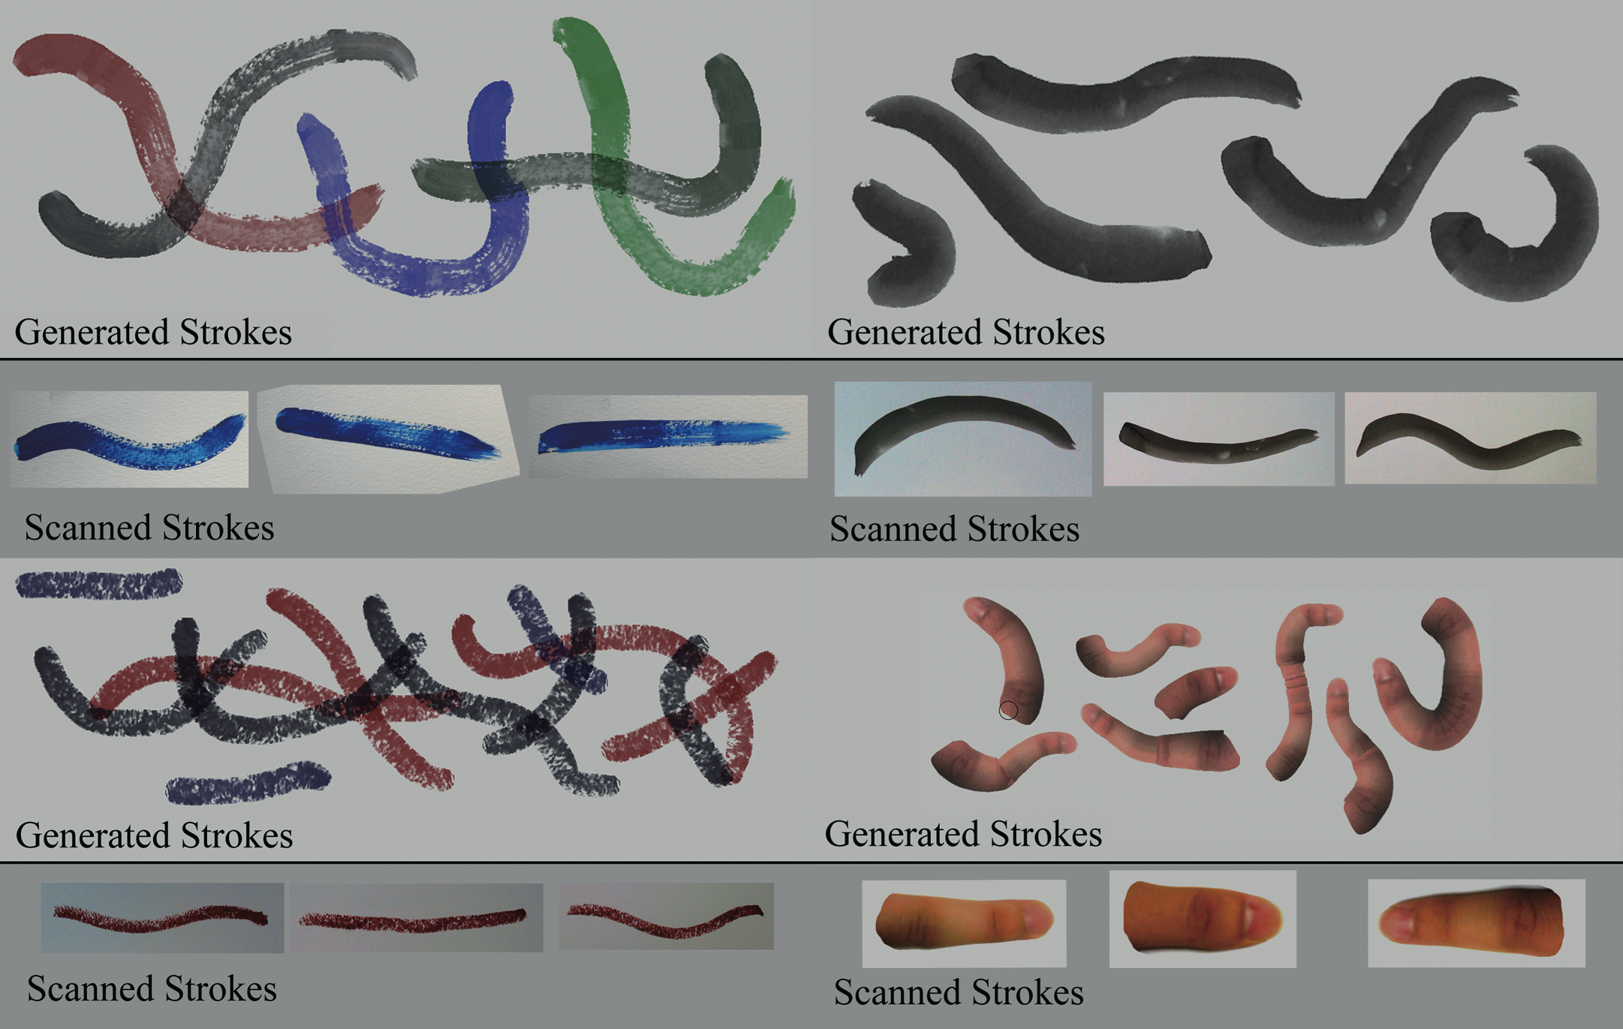
Results
Segmental Brush Stroke Synthesis by Example - Ryoichi Ando
Notes:
Here’s a brief table of generated stokes by our method. In clockwise, hairy brushes, sumie brushes, fingers, lipsticks. As you can see, some artifacts still remain. But most of the brushes are nicely generated like this.
And here’s some videos....

Slide 15
Future work
Poisson blending on GPUs [Farbman SG09]
Pack features ( PCA Projection )
Find good features ( tilt, pressure ) ?
Segmental Brush Stroke Synthesis by Example - Ryoichi Ando
Notes:
In future work, we would like to improve our method as follows: Use fast poisson blending to remove artifacts around boarders. You know, recently, a fast poisson blending method has been proposed in Siggraph 2009 by farbman, so we would like to incorporate this into our method. Pack features, you know, low dimensional feature vector allows us to search nearest features more quickly. And the last one is to find good features. You know, there’re a lot of selection of features. For example, we would like to measure tilt, pressure of a brush, to generate more natural strokes.

Slide 16
Conclusion
We proposed an image-based brush generation method
We employed a 1D texture synthesis method combined with min-cut method to generate strokes
Segmental Brush Stroke Synthesis by Example - Ryoichi Ando
Notes:
In conclusion, we have proposed a new method to generate stroke images by example. Our approach was to decompose example strokes into the pieces of rectangle sources and stitch them together using 1D texture synthesis and min-cut method to generate natural strokes. As seen from the result, we succeeded to simulate large variety of brushes instantly. In the future work, we would like to improve our method and generate more realistic strokes. Thank you !

