Slide 1

“Hangman”
Invent Your Own Computer Games with Python

Slide 2
Introduction
ASCII Art
“Hangman”
  Sample Run
  Source Code
Designing the Program
Code Explanation
Things Covered In This Chapter

Slide 3
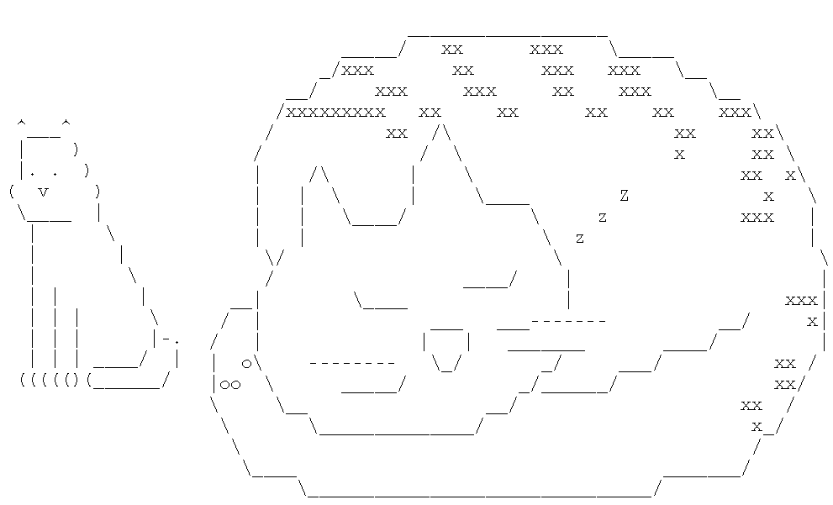
ASCII Art
ASCII Art
  Half of the lines of code in the Hangman aren't really code at all.
  Multiline Strings that use keyboard characters to draw pictures.
    ASCII stands for American Standard Code for Information Interchange

Slide 4
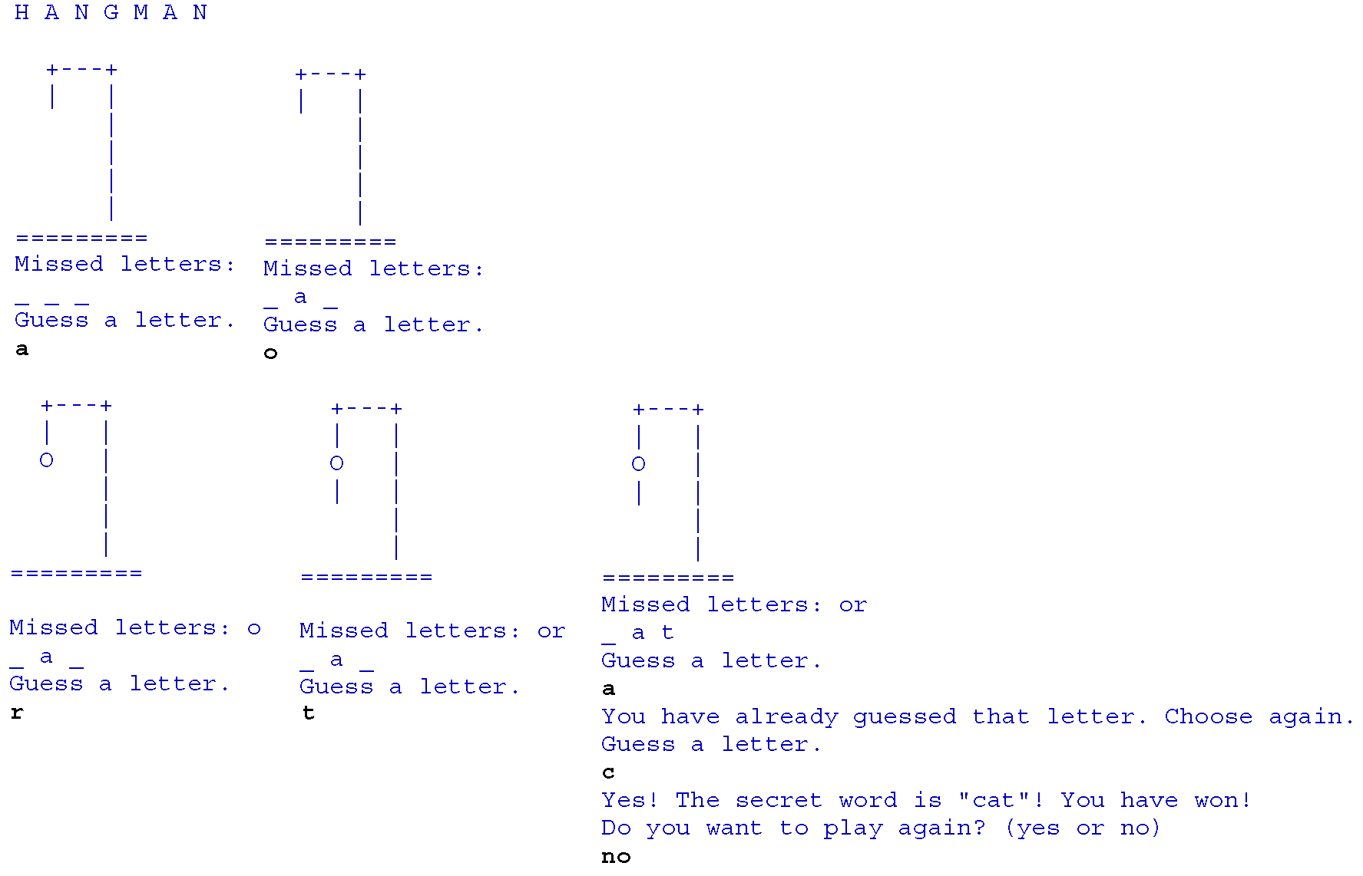
“Hangman”
Sample Run

Slide 5
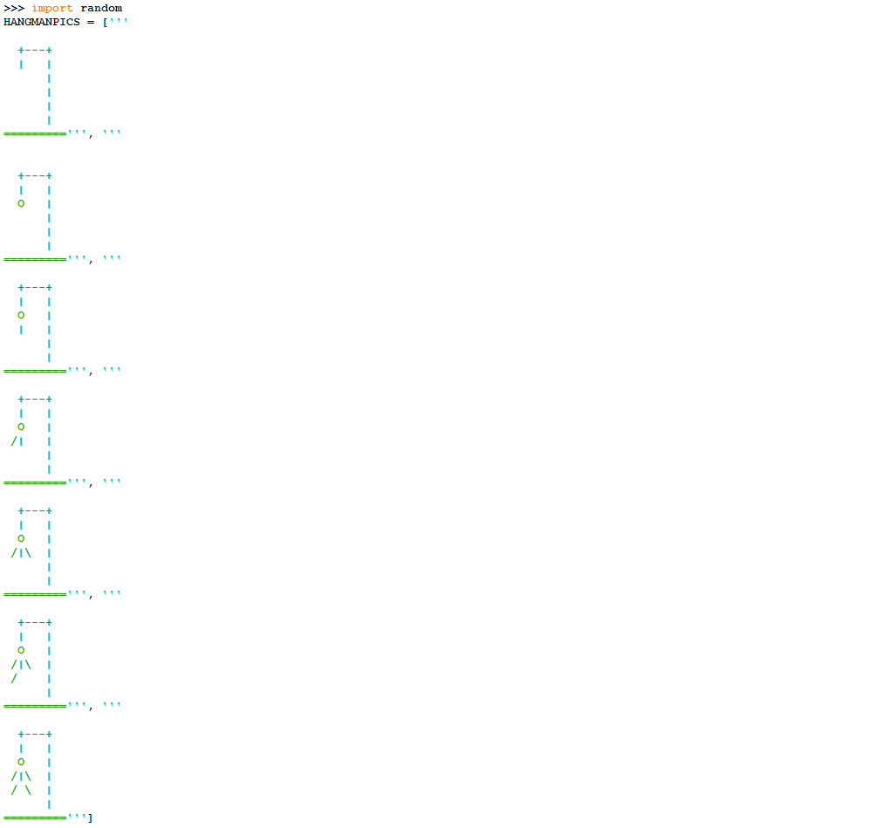
“Hangman”
Source Code(1/4)

Slide 6
“Hangman”
Source Code(2/4)

Slide 7
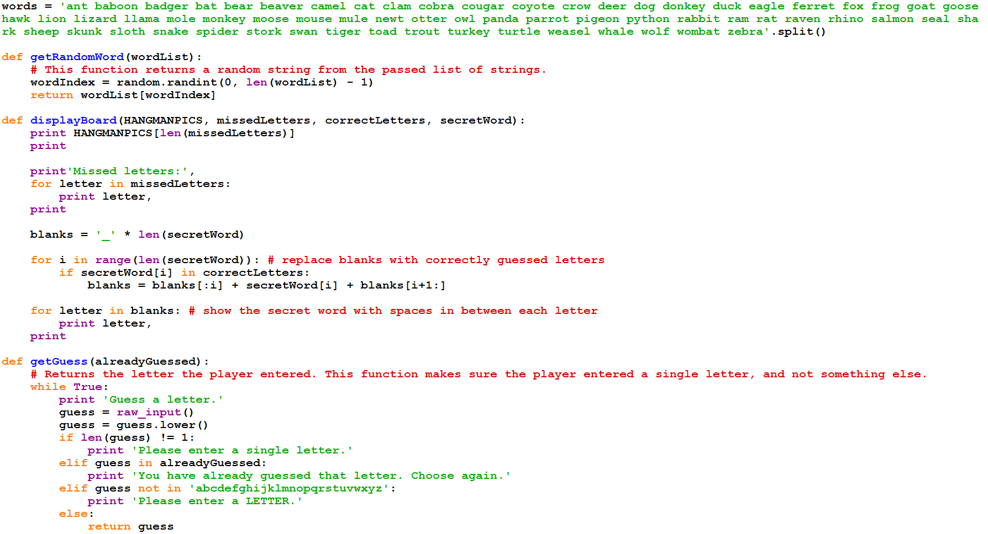
“Hangman”
Source Code(3/4)

Slide 8
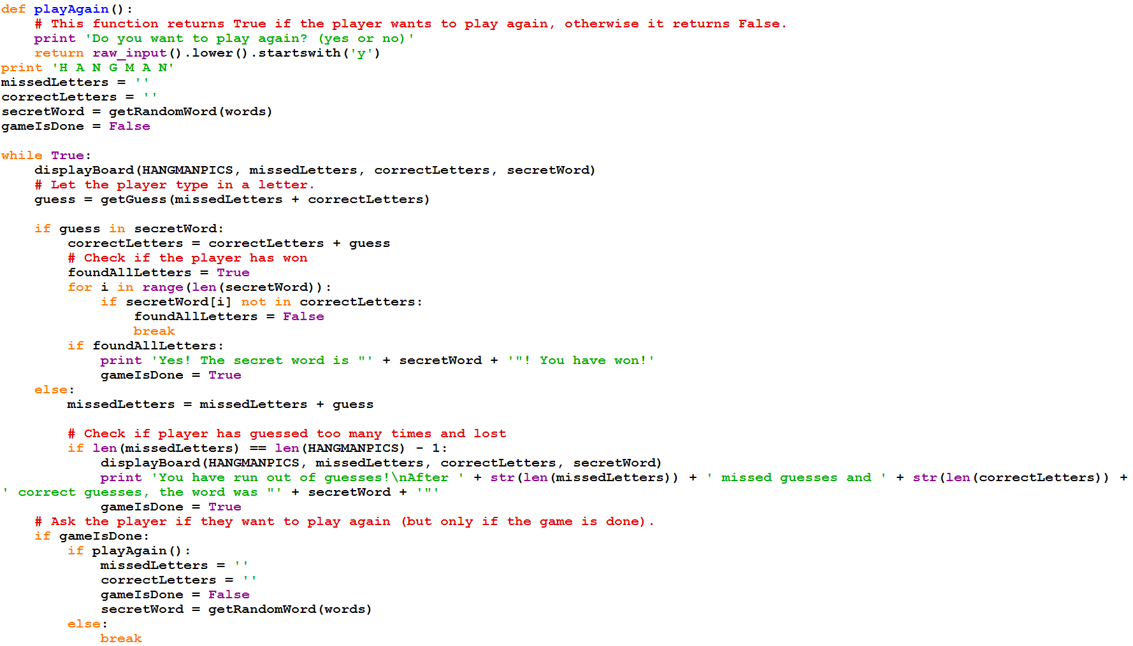
“Hangman”
Source Code(4/4)

Slide 9
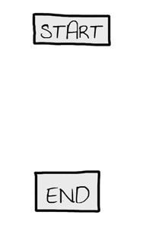
Designing the Program
Designing a Program with a Flowchart
  Create a flow chart to help us visualize what this program will do.
  A flow chart is a diagram that shows a series of steps as a number of boxes connected with arrows.
  Begin your flow chart with a Start and End box.

Slide 10
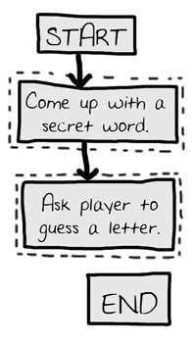
Designing the Program
Designing a Program with a Flowchart
  Draw out the first two steps of Hangman as boxes with descriptions.

Slide 11
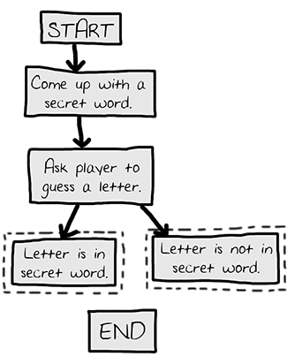
Designing the Program
Designing a Program with a Flowchart
  There are two different things that could happen after the player guesses, so have two arrows going to separate boxes.

Slide 12
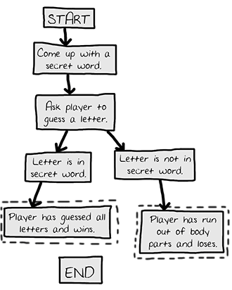
Designing the Program
Designing a Program with a Flowchart
  After the branch, the steps continue on their separate paths.

Slide 13
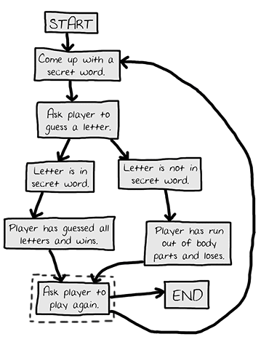
Designing the Program
Designing a Program with a Flowchart
  The game ends if the player
  doesn't want to play again,
  or the game goes back to the beginning.

Slide 14
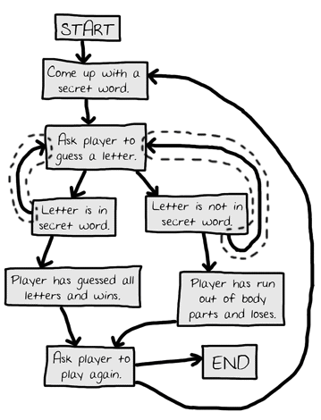
Designing the Program
Designing a Program with a Flowchart
  The game does not always end after a guess. The new arrows show that the player can guess again.

Slide 15
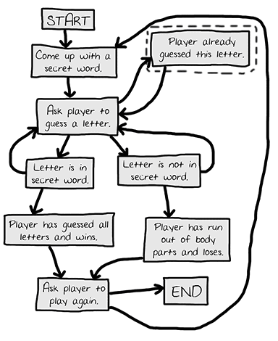
Designing the Program
Designing a Program with a Flowchart
  Adding a step in case the player guesses a letter they already guessed.

Slide 16
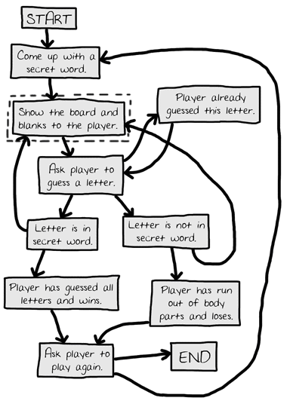
Designing the Program
Designing a Program with a Flowchart
  Adding "Show the board and blanks to the player." to give the player feedback.

Slide 17

Code Explanation
How the Code Works
  The Hangman program is going to randomly select a secret word from a list of secret words.
    This means we will need the random module imported.

Slide 18
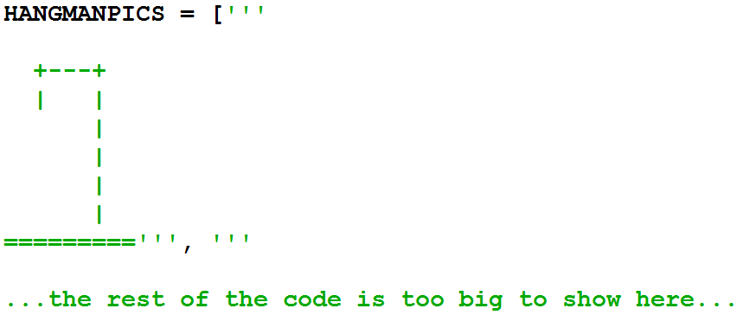
Code Explanation
How the Code Works
  This "line" of code is a simple variable assignment.
    but it actually stretches over several real lines in the source code.

Slide 19
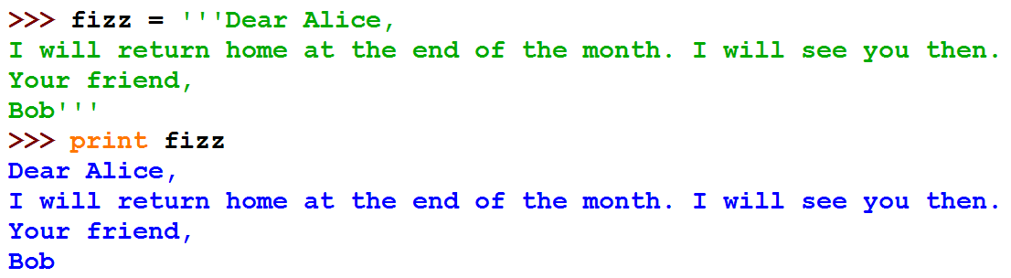
Code Explanation
Multi-line Strings
  if you use three single-quotes instead of one single-quote to begin and end the string, the string can be on several lines.

Slide 20
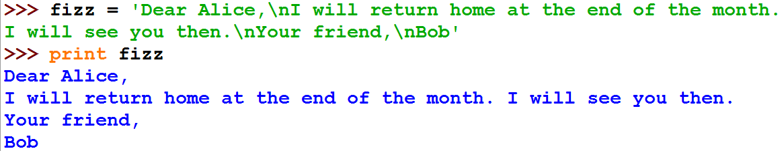
Code Explanation
Multi-line Strings
  we would have to use the \n escape character to represent the new lines.
    can make the string hard to read in the source code.

Slide 21
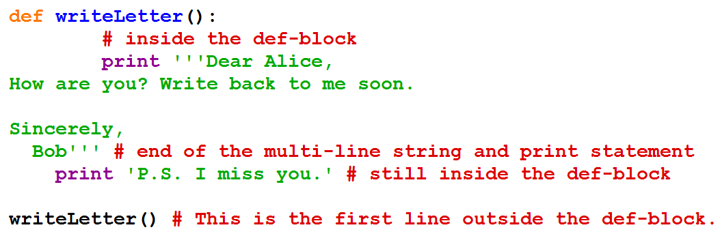
Code Explanation
Multi-line Strings
  Do not have to keep the same indentation to remain in the same block.
  Within the multi-line string, Python ignores the indentation rules it normally has for where blocks end.

Slide 22
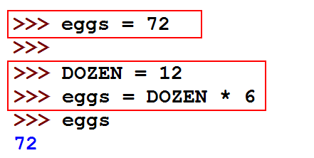
Code Explanation
Constant Variables
  HANGMANPICS's name is in all capitals.
    This is the programming convention for constant variables.
    Constants are variables whose values do not change throughout the program.

Slide 23
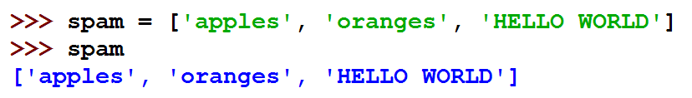
Code Explanation
Lists
  A list value can contain several other values in it.
    This is a list value that contains three string values.
    Just like any other value, you can store this list in a variable.

Slide 24
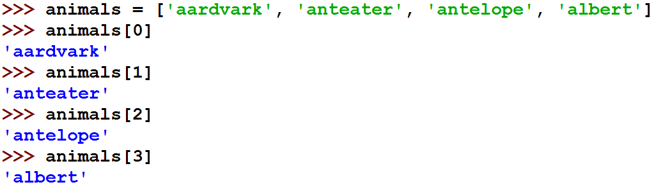
Code Explanation
Lists
  The individual values inside of a list are also called items.
    The square brackets can also be used to get an item from a list.
    The number between the square brackets is the index.

Slide 25
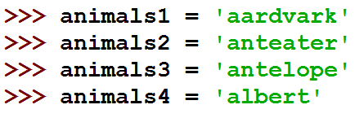
Code Explanation
Lists
  Lists are very good when we have to store lots and lots of values.
    but we don't want variables for each one.
    Otherwise we would have something like this:

Slide 26

Code Explanation
Lists
  Using the square brackets
    you can treat items in the list just like any other value.
    the expression animals[0] + animals[2] is the same as 'aardvark' + 'antelope'.

Slide 27

Code Explanation
Quiz
  What happens if we enter an index that is larger than the list's largest index?

Slide 28
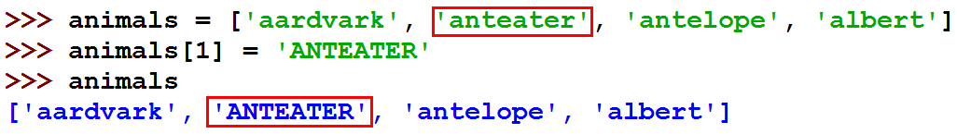
Code Explanation
Changing the Values of List Items with Index Assignment
  Use the square brackets to change the value of an item in a list.
    overwritten with a new string.

Slide 29
Code Explanation
List Concatenation
  Join lists together into one list with the + operator.
    this is known as list concatenation.

Slide 30
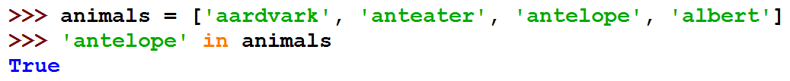
Code Explanation
The in Operator
  Makes it easy to see if a value is inside a list or not.
    Expressions that use the in operator return a Boolean value.
    True if the value is in the list
    False if the value is not in the list.

Slide 31
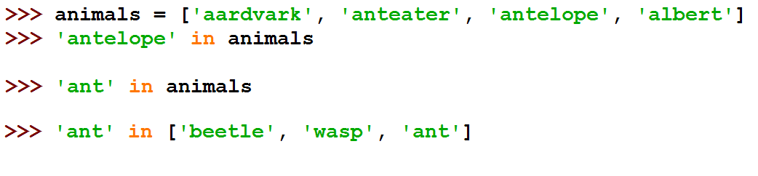
Code Explanation
Quiz

Slide 32
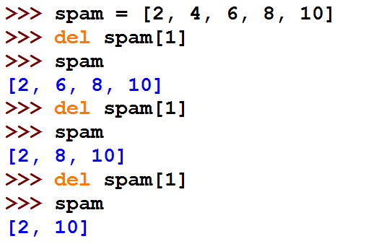
Code Explanation
Removing Items from Lists with del Statements
  You can remove items from a list with a del statement.

Slide 33
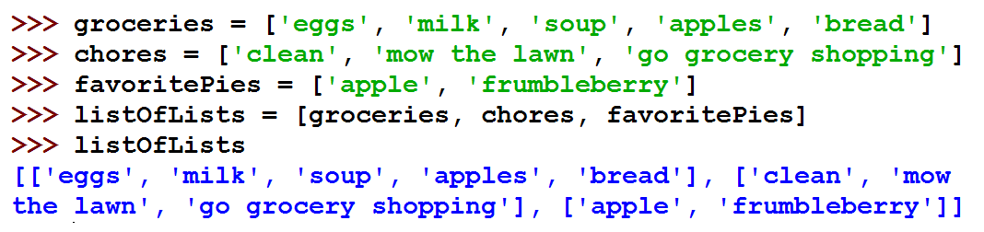
Code Explanation
Lists of Lists
  Lists are a data type that can contain other values as items in the list.
    But these items can also be other lists.

Slide 34
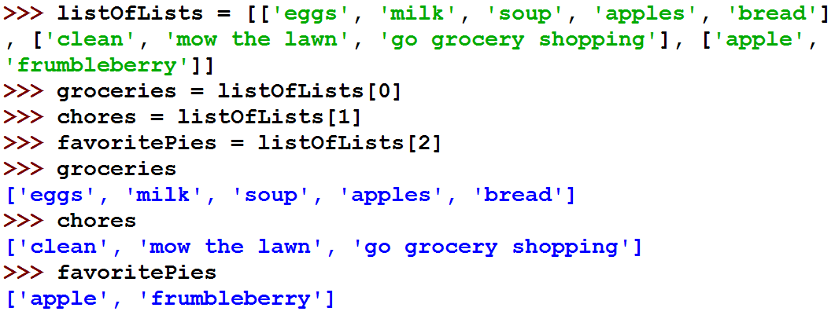
Code Explanation
Lists of Lists
  You could also type the following and get the same values for all four variables.

Slide 35
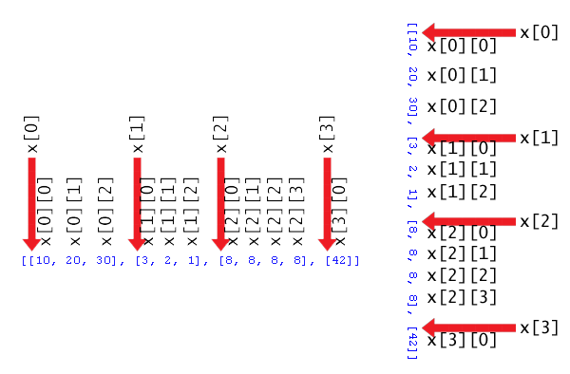
Code Explanation
Lists of Lists
  The indexes of a list of lists.

Slide 36
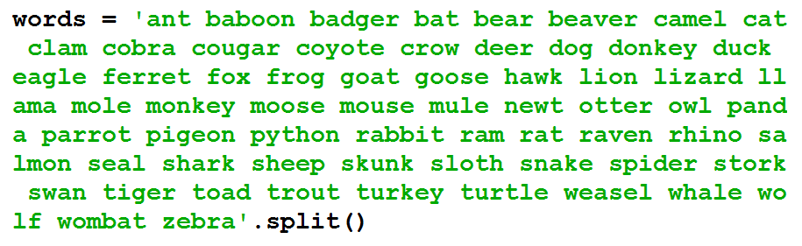
Code Explanation
List of multi-line strings
  Assign a list to the variable words.

Slide 37
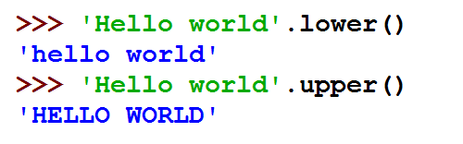
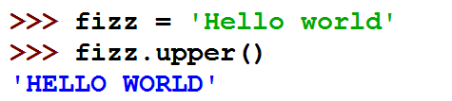
Code Explanation
Methods
  Methods are just like functions, but they are always attached to a value.
  The lower() and upper() String Methods
  Can call a string method on that variable.

Slide 38
Code Explanation
Quiz
>>> type('Hello world')
>>> help(str)
>>> str.upper('Hello world')
>>> 'Hello world'.upper()
>>> str.lower(str.upper('Hello world'))

Slide 39
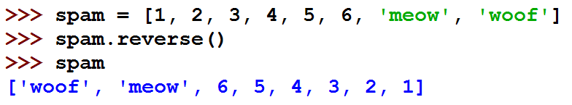
Code Explanation
Methods
  The reverse()List Method
    reverse the order of the items in the list.

Slide 40
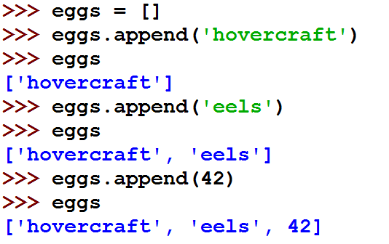
Code Explanation
Methods
  The append() List Method
    add the value you pass as an argument to the end of the list.

Slide 41
Code Explanation
Methods
  The split() List Method
    This line is just one very long string, full of words separated by spaces.
    The split()method changes this long string into a list, with each word making up a single list item.

Slide 42
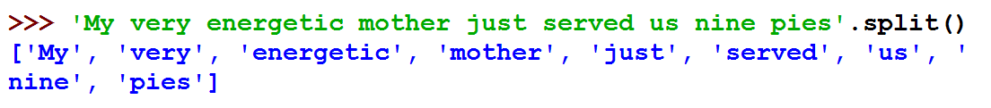
Code Explanation
Methods
  The split() List Method
    For an example of how the split()string method works.

Slide 43
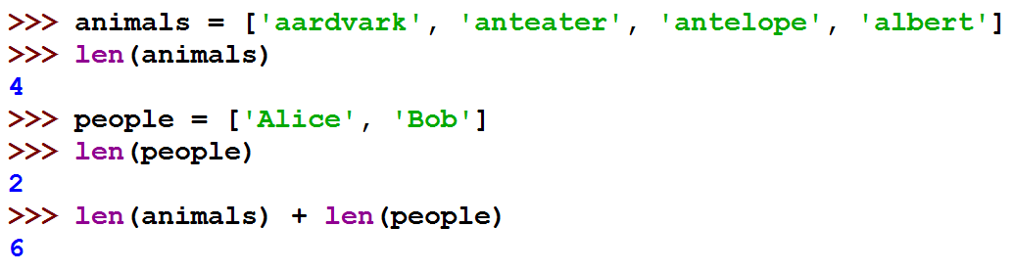
Code Explanation
The len()Function
  Takes a list as a parameter and returns the integer of how many items are in a list.

Slide 44
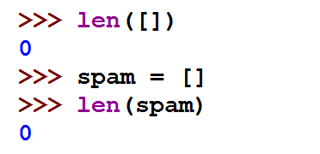
Code Explanation
The len()Function
  The square brackets by themselves are also a list value known as the
  empty list.

Slide 45
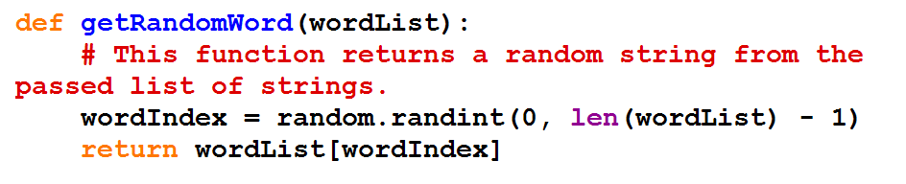
Code Explanation
The getRandomWord() Function
  store a random index for this list in the wordIndex variable.
  do this by calling randint() with two arguments.
    The reason we need the - 1 is because the indexes for lists start at 0.

Slide 46
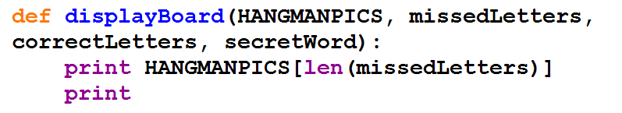
Code Explanation
The displayBoard() Function
  This function has four parameters.
HANGMANPICS | a list of multi-line strings that will display the board as ASCII art
missedLetters | a string made up of the letters the player has guessed that are not in the secret word.
correctLetters | a string made up of the letters the player has guessed that are in the secret word.
secretWord | the secret word that the player is trying to guess.

Slide 47
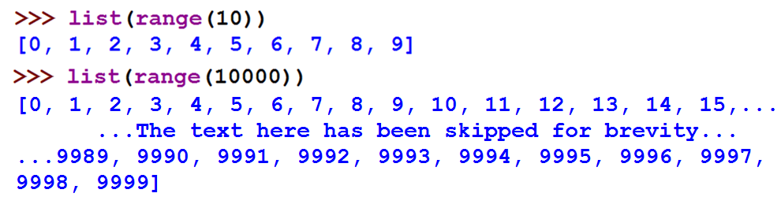
Code Explanation
The range() Function
  When called with one argument,
    range()will return a range object of integers from 0 up to the argument.

Slide 48


Code Explanation
The range() Function
  The list is so huge, that it won't even all fit onto the screen.
    But we can save the list into the variable just like any other list by entering this.
  If you pass two arguments to range(),
    the list of integers it returns is from the first argument up to the second argument.

Slide 49
Code Explanation
for Loops
  The for loop is very good at looping over a list of values.
  begins with the for keyword, followed by a variable name, the in keyword, a sequence or a range object, and then a colon.
  Each time the program execution goes through the loop
  (on each iteration through the loop)

Slide 50
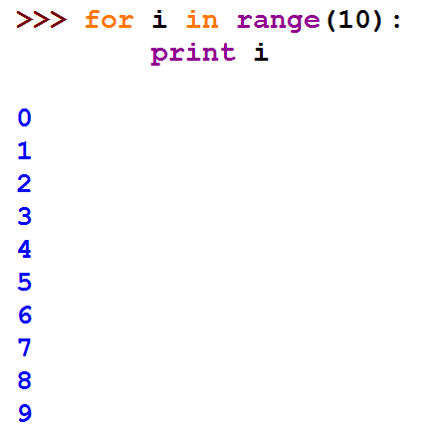
Code Explanation
for Loops
  For example

Slide 51
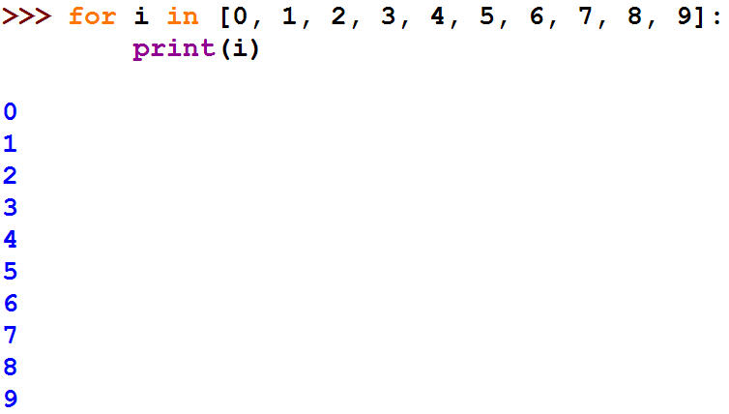
Code Explanation
for Loops
  we used the for statement with the list instead of range().

Slide 52
Code Explanation
Quiz

Slide 53
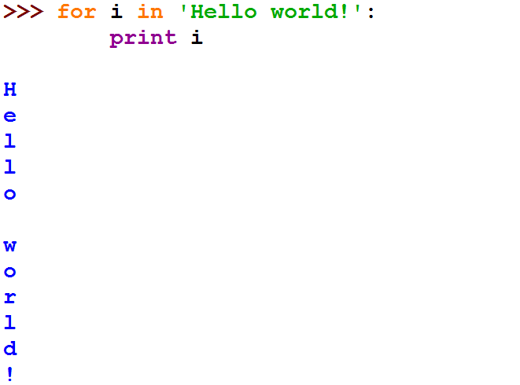
Code Explanation
for Loops
  uses a single character from the string on each iteration.

Slide 54
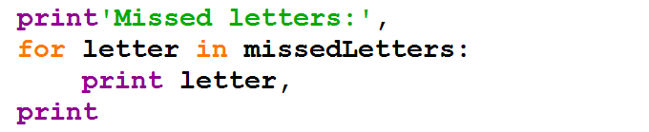
Code Explanation
for Loop
  This for loop will display all the missed guesses that the player has made.
  If missedLetters was 'ajtw‘,
  then this for loop would display a j t w.

Slide 55
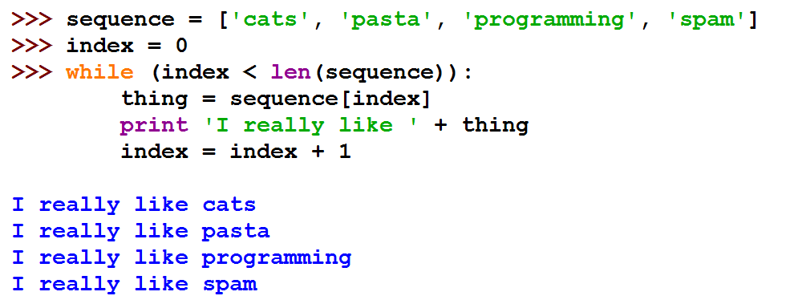
Code Explanation
A while Loop Equivalent of a for Loop
  You can make a while loop that acts the same way as a for loop by adding extra code.

Slide 56
Code Explanation
Displaying the Secret Word with Blanks
  Now we want to print the secret word, except we want blank lines for the letters.
  We can use the _ character (called the underscore character) for this.
secret word | blanked string
otter | _____ (five _ characters)
correctLetters | blanked string
rt | _tt_r

Slide 57
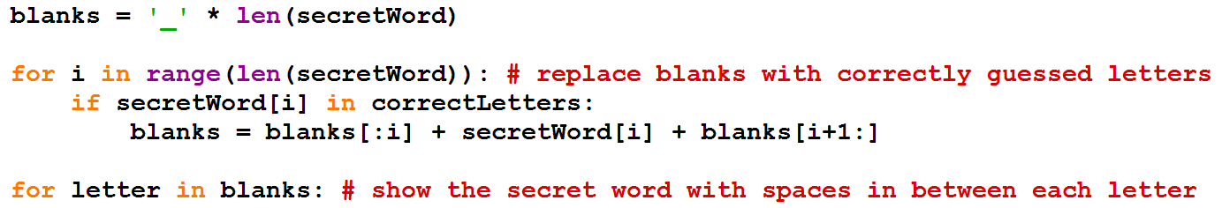
Code Explanation
Displaying the Secret Word with Blanks
  * operator can also be used on a string and an integer.
    so the expression 'hello' * 3 evaluates to 'hellohellohello'
  This will make sure that blanks has the same number of underscores as secretWord has letters.

Slide 58
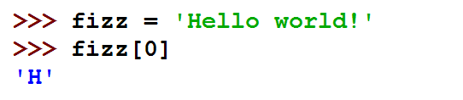
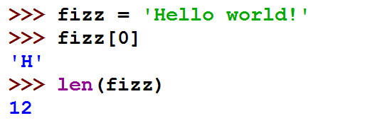
Code Explanation
Strings Act Like Lists
  Just think of strings as “list” of one-letter strings.
  You can also find out how many characters are in a string with the len()function.

Slide 59
Code Explanation
Strings Act Like Lists
  You cannot change a character in a string or remove a character with del statement.
    List: mutable sequence (changeable)
    String: immutable sequence (cannot be changed)
Sequences
(Immutable)
Strings
(Mutable)
Lists

Slide 60
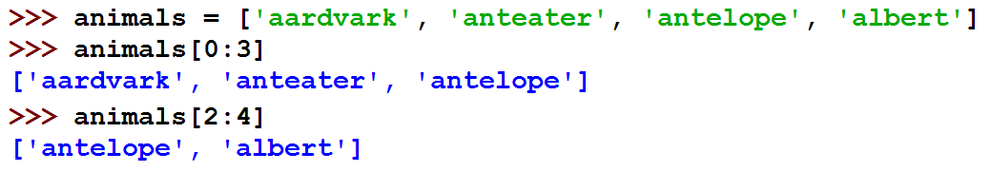
Code Explanation
List Slicing and Substrings
  Slicing
    Like indexing with multiple indexes instead of just one.
    Put two indexes separated by a colon.
    Can use slicing to get a part of a string(called a substring from a string.)

Slide 61

Code Explanation
Quiz

Slide 62
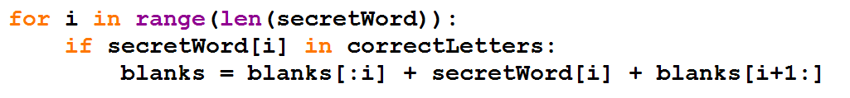
Code Explanation
Replacing the Underscores with Correctly Guessed Letters
  Let's pretend
    the value of secretWord is 'otter'
    the value in correctLetters is 'tr'
  Then len(secretWord) will return 5.
  Then range(len(secretWord)) becomes range(5), which in turn returns the list [0, 1, 2, 3, 4].

Slide 63
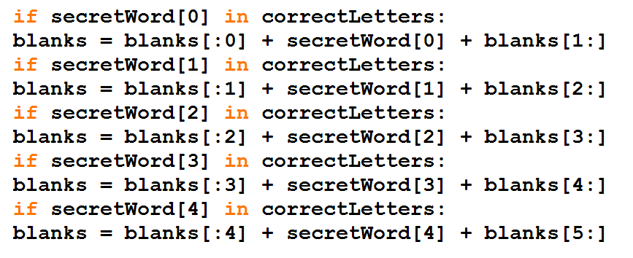
Code Explanation
Replacing the Underscores with Correctly Guessed Letters
  The value of i will take on each value in [0, 1, 2, 3, 4]
    then the for loop code is equivalent to this ( called loop unrolling).

Slide 64

Code Explanation
Replacing the Underscores with Correctly Guessed Letters
  It shows the value of the secretWord and blanks variables.
    the index for each letter in the string.

Slide 65

Code Explanation
Replacing the Underscores with Correctly Guessed Letters
  The unrolled loop code would be the same as this.

Slide 66

Code Explanation
Replacing the Underscores with Correctly Guessed Letters
  This for loop will print out each character in the string blanks.
  Show the secret word with spaces in between each letter

Slide 67

Code Explanation
Get the Player's Guess
  The getGuess()
    called whenever we want to let the player type in a letter to guess.
  while loop
    it will loop forever (unless it reaches a break statement).
    Such a loop is called an infinite loop.

Slide 68

Code Explanation
elif ("Else If") Statements
  Take a look at the following code.
  If the catName variable is equal to the string 'Fuzzball'
    then the if statement's condition is True
    and we tell the user that her cat is fuzzy.
  If catName is anything else
    then we tell the user her cat is not fuzzy.

Slide 69

Code Explanation
elif ("Else If") Statements
  We could put another if and else statement inside the first else block like this.

Slide 70

Code Explanation
elif ("Else If") Statements
  if we wanted more things, then the code starts to have a lot of indentation.

Slide 71

Code Explanation
elif ("Else If") Statements
  Using elif, the above code looks like this.

Slide 72

Code Explanation
Making Sure the Player Entered a Valid Guess
  The guess variable contains the text the player typed in for their letter guess.
  The if statement's condition checks that the text is one and only letter.

Slide 73

Code Explanation
Making Sure the Player Entered a Valid Guess
  The elif statement.

Slide 74

Code Explanation
Asking the Player to Play Again
  The playAgain()function
    just a print() function call and a return statement
    The function call is input() and the method calls are lower() and startswith('y')

Slide 75

Code Explanation
Asking the Player to Play Again
  Here's a step by step look at how Python evaluates this expression if the user types in YES.

Slide 76
Code Explanation
Review of the Functions We Defined
  getRandomWord(wordList)
  displayBoard(HANGMANPICS, missedLetters,
  correctLetters, secretWord)
  getGuess(alreadyGuessed)
  playAgain()

Slide 77

Code Explanation
Review of the Functions We Defined
  The complete flow chart of Hangman.

Slide 78

Code Explanation
The Main Code for Hangman
  Setting Up the Variables
    what we do before the player starts guessing letters.
    This line is the first actual line that executes in our game.

Slide 79

Code Explanation
Displaying the Board to the Player
  The while loop's condition is always True
    always loop forever until a break statement is encountered.
    execute a break statement when the game is over.

Slide 80

Code Explanation
Letting the Player Enter Their Guess
  Remember that the function needs all the letters in missedLetters and correctLetters combined.
Checking if the Letter is in the Secret Word
  concatenate the letter in guess to the correctLetters string

Slide 81

Code Explanation
Checking if the Player has Won
  The only way we can be sure the player won is
    to go through each letter in secretWord and see if it exists in correctLetters.

Slide 82

Code Explanation
Checking if the Player has Won
  This is a simple check to see if we found all the letters.
  If we have found every letter in the secret word
    we should tell the player that they have won.

Slide 83

Code Explanation
When the Player Guesses Incorrectly
  This is the start of the else-block.
    the code in this block will execute if the condition was False.
  The player's guessed letter was wrong
    we will add it to the missedLetters string.

Slide 84

Code Explanation
When the Player Guesses Incorrectly
  How we know when the player has guessed too many times.
  Remember that each time the player guesses wrong,
    add the wrong letter to the string in missedLetters.
    the length of missedLetters can tell us the number of wrong guesses.

Slide 85
Code Explanation
When the Player Guesses Incorrectly
  len(HANGMANPICS) - 1
    when we read the code in this program later, we know why this program behaves the way it does.
    Of course, you could write a comment to remind yourself, like.
    But it is easier to just use len(HANGMANPICS) - 1 instead.

Slide 86

Code Explanation
When the Player Guesses Incorrectly
  If the player won or lost after guessing their letter
    then our code would have set the gameIsDone variable to True.
    If this is the case, we should ask the player if they want to play again.

Slide 87

Code Explanation
When the Player Guesses Incorrectly
  If the player typed in 'no'
    return value of the call to the playAgain() function would be False
    the else-block would have executed.

Slide 88

Code Explanation
Making New Changes to the Hangman Program
  We can easily give the player more guesses
    by adding more multi-line strings to the HANGMANPICS list.

Slide 89


Code Explanation
Making New Changes to the Hangman Program
  We can also change the list of words.
    colors, shapes, fruits

Slide 90

Code Explanation
Dictionaries
  A collection of many values.
  Accessing the items with an index (the indexes are called keys) of any data type (most often strings).

Slide 91

Code Explanation
Dictionaries
  Curly braces { and }
    On the keyboard they are on the same key as the square braces [ and ].
    We use curly braces to type out a dictionary value in Python.
      The values in between them are key-value pairs.

Slide 92

Code Explanation
Getting the Size of Dictionaries with len()
  This will evaluate to the value for that key.
    You can get the size with the len() function.
  The list version of this dictionary would have only the values.

Slide 93

Code Explanation
The Difference Between Dictionaries and Lists
  Dictionaries are unordered.
    Dictionaries do not have any sort of order.

Slide 94

Code Explanation
The Difference Between Dictionaries and Lists
  Lists are ordered.
    so a list with the same values in them but in a different order are not the same.

Slide 95

Code Explanation
The Difference Between Dictionaries and Lists
  You can also use integers as the keys for dictionaries.
  Dictionaries can have keys of any data type, not just strings.

Slide 96

Code Explanation
The Difference Between Dictionaries and Lists
  use a dictionary in a for loop

Slide 97

Code Explanation
The Difference Between Dictionaries and Lists
  Dictionaries also have two useful methods
    keys() and values()
    These will return values of a type called dict_keys and dict_values, respectively.

Slide 98

Code Explanation
Sets of Words for Hangman
  So how can we use dictionaries in our game?
    First, let's change the list words into a dictionary
      keys are strings
      values are lists of strings

Slide 99

Code Explanation
The random.choice()Function
  Change our getRandomWord()function
    it chooses a random word from a dictionary of lists of strings, instead of from a list of strings.
    Here is what the function originally looked like:

Slide 100

Code Explanation
The random.choice() Function
  Change our getRandomWord()function
  Change the code in this function so that it looks like this:

Slide 101

Code Explanation
The random.choice() Function
  randint(a, b)
    return a random integer between the two integers a and b
    choice(a)returns a random item from the list a

Slide 102

Code Explanation
Evaluating a Dictionary of Lists
  wordDict[wordKey][wordIndex]may look kind of complicated
  but it is just an expression you can evaluate one step at a time like anything else.

Slide 103

Code Explanation
Evaluating a Dictionary of Lists
  There are just three more changes to make to our program.
    The first two are on the lines that we call the getRandomWord() function.
    The function is called on lines 148 and 184 in the original program

Slide 104

Code Explanation
Evaluating a Dictionary of Lists
  We would then have to change the code as follows

Slide 105

Code Explanation
Multiple Assignment
  An easier way by doing a little trick with assignment statements.
    to put the same number of variables on the left side of the = sign as are in the list on the right side of the = sign.

Slide 106
Code Explanation
Quiz

Slide 107

Code Explanation
Multiple Assignment
  So we should change our code in Hangman to use this trick
    which will mean our program uses fewer lines of code.

Slide 108

Code Explanation
Printing the Word Category for the Player
  The last change
    to add a simple print statement to tell the player which set of words they are trying to guess.
    Here is the original code:

Slide 109

Code Explanation
Printing the Word Category for the Player
  The last change
    Add the line so your program looks like this:

Slide 110

Things Covered In This Chapter(1/3)
  Designing our game by drawing a flow chart before programming.
  ASCII Art
  Multi-line Strings
  Lists
  List indexes
  Index assignment
  List concatenation
  The in operator
  The del operator
  Methods
  The append() list method

Slide 111
Things Covered In This Chapter(2/3)
  The lower() and upper() string methods
  The reverse()list method
  The split()list method
  The len()function
  Empty lists
  The range() function
  for loops
  Strings act like lists
  Mutable sequences(lists) and immutable sequences(strings)
  List slicing and substrings
  elif statements

Slide 112
Things Covered In This Chapter(3/3)
  The startswith(someString)
  and endswith(someString)string methods
  The dictionary data type(which is unordered, unlike list data type which is ordered)
  key-value pairs
  The keys()and values() dictionary methods.
  Multiple variable assignment, such as a, b, c = [1, 2, 3]

