Slide 1
AllSeen Alliance C&C WG meeting
April 16th, 2014

Slide 2
Antitrust Compliance Notice
AllSeen Alliance meetings involve participation by industry competitors, and it is the intention of AllSeen Alliance to conduct all of its activities in accordance with applicable antitrust and competition laws. It is therefore extremely important that attendees adhere to meeting agendas, and be aware of and not participate in any activities that are prohibited under applicable US state, federal or foreign antitrust and competition laws.
Examples of types of actions that are prohibited at AllSeen Alliance meetings and in connection with AllSeen Alliance activities are described in the AllSeen Alliance Antitrust Policy. If you have questions about these matters, please contact your company counsel, or if you are a member of AllSeen Alliance, feel free to contact Lee Gesmer or Andrew Updegrove, of the firm of Gesmer Updegrove LLP, which provides legal counsel to AllSeen Alliance.

Slide 3
Guidelines
This is a reminder that all AllSeen Alliance activities are subject to strict compliance with the AllSeen Alliance By-laws. Each individual participant and attendee at this meeting is responsible for knowing the contents of the AllSeen Alliance By-laws, and for complying with the AllSeen Alliance By-laws. Copies of the AllSeen Alliance By-laws are available at:
https://allseenalliance.org/allseen/bylaws

Slide 4
Agenda
Opening Items – 15 min
Open remarks
Meeting Process
WG Updates – 30 min
Doc Templates Approval -- Vote
Documentation process – Vote
Test case Review Process
Test setup and Test execution
Types of Certification
Closing Items – 15 min
Future Agendas review (All)
Action Item Review
Opens

Slide 5
C&C WG
To access the wiki page please go to https://wiki.allseenalliance.org/compliance/overview
To contact the Certification and Compliance Work Group, send an email to the allseen-cc@lists.allseenalliance.org
To join the Certification and Compliance Work Group Mailing List, please self-subscribe here.
C&C WG meetings every week
The meeting will be held on:
Wednesdays 20:00PM - 21:00PM Eastern Time
Wednesdays 17:00PM - 18:00PM Pacific Time
Thursdays 9:00AM - 10:00 AM Korea/Japan
Thursdays 1:00AM - 2:00 AM France

Slide 6
C&C WG Updates

Slide 7
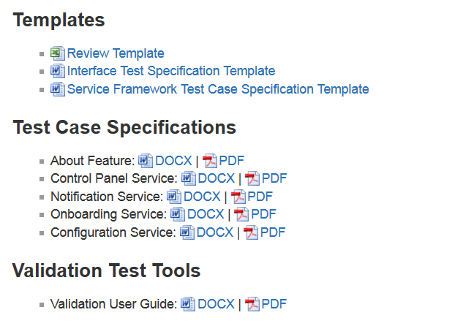
Docs
https://wiki.allseenalliance.org/compliance/overview

Slide 8
WG’s next steps
Review Doc Templates ( 1wk )
Interface Specification Template
Service Framework Test Case Specification Template
Review Test Case Specs for ( 3wks)
About Feature
Control Panel Service
Notification Service
Onboarding Service
Configuration Service

Slide 9
Generate Docs and Setup and Run test cases

Slide 10
What the Core/Service contributions Do?
Core or Service Framework Interface Definition Template
Core or Service Framework Test Case Template
Validation Test User Guide
Eg..” Notifications Service Framework Interface Test Cases”
Use template to write the Interface Definition
Use test user guide and test cases to write
test code
Use <XXXX> Service Framework Interface Definition and test case template to write the test cases
<XXXX> Service
Framework Test Cases
<XXXX> Core or Service Framework Interface Definition
Test Code
Eg.”Notifications Service Framework Interface Definition”
AllSeen Alliance Contributions
GIT
Examples

Slide 11
Links and Examples
Service Framework Interface Definition Template
https://wiki.allseenalliance.org/compliance/overview?&#templates
<XXXX> Core or Service Framework Interface Definition
https://allseenalliance.org/docs-and-downloads/documentation/alljoyn-notification-service-framework-interface-specification
Core or Service Framework Test Case Template
https://wiki.allseenalliance.org/compliance/overview?&#templates
<XXXX> Core or Service Framework Test Cases
https://wiki.allseenalliance.org/_media/compliance/alljoyn_notification_service_framework_test_case_specifications.pdf
Validation Test User Guide
https://wiki.allseenalliance.org/_media/compliance/alljoyn_validation_test_user_guide.pdf
Test Code (Not delivered yet)

Slide 12
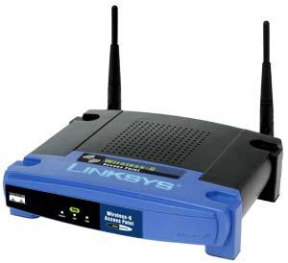


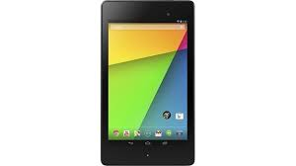
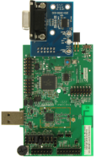
Test setup and execute Test cases
GIT
Configure a Nexus Tablet (Android test device) to connect to Personal Access Point. Nexus 7 Tablet is the device on which the tests are executed
Onboard the Device Under Test (DUT) to Personal Access Point. DUT is the device against which tests will be executed
Connect the Nexus 7 Tablet to a PC/Laptop (Win 7) via USB cable
Download the test code from GIT repository on to PC/Laptop
Compile the test code and build test app on the PC/laptop
Deploy the test app to the Nexus 7 Tablet
Execute command on the PC/Laptop to start the execution of tests on Nexus 7 Tablet against the Device Under Test
View and analyze the test results produced on the PC/Laptop
4
1
2
3
6
5
8
7
DUT
PC Software | Minimum version requirement
Java SE Development Kit (JDK) | 1.6
Android SDK | API/Platform 16
Apache Maven | 3.1.1
Git (required to download code from the validation repository) | N/A

Slide 13
Test Case review process
Takeshi Matsushita SHARP

Slide 14
Test case Review Process
Each WG will submit "code", "service framework I/F spec", "test case" and "test code" XXX weeks prior to commit.
CCWG to form ad-hoc team which is in charge of review the deliverables for each test case.
Each ad-hoc team to review (XX weeks) and recommend to approve commit (sufficient deliverables) or disapprove (insufficient)
CCWG to adopt the recommendation from ad-hoc team and respond to the each WG.

Slide 15
Types of Certification

Slide 16
Derivative Certification
Derivative Certification applies to products that are related to a product that has already been certified. They could be different products in a company’s product line, or they could be the same product with bug fixes or feature enhancements.
Not all derivative products may require a full-recertification.
The derivative certification process:
Defines types of changes to products
Defines types of actions required for changes
Maps changes to actions

Slide 17
Types of Changes
Changes to Identifying Attributes
e.g. Name, System-Model, System-Id
Change to Software
e.g. Addition of a Software Feature, Removal of a Software Feature, transport driver.
Change Hardware Component
e.g. Change of Sensor. Clock. RAM/ROM, Processor,
Addition or Removal of non-Alljoyn Software Features
e.g. Addition/Removal of a new non-Alljoyn software application, user interface changes that do not change Alljoyn functionality
NOTE: If a recompile of any software modules is required the change is considered a Change to Alljoyn Software.

Slide 18
Types of Actions Required
Complete Re-test done at Testing Lab or Self-certification(Type A)
This is done for changes that are considered significant enough that they may likely cause an interoperability or compliance failure in a device.
Partial Retest and Certificate Update (Derivative)
This is done for changes that are limited in scope to a component of the system. These changes do not necessitate a complete retest but do require documentation to be submitted detailing the change, and test suites that apply to the effected components to be re-run and re-submitted.
CCWG will determine if the retest must be done in a lab or if some types of retest are allowed to be performed as self-test.
Certificate Update
These changes are changes that do not affect functionality, such as form factor changes. These require an update to the currently held certification information but do not require a retesting.

Slide 19
Map of Changes to Actions
 | Complete Re-test done at Testing Lab (Type A) | Partial Retest and Certificate Update (Derivative) | Certificate Update
Changes to Identifying Attributes |  | X Self-test should be allowed here | X
Changes to Alljoyn Software | X
Change Hardware Component | X | X | X
Addition or Removal of non-Alljoyn Software Features |  | X | X (This is only needed if we change a feature tracked by the certification DB)

Slide 20
Future Agenda, Action Items Review

Slide 21
Future Agendas
 |  | Mar |  |  | April |  |  |  |  | May
Topic | Owner | 12 | 19 | 26 | 2 | 9 | 16 | 23 | 30 | 7 | 14 | 21 | 28
Test case spec template, and testcode | Telis | √
WGs requirements Types of Certification Version of the certification Test suites | Telis |  | √
Document Review Form | Jun ZHANG |  |  | √
Certification type | Takeshi Matsushita |  |  | √
Interoperability as part of CERT | Telis |  |  |  | √
Certification types | Takeshi Matsushita |  |  |  | √

Slide 22
Action Items
Number | Date Assigned | AI Description | Owner | Status
1 | 3/27/2014 | How to write testcode-training | Telis | postponed
2 | 4/1/2014 | Requirements for WGs | Teliis | completed
3 | 4/9/2014 | Review Test Case Specs | All | assigned
5 | 4/9/2014 | Test cases Review Process for C&C WG | Matshushita-san | assigned
6 | 4/9/2014 | Review Test case specs in the wiki | All | assigned

