Slide 1
AllSeen Alliance C&C WG meeting
April 2nd, 2014

Slide 2
Antitrust Compliance Notice
AllSeen Alliance meetings involve participation by industry competitors, and it is the intention of AllSeen Alliance to conduct all of its activities in accordance with applicable antitrust and competition laws. It is therefore extremely important that attendees adhere to meeting agendas, and be aware of and not participate in any activities that are prohibited under applicable US state, federal or foreign antitrust and competition laws.
Examples of types of actions that are prohibited at AllSeen Alliance meetings and in connection with AllSeen Alliance activities are described in the AllSeen Alliance Antitrust Policy. If you have questions about these matters, please contact your company counsel, or if you are a member of AllSeen Alliance, feel free to contact Lee Gesmer or Andrew Updegrove, of the firm of Gesmer Updegrove LLP, which provides legal counsel to AllSeen Alliance.

Slide 3
Guidelines
This is a reminder that all AllSeen Alliance activities are subject to strict compliance with the AllSeen Alliance By-laws. Each individual participant and attendee at this meeting is responsible for knowing the contents of the AllSeen Alliance By-laws, and for complying with the AllSeen Alliance By-laws. Copies of the AllSeen Alliance By-laws are available at:
https://allseenalliance.org/allseen/bylaws

Slide 4
Agenda
Opening Items – 15 min
Open remarks
Meeting Process
WG Updates – 30 min
Certification Types
Interoperability as part of certification
Closing Items – 15 min
Future Agendas review (All)
Action Item Review
Opens

Slide 5
C&C WG
To access the wiki page please go to https://wiki.allseenalliance.org/compliance/overview
To contact the Certification and Compliance Work Group, send an email to the allseen-cc@lists.allseenalliance.org
To join the Certification and Compliance Work Group Mailing List, please self-subscribe here.
C&C WG meetings every week
The meeting will be held on:
Wednesdays 20:00PM - 21:00PM Eastern Time
Wednesdays 17:00PM - 18:00PM Pacific Time
Thursdays 9:00AM - 10:00 AM Korea/Japan
Thursdays 1:00AM - 2:00 AM France

Slide 6
C&C WG Updates

Slide 7
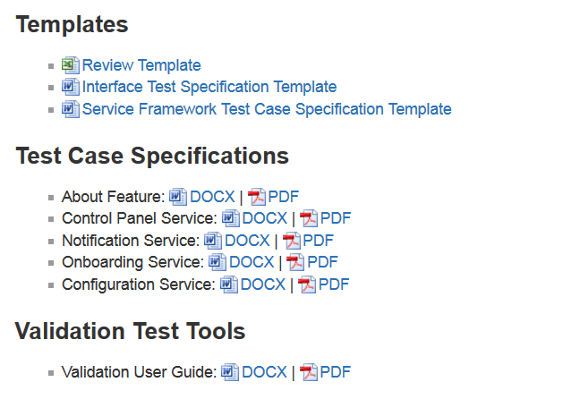
Milestones
https://wiki.allseenalliance.org/compliance/overview

Slide 8
Certification Types Takeshi Matsushita

Slide 9
Certification program have to explicitly define following items for each product
When is the further certification required?
In case of only first product, new category, new service or new model?
Which portion of the whole certification program is required?
All applicable items, newly implemented portion or others?
Where is certification executed?
At authorized entity or at each company?
Who will be penalized in case of incompliant or breach?
Final shipper to retailer, brand holder, manufacture or others?

Slide 10
Certification program have to be designed for reliability and convenience
Example which only focuses on convenience.
When | Which | Where | Who
First product | All applicable | Authorized entity | Brand holder
New category | No | No | Brand holder
New service | No | No | Brand holder
New model | NO | No | Brand holder
Remark; “No” means that no certification is required but compliance is required
Examples which balance convenience and reliability.
When | Which | Where | Who
First product | All applicable | Authorized entity | Brand holder
New category | All applicable | Each company | Brand holder
New service | Newly implemented | Each company | Brand holder
New model | No | No | Brand holder
When | Which | Where | Who
First product | All applicable | Authorized entity | Brand holder
New category | All applicable | Authorized entity | Brand holder
New service | Newly implemented | Authorized entity | Brand holder
New model | No | No | Brand holder
When | Which | Where | Who
First product | All applicable | Authorized entity | Brand holder
New category | All applicable | Authorized entity | Brand holder
New service | All applicable | Authorized entity | Brand holder
New model | All applicable | Each company | Brand holder

Slide 11
Certification program have to be designed for reliability and convenience
Example which only focuses on reliability.
When | Which | Where | Who
First product | All applicable | Authorized entity | Brand holder
New category | All applicable | Authorized entity | Brand holder
New service | All applicable | Authorized entity | Brand holder
New model | All applicable | Authorized entity | Brand holder

Slide 12
Interoperability As Part of Certification
Telis Kaleas

Slide 13
Interoperability (IOP)
Primary purpose of IOP testing is to:
Verify that one AllJoyn device from one vendor can interoperate with other vendors’ devices
Verify the end-to-end behavior of AllJoyn devices in actual operating conditions on real world systems.
Interoperability procedures (specs) are used during AllJoyn Alliance Plugfests (TBD) and are useful for identifying common issues and ambiguities.

Slide 14
What are we trying to solve?
Seemingly “Perfect Compliance would mean perfect Interoperability”
Yet we all agree, “You can never really guarantee Interoperability. ”
Our goal is to provide a program that provides the best chance of interoperability for certified devices.

Slide 15
Designing our Program
Finding the Best Compromise

Slide 16
Ways to increase IOP
The Role of IOP Events
IOP issues should be found during this event.
Issue reports from these events identify procedures ambiguity problems.
Addition of Conformance Tests
As failures are found at Interop Events or elsewhere new interoperability procedures will be added.
The Test Tools should be constantly evolving with these updates.
Are there other ways outside of the Cert process to improve IOP?

Slide 17
Maintaining the IOP Test Bed
What do you do when the test bed devices are shown to be non-compliant.
Who is responsible for maintaining the devices.
Updates, software fixes etc.
How long does it take to get enough devices to launch Interop Events.
We have limited control of “Real Devices”
Can only test main path (no corner cases)
Limited ability to recreate scenarios
Could we use the Device Simulators as our Golden Units (Devices) initially?
We control and maintain these.

Slide 18
Interop Attendance
Must attend with same device that will be certified.
Benefits:
Promotes the Interop program
Allows more complex interoperability procedures to be run.
Find interoperability problems

Slide 19
Summary of Proposal

Slide 20
Proposal
Basic Interoperability Procedures will be defined and be part of the Certification process.
The Procedures will test the core functionality of the device under test.
These procedures will be limited to normative behavior. (No error cases, no negative test cases)
DUT will have to pass the interoperability procedures against X other devices compatible with the same device specialization.
Attendance at a Interop Event prior to certification with the device is required ??.

Slide 21
AllSeen Alliance Resources for IOP
Technical Committee for Interop Testing Methods
Development of methodologies, techniques and languages
Development of Interoperability procedures (specs)
Interop Labs
Authorized Test Providers, Tools, IOP topologies,
Interop Events Service
Validation of procedures (specs) and prototypes through interoperability events

Slide 22
IOP Testing Matrix
Open Question: IOP partners will be randomly selected from the database of certified products.
Open Question: If the IOP testing fails and the certified product is determined to be at fault, it will immediately lose its certification.

Slide 23
Future Agenda, Action Items Review

Slide 24
Future Agendas
 |  | Mar |  |  | April |  |  |  |  | May
Topic | Owner | 12 | 19 | 26 | 2 | 9 | 16 | 23 | 30 | 7 | 14 | 21 | 28
Test case spec template, and testcode | Telis | √
WGs requirements Types of Certification Version of the certification Test suites | Telis |  | √
Document Review Form | Jun ZHANG |  |  | √
Certification type | Takeshi Matsushita |  |  | √
Interoperability as part of CERT | Telis |  |  |  | √
Certification types | Takeshi Matsushita |  |  |  | √

Slide 25
Action Items
Number | Date Assigned | AI Description | Owner | Status
1 | 3/27/2014 | How to write testcode-training | Telis | postponed
2 | 4/1/2014 | Requirements for WGs | Teliis | In progress
3

