Slide 1
AllSeen Alliance C&C WG meeting
April 9th, 2014

Slide 2
Antitrust Compliance Notice
AllSeen Alliance meetings involve participation by industry competitors, and it is the intention of AllSeen Alliance to conduct all of its activities in accordance with applicable antitrust and competition laws. It is therefore extremely important that attendees adhere to meeting agendas, and be aware of and not participate in any activities that are prohibited under applicable US state, federal or foreign antitrust and competition laws.
Examples of types of actions that are prohibited at AllSeen Alliance meetings and in connection with AllSeen Alliance activities are described in the AllSeen Alliance Antitrust Policy. If you have questions about these matters, please contact your company counsel, or if you are a member of AllSeen Alliance, feel free to contact Lee Gesmer or Andrew Updegrove, of the firm of Gesmer Updegrove LLP, which provides legal counsel to AllSeen Alliance.

Slide 3
Guidelines
This is a reminder that all AllSeen Alliance activities are subject to strict compliance with the AllSeen Alliance By-laws. Each individual participant and attendee at this meeting is responsible for knowing the contents of the AllSeen Alliance By-laws, and for complying with the AllSeen Alliance By-laws. Copies of the AllSeen Alliance By-laws are available at:
https://allseenalliance.org/allseen/bylaws

Slide 4
Agenda
Opening Items – 15 min
Open remarks
Meeting Process
WG Updates – 30 min
Docs reviews
Test cases for Release 14.06
High Level Work Items
Closing Items – 15 min
Future Agendas review (All)
Action Item Review
Opens

Slide 5
C&C WG
To access the wiki page please go to https://wiki.allseenalliance.org/compliance/overview
To contact the Certification and Compliance Work Group, send an email to the allseen-cc@lists.allseenalliance.org
To join the Certification and Compliance Work Group Mailing List, please self-subscribe here.
C&C WG meetings every week
The meeting will be held on:
Wednesdays 20:00PM - 21:00PM Eastern Time
Wednesdays 17:00PM - 18:00PM Pacific Time
Thursdays 9:00AM - 10:00 AM Korea/Japan
Thursdays 1:00AM - 2:00 AM France

Slide 6
C&C WG Updates

Slide 7
C&C Requirements
Proposal approved by TSC
–Puts requirements on the WG’s
•Requires WG’s to provide:
–Interface definitions for AllJoyn interfaces implemented by the service or core features
–Test case specifications for each interface
–Test code that exercises the functionality of the interface

Slide 8
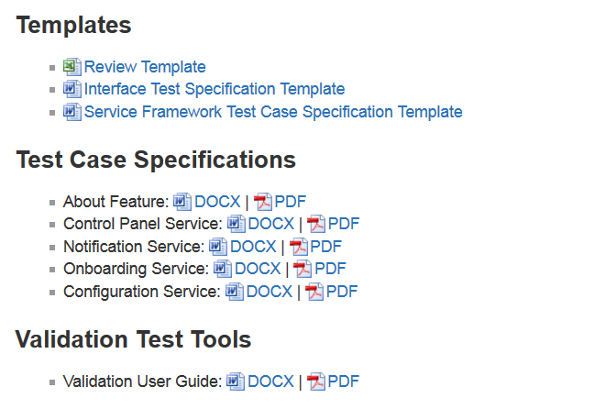
Docs
https://wiki.allseenalliance.org/compliance/overview

Slide 9
WG’s next steps
Review Doc Templates ( 1wk )
Interface Specification Template
Service Framework Test Case Specification Template
Review Test Case Specs for ( 3wks)
About Feature
Control Panel Service
Notification Service
Onboarding Service
Configuration Service

Slide 10
Generate Docs and TestCode for new Services

Slide 11
Process for each Service
Service Framework Interface Specs Template
Validation Test User Guide
Test Case Specs Template
Use template to write the Interface Specs
Use test user guide and test case specs to write
test code
<XXXX> Service
Test Case Specs
Use <XXXX> Service Interface Specs and test case template to write the test cases Specs
<XXXX> Service Interface Specs
Test Code

Slide 12
Plan for 14.06
Review the 14.06 Release Plan presented at the TSC
https://wiki.allseenalliance.org/_media/tsc/allseen-tsc-03-24-14.pdf
Outline additional Test case for the certification suite (if any)
Review the new proposed test cases
Identify Working groups for writing the Test code
Review the validation Tool
Identify any improvements to the tool

Slide 13
Work Items

Slide 14
High Level Work Items
Processes
Test Tools
Characterize needed types of test tools (if any)
Interop Laboratory
Define Test Lab Selection Criteria
Certification Program Management Document
Operational Management Document
Review available systems and tools
Assist in test tool selection process / RFP
Identify candidate laboratories
Assist with Lab Selection Process
Interop Event / Test Events
Program Management
Certification Body Role
Certification Program Manager Role

Slide 15
Future Agenda, Action Items Review

Slide 16
Future Agendas
 |  | Mar |  |  | April |  |  |  |  | May
Topic | Owner | 12 | 19 | 26 | 2 | 9 | 16 | 23 | 30 | 7 | 14 | 21 | 28
Test case spec template, and testcode | Telis | √
WGs requirements Types of Certification Version of the certification Test suites | Telis |  | √
Document Review Form | Jun ZHANG |  |  | √
Certification type | Takeshi Matsushita |  |  | √
Interoperability as part of CERT | Telis |  |  |  | √
Certification types | Takeshi Matsushita |  |  |  | √

Slide 17
Action Items
Number | Date Assigned | AI Description | Owner | Status
1 | 3/27/2014 | How to write testcode-training | Telis | postponed
2 | 4/1/2014 | Requirements for WGs | Teliis | completed
3 | 4/9/2014 | Review Test Case Specs | All | assigned
5 | 4/9/2014 | Test cases Review Process for C&C WG | Matshushita-san | assigned

