Slide 1
AllSeen Alliance C&C WG
March 19th, 2014

Slide 2
Antitrust Compliance Notice
AllSeen Alliance meetings involve participation by industry competitors, and it is the intention of AllSeen Alliance to conduct all of its activities in accordance with applicable antitrust and competition laws. It is therefore extremely important that attendees adhere to meeting agendas, and be aware of and not participate in any activities that are prohibited under applicable US state, federal or foreign antitrust and competition laws.
Examples of types of actions that are prohibited at AllSeen Alliance meetings and in connection with AllSeen Alliance activities are described in the AllSeen Alliance Antitrust Policy. If you have questions about these matters, please contact your company counsel, or if you are a member of AllSeen Alliance, feel free to contact Lee Gesmer or Andrew Updegrove, of the firm of Gesmer Updegrove LLP, which provides legal counsel to AllSeen Alliance.

Slide 3
Guidelines
This is a reminder that all AllSeen Alliance activities are subject to strict compliance with the AllSeen Alliance By-laws. Each individual participant and attendee at this meeting is responsible for knowing the contents of the AllSeen Alliance By-laws, and for complying with the AllSeen Alliance By-laws. Copies of the AllSeen Alliance By-laws are available at:
https://allseenalliance.org/allseen/bylaws

Slide 4
Agenda
Opening Items – 15 min
Open remarks
Meeting Process
WG Updates – 30 min
WGs Requirements
Types of Certification
Versioning of the Compliance Test suites and Interoperability Procedures
Closing Items – 15 min
Future Agendas review (All)
Action Item Review
Opens

Slide 5
C&C WG
To access the wiki page please go to https://wiki.allseenalliance.org/compliance/overview
To contact the Certification and Compliance Work Group, send an email to the allseen-cc@lists.allseenalliance.org
To join the Certification and Compliance Work Group Mailing List, please self-subscribe here.
C&C WG meetings every week
The meeting will be held on:
Wednesdays 20:00PM - 21:00PM Eastern Time
Wednesdays 17:00PM - 18:00PM Pacific Time
Thursdays 9:00AM - 10:00 AM Korea/Japan
Thursdays 1:00AM - 2:00 AM France

Slide 6
C&C WG Updates

Slide 7
Next steps
Short-Term (April)
Nominations for chairman
Seeking more active contributors and committers
Contributions (tentative plan for March 25th)
Test case specs template
Test code guidelines
Review contributions (testcase specs, testcode)
Contribute a validation tool.
Program Management Document (Certification policies)
Propose external assistance from a consulting company to help the process and management

Slide 8
Requirements for WGs

Slide 9
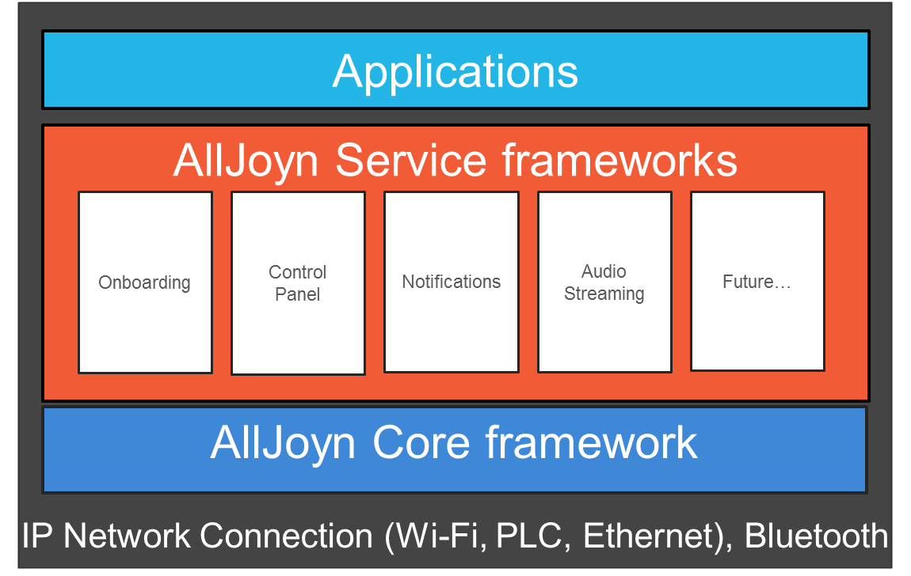
Requirements
Committer or Contributor of Core MUST Provide:
The source code of the new (or updates) Core
Test case Specs which are written against the Core features (About..)
Provide Test code implementing the Test case Specs
Committer or Contributor of each Service Frameworks (Config, Control Panel, Notifications,Lighting…) MUST Provide:
The source code of the new (or updates) Service Framework
Interface Specs associated with that Service Framework
Test case Specs which are written against the Service Framework Interface Specs
Provide Test code implementing the Test case Specs

Slide 10
C&C WG role
C&C Working group
Working groups
TSC
Technical strategies
Service Frameworks Interface Specs
Test case Specs
Test Code
Service Frameworks Interface Specs
Test case Specs
Test Code
Service Frameworks Interface Specs
Test case Specs
Test Code
WGs
Compliance Tests
Golden Units guidelines
Interoperability procedures
C&C WG

Slide 11
Service Frameworks Interface Specs
https://allseenalliance.org/sites/default/files/resources/aj_notif_sf_interface_spec.pdf
Common Template sections:
Introduction
Service Messages
Service Interface
Call Flows
Introspect XML

Slide 12
Test Case Specification Template
Proposed template for writing specs
Includes instructions to assist with writing
Template sections:
Introduction
Environment setup (Requirements, Preconditions, Test Execution Notes, and Test Parameters)
List of Test Cases (Test Case Id, Title, Objective, Procedure, and Expected results)

Slide 13
Test Case Code
Validation Framework API
Validation Test Runner
Validation Test Cases
How to write test case code – March 27th

Slide 14
Types of Certification

Slide 15
Goal
To provide a certification process that provides thorough testing of all devices while making certification as simple as possible for OEMs.
Each type of certification has a slightly different procedure.

Slide 16

Types of Certification
Type A
New product.
Type O
Re-labeling of a Type A or Type D by a second vendor.
OEM A
Type D
Derivative
Update
OEM A
BMI:
Vendor B

Slide 17
Proposed Types
Type A Certification is for New Products that have not gone through certification before. This is the most extensive certification procedure. The device must run through all the tests prescribed by the Certification process.
Devices that have been previously certified but have changes or additions not listed in the Allowed Modifications List are considered new products, even if the product was derived from a pre-existing certified product.
Type D Certification is for products with an existing Type A certification that have undergone a modification to a feature listed in the Allowed Modifications List (memory size, User Interface,…)
Type O Certification is for products that have an existing Type A certification under the name of another company. Type O certification allows vendors to use products from an OEM who has gone through certification and still use the AllSeen logo.

Slide 18
Type A
OEM submits a certification application with the supported features.
Device must complete all the Compliance Testing (self-certification, authorized lab).

Slide 19
Type D
OEM submits a certification application with the supported features.
Application must indicates which Type A certified device this derives from.
Test administrator will check the Allowed Modifications List to make sure the modifications are acceptable for type D.
Questions:
Do we do an abbreviated set of tests? (for instance random sample of compliance tests.)
Do we let the vendor do self certification? (run the tool in their lab and submit the report)

Slide 20
Type O
OEM submits a certification application of a re-branded Type A or D certified product.
Do we want this type of certification?
Pros: Track legitimate users of the brand, additional source of revenue, promotes membership in AllSeen Alliance.
Cons: Adds complexity and cost to re-sellers using the logo.

Slide 21
General Questions for Discussion
Are these three types of certification acceptable?
What kind of testing should be done for each type?

Slide 22
Versioning

Slide 23
Modifications and Revisions
Modification of Devices
The certification mark is awarded by AllJoyn Alliance to particular version of the Device
Any modification to the device will result in a new version. (see Types of Certification)
New version of the device may not require testing in order to be certified. (See Types of Certification)
Changes in the device that affect the AllJoyn Service Frameworks Interface Specs will require testing.
Revisions to AllJoyn Service Frameworks Interface Specs
AllJoyn Alliance will announce major releases.
Test Cases Specs will be revised to the new Release.
A grace period will be declared(Alliance Members still can use the old Test Cases Specs)
After grace period all devices must be tested against latest Test Cases Specs
Major Revisions Affecting Interoperability
Alliance mandates the resubmission for certification testing when:
Serious deficiency in the Test Cases Specs or process is uncovered,
Interoperability issues

Slide 24
Future Agenda, Action Items Review

Slide 25
Future Agendas
 |  | Mar |  |  | April |  |  |  |  | May
Topic | Owner | 12 | 19 | 26 | 2 | 9 | 16 | 23 | 30 | 7 | 14 | 21 | 28
Test case spec template, and testcode | Telis | √
WGs requirements Types of Certification Version of the certification Test suites | Telis |  | √
Document Review Form | Jun ZHANG |  |  | √
E-Qualus Certification Program Considerations | Alan |  |  |  |  | √

Slide 26
Action Items
Number | Date Assigned | AI Description | Owner | Status
1 | 3/27/2014 | How to write testcode-training | Telis | In progress
2

