Slide 1
AllSeen Alliance C&C WG meeting
March 26th, 2014

Slide 2
Antitrust Compliance Notice
AllSeen Alliance meetings involve participation by industry competitors, and it is the intention of AllSeen Alliance to conduct all of its activities in accordance with applicable antitrust and competition laws. It is therefore extremely important that attendees adhere to meeting agendas, and be aware of and not participate in any activities that are prohibited under applicable US state, federal or foreign antitrust and competition laws.
Examples of types of actions that are prohibited at AllSeen Alliance meetings and in connection with AllSeen Alliance activities are described in the AllSeen Alliance Antitrust Policy. If you have questions about these matters, please contact your company counsel, or if you are a member of AllSeen Alliance, feel free to contact Lee Gesmer or Andrew Updegrove, of the firm of Gesmer Updegrove LLP, which provides legal counsel to AllSeen Alliance.

Slide 3
Reminder: This call is being recorded

Slide 4
Guidelines
This is a reminder that all AllSeen Alliance activities are subject to strict compliance with the AllSeen Alliance By-laws. Each individual participant and attendee at this meeting is responsible for knowing the contents of the AllSeen Alliance By-laws, and for complying with the AllSeen Alliance By-laws. Copies of the AllSeen Alliance By-laws are available at:
https://allseenalliance.org/allseen/bylaws

Slide 5
Agenda
Opening Items – 15 min
Open remarks
Meeting Process
WG Updates – 30 min
Types of Certification by Takeshi Matsushita
Document Review Template by Jun Zhang
Versioning of the Compliance Test suites and Interoperability Procedures
Closing Items – 15 min
Future Agendas review (All)
Action Item Review
Opens

Slide 6
C&C WG
To access the wiki page please go to https://wiki.allseenalliance.org/compliance/overview
To contact the Certification and Compliance Work Group, send an email to the allseen-cc@lists.allseenalliance.org
To join the Certification and Compliance Work Group Mailing List, please self-subscribe here.
C&C WG meetings every week
The meeting will be held on:
Wednesdays 20:00PM - 21:00PM Eastern Time
Wednesdays 17:00PM - 18:00PM Pacific Time
Thursdays 9:00AM - 10:00 AM Korea/Japan
Thursdays 1:00AM - 2:00 AM France

Slide 7
Types of Certification
Takeshi Matsushita
Sharp Corporation

Slide 8
Types of Certification
Official certification vs self certification
Official certification: Done by authorized entity and may cause long time and much cost.
Self certification: Done by each company itself and may reduce time and cost.
How “heavy” is each type of certification is?
Full certification vs partial certification vs no certification
Full certification: ALL applicable test items have to be tested and recorded.
Partial certification: Certain test items (such as for newly implemented portion) have to be tested and recorded.
No certification: No record of test is needed. Each company is required to have product “compliant”.
How “heavy” is each type of certification is?

Slide 9
Types of Certification
Effective range of Certificate (what is meant by “derivative model”?)
All product of the company (this means no more certification is required once one product is certified)
Same product category (such as TV, PVR, refrigerator, etc..)
Same Model family
Exact model (this means each product with different model name is required to certify)
How is above “range” is defined?
Who is obligated to pass certification of OEM products?
Final shipper to the retailer
Brand holder
Manufacturer
Developer of the feature/component

Slide 10
Examples
An example will be:
Official Full certification is required for the first product is required.
Self Full certification is allowed for the secondary products of the same category.
Official Partial certification is required again for the first product of “different category”.
Brand holder is obligated to pass certification but such task can be subcontracted.
In this case, Full certification may be relatively “heavy”.
However, self certification and Partial certification should be “light weight”.
Another example may be:
Official certification is required for the first product is required.
No certification is required for secondary products of the same model family.
Official and Full certification is required again for the “different model family”.
Developer of the feature/component have to pass certification.
In this case, Full certification have to be light weight.

Slide 11
AllSeen C&C Review Template
Jun ZHANG
Haier

Slide 12
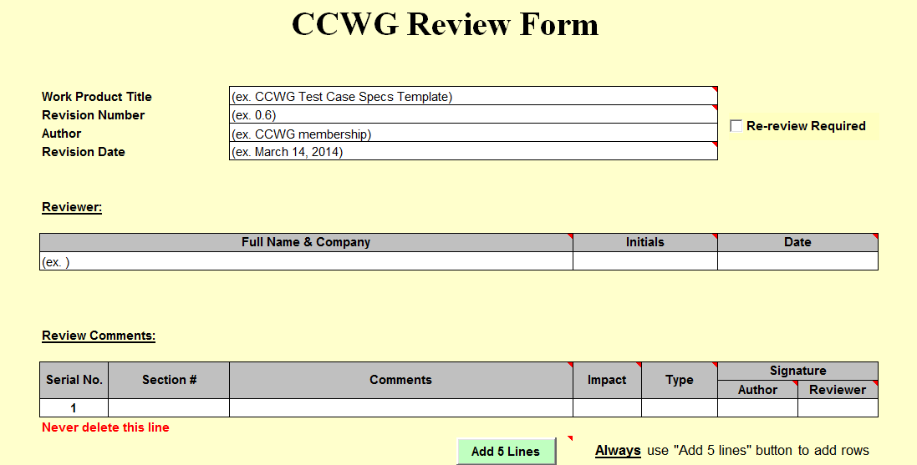

Slide 13
Versioning

Slide 14
Modifications and Revisions
.
Revisions to AllJoyn Service Frameworks Interface Specs
AllJoyn Alliance will announce major releases.
Test Cases Specs will be revised to the new Release.
A grace period will be declared(Alliance Members still can use the old Test Cases Specs)
After grace period all devices must be tested against latest Test Cases Specs
Major Revisions Affecting Interoperability
Alliance mandates the resubmission for certification testing when:
Serious deficiency in the Test Cases Specs, interoperability procedures or process is uncovered,
Interoperability issues

Slide 15
Future Agenda, Action Items Review

Slide 16
Future Agendas
 |  | Mar |  |  | April |  |  |  |  | May
Topic | Owner | 12 | 19 | 26 | 2 | 9 | 16 | 23 | 30 | 7 | 14 | 21 | 28
Test case spec template, and testcode | Telis | √
WGs requirements Types of Certification Version of the certification Test suites | Telis |  | √
Document Review Form | Jun ZHANG |  |  | √
Certification type | Takeshi Matsushita |  |  | √
E-Qualus Certification Program Considerations | Alan |  |  |  |  | √

Slide 17
Action Items
Number | Date Assigned | AI Description | Owner | Status
1 | 3/27/2014 | How to write testcode-training | Telis | In progress
2 | 4/1/2014 | Requirements for WGs | Teliis | In progress
3

