Slide 1
C&C Working Group Meeting
14 May 2014

Slide 2
Antitrust Compliance Notice
AllSeen Alliance meetings involve participation by industry competitors, and it is the intention of AllSeen Alliance to conduct all of its activities in accordance with applicable antitrust and competition laws. It is therefore extremely important that attendees adhere to meeting agendas, and be aware of and not participate in any activities that are prohibited under applicable US state, federal or foreign antitrust and competition laws.
Examples of types of actions that are prohibited at AllSeen Alliance meetings and in connection with AllSeen Alliance activities are described in the AllSeen Alliance Antitrust Policy. If you have questions about these matters, please contact your company counsel, or if you are a member of AllSeen Alliance, feel free to contact Lee Gesmer or Andrew Updegrove, of the firm of Gesmer Updegrove LLP, which provides legal counsel to AllSeen Alliance.

Slide 3
Guidelines
This is a reminder that all AllSeen Alliance activities are subject to strict compliance with the AllSeen Alliance By-laws. Each individual participant and attendee at this meeting is responsible for knowing the contents of the AllSeen Alliance By-laws, and for complying with the AllSeen Alliance By-laws. Copies of the AllSeen Alliance By-laws are available at:
https://allseenalliance.org/allseen/bylaws

Slide 4
Goals for Today’s Discussion
Review & Vote on 3 Test Case Specs: https://wiki.allseenalliance.org/compliance/overview#test_case_specifications
Feedback on Homework

Slide 5
About Feature Test Case Spec
These test cases evaluate and verify the functionality related to the AllJoyn™ About feature exposed by a device through the About 1.0 interface.
The About interface is required by an application to provide the discovery mechanism for the service framework interfaces that it supports, as well as providing the basic identification information.
VOTE to approve “About Feature Test Case Spec” as part of Certification
Approved on May 7th with stipulations to add s/w release number 14.02 and add ability to use Ethernet connection (section 2.1)
Document on wiki needs to be updated

Slide 6
Control Panel Service Test Case Spec
These test cases evaluate and verify the functionality related to the AllJoyn Control Panel service framework 1.0's collection of interfaces.
These interfaces provide the Control Panel service framework a mechanism to allow for a controller application to render the UI based on the controllee application’s widget metadata.
Control Panel: Infrastructure for exposing user interfaces for devices remotely
  After receiving a notification that the oven has been on Broil for 5 minutes a user could bring up the oven’s control panel and change the setting to “bake at 250” to keep the food warm
  A user could check the current values of a refrigerator (including current temperature) and modify the settings to make things hotter or colder as needed.
VOTE to approve changes
Changes approved May 7th; Tests 1-7 need to be written
Tests 1-7 need to be added to document on wiki

Slide 7
Notification Service Test Case Spec
These test cases evaluate and verify the functionality related to the AllJoyn Notification service framework when used by an application to do one or both of the following using the Notification interface:
  Receive (or consume) notifications from other applications
  Send (or produce) notifications to other applications
The Notification interface is used by an AllJoyn application to send events or state update notifications to other devices connected to an end user's home network, such as a Wi-Fi network.
Notifications: Simple, standardized interface for sending and receiving human-readable messages. “The text message for the Internet of Everything”
  Refrigerator could send a notification that freezer door has been left open for more than 5 minutes
  This could be rendered on any consumer: mobile device, TV, set top box, etc…
  Washing machine can send a notification when wash cycle is complete
Review Questions
VOTE to approve changes

Slide 8
Onboarding Service Test Case Spec
These test cases evaluate and verify the functionality related to the Onboarding service framework exposed by a device through the Onboarding 1.0 interface.
The Onboarding interface allows an onboader to send the Wi-Fi credentials to the onboardee to allow it to join the personal access point.
Onboarding: Provides a standard way to get devices onto a Wi-Fi Network (Wi-Fi is needed)
Review Questions
VOTE to approve changes

Slide 9
Configuration Test Case Spec
These test cases evaluate and verify the functionality related to the AllJoyn™ Configuration service framework exposed by a device through the Config 1.0 interface.
The Config interface is a secure interface that provides the functionality to perform device-specific configuration and actions. It is expected that an OEM's developed application for the device (referred to as the System App) will bundle this service framework.
Configuration: Enables ability to set configurable persistent values
  By default allows for a “Friendly Name” to be set. This name provides an end user the ability to specify a string that they can associate with the product, i.e. “Living Room TV”, “Patio Speaker”, "Garage Refrigerator" etc.
VOTE to approve changes

Slide 10
Feedback:
Setup and Run
Test Cases

Slide 11
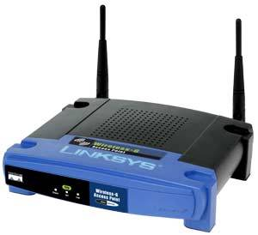


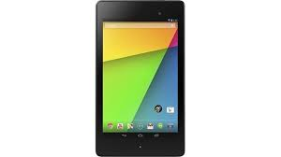
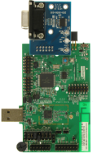
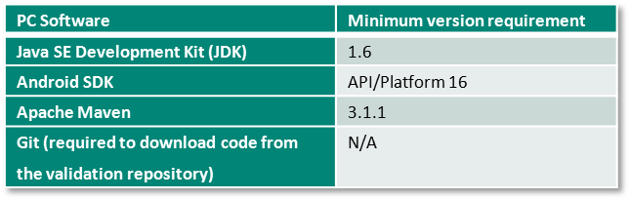
Example: Self Validation Test Setup and Executing Test Cases
Configure a Nexus Tablet (Android test device) to connect to Personal Access Point. Nexus 7 Tablet is the device on which the tests are executed
Onboard the Device Under Test (DUT) to Personal Access Point. DUT is the device against which tests will be executed
Connect the Nexus 7 Tablet to a PC/Laptop (Win 7) via USB cable
Download the test code from GIT repository on to PC/Laptop
Compile the test code and build test app on the PC/laptop
Deploy the test app to the Nexus 7 Tablet
Execute command on the PC/Laptop to start the execution of tests on Nexus 7 Tablet against the Device Under Test
View and analyze the test results produced on the PC/Laptop
GIT
4
1
2
3
6
5
8
7
DUT

Slide 12
Feedback on Homework from May 7th
Using the example on previous slide, setup and execute Self Validation Test Cases:
  Acquire/configure an Android device (preferably Nexus 7)
  Setup the Test Environment as per Validation Test User Guide
  Compile the test cases as per Validation Test User Guide
  Execute the test cases as per Validation Test User Guide
  Provide feedback on process
Validation Test User Guide
  https://wiki.allseenalliance.org/_media/compliance/alljoyn_validation_test_user_guide.pdf
Test Code
  https://git.allseenalliance.org/cgit/compliance/tests.git/

Slide 13
Release & Certification Timeline Examples

Slide 14
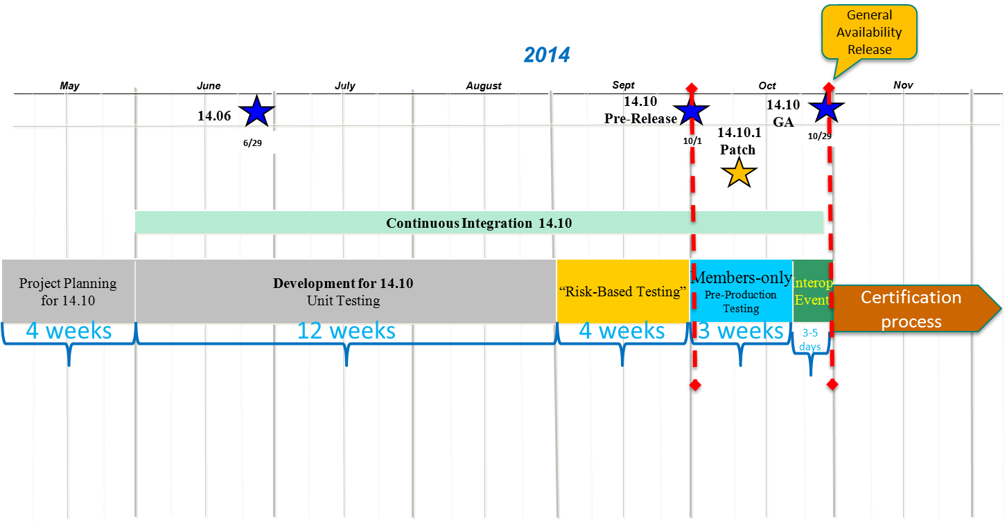
Timeline example for 1 AllSeen release

Slide 15
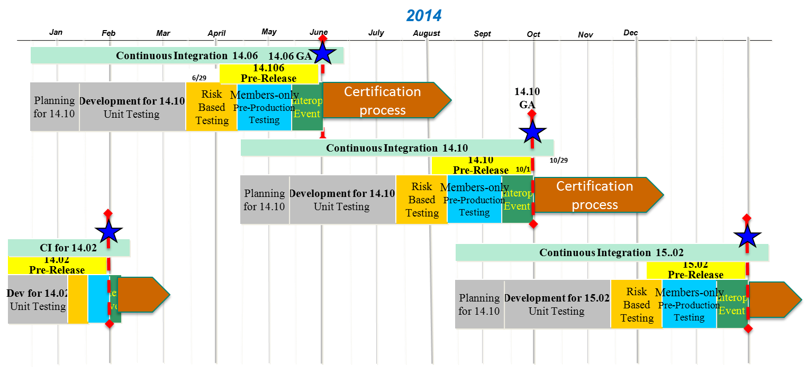
A full year of releases and certification cycle

Slide 16
C&C Working Group Information
To access the wiki page please go to https://wiki.allseenalliance.org/compliance/overview
To contact the Certification and Compliance Work Group, send an email to the allseen-cc@lists.allseenalliance.org
To join the Certification and Compliance Work Group Mailing List, please self-subscribe at https://lists.allseenalliance.org/mailman/listinfo/allseen-cc.
C&C WG meetings every week
  The meeting will be held on:
  Wednesdays 20:00PM - 21:00PM Eastern Time
  Wednesdays 17:00PM - 18:00PM Pacific Time
  Thursdays 9:00AM - 10:00 AM Korea/Japan
  Thursdays 1:00AM - 2:00 AM France

Slide 17
For more information on AllSeen Alliance, visit us at: allseenalliance.org & allseenalliance.org/news/blogs

