Slide 1
C&C Working Group Meeting
16 JULY 2014

Slide 2
Antitrust Compliance Notice
AllSeen Alliance meetings involve participation by industry competitors, and it is the intention of AllSeen Alliance to conduct all of its activities in accordance with applicable antitrust and competition laws. It is therefore extremely important that attendees adhere to meeting agendas, and be aware of and not participate in any activities that are prohibited under applicable US state, federal or foreign antitrust and competition laws.
Examples of types of actions that are prohibited at AllSeen Alliance meetings and in connection with AllSeen Alliance activities are described in the AllSeen Alliance Antitrust Policy. If you have questions about these matters, please contact your company counsel, or if you are a member of AllSeen Alliance, feel free to contact Lee Gesmer or Andrew Updegrove, of the firm of Gesmer Updegrove LLP, which provides legal counsel to AllSeen Alliance.

Slide 3
Guidelines
This is a reminder that all AllSeen Alliance activities are subject to strict compliance with the AllSeen Alliance By-laws. Each individual participant and attendee at this meeting is responsible for knowing the contents of the AllSeen Alliance By-laws, and for complying with the AllSeen Alliance By-laws. Copies of the AllSeen Alliance By-laws are available at:
https://allseenalliance.org/allseen/bylaws
Reminder: This call is being recorded

Slide 4
The Path to Certification

Slide 5


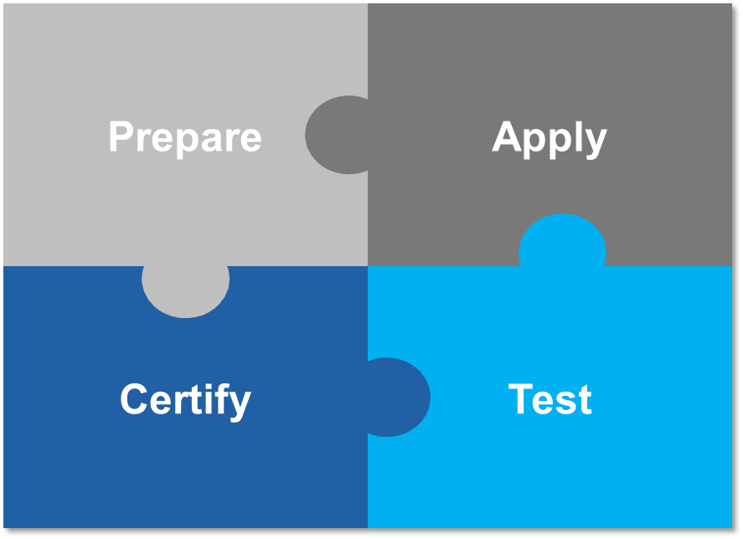



The Path to Certification
Member completes product
Study the certification program
Prepare ICS
Apply for Certification
Sign certification Agreement
Certification received when tests passed
Legal documents are signed
Testing begins
  Self-certification
  Test Lab

Slide 6
Prepare
Interface Definitions
TestCase Specs
Certification Program Guide
Allseen Alliance Test Tool
OEM performs Development and QA testing
Certification Agreement
Certification Policy
ICS/IXIT Template
OEM becomes familiar with program requirements
OEM completes the Implementation Conformance Statement (ICS)
ICS/IXIT
OEM chooses
Self-Certification or TestLab
QM Data
OEM develops Test Plan
Inherited
Test Results
Test Plan

Slide 7
Prepare
Prior to registering for certification, it is recommended that the OEM performs internal development and quality assurance testing using AllSeen Alliance validated test tools and the Test case Specifications.
OEM becomes familiar with the AllSeen Alliance Legal Agreements
OEM prepares the Implementation Conformance Statement for the product using the ICS Template available from the Certification Program
OEM develops a test plan for the product. The development of the test plan takes into consideration the OEM’s Quality Management data to identify which aspects of the product have changed as compared with any previously certified versions of the product. The test plan development also takes into account whether any test results may be inherited from previously OEM certified Implementations that are incorporated in the product.
The OEM is responsible for ensuring that the ICS and Test Plan for the product are complete and correct.

Slide 8
Testing Requirements Overview
Implementation Conformance Statement (ICS)
  Defines structure for the selection of mandatory and optional features implemented in the IUT.
Implementation eXtra Information for Testing (IXIT)
Test Specification (Test Case Mapping Tables)
  Defines test structures, sequence charts and test procedures for testing the Interface Definitions of the device.
  Test Case Mapping Table (TCMT) maps test cases to specific ICS items and features.
Test Case Control List (TCCL)
  The (TCCL) Test Case Categories List is a document that lists all Test Cases and their associated test category. It serves as a reference document that can be updated at short notice without any update to the Test Specifications. (A-Applicable Test case that must be run for Certification if a relevant feature is present)

Slide 9
ICS = Implementation Conformance Statement
A checklist of the capabilities supported by the IUT
  Status of capability in the Interface Definitions
    Mandatory, optional , conditional
    prohibited, excluded
    out-of scope, not applicable
A questionnaires completed by OEM IUT to present conformance requirements
Produced by filling out an ICS proforma with static requirements
Provides an overview of the features and options that are implemented
Used to select and parameterize test cases and as an indicator for basic interoperability between different IUTs

Slide 10
IXIT = Implementation eXtra Information for Testing
Contains additional information beyond Definitions as ICS
An IXIT proforma filled out by test OEM for the Device Under Test
Specify additional testing information related to an Interface Definition
  Physical setup, connection of test, and testing environment
  IUT hardware, telephone numbers, and tester addresses
  Test-specific timer or parameter values
List references to Interface Definitions of the DUT, related ICSs, related test reports

Slide 11


ICS/IXIT vs Configurations
Test Cases
Verdicts
Fill ICS/IXIT for
Configuration 1
Applicable Test Cases
Execution
Test Cases
Verdicts
Different sets of Test Cases are executed for each configuration.
It is necessary that DUT PASS all Test Cases for the specific configuration to be compliant with the Compliant Requirements
Fill ICS/IXIT for
Configuration 2
Applicable Test Cases
Execution
OEM subsystem
:
:
:
Test Cases
Verdicts
Fill ICS/IXIT for
Configuration 3
Applicable Test Cases
Execution

Slide 12
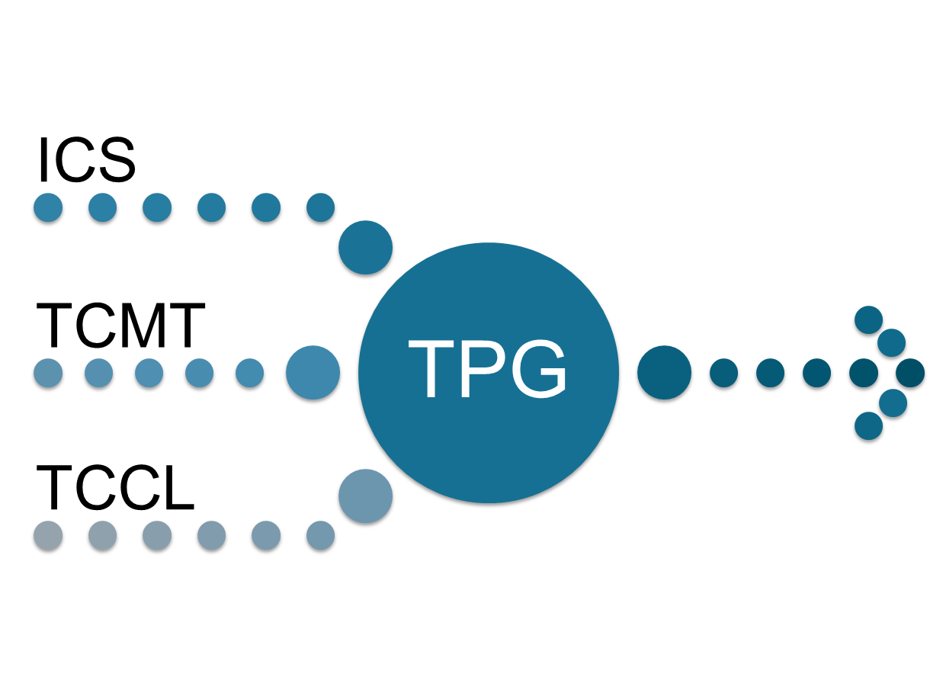
Test Plan Generator
TPG Automates the mapping of ICS/IXIT to test cases
Test Plan

Slide 13
Mapping Features to Test Cases
ICS
Item | Service Capability | Interface Definition | Status | Support
1 | Notification Producer Msg Priority | NS.14.02 | M | [Y/N] = Y
2 | Notification Producer Text Content | NS.14.02 | O | [Y/N] = Y
TCMT
Item | Feature | Test Suite | TestCase
1 | Sending Notification Messages-Priority | NS.PROD.1.0 | PROD/Notification-v-1-01
2 | Sending Notification Messages-Text | NS.PROD.1.0 | PROD/Notification-v-1-02
TCCL
Item | TestCase | Interface Definition | TC CAT | Test Platform
1 | PROD/Notification-v-1-01 | NS.14.02 | A
2 | CON/Notification-v-1-01 | NS.14.02 | A
Service Capability | Test Cases |  |  | Available Date | Active Date
Notification Producer Msg Priority | PROD/Notification-v-1-01 | Sending Notification Messages | NS.PROD.1.0 | 5-June-14 | 16-July-14
Notification Producer Msg Text Content | PROD/Notification-v-1-01 | Sending Notification Messages | NS.PROD.1.0 | 5-June-14 | 16-July-14
TEST
PLAN

Slide 14
For more information on AllSeen Alliance, visit us at: allseenalliance.org & allseenalliance.org/news/blogs

