Slide 1
Core Working Group: Security 2.0
September 15, 2015
The contents of this document, and the interfaces described, and all the information herein, are the result of collaborative discussions by the Core Working Group.
This summary documents the final consensus of the team.

Slide 2
Reminder: This call is being recorded

Slide 3
Antitrust Compliance Notice
AllSeen Alliance meetings involve participation by industry competitors, and it is the intention of AllSeen Alliance to conduct all of its activities in accordance with applicable antitrust and competition laws. It is therefore extremely important that attendees adhere to meeting agendas, and be aware of and not participate in any activities that are prohibited under applicable US state, federal or foreign antitrust and competition laws.
Examples of types of actions that are prohibited at AllSeen Alliance meetings and in connection with AllSeen Alliance activities are described in the AllSeen Alliance Antitrust Policy. If you have questions about these matters, please contact your company counsel, or if you are a member of AllSeen Alliance, feel free to contact Lee Gesmer or Andrew Updegrove, of the firm of Gesmer Updegrove LLP, which provides legal counsel to AllSeen Alliance.

Slide 4
Agenda
Schedule
Bindings
Triage
HLD updates
Discussion
Action items

Slide 5
Schedule

Slide 6
Review blocking tickets
https://jira.allseenalliance.org/issues/?filter=11613

Slide 7
Schedule
Dashboard: https://jira.allseenalliance.org/secure/Dashboard.jspa?selectPageId=10903
Milestones
Merged with master
All changes should go to the master branch
15.09 release – September 30
Release branch cut – changes for the release need to go to the release branch.
Interop testing
QCE will conduct the documented backwards compatibility tests in the E2E section of the test spreadsheet.
MSFT will communicate the E2E testing they will conduct for Security 2.0
TSC informed: Security 2.0 released as experimental “Developer Preview”
Post 15.09 evolution
Continue work on master
Proposal: 15.09 patch release made once all unit tests are written and passed
Identify the tickets required based on severity

Slide 8
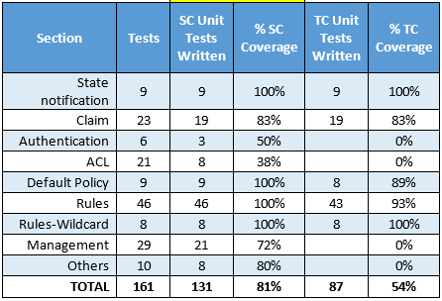
Test Case Coverage As of 9/15/15

Slide 9
Bindings

Slide 10
Bindings
Core implementation
SC: C++
Gavin (MSFT) to verify internally if they will handle the C binding for Security 2.0
Will have more details by next week
TC: C

Slide 11
Triage

Slide 12
Triage
Review unassigned tickets
https://jira.allseenalliance.org/issues/?filter=11142

Slide 13
HLD updates

Slide 14
HLD Updates
No pending updates

Slide 15
Discussion

Slide 16
Discussion
…

Slide 17
Action Items

Slide 18
Action Items
None noted

Slide 19







For more information on AllSeen Alliance, visit us at: allseenalliance.org & allseenalliance.org/news/blogs

