Slide 1
Data-driven API breakout session
DOMINIQUE CHANET
Qeo LLC a subsidiary of Technicolor SA

Slide 2
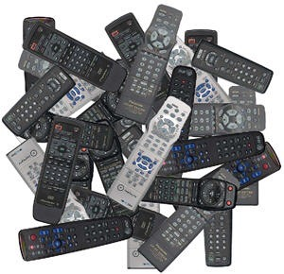

IoT is many things to many people
By 2020, 200bn devices are projected to be connected (source: Intel)
That’s 26 smart objects per person
Boring
Remote Control
Telemetry

Slide 3


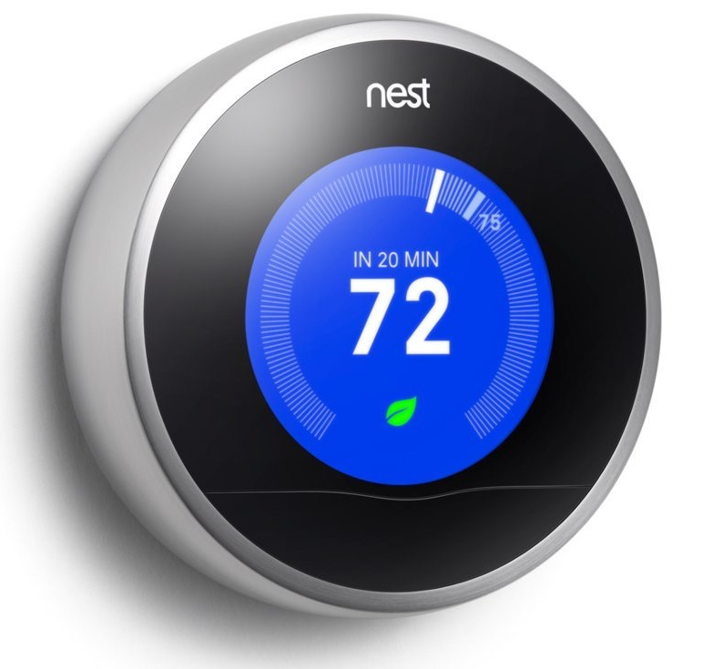
IoT is many things to many people
By 2020, 200bn devices are projected to be connected (source: Intel)
That’s 26 smart objects per person
Draws conclusions & acts
Observes its environment
Reactive Things

Slide 4

IoT is many things to many people
By 2020, 200bn devices are projected to be connected (source: Intel)
That’s 26 smart objects per person
Draws conclusions & acts
Interesting
Observes its environment
Reactive Things

Slide 5
Motivation
Data Models
Interaction with AllJoyn Core
Current Status

Slide 6
26 smart objects

Slide 7
up to 650 observer-subject pairs

Slide 8
mobile / battery operated / wireless

Slide 9
Classic AllJoyn interaction model (discover-connect-query) does not scale.

Slide 10
AllJoyn as a universal data bus
Data you offer is more important than the services you provide reactive things versus remote controlled things
Publish-subscribe paradigm push versus pull model
Loosely coupled more resilient to adverse network conditions
Strongly typed data well-defined, formalised, standardised data models
Total abstraction of the communication layer lets developers focus on business logic, not communication logic

Slide 11
Data-driven API
Observer <temperature>
Provider #1
temperature
Consumer #1
humidity
Observer <temperature>
Consumer #2

Slide 12
Data-driven API
Observer <temperature>
Provider #1
temperature
Consumer #1
humidity
Observer <temperature>
The data space is organised in topics.
Topics have well-defined data types.
Consumer #2

Slide 13
Data-driven API
Observer <temperature>
Provider #1
temperature
Consumer #1
humidity
Observer <temperature>
Local cache keeps track of latest state of each discovered object.
Consumer #2

Slide 14
Data-driven API
Observer <temperature>
Provider #1
temperature
Consumer #1
humidity
Observer <temperature>
State updates are propagated transparently from provider to consumer.
Consumer #2

Slide 15
Data-driven API
Observer <temperature>
Provider #1
temperature
Consumer #1
Provider #2
humidity
Observer <temperature>
Consumer #2
Peer discovery is abstracted to object discovery.

Slide 16
Motivation
Data Models
Interaction with AllJoyn Core
Current Status

Slide 17
Types of data
Represents state of physical or logical entities in the problem domain.
Persistent: as long as an entity exists, it is in a certain state.
Observers keep track of latest state of each discovered object. Latest state remains discoverable by late joiners.
STATE
Represents ephemeral occurrences (e.g. a keypress).
Every event counts.
Discrete: only valid at one point in time.
No support for late joiners: if you weren’t there to observe an event, you missed it for good.
EVENT

Slide 18
AllJoyn Interface is the data model
<node>
<interface name="org.allseenalliance.door">
<property name="Location" type="s"/>
<property name="Open" type="b"/>
<signal name="PersonPassedThrough">
<arg name="Who" type="s"/>
</signal>
<method name="ChangeState">
<arg name="Open" type="b"/>
</method>
</interface>
</node>
An interface is a collection of related data and behaviour.
Every bus object that implements an interface serves as an instance on the associated topic.

Slide 19
AllJoyn Interface is the data model
<node>
<interface name="org.allseenalliance.door">
<property name="Location" type="s"/>
<property name="Open" type="b"/>
<signal name="PersonPassedThrough">
<arg name="Who" type="s"/>
</signal>
<method name="ChangeState">
<arg name="Open" type="b"/>
</method>
</interface>
</node>
Properties represent an object’s observable state.
Hence, we use them to model STATE data.
<property name="Location" type="s"/>
<property name="Open" type="b"/>

Slide 20
AllJoyn Interface is the data model
<node>
<interface name="org.allseenalliance.door">
<property name="Location" type="s"/>
<property name="Open" type="b"/>
<signal name="PersonPassedThrough">
<arg name="Who" type="s"/>
</signal>
<method name="ChangeState">
<arg name="Open" type="b"/>
</method>
</interface>
</node>
Signals model ephemeral occurrences.
Hence, we use them to model EVENT data.
<signal name="PersonPassedThrough">
<arg name="Who" type="s"/>
</signal>

Slide 21
AllJoyn Interface is the data model
<node>
<interface name="org.allseenalliance.door">
<property name="Location" type="s"/>
<property name="Open" type="b"/>
<signal name="PersonPassedThrough">
<arg name="Who" type="s"/>
</signal>
<method name="ChangeState">
<arg name="Open" type="b"/>
</method>
</interface>
</node>
Methods model behaviour.
Allows for seamless interoperability with service-oriented AllJoyn applications.
<method name="ChangeState">
<arg name="Open" type="b"/>
</method>

Slide 22
The current interface definition language is too limited.
<interface name="org.alljoyn.About">
<property name="Version" type="q" access="read"/>
<method name="GetAboutData">
<arg name="languageTag" type="s" direction="in"/>
<arg name="aboutData" type="a{sv}" direction="out"/>
</method>
<method name="GetObjectDescription">
<arg name="objectDescription" type="a(sas)" direction="out"/>
</method>
<signal name="Announce">
<arg name="version" type="q"/>
<arg name="port" type="q"/>
<arg name="objectDescription" type="a(sas)"/>
<arg name="metaData" type="a{sv}"/>
</signal>
</interface>

Slide 23
The current interface definition language is too limited.
Machine-readable, not human-readable. What does “q” mean?
<interface name="org.alljoyn.About">
<property name="Version" type="q" access="read"/>
<method name="GetAboutData">
<arg name="languageTag" type="s" direction="in"/>
<arg name="aboutData" type="a{sv}" direction="out"/>
</method>
<method name="GetObjectDescription">
<arg name="objectDescription" type="a(sas)" direction="out"/>
</method>
<signal name="Announce">
<arg name="version" type="q"/>
<arg name="port" type="q"/>
<arg name="objectDescription" type="a(sas)"/>
<arg name="metaData" type="a{sv}"/>
</signal>
</interface>
Array of some kind of struct that represents something.
AllJoyn has five different kinds of signals, each with their own semantics. Which one is intended here?

Slide 24
The current interface definition language is too limited.
<struct name="ObjectDescription">
<field name="path" type="s"/>
<field name="interfaces" type="as"/>
</struct>
type="a[ObjectDescription]"
type="sessionless"
type="a[ObjectDescription]"
<interface name="org.alljoyn.About">
<struct name="ObjectDescription">
<field name="path" type="s"/>
<field name="interfaces" type="as"/>
</struct>
...
<method name="GetObjectDescription">
<arg name="objectDescription" type="a[ObjectDescription]" direction="out"/>
</method>
<signal name="Announce" type="sessionless">
...
<arg name="objectDescription" type="a[ObjectDescription]"/>
<arg name="metaData" type="a{sv}"/>
</signal>
</interface>

Slide 25
Leverage code generator to turn formal XML definition into code.
codegen
DoorInterface.cc
Door.xml
DoorProxy.cc
Manual type definition and message marshalling are tedious and error prone. The code generator can do these things on your behalf.

Slide 26
Common data models must be standardised.
Universally available data must be universally understood.
Data models for common concepts must be standardised. Canonical data models for light bulbs, various sensors, …
Beyond data models: modeling style, physical units, … e.g. temperature: Kelvin, Fahrenheit or Celsius?
The Alliance must take the lead in such a standardisation. Change of approach: centralised versus working group centric.

Slide 27
Standardised data models will evolve over time.
v1
v2
v3
Linear Evolution

Slide 28
Standardised data models will evolve over time.
v1
v1
v2
v2
v1.ACME
v3
v3
v2.ACME
Linear Evolution
Vendor Extensions

Slide 29
Standardised data models will evolve over time.
v1
v1
v2
v2
v1.ACME
Providers and consumers of all different versions of the data model must interoperate in a foolproof and elegant way.
v3
v3
v2.ACME
Linear Evolution
Vendor Extensions

Slide 30
This is not what we think of as “foolproof and elegant”.
if (version == 3) { ... } else if (version > 4) { if (version == 5) { ... } else if (IS_ACME_EXTENDED()) {
...
} ... }

Slide 31
The Alliance needs to formulate a clear vision on data model evolution.
Is there a deprecation strategy for older interface versions?
Some AllJoyn-enabled products have >20yr life cycles.
How do application developers deal with peers that offer different versions of the same interface?
We desperately want to avoid version number spaghetti.
Are vendor extensions allowed?
If not, how do we convince vendors to use the standardised interfaces instead of rolling their own proprietary versions?
What is the nature of an Interface? There are 2 factions:
an ADT that is subject to SOLID principles
a formally defined set of messages that can be exchanged between peers, where the definition of these messages can evolve over time according to well-understood rules

Slide 32
Motivation
Data Models
Interaction with AllJoyn Core
Current Status

Slide 33
DDAPI is a helper library on top of AllJoyn Core.
Application business logic communication logic type description & marshaling
AllJoyn Core

Slide 34
DDAPI is a helper library on top of AllJoyn Core.
Application business logic
Generated Code type description & marshaling
DDAPI communication logic
codegen
AllJoyn Core

Slide 35
DDAPI applications work together well with plain AllJoyn applications
if those applications are well-behaved = don’t rely on ad hoc behaviours
use About for object announcement
emit PropertiesChanged signals
use sessioncast signals
don’t do funky stuff in session setup
AllJoyn needs best practices, conventions that define when to use what parts of its toolbox. DDAPI proposes and implements these conventions.

Slide 36
The best DDAPI is no DDAPI.
Having two competing APIs for AllJoyn is a Bad Idea™.
Long-term goal is to integrate DDAPI into Core.
Short term, the DDAPI working group contributes ideas and code back to Core.
better discovery and peer presence detection
raising the bar for data model design
extensions to the Interface definition language
re-thinking session setup
AllJoyn usage best practices
…

Slide 37
Motivation
Data Models
Interaction with AllJoyn Core
Current Status

Slide 38
Where are we today?
Data-driven API
C++ version: API more or less complete
experimental version based on R14.06 in Alliance git repositories
working hard on a production-ready version based on R14.12 with better interoperability with plain AllJoyn applications
Other language bindings in next releases
Interface Definition Language Extensions
Initial enhancements (named types) will be introduced for R14.12 release of devtools/codegen
Subsequent evolutions (optional fields, enumerations, data model evolution support, …) for next releases
Code Generator
DDAPI/C++ code generator for the experimental DDAPI version is available on a feature branch in the Alliance git repositories
version that coincides with the DDAPI R14.12 release is underway

Slide 39
Our lasting legacy must not be an API, but a vision.
Make Alliance members think outside of the ad hoc and remote control use cases.
Stimulate the definition of best practices and conventions for the idiomatic, expected use of AllJoyn in IoT contexts.
Foster the development of new, unexpected uses for smart devices and the data they share over AllJoyn.

Slide 40
For more information on AllSeen Alliance, visit us at: allseenalliance.org & allseenalliance.org/news/blogs

