Slide 1
ALLJOYN UPDATE SERVICE Updated CONTRIBUTION & dEMO pLAN
Aug 2015

Slide 2
Status update from MID 2014 activity
Alljoyn has matured significantly
Device Update scenarios/use cases crystallized
Alljoyn hardware requirements to implement device update client (as reference/contribution/demo ) eased:
From QCA Boards to e.g. Raspberry Pi

Slide 3
PLAN OF ACTION AUG 2015
Redefine the update scenarios/use cases
Based on refinement of use cases
(including J.Spain input)
Provide requirements for contribution and demo
For the simple scenario only
Develop from 1st week of September
Demo ready for AJ Summit

Slide 4
main device update scenarios
Scenario 1: Alljoyn (mostly thin) devices are updated directly from OEM Cloud, no central gateway involved
1a variant
Update via AJ Smart Device implementing:
Update Service
Alljoyn Control App
Where the AJ Control App is configured to communicate with OEM update server
OEM update server notifies AJ Control App of update availability for the AJ thin device
AJ Control app downloads the update to the Smart Device
Update service notifies AJ Thin device (update client) of update availability
Update client downloads update package from Smart device
(update installation conditions rule engine implemented in client –out of scope)

Slide 5
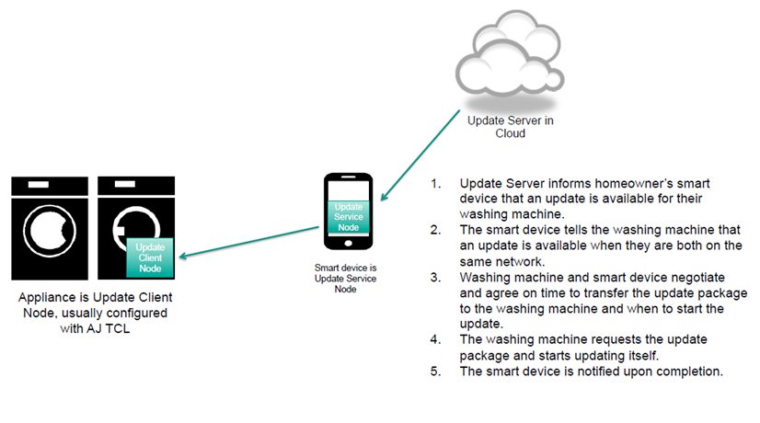
SCEnario 1A depiction

Slide 6
main device update scenarios
Scenario 1: Alljoyn (mostly thin) devices are updated directly from OEM Cloud, no central gateway involved
1b variant
AJ thin device (configured on WiFi network and able to communicate with OEM server) downloads update package directly from OEM update server
AJ Control app and Update service manage the update discovery, triggering and process control
AJ Smart Device implementing:
Update Service
Alljoyn Control App
Where the AJ Control App is configured to communicate with OEM update server
OEM update server notifies AJ Control App of update availability for the AJ thin device
Update service notifies device ( AJ update client) of update availability
Update client triggers a direct download of update package from OEM server to AJ thin device
AJ Control App displays process to user, notified of status via Update service

Slide 7
main device update scenarios
Scenario 2: Alljoyn (mostly thin) devices are updated via Gateway Agent running on a dedicated gateway device

Slide 8
Sw Elements required for demo
Alljoyn Thin Device
AllJoyn Core
AllJoyn Services
Control Panel
Notifications
Update Client
Smart Device
AllJoyn Core
AllJoyn Services
Control Panel
Notifications
Update Service
AJ Dashboard app (QCOM)
(GW Agent)?
Other AJ Device (able to announce notifications)
AllJoyn Core
AllJoyn Services
Control Panel
Notifications

Slide 9
ORIGINAL PROPOSED Update Flow
Agent
Installer
Client
Service
Find Name
(Update Service)
About
(Model, Version, Interfaces)
NewUpdateAvailable
(Size, Signature, Urgency)
GetUpdatePackage
(Offset, Size)
Repeat
WriteUpdatePart
(Offset, Size)
Update*
()
CompleteUpdate
()
UpdateCompleted
(Status)
About
(Model, Version, Interfaces)
* Update Agent invocation depends on device flash layout (see later)

Slide 10
Additional: service mgmt flow
Update Client
Update Service
Mgmt Layer
About
(Model, Version, Interfaces)
Local update
Available?
NewUpdateAvailable
(Size, Signature, Urgency)
Notify new device
(Model, version…)
Yes
No
Update Flow continues
until another About is sent
Update package
may be downloaded
and placed locally on
Update Service storage
Notify Update available

Slide 11
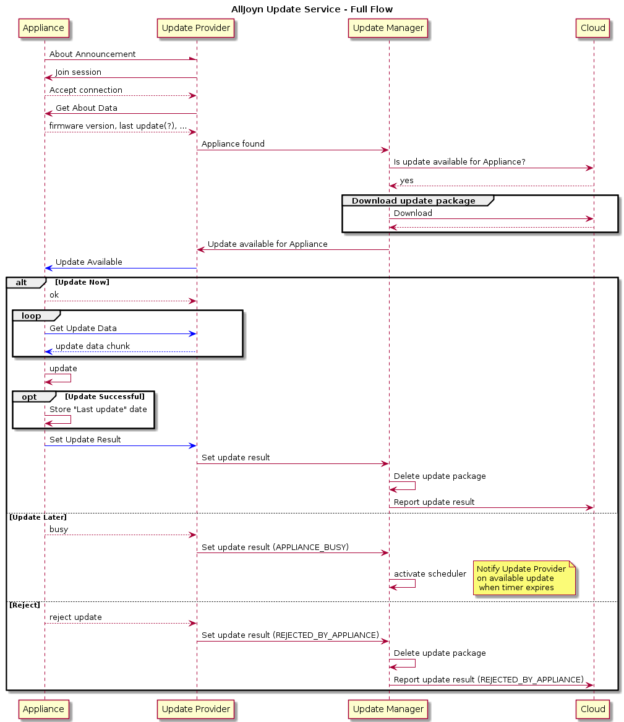

Slide 12
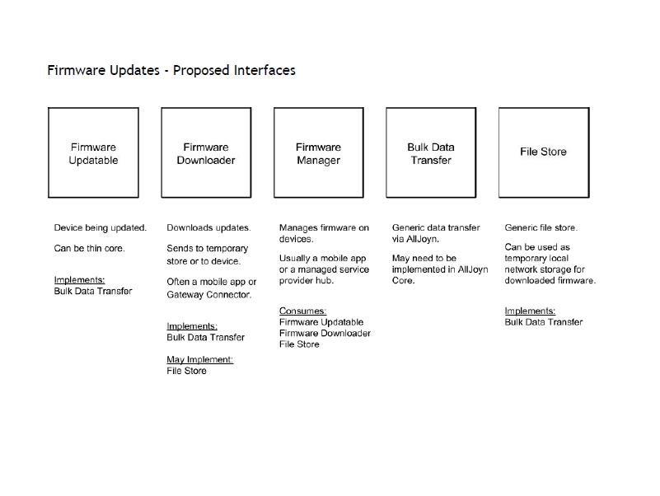
Josh SPAIN (Affinegy) Suggestion
We think these interfaces are generic and not specific to Update Services

Slide 13
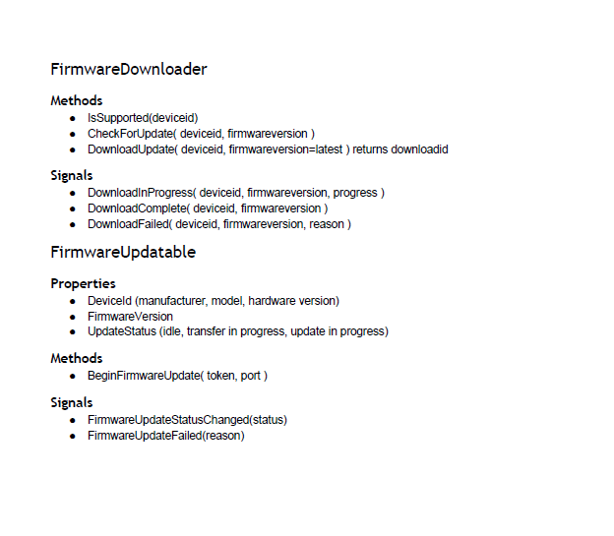

Slide 14
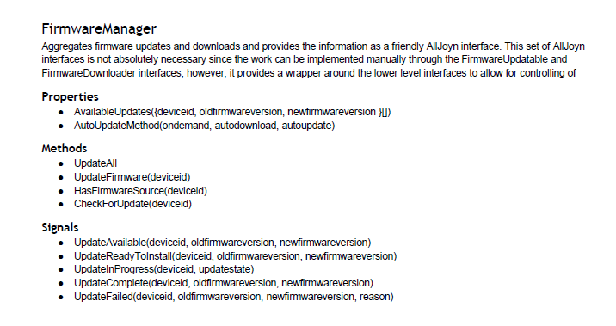

Slide 15
Other AJ Devices
Smart Device with AJ Control App
AJ Thin Device
AJ Core
Control Panel
AJ Core
Display Control Panel
AJ App
Device Update Notification
AJ Core
AJ App
AJ App
Update Service
Find Name
About
Update Client
Update Service
About
Update Client
Update Service
Update Client
Update Client
AJ Core

Slide 16
DEMO notes
(on-boarding assumed already)
Fridge sends ”Control Panel” to core AJ service
Fridge sends “Find Name Update service”
Fridge sends “About”
Update availability notification (Update Service) to the Fridge
Update availability general notification (using AllJoyn notification)
Text: “Fridge says: I have an important update. It was verified” …pls allow
Update user acceptance
Update progress (shown on other devices), LCD on Pi?
Update complete notification (audio, visual)
Control Panel/About- change viewed
[update of capability reflected in Control Panel]

