Slide 1
Gateway Agent Overview Presentation
Art Lancaster
CTO Affinegy, AllSeen Alliance Board Member and Chair Gateway W.G. September 8, 2014

Slide 2





Why the AllJoyn proximal network topology matters
“Someone’s at the door”
“Someone’s at the door”
“Laundry is ready!”
“Coffee is done”
Direct communication with the AllJoyn framework is fast, efficient, and secure.
No need to go out to the cloud to talk to the device right next to you!
“Someone’s at the door”
“Laundry is ready!”
“Coffee is done”
NOW PLAYING:
Artist: Flowers
Song: Daisy
Notes:
Why the AllJoyn Proximal Network Topology Matters.
AllJoyn is different in that you DON’T have to go out to the cloud to talk to the device right next to you!
Much FASTER. Much more EFFICIENT. And SAFER.

Slide 3








Gateway Agent – AllJoyn meets Cloud Services
Cloud Services
Dryer:
Laundry is ready
TV: My WiFi video
Picture is poor
Fix it?
Laundry is ready
Gateway
Agent
DVR: play
my Hawaii vacation
movie
TV: Trying WiFi channel
change fix
DVR: OK playing
My Hawaii vacation
movie
72°
OK changing
to away mode
120
80
Turn off the kitchen lights,
Set away mode.
Laundry is ready
Car: OK Lights are
now ON
The AllJoyn software framework is a collaborative open source project of the AllSeen Alliance

Slide 4
AllSeen Gateway Agent
A new gateway software application targeting automation hubs, home gateways, IP set tops, etc. – any always on hardware device in the proximal network
Provides a standard and secure method for connecting AllJoyn devices and applications to cloud services, PAN technologies, other networks
Works with any Internet connection
Supports persistent remote connections without special firewall or port settings
Maintains AllJoyn security end-to-end
Provides a new, managed and secure AllJoyn routing node for services providers and connected device services suppliers
Filters LAN AllJoyn traffic from WAN traffic – only traffic needed for the user’s cloud or other remote services are passed through the gateway
Traffic is managed by Gateway Agent standard Service Profiles and a Standard AllSeen API
Architecture supports multiple independent cloud services in one gateway device with modular, plug-in Cloud Connectors

Slide 5
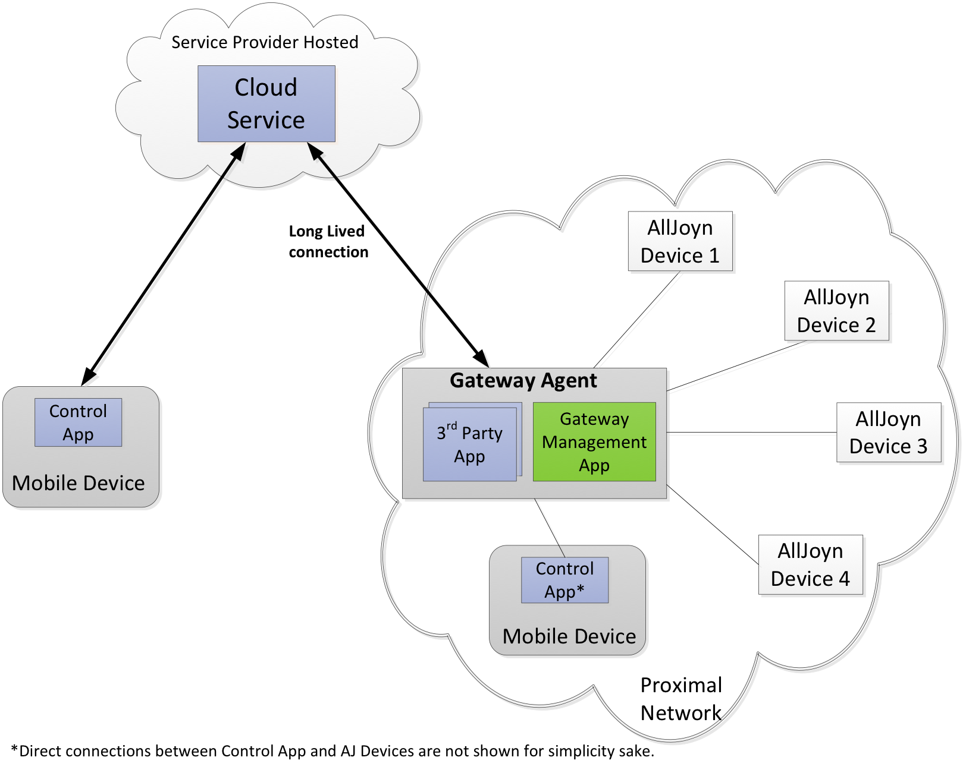
Overall Architecture
Cloud
Services
Gateway Agent
Gateway Management App
Embedded in gateway device
Management APIs for controlling the remote access and filtering for each cloud service to their included AllJoyn devices
Includes a TR-069 component for service provider remote provisioning management
Remote Connector App(s)
AllJoyn to Cloud (or other technology/network) Protocol connector
Installable and portable
One or more Connectors supported
Control App
A add-on component for an AllJoyn mobile app to enable users to self-manage their cloud service connections
Remote Connector
App(s)

Slide 6
Gateway Agent Control and Management Modes
Consumer Mode – self-service local management
Enables a consumer user to self-manage their AllJoyn connections to cloud services
Services can be initially provisioned via a mobile app that includes the Gateway Control App
The Control App follows the Gateway Agent APIs to install its own Connector App and to manage its Service Profiles
Consumer must be at home when configuring their cloud service using Consumer Mode
Service Provider Mode – secure remote provisioning management
Ideal for broadband service providers and for connected device services suppliers
Remote management implemented with TR-069a5 enhanced with XMPP
Proven, secure, high-scale NAT traversal, compliant with Broadband Forum and XMPP standards
Remote software installation and update management for both the Connector App(s) and the complete firmware of the hub or gateway device.
Remote management of the AllJoyn Services Profile and of the gateway/hub configuration
Can coexist with Consumer Mode, or can remotely block Consumer Mode

Slide 7
Remote Connector App – AllJoyn to XMPP
An XMPP Cloud Services Connector plug-in for the AllSeen Gateway Agent supporting its APIs and service profiles
Relays local AllJoyn messages, to a remote AllJoyn application by wrapping these in XMPP sessions relayed via a standard XMPP server cloud service.
Subscribers authenticate with their cloud service’s XMPP (Jabber) IDs for both their mobile app and for their Gateway Agent XMPP Connector App.
Supports XMPP standard stanzas: message/, presence/, IQ/ (info/query)
Includes XMPP standard security user authentication and for channel encryption (XEP 3920)
Implemented as a LUA script supporting OpenWRT and interfacing through the Gateway Agent API to its AllJoyn routing node

Slide 8
Gateway Agent Open Source Code and Status
Gateway Agent Component | Details | Status | Contributor
1. Gateway Management App | Main management embedded app | Code available in AllSeen GIT | Qualcomm
2. TR-069 client | Service provider mode management client | Porting to AllSeen open source, available Oct. | Affinegy
3. Connector App | XMPP cloud to AllJoyn connector. | Adding AllSeen gateway API support, available Oct. | Affinegy
4. Package manager | Software installation manager for Connector Apps | Code available in AllSeen GIT Sept. | Affinegy
5. Mobile Control App | Android based mobile Control App | Code available in AllSeen GIT | Qualcomm
6. Full Gateway Agent Release 1 – Reference implementation | Integrated full Gateway Agent in OpenWRT & developer cloud reference | Q4 2014 | Qualcomm & Affinegy

Slide 9
Cloud Services for Gateway Agent available from Affinegy
Affinegy CHARIOT Server
High scale, proven TR-069 remote management ACS server deployed worldwide with millions of devices under management
XMPP server for high scale, persistent IOT services and management
Integrated with the Affinegy TR-069 ACS and Affinegy’s Home and Business user portals
Provides IOT cloud services fully compatible with AllSeen Gateway Agent
No cost developer hosted access available from Affinegy
Commercial CHARIOT server licensing available from Affinegy, both hosted and installed options

Slide 10
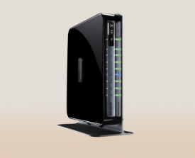




About Affinegy – CHARIOT Platform Overview
Installation | Apps & Services | Support | Management | Analytics
CHARIOT CAP Customer Activation Portal | CHARIOT Home CHARIOT Business | CHARIOT Care | CHARIOT Server | CHARIOT Insights
Automated gateway & device provisioning TR-069 with DOCSIS provisioning | Easy, self-service user experiences for home networks and IOT All devices: Wi-Fi and smart automation Mobile/Web apps Value added brand-able services portal Enterprise grade secure Wi-Fi Available for Homes and Small Businesses | Remote care dashboard for devices and services Easy alerts and fixes for common service & connectivity problems Advanced diagnostics for LAN/WAN issues Web APIs for trouble ticket and back office systems | Advanced remote MGMT server Supports millions of customers TR-069 ACS with IOT protocol enhancements Integral high scale database and quick reports Powerful Web APIs for OSS/BSS | Services usage Connected device ID Traffic consumption by type Current system demographics Issue histories and pareto analytics By customer and region statistics
CHARIOT Client
Embedded management client Gateways, hubs, routers Latest TR-069 and XMPP standards

Slide 11
AllSeen Gateway Working Group Contributors
Affinegy
Art Lancaster, CTO – contributor and W.G. chair
Committers: Josh Spain, Kevin Sandifer, Jim Howard
Qualcomm
Shane Dewing, Senior Director Product Management – contributor
Committers: Tsahi Asher, Tali Messing, Benita Gupta, Josh Hershberg

Slide 12
For More Information
Art Lancaster – alancaster@affinegy.com
Shane Dewing – sdewing@qce.qualcomm.com
Tim Colleran – tcollera@qca.qualcomm.com
AllSeen Alliance information at https://allseenalliance.org/
AllSeen Gateway Workgroup Wiki – https://wiki.allseenalliance.org/tsc/technical_steering_committee/proposals/gatewayagent

