Slide 1
Gateway Agent Product & Architecture
14.12 Alliance Release

Slide 2
AllJoyn Gateway Agent (planning for Q4’2014 release)
Features | Benefits
Enables secure environment for interfacing to existing cloud and web services | Operator services Social networks and applications
Proximal to cloud | Mobility Remote control
Cloud to proximal | Offers common gateway and methods for Remote access Control and Automation Service discovery and delivery Remote diagnostic / data collection
Connecting multiple proximal environments | Notifications and Control between proximal environments AllJoyn to AllJoyn AllJoyn to other PAN (Zigbee etc.)
Secure discovery and installation of Connectors | User can add and update functionality Service Providers can push updates

Slide 3
AllSeen Gateway Agent
A new gateway software application targeting automation hubs, home gateways, IP set tops, etc. – any always on hardware device in the proximal network
Provides a standard and secure method for connecting AllJoyn devices and applications to cloud services, PAN technologies, other networks
Works with any Internet connection
Supports persistent remote connections without special firewall or port settings
Maintains AllJoyn security end-to-end
Provides a new, managed and secure AllJoyn routing node for services providers and connected device services suppliers
Filters LAN AllJoyn traffic from WAN traffic – only traffic needed for the user’s cloud or other remote services are passed through the gateway
Traffic is managed by Gateway Agent standard Service Profiles and a Standard AllSeen API
Architecture supports multiple independent cloud services in one gateway device with modular, plug-in Cloud Connectors

Slide 4
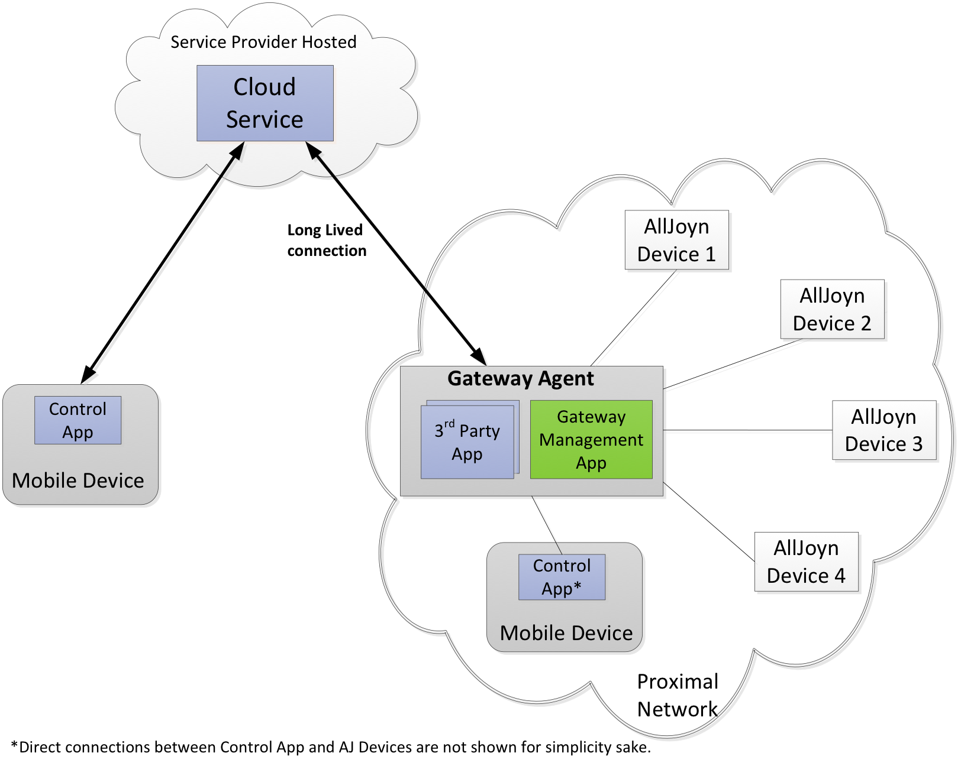
Overall Architecture
Cloud
Services
Gateway Agent
Gateway Management App
Embedded in gateway device
Management APIs for controlling the remote access and filtering for each cloud service to their included AllJoyn devices
Includes a TR-069 component for service provider remote provisioning management
Remote Connector App(s)
AllJoyn to Cloud (or other technology/network) Protocol connector
Installable and portable
One or more Connectors supported
Control App
A add-on component for an AllJoyn mobile app to enable users to self-manage their cloud service connections
Remote Connector
App(s)

Slide 5
Gateway Agent Control and Management Modes
Consumer Mode – self-service local management
Enables a consumer user to self-manage their AllJoyn connections to cloud services
Services can be initially provisioned via a mobile app that includes the Gateway Control App
The Control App follows the Gateway Agent APIs to install its own Connector App and to manage its Service Profiles
Consumer must be at home when configuring their cloud service using Consumer Mode
Service Provider Mode – secure remote provisioning management
Ideal for broadband service providers and for connected device services suppliers
Remote management implemented with TR-069a5 enhanced with XMPP
Proven, secure, high-scale NAT traversal, compliant with Broadband Forum and XMPP standards
Remote software installation and update management for both the Connector App(s) and the complete firmware of the hub or gateway device.
Remote management of the AllJoyn Services Profile and of the gateway/hub configuration
Can coexist with Consumer Mode, or can remotely block Consumer Mode

Slide 6
Gateway Agent Open Source Code and Status
Gateway Agent Component | Details | Status | Contributor
1. Gateway Management App | Main management embedded app | Code available in AllSeen GIT | Qualcomm
2. TR-069 client | Service provider mode management client | Porting to AllSeen open source, available Oct. | Affinegy
3. Connector App | XMPP cloud to AllJoyn connector. | Adding AllSeen gateway API support, available Oct. | Affinegy
4. Package manager | Software installation manager for Connector Apps | Code available in AllSeen GIT Sept. | Affinegy
5. Mobile Control App | Android based mobile Control App | Code available in AllSeen GIT | Qualcomm
6. Full Gateway Agent Release 1 – Reference implementation | Integrated full Gateway Agent in OpenWRT & developer cloud reference | Q4 2014 | Qualcomm & Affinegy

Slide 7



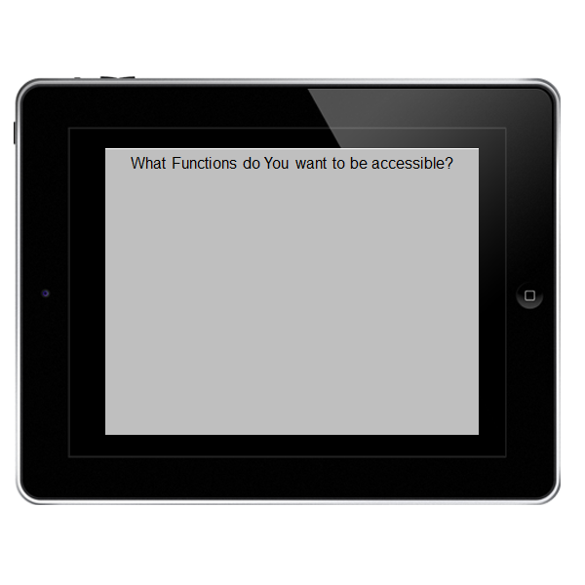
Use case: Securely Expose Specific Devices or Interfaces to the Cloud
AllJoyn
Securely control your thermostat
from outside your home
Select the features to enable for
Remote access
On
Off
Temperature Up
Temp Down

Slide 8
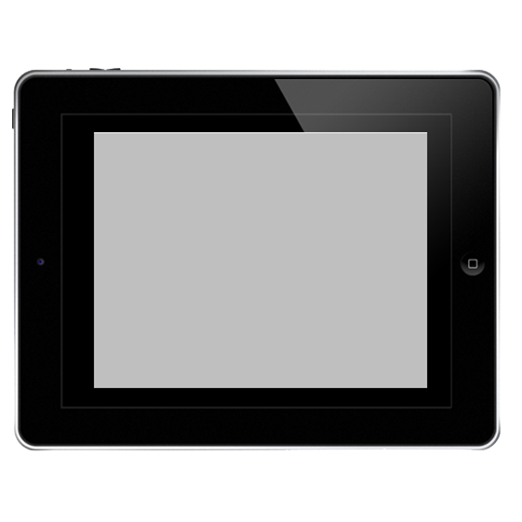

Use case: Services Delivery via Gateway Agent
AllJoyn
Provision New Service
XYZ Weather Service would like to offer the following services:-
Control your thermostat using temperature and humidity predictions for the next 24 hours
Turn your sprinklers on and off based on temperature and precipitation

Slide 9
Use case: Services Discovery via Gateway Agent
AllJoyn
ABC Home Automation and Monitoring
ABC Home Automation and Monitoring Service is offering you the following services:
Automate climate control
Automate sprinkler system
Monitor motion detectors and door sensors
Remote access to all devices
All this for just $4.99 per month. No contract!
Purchase
Cancel

Slide 10
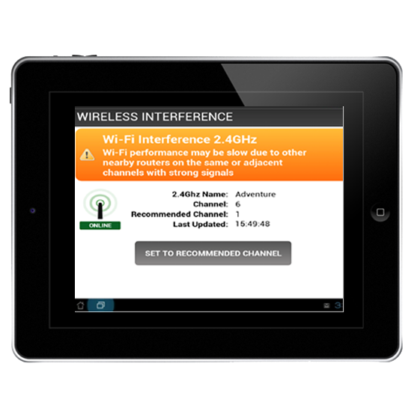
Use Case: Remote Diagnostic via TR-69
Fix Wi-Fi and other issues both while at home and away
AllJoyn

Slide 11
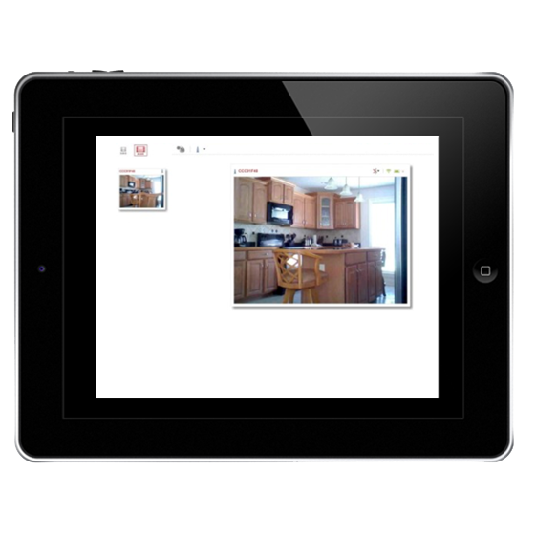
Use Case: Secure Remote access via XMPP/Bosh
Securely connect to and control devices while away from home
No router/firewall changes required
AllJoyn

Slide 12
Gateway Agent – Roadmap Ideas* *Not yet in planning
MQTT connector
Standardized RESTful connector, including corresponding web server components
IETF XMPP XEP
Secure Connector package discovery, download and installation (outside of TR-069)

Slide 13







For more information on AllSeen Alliance, visit us at: allseenalliance.org & allseenalliance.org/news/blogs

