Slide 1
Technical Steering Meeting
Aug 11, 2014

Slide 2
Antitrust Compliance Notice
AllSeen Alliance meetings involve participation by industry competitors, and it is the intention of AllSeen Alliance to conduct all of its activities in accordance with applicable antitrust and competition laws. It is therefore extremely important that attendees adhere to meeting agendas, and be aware of and not participate in any activities that are prohibited under applicable US state, federal or foreign antitrust and competition laws.
Examples of types of actions that are prohibited at AllSeen Alliance meetings and in connection with AllSeen Alliance activities are described in the AllSeen Alliance Antitrust Policy. If you have questions about these matters, please contact your company counsel, or if you are a member of AllSeen Alliance, feel free to contact Lee Gesmer or Andrew Updegrove, of the firm of Gesmer Updegrove LLP, which provides legal counsel to AllSeen Alliance.

Slide 3
Reminder: This call is being recorded

Slide 4
Agenda
Approve minutes from previous meeting
Release process evolution - proposal
AllJoyn Discovery Redesign (14.02 to 14.06)

Slide 5
Proposal for Evolving the Release Process

Slide 6
Introduction: Lessons learned over the last few releases
Coordinating a large number of features
A significant factor in the delay of 14.06 release
Need better definition of quality level
Not possible for one member to ensure release works on all member’s products
Need to define a process for members to contribute
Platform specific support
Release testing
Working Group coordination issues
Coordination between two working groups (base services and core) was challenging
As more WGs are added, this will become more difficult

Slide 7
Proposed changes
Separate features from releases
Features are targeted for releases but releases do not depend on specific features
Features are developed and tested on public branches
If a feature does not meet quality for the targeted release, it is slipped to the following release
Once at release quality features are merged into the master branch for inclusion into next release
Release quality implies feature testing is complete
Members are responsible for integration testing and hardening on their products
Need member input on process for platform specific contributions and testing
Move away from a simultaneous release model
Each Working Group (WG) determines when they will release
Core currently on a 4 month cadence (February, June, & October)
Core WG would like TSC approval to change to a 6 month cadence (April & October)
Cross WG integration and resolution of technical dependencies is coordinated by the working groups

Slide 8
Benefits / details of each recommendation

Slide 9
Separate features from releases
Allows members to take features that have not been released
Members can harden the feature branch and contribute bug fixes, etc. to the WG
Allows working groups to make better trade off decisions on feature priorities
If a feature becomes high priority, WG can better understand the impact on the lower priority features without having to contend with the “global” view
Allows features that do not meet the quality bar to be slipped without impacting the release date
A Release is defined as an effort to validate on a specific set of platforms
Each working group defines the platforms supported and the timing of their release
The name/number of the release follows the core version on which it is based
Example on slide 11

Slide 10
Members are responsible for integration testing and hardening on their products
Each member that “hardens” the code is strongly encouraged for feeding the fixes back to the Alliance code base
Not doing so implies the member will have to maintain their own fork
Need to define how members contribute platform support and testing

Slide 11
Move away from a simultaneous release model
Working Group releases are based on a specific Core release version
Version naming is same as Core release version used
WG will identify the number of commits taken in after the Core release
Examples:
Base Services WG commits to having a release for each core version
Lighting WG may chose not to update after 14.06
This implies that there would only be a Lighting 14.10 if a member chooses to do the work
Base Services 14.10
Timeline Example
(Dates and cadence only for example)
Gateway
Services
14.10
Lighting
Services
14.06
Security 2.0 14.10
Base
Services
15.02
July
Aug
Sep
Oct
Nov
Dec
Jan 2015
Feb
Mar
CORE 14.06
CORE 14.10
CORE 15.02

Slide 12

Feature to Release Process
Release A
Includes Green
& Blue
Release B
Includes Red
Master
DC
Feature Green
Rel
Qty
DC
DC
Feature Red
Rel
Qty
Feature Blue
Rel
Qty
DC: Development Complete (All features implemented and only bug fixing remains)
RQ: Release Quality (All feature testing is complete and feature is merged)
Releases: Focused on feature integration, system, and regression testing

Slide 13
Thank You
Proposal review and comment period
8/5/14 to 8/18/14
Members encouraged to use the TSC mailing list if they wish to ask questions and/or comment
Proposal vote
8/18/14

Slide 14
AllJoyn Discovery Redesign (14.02 to 14.06)

Slide 15
Outline
Review 14.02 (NS) Baseline
Wi-Fi Multicast Dependency
Analytical model
Outline Performance Objectives
Discovery
Presence
NGNS Results
Analytical Model
Test Results
NGNS Stack and APIs
NGNS Message Sequences

Slide 16
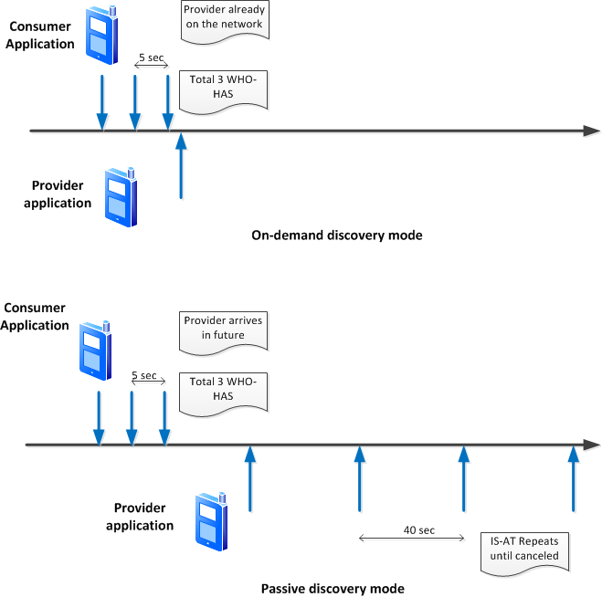
NS Discovery Modes

Slide 17
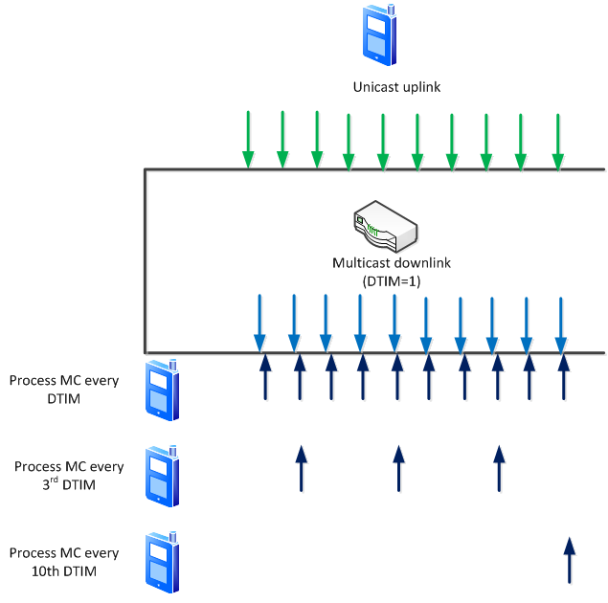
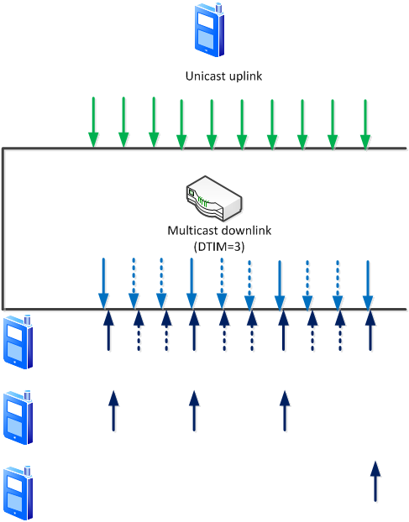
Multicast Reception
Send MC packet 100msec apart (beacon interval = 102.4 msec)

Slide 18
Characterization: Multicast over Wi-Fi
100% network available; AP DTIM=1; partial wake lock (standby)
Notice probability of success concentrated around 1/3 or close to 100%.

Slide 19
Characterization: Multicast over Wi-Fi
100% network available; AP DTIM=3; partial wake lock (standby)
Notice probability of success concentrated around 1/10, 1/3 or close to 100%.

Slide 20
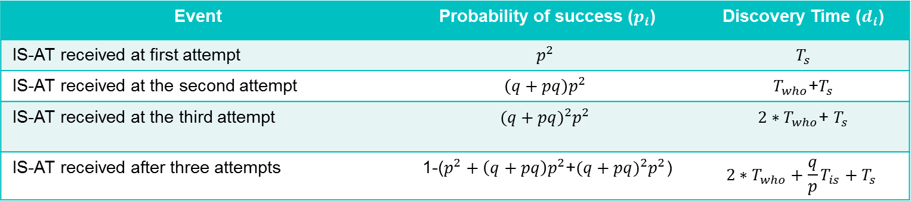
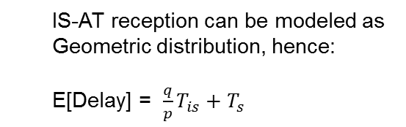
Latency – Analytical Modeling
On-demand discovery
Event | Probability of success () | Discovery Time ()
IS-AT received at first attempt
IS-AT received at the second attempt |  | +
IS-AT received at the third attempt |  | +
IS-AT received after three attempts | 1-(+)
Parameter | Description | Value
p | Probability of successful receipt on multicast | 0.35, 0.95
T_{who} | Timer for WHO-HAS transmissions | 5 sec
T_{is} | Timer for IS-AT transmissions | 40 sec
T_{s} | Discovery time in a successful case | 500 ms
Passive discovery:
IS-AT reception can be modeled as
Geometric distribution, hence:
E[Delay] = $\frac{q}{p}{T_{is}+T}_{s}$

Slide 21
Expected Performance
Current Baseline - Analytical
Key metrics | Value (p =0.35) | Value (p =0.95)
Prob. that IS-AT received within first iteration | 12.3% | 90.3%
Prob. that IS-AT received within three WHO-HAS iterations | 32.4% | 99.9%
Expected Latency (passive mode) | 74.29 sec* | 2.11sec
Expected Latency to detect presence (deterministic) | 120 sec | 120 sec
* Notification benchmarking data supports this estimated result

Slide 22
NGNS Problem Statement
Discovery:
The expected time taken to find a match for both on-demand and passive discovery modes are unacceptable
Objectives
On demand discovery 50th percentile: 1 sec, 95th percentile: 10 sec
Presence:
The expected time taken to find a name has left the network is unacceptable
Objectives
On demand discovery 50th percentile: 0.5 sec, 95th percentile: 1 sec

Slide 23
Discovery Use Cases
Make Consumer Application the “Driver”
 | Use Case | Realized By
1 | Consumer application initiated search | DNS-SD query over *mDNS; mDNS unicast response
2 | Provider application initiated unsolicited advertisement | DNS-SD response over mDNS
3 | Consumer application polling for the provider application’s existence | Unicast query and Unicast response
*mDNS IP address/port preferred over AllJoyn assigned address/port

Slide 24


Improved Algorithm
Achieve 50th percentile: 1sec, 95th percentile: 10sec;
Model similarly to Bonjour (Tx = 0,1,3,9)
$P=1−{\left(1−p\right)}^{4};p is prob. of success for each transmission$
P of 0.95 → p ~ 0.6
Determine #quick-repeats to realize p ~ 0.6

Slide 25
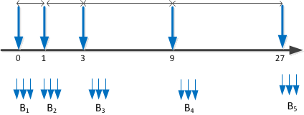
Transmission Schedule
Each MC message follows the transmission schedule
Each message quick-repeated to address misbehaving devices
Provides the desired prob. of success (p)
MC messages within a burst are 100ms apart so that DTIM in successive Beacon frames is set

Slide 26
Analytical Modeling
New Transmission Schedule + Quick Repeats + Unicast response
Key metrics | 14.02 Value (*p =0.35) | 14.06 Value (p =0.35)
Prob. that discovery succeeds within 1 sec | 12.3% | 60%
Prob. that discovery succeeds within 10 sec | 32.4% | 97.4%
*p is probability of success of receiving multicast packet

Slide 27
Comparison with Test Data
Name Based Discovery
Test iteration
Start 5 Advertisers, each advertising one name for a duration of 80 seconds, on five of the six Android devices (all devices advertise with a common prefix)
Wait for 45 seconds, to wait out the unsolicited advertisement traffic.
Start 1 Finder, each attempting to discover five names based on the common prefix for a duration of 37 seconds (essentially 80s - 45s, plus a safety buffer of two seconds)
Wait for the program to exit on all devices. The Finder reports each name that was found and how long it took to discover it.
Key metrics | 14.02 Estimate (p =0.35) | 14.06 Estimate (p =0.35) | 14.06 Android (sleep) | 14.06 Android (no sleep)
Prob. that discovery succeeds within 1 sec | 12.3% | 60% | 41.9% | 74.3%
Prob. that discovery succeeds within 10 sec | 32.4% | 97.4% | 89.4% | 99.9%

Slide 28
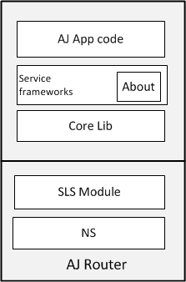
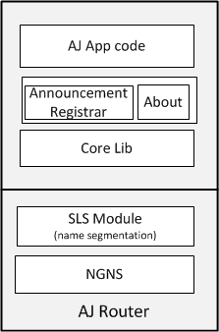
Protocol Stacks
14.02 vs 14.06

Slide 29
Discovery Functions
Discovery | Discovery use case | Pre-condition | API | Input | Output
Existing | Advertise WKN |  | AdvertiseName | WKN
Existing | WKN based search | WKN is advertised | FindAdvertisedName | WKN prefix | WKN
Existing | Presence | FindAdvertisedName | LostAdvertisedName |  | WKN
Existing | Send Announce signal | Application provides Announce() payload | SendAnnounce() | Announce payload | Consumer App receives all Announce signals due to addMatch rules
New | Interface-name based search | Announce is being emitted by the Provider Application | RegisterAnnounceHandler() | Interface Name(s) | Announce signals that match the search criteria
New | On-demand Presence | Name has been discovered before | Ping() | name | Enumeration

Slide 30
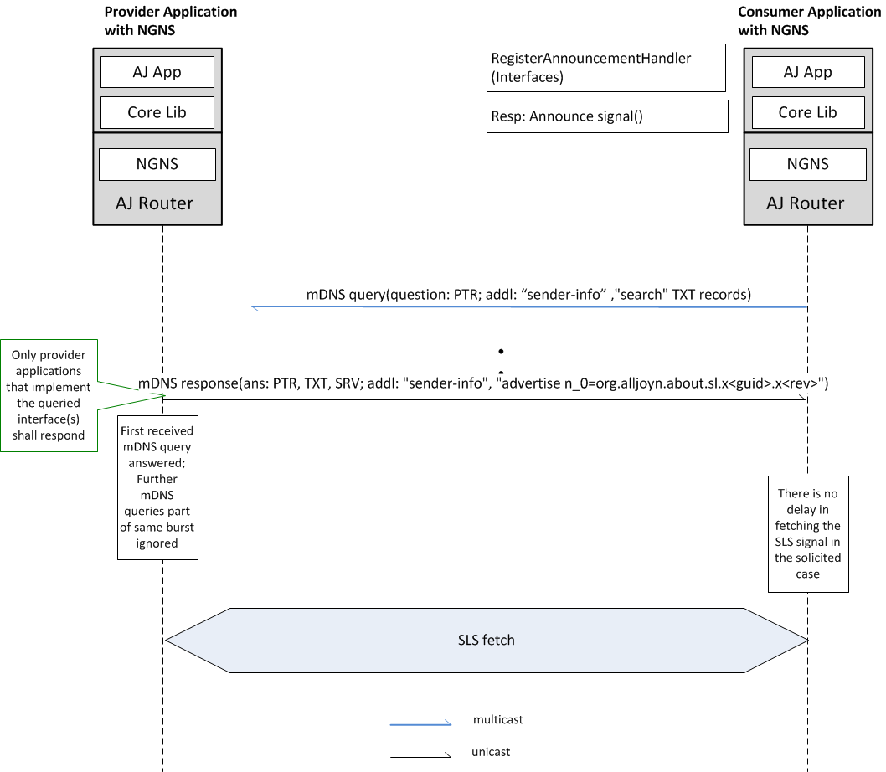
Interface-based query (NGNS-NGNS)

Slide 31
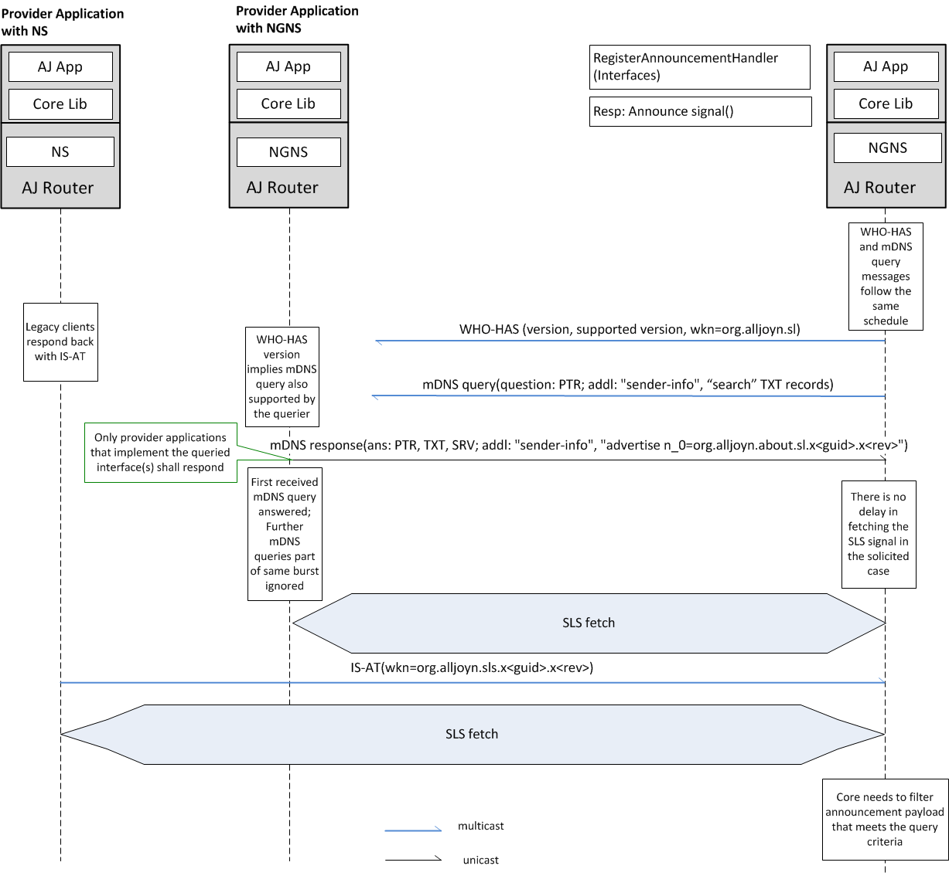
Interface-based query (NGNS-mixed mode)

Slide 32
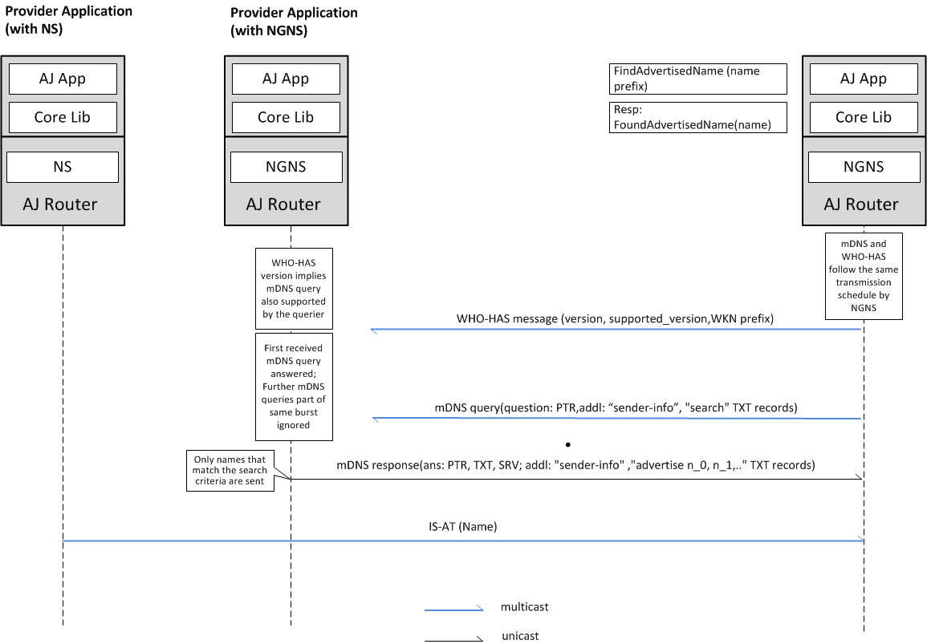
Name Based Query (NGNS-mixed mode)

Slide 33
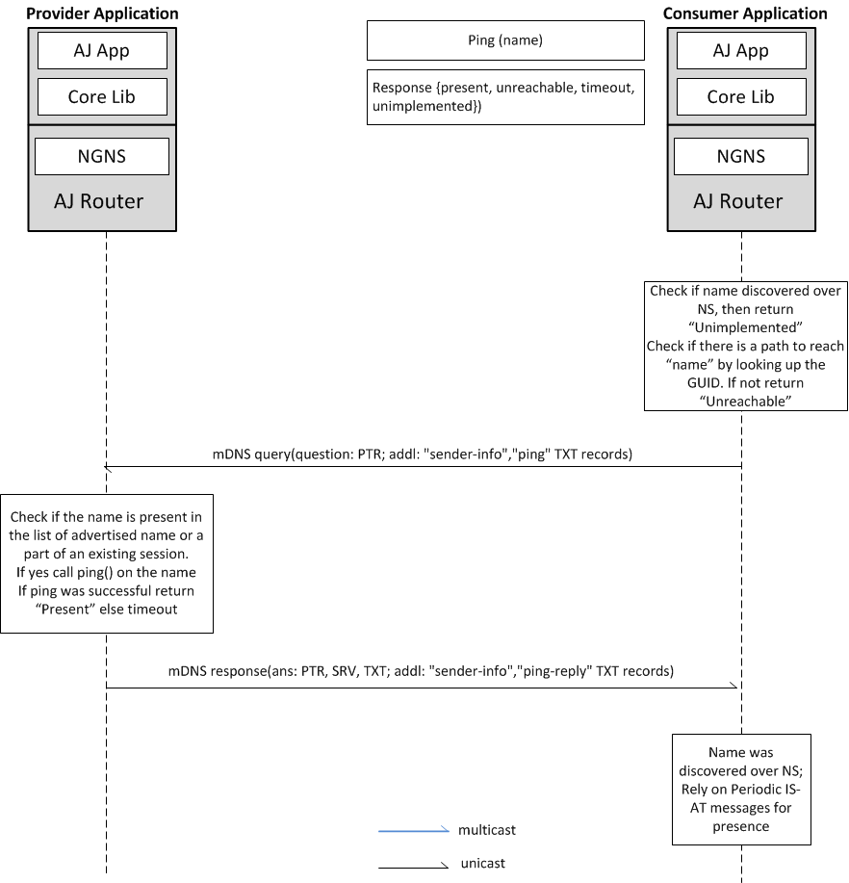
Presence – Ping API

Slide 34
Interface search: mDNS Query
mDNS Query
sent to multicast IP and port as specified in RFC 6762 always and Subnet directed broadcast (if configured to true)
Top bit in the qclass field in the DNS header is set to indicate unicast responses are accepted
Question Section: _alljoyn._udp.local. PTR record
Additional
Name=“search.<guid>.local.” TXT [i_0] or [i_0,i_1,..] //if multiple interfaces are being queried; could be wild char *
Keys are ANDed
One search record per query
Name=“sender-info.<guid>.local.” TXT [pv, bid, guid, UDPv4, IPv4] //connection specs for the unicast NS
Where key nomenclature is as follows:
pv: version of the NS
bid: burst identifier (1..n where n is determined by the schedule) ← As per the schedule it is 1..5 in 14.06 release
guid: daemon guid
UDPv4: UDP port to be used with IPv4
IPv4: unicast IPv4

Slide 35
Examples Search Record
Name=“search.<guid>.local.” TXT record
One Search record per query
Example1: keys are ANDed
txtvers=0
i_0=org.alljoyn.Clock
i_1=org.alljoyn.Radio

Slide 36
mDNS Response
mDNS Response (unicast)
Answer
_alljoyn._udp.local. PTR record to domain name <guid>._alljoyn._udp.local.
<guid>._alljoyn._udp.local. TXT record [UDPv6] ← reflects UDPv6 port for AJ (D-D) over IPv6
<guid>._alljoyn._udp.local. SRV record UDPv4, <guid>.local. ← reflects UDPv4 for AJ (D-D) over IPv4
Additional
Name=“sender-info.<guid>.local.” TXT [pv, bid, guid, UDPv4] ← reflects where unicast polling over UDP is sent using NS; IP addresses are sent in the A and AAAA record
Name=“advertise.<guid>.local.” TXT [n_0=org.alljoyn.about.sl.x<guid>.x<id>]
<guid>.local. A record for IPv4 ← reflects IPv4 for AJ session (D-D) over IPv4
<guid>.local. AAAA record for IPv6 ← reflects IPv6 for AJ TCP session (D-D) over IPv6
Where key nomenclature is as on the previous slide
Address records always populated in unicast responses

Slide 37
NGNS in nutshell
NGNS Discovery protocol is based on DNS-SD over mDNS
Completely backwards compatible with 14.02 APIs and wire protocol
Interface based query and Presence APIs are two key additions to the API set
Subject to much stricter latency objectives
https://allseenalliance.org/docs/api/cpp/classajn_1_1_bus_attachment.html
https://allseenalliance.org/docs/api/cpp/classajn_1_1services_1_1_announcement_registrar.html

Slide 38
Technical Steering Meeting

