Slide 1
Technical Steering Meeting
October 20, 2014

Slide 2
Antitrust Compliance Notice
AllSeen Alliance meetings involve participation by industry competitors, and it is the intention of AllSeen Alliance to conduct all of its activities in accordance with applicable antitrust and competition laws. It is therefore extremely important that attendees adhere to meeting agendas, and be aware of and not participate in any activities that are prohibited under applicable US state, federal or foreign antitrust and competition laws.
Examples of types of actions that are prohibited at AllSeen Alliance meetings and in connection with AllSeen Alliance activities are described in the AllSeen Alliance Antitrust Policy. If you have questions about these matters, please contact your company counsel, or if you are a member of AllSeen Alliance, feel free to contact Lee Gesmer or Andrew Updegrove, of the firm of Gesmer Updegrove LLP, which provides legal counsel to AllSeen Alliance.

Slide 3
Reminder: This call is being recorded

Slide 4
Agenda
Approve minutes from previous meeting
Vote on Living Scenario Proposal
Security 2.0 Status Update

Slide 5
Best Practices for Project Releases
Mathew Martineau

Slide 6
Release Planning
Projects share their plans and status using the wiki.
Plan: Provided early in the release cycle
Status: Updates while work is in progress
Review: Final results and test coverage information
Monitor the release plans and status for projects you depend on.
Example: https://wiki.allseenalliance.org/release/14.06
Details and templates: https://wiki.allseenalliance.org/release/process

Slide 7
Release Practices
As a project nears release time, create a release branch. Example: RB14.06, RB14.12
The release can be stabilized on this branch while other work continues on the master branch.
Make sure bug fix changes are merged or cherry-picked to the master branch
When the release is ready, tag the final commit
Tag examples: “v14.06”, “v14.06a”, “v14.06.01”
Update documentation including the wiki, allseenalliance.org, or other documents.

Slide 8
Release Practices
Publish a source archive (.tar.gz or .zip) at http://mirrors.kernel.org/allseenalliance/alljoyn
Archives should be generated using Jenkins build automation or using the download links on https://git.allseenalliance.org/cgit/
Send email to allseen-infrastructure@lists.allseenalliance.org requesting to post your files
Send questions to allseen-infrastructure@lists.allseenalliance.org

Slide 9
Security 2.0 Status
Technicolor

Slide 10
Security 2.0 - Architecture
Technicolor
Security Manager
AllSeen API
-
Permission Mngt
&
Notification
Application
Android Sample App
Language Bindings
Config API
Security Manager
Library
AllJoyn
Core
AllJoyn
Core
Claiming
Membership
Manifest (stub)
iOS
Sample
App
Microsoft
Sample App
Security 2.0
Security 2.0
Platform API
Key Store (Windows)
QCE
Permission/Manifest Enforcement
Microsoft

Slide 11
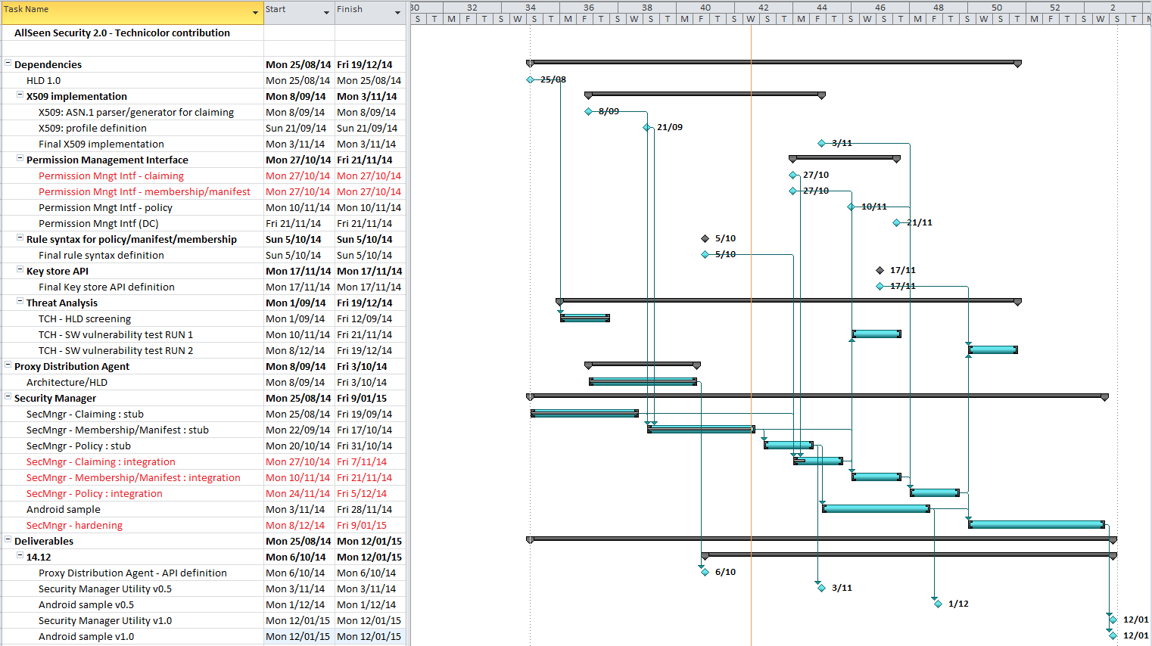
Security 2.0 – 14Q4 schedule

Slide 12
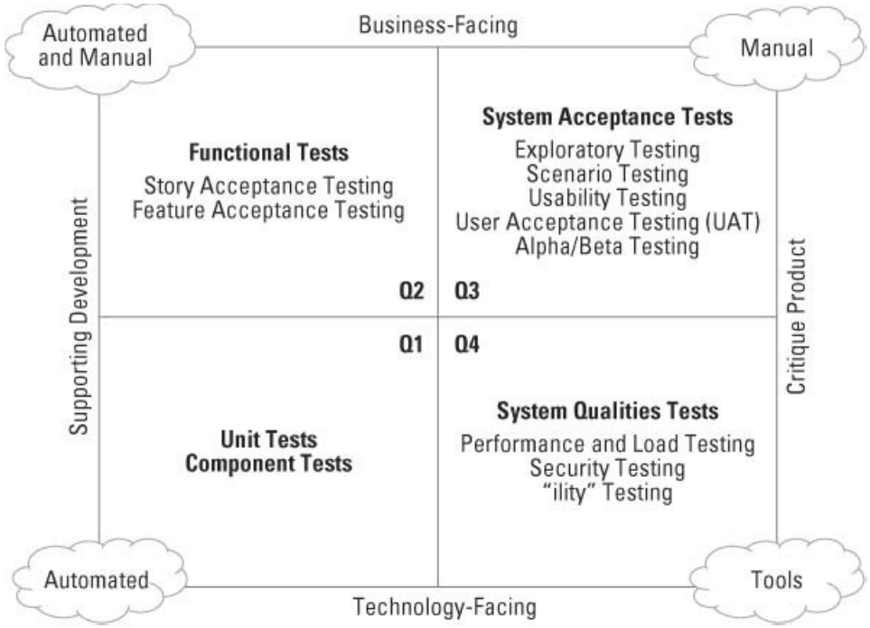
Security 2.0 – 14Q4 milestones
Security Mngr +
AllJoyn Core
Security Manager
HLD update oct’14 done : Distribution of policy updates and membership certificates
Claiming : stub commit to core/securitymgr.git 19/9
Expected integration release date 17/10 >> 7/11 U/F tested (Q1 + Q2), 19/12 >> 12/1 scenario tested (Q3)
Membership/Manifest : stub commit to core/securitymgr.git 17/10
Expected integration release date 31/10 >> 21/11 U/F tested (Q1 + Q2), 19/12 >> 12/1 scenario tested (Q3)
Policy : stub commit to core/securitymgr.git 31/10
Expected integration release date 14/11 >> 5/12 U/F tested (Q1 + Q2), 19/12 >> 12/1 scenario tested (Q3)
Threat Analysis – Security Testing (Q4)
HLD screening : done 29/9, report available
SW vulnerability test RUN 1 : 20/10/2014 – 31/10/2014 >> 21/11/2014
SW vulnerability test RUN 2 : 17/11/2014 – 28/11/2014 >> 19/12/2014

Slide 13
Security 2.0 – Open issues
Permission notification is session based [QCE]
Session-less solution needed to start claiming integration (expected delivery 27/10)
Authorization Data incomplete [QCE/TCH]
Final syntax to be agreed & extension for policy to be added (guild grouping/equivalence)
To be implemented both on application side as in the security manager
Solution needed to start membership/manifest & policy integration 10/11/2014
Security 2.0 module doesn’t host a session [QCE]
Proposal: host a session on a pre-allocated port to access the Permission Mngt Interface
Workaround: sample application hosts the session
Bus Attachment : Session type selection ECDHE_NULL or ECDHE_DSA not possible [QCE]
Workaround: temporary use 2 Bus Attachments

Slide 14
Lighting Applications Project Proposal
Marc Alexander

Slide 15
Lighting Apps Proposal
Purpose and intent of the project
Container project for Android and iOS sample applications that interact with the Lighting Service Framework,
Intended to make it easier for developers to create their own apps that use Lighting Service Framework
Benefits
One place to go to find LSF applications
Developers will be able to quickly and more easily develop AllJoyn Lighting apps for Android and iOS by:
Leveraging the Java and Objective-C language bindings
Using the functional sample applications as an example

Slide 16
Lighting Apps Project Scope and Functionality
Features and functionality to be developed
Java and Objective-C language bindings that wrap the existing Lighting controller client
Android and iOS applications that allow the user to view and interact with the lamps, lamp groups, presets, scenes, and master scenes present in the Lighting System
How will the development be staged
Will be staged in Alliance Jenkins once Lighting Jenkins is available
What AllJoyn interfaces will be developed
No new AllJoyn interfaces are proposed
What is the completion criteria
On-going feature development based on committee/customers' requests

Slide 17
Project Details
lighting/apps.git
Dependencies
AllJoyn Core (core/alljoyn.git)
AllJoyn Lighting (lighting/service_framework.git)
External Dependencies
For Android development: Android SDK and NDK
For iOS development: Xcode and associated libraries
Other platforms as required
Proposed Project Name and Working Group
lighting/apps.git
Will reside in the existing Connected Lighting WG
Release date
First release is proposed for October 31st 2014

Slide 18
Committers/Contributors
Bharanee Rathna, Engineer, LIFX
Marc Alexander, CTO, LIFX
Dean Camera, Engineer, LIFX
Kitty Lou, Engineer, LIFX
Shane Hanna, Engineer, LIFX
Eric Rongo, Senior Engineer, Qualcomm Connected Experiences
Padma Narayanan, Senior Engineer, Qualcomm Connected Experiences
David Diplock, Staff Engineer, Qualcomm Connected Experiences
Jason Fullen, Engineer, Qualcomm Connected Experiences
Niral Bhalodia, Engineer, Qualcomm Connected Experiences
Kenny Fok, Director, Qualcomm Connected Experiences

Slide 19
Have We Been Busy!

Slide 20
Commit Activity
Project | 13-12 | 14-01 | 14-02 | 14-03 | 14-04 | 14-05 | 14-06 | 14-07 | 14-08 | 14-09 | 14-10 | Total
compliance/tests | 0 | 0 | 0 | 0 | 0 | 2 | 5 | 19 | 3 | 4 | 5 | 38
core/ajtcl (adj) | 31 | 37 | 37 | 11 | 9 | 19 | 59 | 33 | 33 | 31 | 1 | 301
core/alljoyn | 23 | 34 | 48 | 27 | 18 | 168 | 230 | 92 | 79 | 106 | 114 | 939
core/alljoyn-js | 0 | 0 | 0 | 0 | 0 | 0 | 0 | 16 | 19 | 24 | 6 | 65
core/openwrt_feed | 0 | 0 | 3 | 6 | 0 | 4 | 0 | 5 | 13 | 2 | 4 | 37
core/securitymgr | 0 | 0 | 0 | 0 | 0 | 0 | 0 | 0 | 0 | 1 | 1 | 2
data/datadriven_api | 0 | 0 | 0 | 0 | 0 | 0 | 1 | 15 | 0 | 0 | 0 | 16
devtools/codegen | 1 | 1 | 1 | 6 | 8 | 1 | 7 | 2 | 3 | 1 | 1 | 32
gateway/gwagent | 0 | 0 | 0 | 0 | 0 | 0 | 14 | 30 | 7 | 1 | 1 | 53
lighting/service_framework | 0 | 0 | 0 | 0 | 0 | 12 | 12 | 12 | 8 | 16 | 7 | 67
multimedia/audio | 0 | 1 | 0 | 0 | 0 | 0 | 0 | 0 | 5 | 1 | 0 | 7
services/base (adj) | 29 | 70 | 123 | 59 | 56 | 73 | 95 | 26 | 4 | 2 | 9 | 546
services/base_tcl (adj) | 14 | 35 | 62 | 29 | 13 | 31 | 38 | 12 | 6 | 4 | 4 | 248
smarthome/homeservice | 0 | 0 | 0 | 0 | 0 | 0 | 0 | 0 | 1 | 0 | 0 | 1
Total | 141 | 283 | 459 | 226 | 173 | 414 | 594 | 300 | 191 | 199 | 166 | 2352

Slide 21







For more information on AllSeen Alliance, visit us at: allseenalliance.org & allseenalliance.org/news/blogs

