Slide 1
AllJoyn Home Device Bridge Project Proposal
Cheol Hwi Kim, Innopia Technologies, Inc.
May, 2016

Slide 2
AllJoyn Home Device Bridge Project Proposal
Background:
The current AllJoyn Device System Bridge is only supported for Windows OS thus there has been limitation for expanding ecosystem in other platforms.
AllJoyn Home Device Bridge Provides a standard Bridge connection to non-AllJoyn devices such as ZigBee, Z-Wave and Bluetooth to AllJoyn in Linux based platform such as Android and OpenWRT.
Objectives:
Provide Home Device Bridge which can initially connect ZigBee and Z-Wave device to AllJoyn in Linux OS and Open WRT OS. The future update will support Bluetooth and Thread. Also Android OS support will be added.
AllJoyn Home Device Bridge creates virtual representation of devices on the AllJoyn bus for each external device.
Virtual representation supports the following AllJoyn services: About, Configuration and Events & Actions.
For Home Device Bridge, notification service is also supported.
From the user’s perspective, any standard ZigBee, Z-Wave and Bluetooth device will be recognized as AllJoyn device.

Slide 3
AllJoyn Home Device Bridge Interfaces
Bridge:
Represents each external devices as AllJoyn device dynamically.
Have specific configuration file for each external device.
Have specific Events & Actions Database for each external device.
Virtual representation supports on-boarding and notification services
Virtual representation has Actions for entering Add/Remove mode for ZigBee/Z-wave
Plugin:
Each plugin needs implementation of network stack for device.
ZigBee Plugin Socket
Z-Wave Plugin Socket

Slide 4
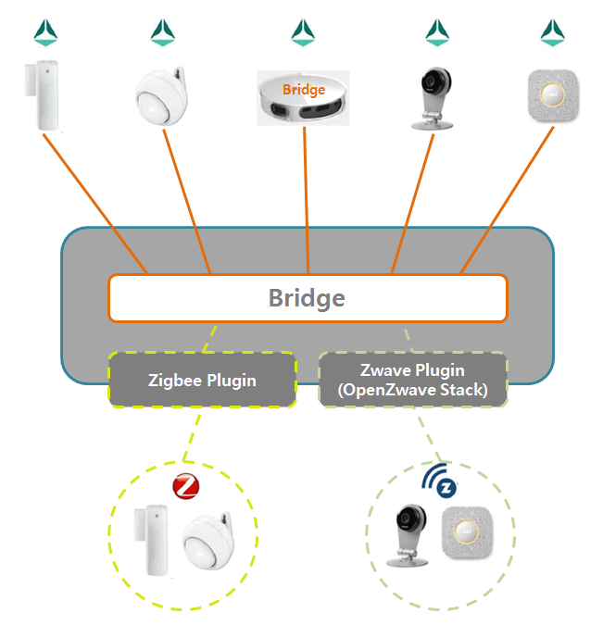
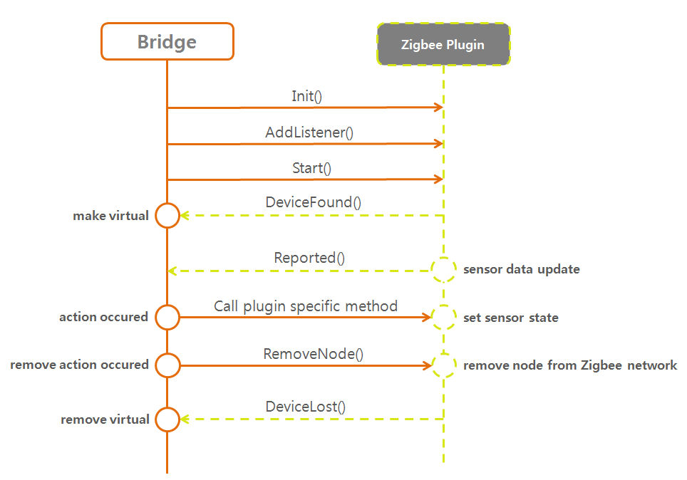
An Application Example

Slide 5
Project Information
Working Group: Gateway Working Group
Staff – from Innopia Technologies, Inc.
Project Maintainer - Dong Seok Shin (dsshin@innopiatech.com)
Sang Heon Lee (shlee@innopiatech.com)
Cheol Hwi Kim (kimcheolhwi@innopiatech.com)
Supported platforms: Linux kernel platforms, e.g. Android, OpenWRT
GIT repository name: Home Device Bridge
Supported AllJoyn Version: Starting from v15.09
Status and schedule
First release is planed to be 2 months after the approval of the project.
We ask support from the TSC for approval of this project.

Slide 6
For more information on AllSeen Alliance, visit us at: allseenalliance.org & allseenalliance.org/news/blogs

