Slide 1
PACKAGE MANGER BRIEF DISCUSSION
PM OVERVIEW
PM ISSUES
PROPOSED AJ PACKAGE FORMAT
Affinegy Dev: Jim Howard, jhoward@affinegy.com

Slide 2
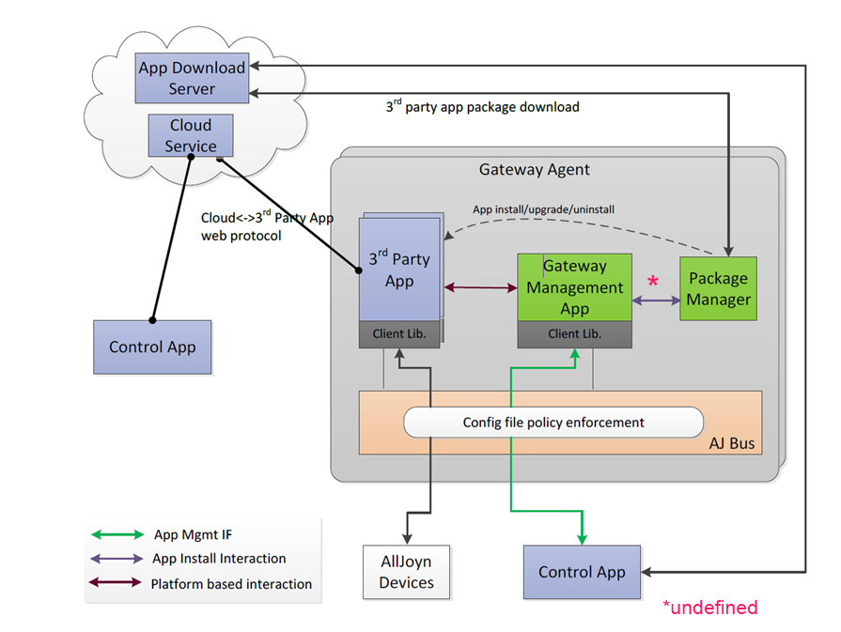
PACKAGE MANAGER OVERVIEW

Slide 3
PM Requirement Summary
Provides functionality to Gateway Mgt App
3rd party app install/upgrade/uninstall
Uses HTTPS GET
Maintains root certificate
Uses AJ package format
Verifies signature of downloaded package
Supports Command Line Interface

Slide 4
PM APP ISSUES
IPC with Gateway Mgr undefined – CLI?
AJ Package Format undefined
Certificate Chain for dev/testing undefined
Does a PM app already exist?

Slide 5
Proposed AJ Package Format
HLD 3.3.3 Requires:
- Single Binary
- Manifest files
- app certificate
- X509 signatures
- any required libraries not present by default
Proposal: Compressed TAR ball
- Executable installer – executable installer or opkg .ipk file
- resources not present by default (libs, images, etc)
- certificate
- signature file (.pem)

Slide 6
JIM HOWARD
jhoward@affinegy.com
Skype: jim.howard42

