Slide 1
Introduction

Slide 2
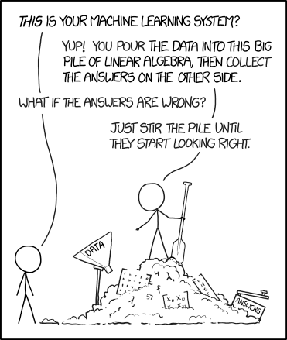

Machine Learning is…
Regression
Typycal problem setup:
Dataset:
X — size of flat
Y — price on the market
Goal:
Predict Y for new X

Slide 3
Machine Learning is...
Regression
Typycal problem setup:
?
?
?
Dataset:
X — size of flat
Y — price on the market
Goal:
Predict Y for new X

Slide 4
Machine Learning is...
Regression
Typycal problem setup:
x
x
x
Dataset:
X — size of flat
Y — price on the market
Goal:
Predict Y for new X

Slide 5
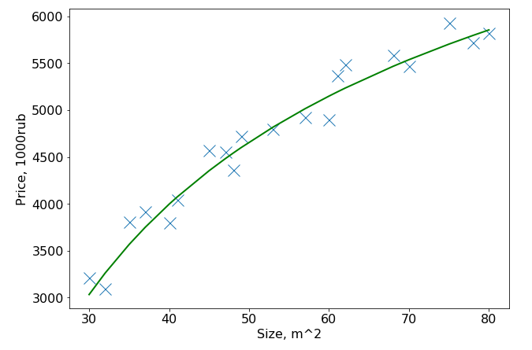
Regression
Typycal problem setup:
x
x
x
x
x
x
Dataset:
X — size of flat
Y — price on the market
Goal:
Predict Y for new X

Slide 6
Machine Learning is...
Regression
Typycal problem setup:
x
x
x
x
x
x
Dataset:
X — size of flat
Y — price on the market
Goal:
Predict Y for new X
Find best F(X) to predict Y

Slide 7
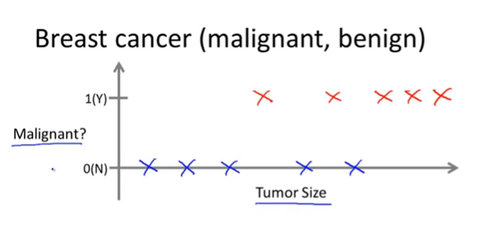
Machine Learning is...
Classification
Dataset:
X — size of the tumor
Y — 1 or 0 (maligant\benign)
Goal:
- Predict Y for new X
- Predict «probability». How sure we are?
Pic. From Andrew Ng ML course

Slide 8
Machine Learning is...
Classification
Likely bening
Not sure
Likely maligant
Dataset:
X — size of the tumor
Y — 1 or 0 (maligant\benign)
Goal:
- Predict Y for new X
- Predict «probability». How sure we are?
Pic. From Andrew Ng ML course

Slide 9
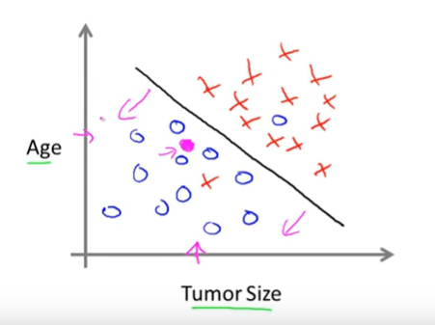
Machine Learning is...
Classification
Dataset:
X — size of the tumor
Y — 1 or 0 (maligant\benign)
Goal:
- Predict Y for new X
- Predict «probability». How sure we are?
Pic. From Andrew Ng ML course

Slide 10
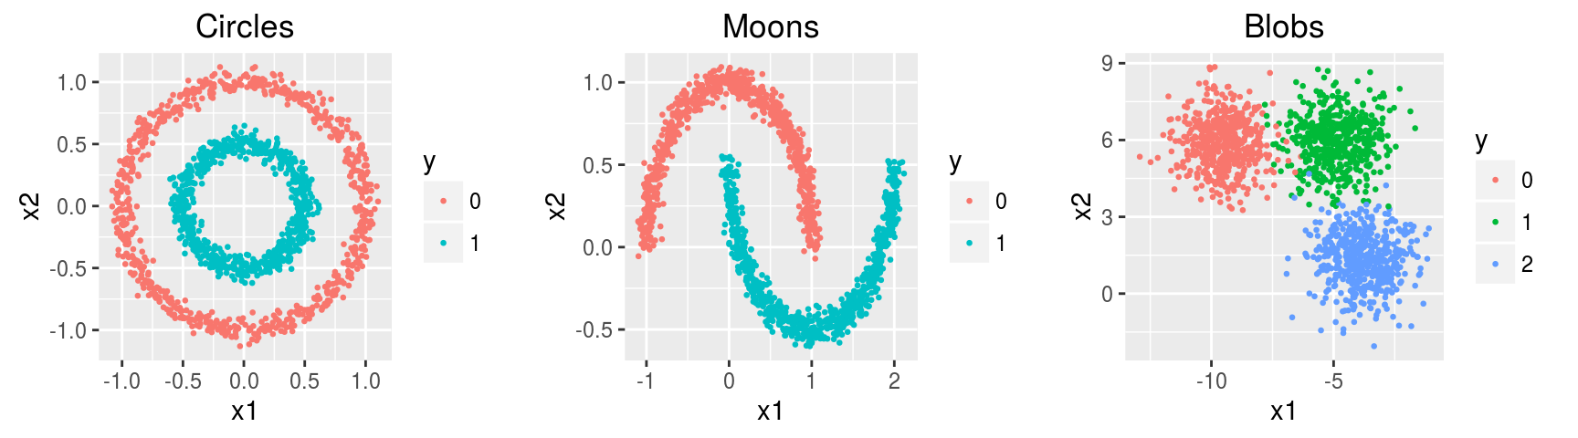
Machine Learning is...
Clustering
Dataset:
X — some characteristics of the object.
- No Y
Goal:
- Find internal structure, clusters

