Slide 1
Mathematical modeling of CRISPR spacer amplification during PCR
Data Science
Student: Anton Rykachevskiy
Scientific Advisor: Evgeny Burnaev
Field expert: Konstantin Severinov
May, 2018

Slide 2
Plan
Intro to the problem
Setup
Data and Pipelines
Best approaches at the moment
Future plans

Slide 3
Intro
This thesis is a part of an ongoing project of developing targeted therapy from Clostridium difficile infection and other simmilar diseases.
Backgroud:
Bacterias have CRISPR-CAS9 mechanism to destroy viruses if they «know» parts from virus DNA
Our goal is to understand which viruses are known to bacteria which lives in exact human body
Thus we can develop a treatment which bacteria could not handle
Bacteria, DNA
Virus, DNA

Slide 4
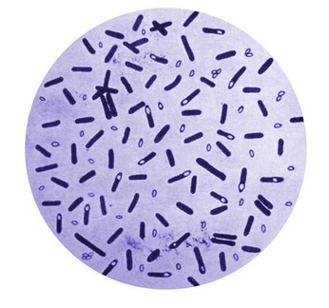

Setup
Bacteria DNA
CRISPR cassettes (2 to 10 in each bacteria)
CRISPR cassette
ACGT….CCCCGGTTTAA….
ACGT
...
Spacers, different
(~20 nucleobases in DNA)
Repeats, almost same
(~25 nucleobases in DNA)

Slide 5
PCR
- PCR is a process of amplification of a several copies of DNA to millions of copies. Required to read DNA.
1
ORIGINAL
COPY
ACGT….CCCCGGTTTAA….
GGTT
2
ORIGINAL
COPY
ACGT….CCCCGGTTTAA….
GGTT
ORIGINAL
COPY
ACGT….CCCCGGTTTAA….
GGTT
Copying
3
2*
ORIGINAL
COPY
OTHER CASSETTE
ACGT….CCCCGGTTTAA….
GGTT

Slide 6
Data
Noisy pairs from original sequences
Wrong pairs
4 letters alphabet
70k to 100k pairs
1- 15% of wrong pairs (could be even more)
~1% probability of mistake in each letter
Goals:
Restore original cassettes
Restore original ratio between cassettes

Slide 7
Data and Pipeline
Pipeline:
- Cluster noisy spacers
- Build directed weighted graph from all pairs
Each pair increases weight of corresponding edge by 1
- Restore chains from graph
Datasets with known answer:
E.coli, single strain*, 2 cassettes, (13 spacers and 5 spacers)
E.coli, two strains*, 4 cassettes, expected ratio 1:5
Clostridium, single strain, 8 cassettes (5 to 12 spacers)
Datasets without answer:
E.coli from Mamonth. Unknown amount of strains, and cassettes
Thermus thermophilus. Several datasets with everything unknown
*strain – bacteria type

Slide 8
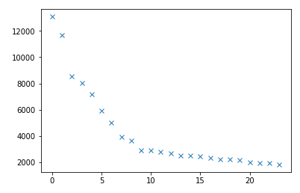
Hierarchical clustering
Hierarchical clustering.
Starting from most frequent spacer, group spacers if edit distance is less than threshold (usually 5-10)
Label all spacers in pairs with cluster number
On E.Coli data:
Originaly 1700 different
spacers in dataset
72 clusters after clustering
35 out of 72, represented by
at least two spacers
These 35 in answer
Occurrences
Group if close
Spacer

Slide 9
Hierarchical clustering
Hierarchical clustering.
Starting from most frequent spacer, group spacers if edit distance is less than threshold (usually 5-10)
Label all spacers in pairs with cluster number
On E.Coli data:
Originaly 1700 different
spacers in dataset
72 clusters after clustering
35 out of 72, represented by
at least two spacers
These 35 in answer
TGTG
TGTA
AAAA
AAAC
ACAA
CCCC
CCCA
CTCC
AGTG
…
...

Slide 10
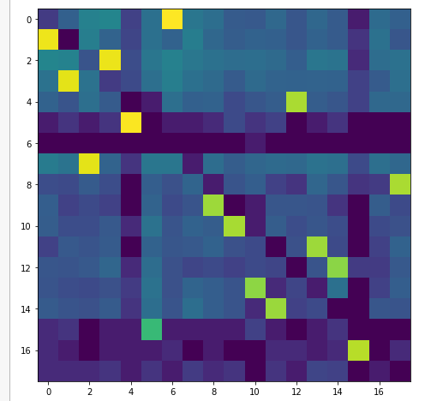
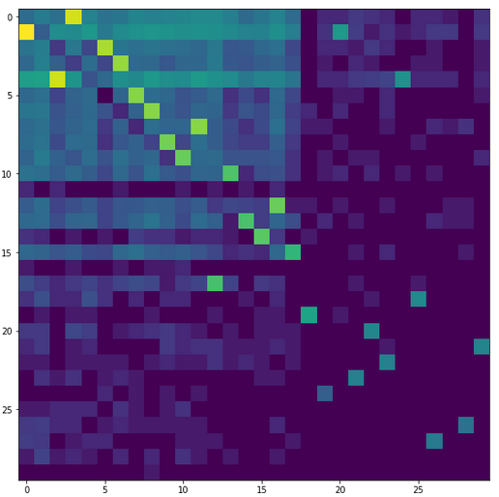

Graph
Transform pairs of spacers to pairs of clusters.
ACCACA…CAC → CGGGCG...ATGGC goes to
cluster i → cluster j
Rerank clusters according to
max(incoming weight, out-coming weight)
Build a graph where each pair i → j adds weight to corresponding edge.
Logarithm of Adjacency matrix for single strain E.coli and two strains of E.coli

Slide 11
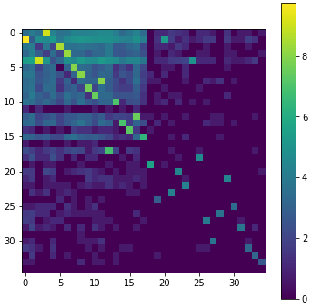
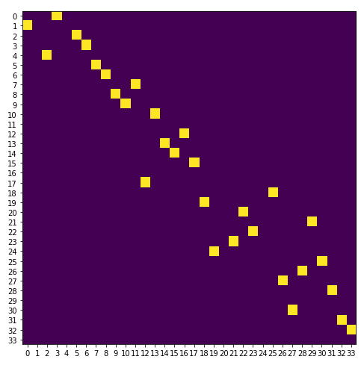
Greedy cassettes restoration
- Add heaviest edge, with restrictions:
No cycles
No undirected cycles
No tree structure
- Stop when next edge to add either not exist or has zero weight
- Drop edges of extremely small weight, to separate chains

Slide 12
Greedy cassettes restoration
- Add heaviest edge, with restrictions:
No cycles
No undirected cycles
No tree structure
- Stop when next edge to add either not exist or has zero weight
- Drop edges of extremely small weight, to separate chains

Slide 13
Probabilistic model of PCR
*Some synthetic initial population*
1
ORIGINAL
COPY
ACGT….CCCCGGTTTAA….
GGTT
* Probability to amplify
* Random place to start
2
ORIGINAL
COPY
ACGT….CCCCGGTTTAA….
GGTT
3
ORIGINAL
COPY
ACGT….CCCCGGTTTAA….
GGTT
2*
ACGT….CCCCGGTTTAA….
GGTT
* Probability to switch

Slide 14
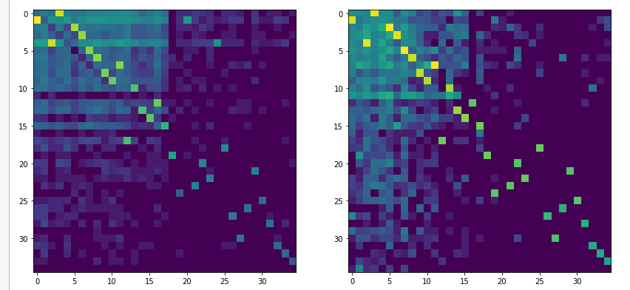
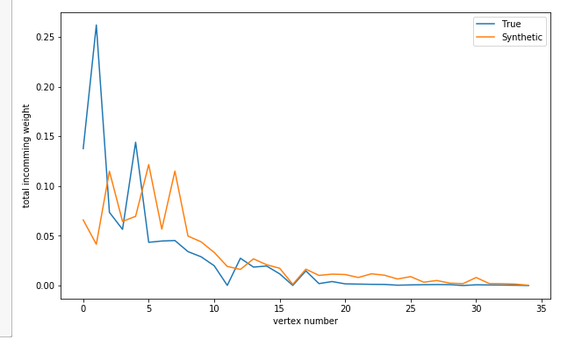
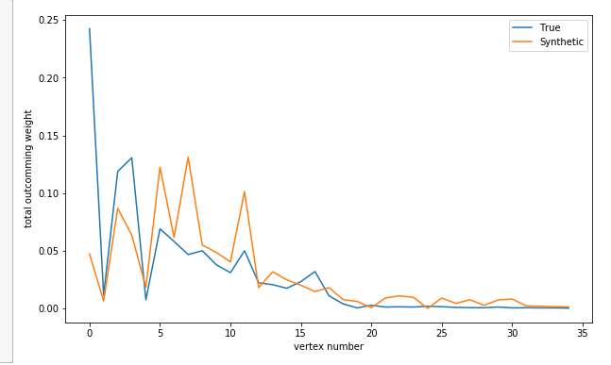
Comparing model to biology
Left: Original adjacency matrix
Right: Simulated for the same cassettes
*ordered as in original

Slide 15
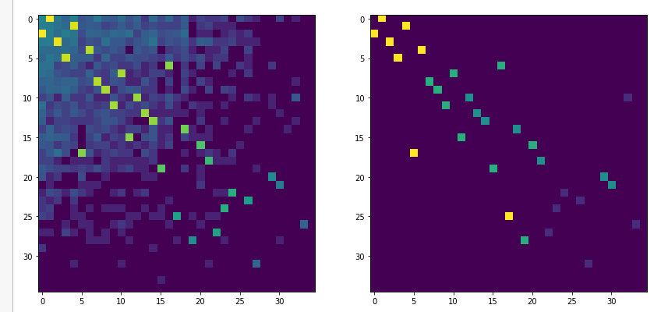
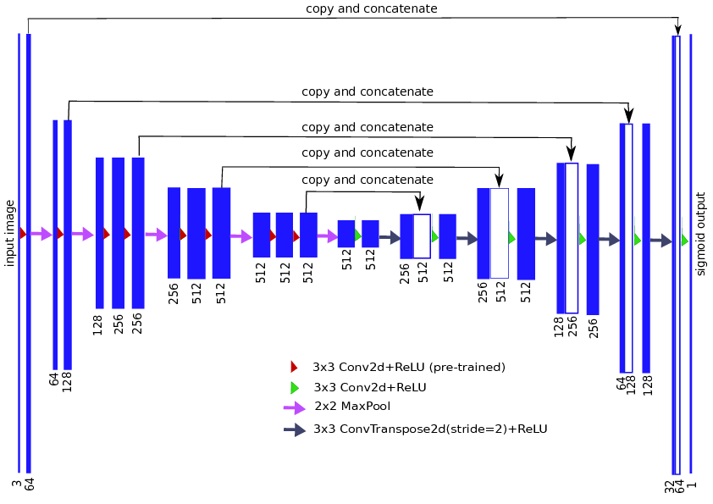
How not to make deeplearning on graphs
Generate 1000 graphs from random initial populations
Train Unet on adjacency matrix
Test on part of generated cassettes
Apply to real data
Original population
Result of simulation

Slide 16
Unet results
 | Unet, weighted loss | Unet | Greedy
Synthetic, edge precision | 0.99 | 0.97 | 0.99
Synthetic, edge recall | 0.98 | 0.94 | 0.95
E.coli, two strains | 2 missed edge out of 31 | Same | Same
Clostridium | 2 missed edges out of 75 | Same | Same
On biological data, Unet and Greedy predict exactly the same edges.
Unet do not require knowledge about cassettes number
Mammoth requires further discussion

Slide 17
Results
Fast and stable greedy algorithm
Reasonable probabilistic model
Investigation of biological effects
Unet based model

Slide 18
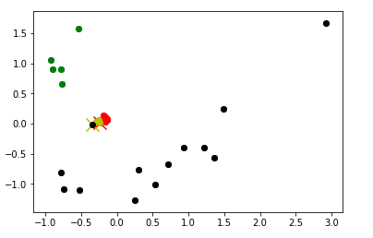
Additional edge prediction
Node → Embedding
Positive edges and Negative edges from greedy algorithm
Logistic regression/SVM/Random Forest/GB/ to rank edges about which we are not sure
Embeddings based on Markov walks + word2vec.
Different colors for different cassettes
PCA
Prediction Model
Does not work yet

Slide 19
Graph Convolution autoencoder
Node
Embeddings
Graph
Conv
Forward Node
Embeddings
Graph
Graph
Encoding
Backward Node
Embeddings
Adjacency
Matrix
Graph Convolution Layer*:
 | Unet, weighted loss | TAGCN
Synthetic, edge precision | 0.99 | 0.34
Synthetic, edge recall | 0.98 | 0.9
Jian Du et. al. Topology Adaptive Graph Convolutional Networks

Slide 20
Further plans
Improve simulation
- Add effects from different repeats
- Different A/T to C/G ratio
- ???
Use Graph convolution networks
- Develop graph analogy of Unet
Several biological experiments to understand effects we saw during simulation

Slide 21
Acknowledgements
Evgeny Burnaev
Albert Matveev
Ivan Oseledets
Konstantin Severinov et. al.

