Slide 1
Assembling CRISPR arrays from PCR data
Data Science

Slide 2
Plan
Intro to the problem
- Setup
- Data and Pipelines
Naive approaches
- Thresholding by occurrences
- Greedy approach
ML approaches
- PCR models
- U-net
- Standard classification
- GNN
Results
In development
Conclusions & Plans

Slide 3
Intro
Bacteria possess CRISPR-Cas immunity systems containing CRISPR arrays of short spacers separated by identical repeats and cas genes. Bacteria can fight against phages if contain CRISPR spacer complementary to phage genome.
Bacteria, DNA
Virus, DNA
Our goal is to reconstitute CRISPR arrays in complex bacterial populations in order to predict which phages will be able to escape CRISPR immunity and, thus, represent a promising tool for phage therapy.

Slide 4
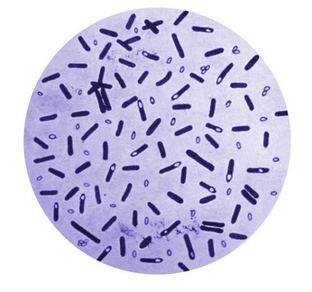

Setup
Bacteria DNA
CRISPR arrays
(2 to 10 in each bacteria)
CRISPR cassette
Spacers (33 bp in E.coli) can be acquired from genomic DNA of phages or plasmids
Repeats (28 bp in E.coli)

Slide 5
Full Pipeline
Collecting DNA templates
PCR amplification of CRISPR arrays
with primers complementary to repeats
High throughput sequencing
Preprocessing of obtained data
Restoration of CRISPR arrays

Slide 6
PCR
PCR is a process of amplification of a several copies of DNA to millions of copies.
1
Repeats
Two strains of DNA template
Primers
Spacers
2
Annealing of primers to random repeats
DNA replication by Taq polymerase
3
New copies of parts of DNA templates

Slide 7
Data
Sequencing procedure returns reads which contain no more than two spacers.
Reads
4 letters alphabet (A, C, T, G)
70k to 100k pairs
1- 15% of wrong pairs (could be even more)
~1% probability of mistake in each letter
Goals:
Restore original cassettes
Restore original ratio between cassettes
Our job
Arrays

Slide 8
Difficulties
Main difficulty is chimeric reads – reads where spacers from different parts of array or different array occur together.
Initial DNA
PCR +
Sequencing
Good reads
Chimeric reads

Slide 9
Preprocessing
Good reads
4 letters alphabet (A, C, T, G)
70k to 100k pairs
1- 15% of wrong pairs (could be even more)
~1% probability of mistake in each letter
Goals:
Restore original arrays
Restore original ratio between arrays
Chimeric reads
Preprocessing steps:
1. Split by repeats
2. Cluster similar pairs of spacers together with hierarchical clustering procedure and count amount of pairs in each cluster

Slide 10
Finally
Counts
Good Pairs
.
.
.
Chimeric pairs
Goal:
Classify all pairs as good\chimeric
Restore arrays from correct pairs

Slide 11
Real data
At the moment:
8 datasets for two different bacterias
C. Difficile
E. Coli
70k to 200k pairs
1% of Chimeric pairs
~1% probability of mistake in each letter
3 datasets:
1x 1 bacteria strain, known answer
2x 2 bacteria strains, known answer
70k to 200k pairs
15% of Chimeric pairs
~1% probability of mistake in each letter
5 datasets:
2x 1 bacteria strains, known answer
2x 2 bacteria strains, known answer
1x lots of strains and no answer

Slide 12
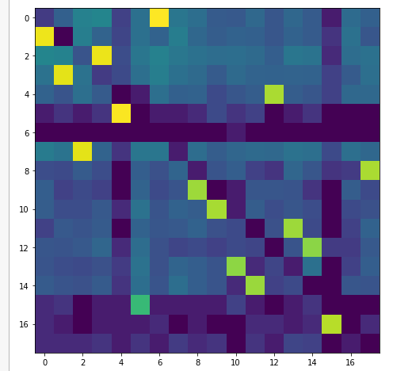
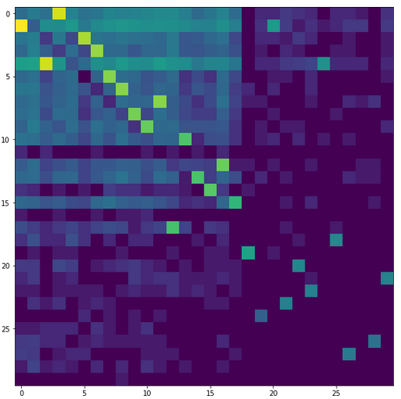

Graph representation I
Graph representation:
- Spacers in nodes
- Edge weight = pair count
Logarithm of Adjacency matrix for single strain E.coli and two strains of E.coli
Yellow pixels represent correct pairs, light blue represents chimeric reads
E.Coli, single strain(left) and two strains(right)

Slide 13
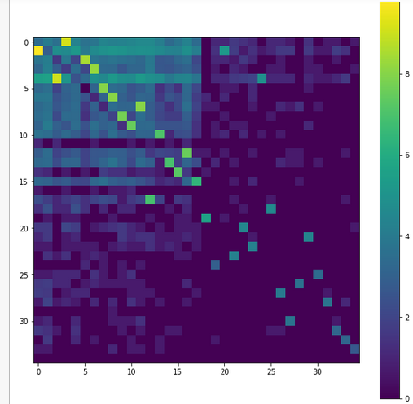
Naive approach
Threshold pairs by counts.
+:
Easy to implement
Works for single strain\balanced strains
-:
Does not work for unbalanced strains
Setting threshold is unclear
E.Coli example
Two unbalanced strains.
Chimeric reads in better presented strain have larger counts than true reads in less presented strain

Slide 14
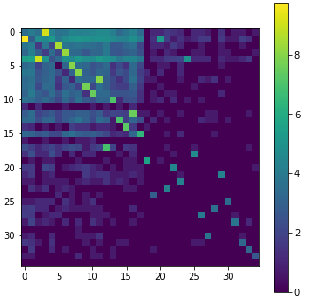
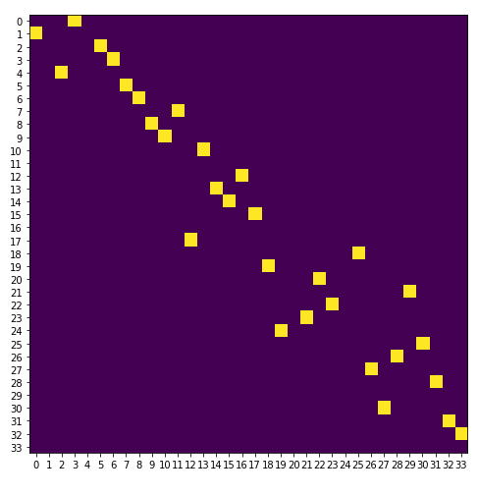
Greedy Approach
Mark pairs as correct starting from most frequent to less frequent with restrictions:
No cycles
No undirected cycles
No tree structure
+:
Easy to implement
Works for unbalanced strains
-:
Misses tree structures if they exist
Setting threshold is unclear

Slide 15
ML approach
To further improve our method we have to tune a lot of thresholds, for different types of pairs.
This task actually looks like ML problem
Problem:
Not enough data.

Slide 16
Stochastic PCR model
We developed 3 different stochastic PCR models
 | CRISPR Array representation | Initial DNA population | Source of errors | Other features
Naive | List of integers. Each integer repr. spacer | 10k random initial arrays sampled from CRISPR E.Coli database | Random switching from one array to another during replication | nothing
Different repeats model | Array of integers. Integers repr. spacers and repeats |  | Repeats-to-repeats annealing. | Annealing between different repeat-repeat and repeat-pimer combinations is different
Fast no repeats model | Array of integers. Each integer repr. spacer |  | Repeats-to-repeats annealing. | Fast model. Allows to set initial DNA to primers ratio, as in real experiments

Slide 17
Stochastic PCR model
We develop stochastic PCR model
0. W sample 10k random initial arrays from CRISPR E.Coli database
1. For each initial arrays setup we model 20 – 35 amplification cycles
1
2
3

Slide 18
Chimeric reads
1
Source of errors for Fast and Different repeats models
2
3
Chimeric read

Slide 19
ML approach
For all ML methods we use the following validation scheme:
Train set: 800 simulations
Test set 1: 200 simulations
Test set 2: real data

Slide 20
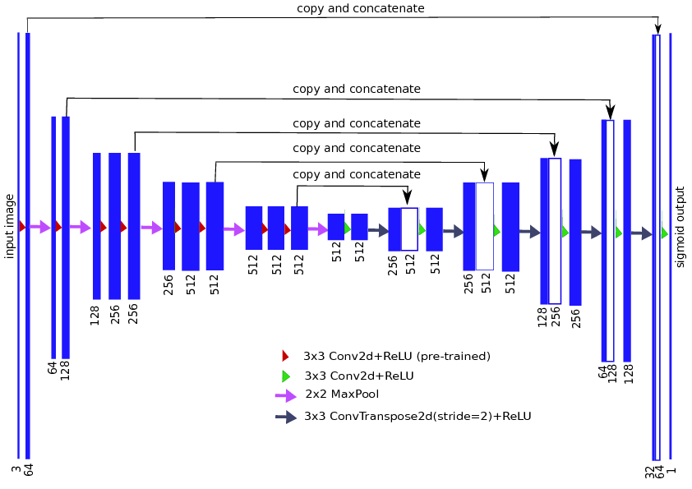
How not to make deeplearning on graphs
Train U-net on normalized adjacency matrix to predict existing edges
Test on part of synthetic data
Apply to real data
Two variations of input for U-net:
U-net-D:
U-net-M:
Where are diagonal matrices with total incoming and outgoing weights,
and are diagonal matrices with maximum incoming and outgoing weights.

Slide 21
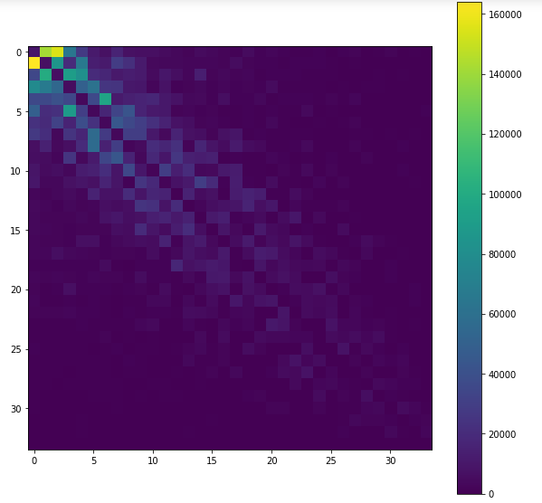
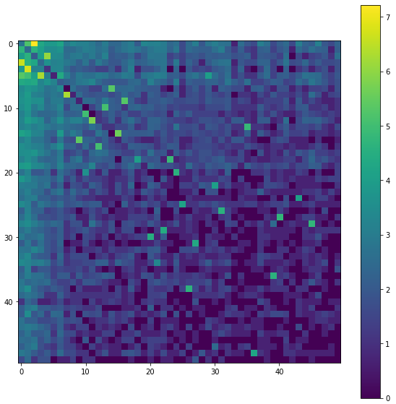
Preparing adjacency matrix
Rearrange vertexes in the graph according to:
Spacers from same arrays are grouped together
Weight in adjacency matrix are grouped around main diagonal
Edges between arrays are separated from background noise aside from main diagonal
Sum of all adjacency matrices of generated data
Part of adjacency matrix for mammoth

Slide 22
U-net results

Slide 23
Pair descriptors
Train some classifier to predict if pair is chimeric or not
Build pair descriptors
Predict for new data
For each pair (I, J) we build the following descriptor:
Where
is a count for pair (I, J)

Slide 24
Classifiers
We split synthetic data in 800 training samples and 200 test samples and train several models.
Models are validated on synthetic test set and real data.
We compare the following standard algorithms:
Logistic Regression
Kernel SVM
Gradient Boosting Classifier

Slide 25
Classifiers results

Slide 26
Graph representation II
Our data has graph nature.
Our task is to classify existing edges in graphs.
Nodes classification investigated much better
This setup allows to classify nodes, thus we rebuild our graph representation in the following manner:
Nodes represent pairs
Edges are directed and exist between pairs with common spacer, like:
(A, B) → (B, C)
Thus we have obtain new graph with nodes descriptors

Slide 27
Gated GNN
Gated GNN is model of neural message passing, where embeddings in vertexes are processed by GRU’s.
Gated GNN allows to classify nodes

Slide 28
Gated GNN
Model works in two steps:
1. Propagation
1. Prediction

Slide 29
Classifiers results

Slide 30
Results
 | Naive | Greedy | U-net | LogReg | SVM | GB | GNN
Synthetic Data |  |  | 0.986 | 0.999 | 0.995 | 0.9999
E.Coli |  |  | 0.8 | 0.983 | 0.960 | 0.999
C.Difficile |  |  | None | None | None | None

Slide 31
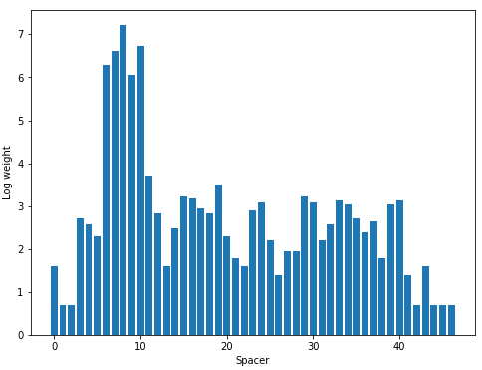
In development
Spacers in one array are not equally amplified.
That is why we can not group equally amplified spacers to highlight arrays.
Log weight
Spacer
Spacers amplification in 3 arrays

Slide 32
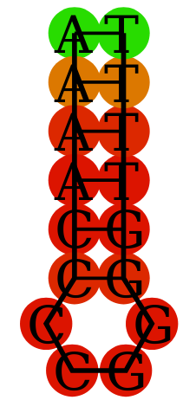
In development
Between denaturation and annealing steps of PCR, arrays can form secondary structures. This could be a reason for different amplification.
We calculated DNA secondary structures and tested several CNN and RNN architectures to predict spacer amplification by it’s array secondary structure
Does not work at the moment, probably due to lack of data

Slide 33
Graph representation II
Thank you for your attention

Slide 34
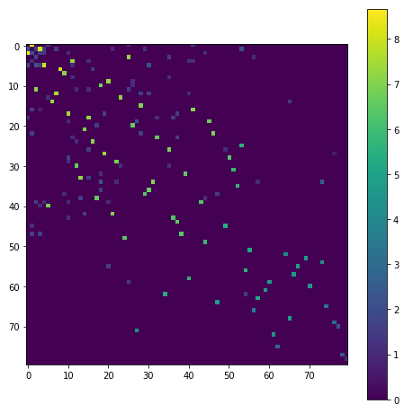

Slide 35
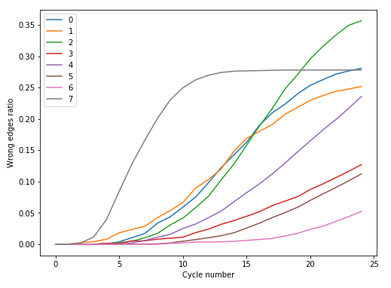

Slide 37
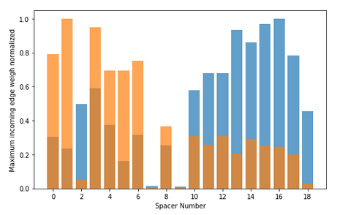

Slide 38
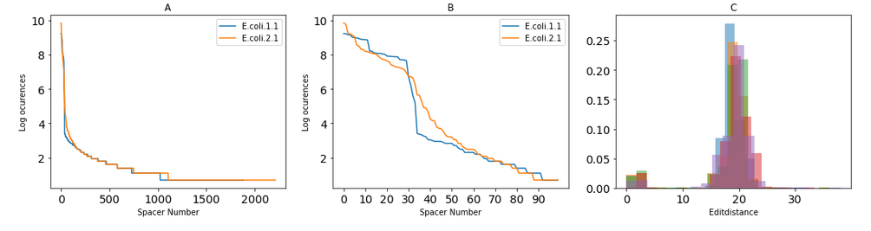

Slide 39
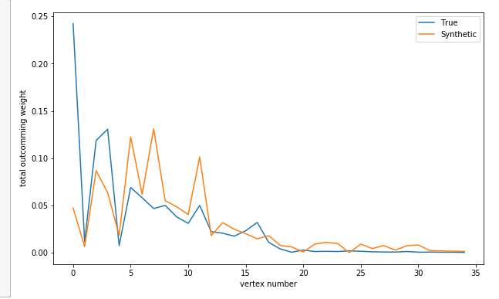

Slide 40
