Slide 1
Working With Git & GitHub

Slide 2
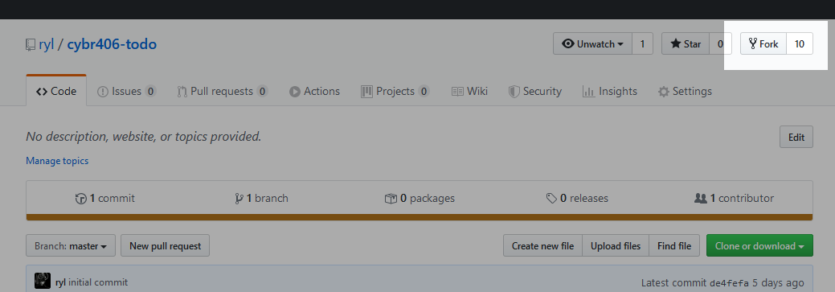
Fork a Class Project
A fork is a copy of a repository in your own account.
Use the “Fork” button in the top right corner.
Read about forks on GitHub

Slide 3
Clone Your Copy
After you fork the class repository, clone it locally.
Using HTTP git clone https://github.com/username/project.git
Using SSH git clone git@github.com:username/project.git
Read about cloning on GitHub

Slide 4
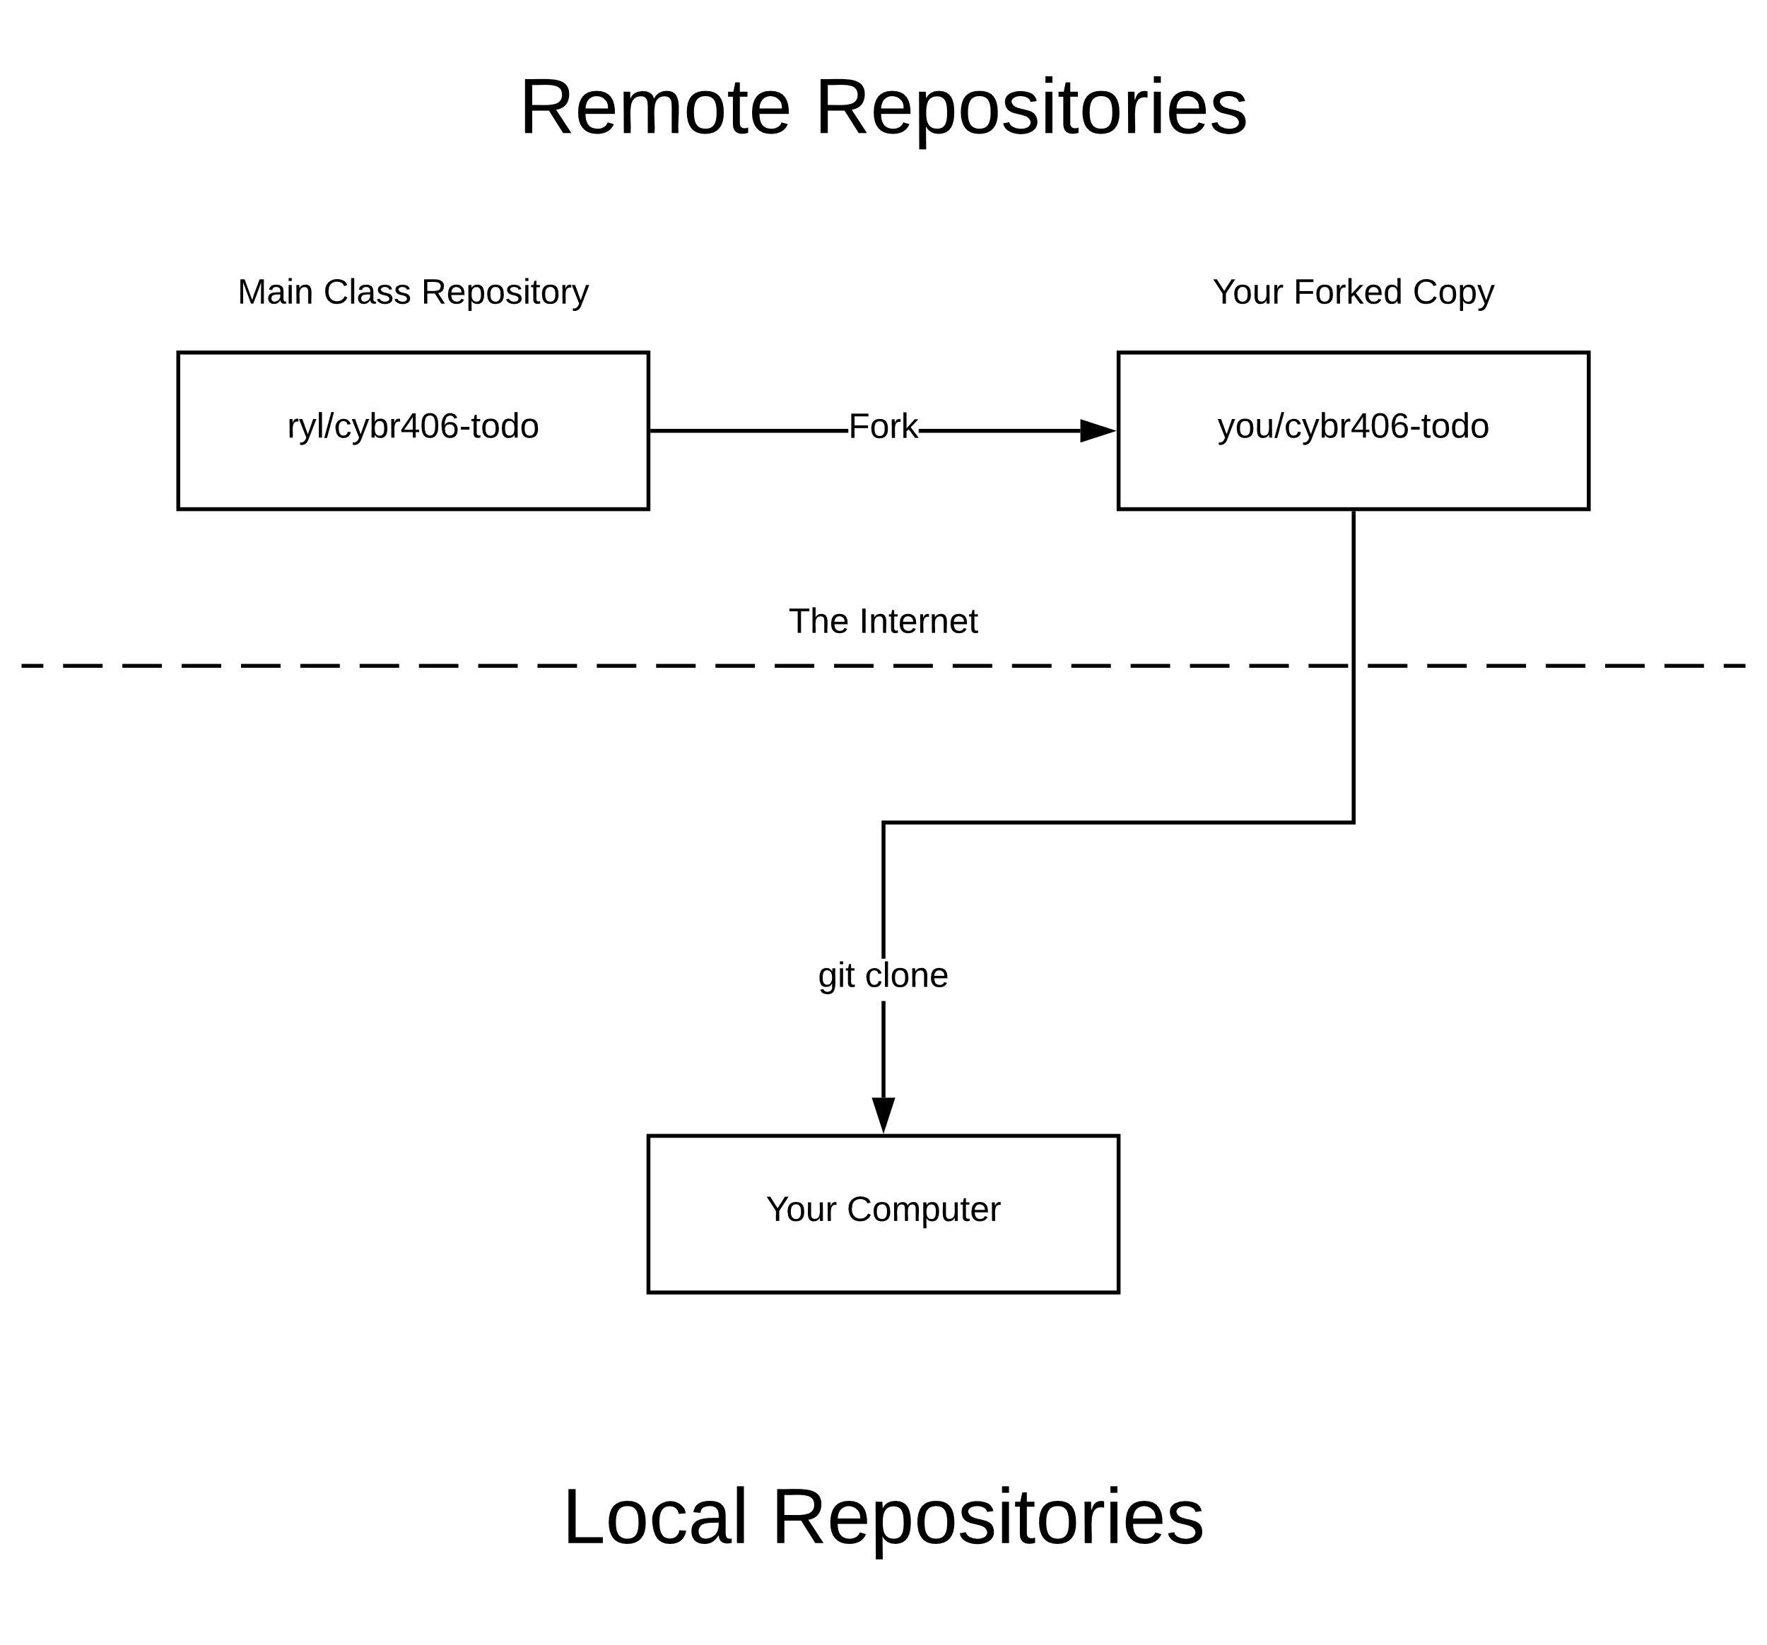

Slide 5
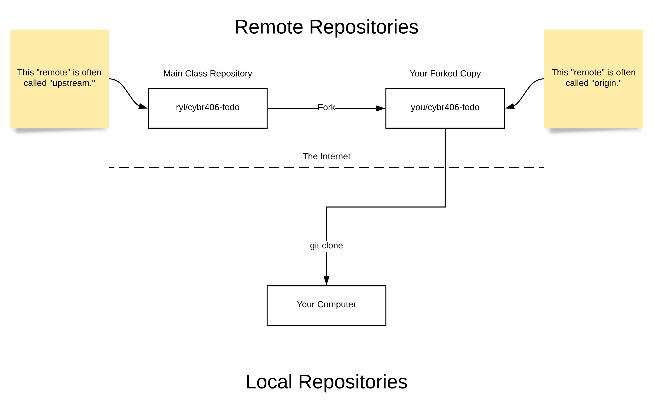

Slide 6
List Remote Repositories
Use “get remote -v” to list remote repositories your local repository is linked to.
$ git remote -v
origin git@github.com:ryl/cybr406-2020.git (fetch)
origin git@github.com:ryl/cybr406-2020.git (push)
The name of the
remote repository
The location of the
remote repository.

Slide 7
Committing Local Changes
Git stores the entire history of your project.
Your local repository is a complete copy of the entire history of the remote repository.
When you make changes locally you must push them back to the remote repository.
This is how code gets shared with others

Slide 8
Committing Local Changes
Use “git status” for an overview of changes.
Use “git add” to prepare the changes you want to commit.
Use “git commit” commit the prepared changes to Git’s history.

Slide 9
Over-Simplification
Red = Not Ready
git status
On branch master
Your branch is up-to-date with 'origin/master'.
Changes not staged for commit:
(use "git add <file>..." to update what will be committed)
(use "git checkout -- <file>..." to discard changes in working directory)
modified: index.md
Untracked files:
(use "git add <file>..." to include in what will be committed)
files/working-with-git-github.pptx
images/git-1.svg
images/github-fork.png
no changes added to commit (use "git add" and/or "git commit -a")
Read about untracked, unstaged, and staged changes.
A change to an existing file that is not recorded in Git’s history.
New files that are not yet recorded in Git’s history.

Slide 10
“git add” lets select which changes you would like to commit. The dot on the end reads as “all changes.”
$ git add .
$ git status
On branch master
Your branch is up-to-date with 'origin/master'.
Changes to be committed:
(use "git reset HEAD <file>..." to unstage)
new file: files/working-with-git-github.pptx
new file: images/git-1.svg
new file: images/github-fork.png
modified: index.md
“git status” now shows changes in green, meaning they are ready to commit.
Over-Simplification
Green = Good 2 Go

Slide 11
“git add” lets select which changes you would like to commit. The dot on the end reads as “all changes.”
$ git add .
$ git status
On branch master
Your branch is up-to-date with 'origin/master'.
Changes to be committed:
(use "git reset HEAD <file>..." to unstage)
new file: files/working-with-git-github.pptx
new file: images/git-1.svg
new file: images/github-fork.png
modified: index.md
“git status” now shows changes in green, meaning they are ready to commit.
Over-Simplification
Green = Good 2 Go

