Slide 1
Spring Boot Basics

Slide 2
What Does Spring Boot Do?
Spring Boot makes it easy to create stand-alone, production-grade Spring based Applications that you can "just run".
We take an opinionated view of the Spring platform and third-party libraries so you can get started with minimum fuss. Most Spring Boot applications need very little Spring configuration.
https://spring.io/projects/spring-boot

Slide 3
How Do I Create a Spring Boot Application?
The Hard Way
Create a Java project and add the required Gradle files yourself, adding dependencies one by one. You better know those long dependency names or know exactly where to find them (good luck)!
There is documentation for numerous build tools if you want to do things by hand.
The Easy Way
Use Spring Initializr (https://start.spring.io/)
Fill out a form which generates a runnable project with everything you need.
You still need to know a bit about what you need, but its easier to find.
If you have the $$$, IntelliJ Ultimate has full Spring Initializr support, so you can do this entirely from your IDE!

Slide 4
I Bootstrapped a Project. How Does it Work?
Like a typical Java app, there is a class with a main method. This is the entry point of the application.
You can run this class from IntelliJ just like you would any simple Java program.
Annotations, annotations, annotations!
Metadata about your program that can be inspected at run-time via reflection.
Spring provides many, many annotations. They are part of the “magic” of Spring Boot and help you create apps quickly (or so they say).

Slide 5
Let’s look at an example main method!

Slide 6
Basic Main Method and Class
1
@SpringBootApplication public class BasicsApplication { public static void main(String[] args) { SpringApplication.run(BasicsApplication.class, args); } }
2
SpringBootApplication We will talk about this in the next few slides.
SpringApplication.run(BasicsApplication.class, args); Javadoc: Static helper that can be used to run a SpringApplication from the specified source using default settings.

Slide 7
Let’s look at some annotations, too!

Slide 8
@SpringBootApplication
You will find this annotation sitting at the top of the class containing the application’s main method.
It indicates the application uses Spring Boot and enables some default behaviors.
Read more about @SpringBootApplication

Slide 9
@Controller
Javadoc: Indicates that an annotated class is a "Controller" (e.g. a web controller).
But what’s a controller?
The workhorse of any web app.
The methods of a controller receive requests and return responses.
The methods themselves are annotated to describe which requests they handle.

Slide 10
@RequestMapping
Javadoc: Annotation for mapping web requests onto methods in request-handling classes with flexible method signatures.
Configures the path, method, etc. that describes which requests the method should respond to.
Fun Facts
Can match one or multiple HTTP methods. By default, matches on ALL of them.
The return type of the annotated method is IMPORTANT (we’ll see why next slide).
Can match on headers, and much more…
…maybe too much more…

Slide 11
@ResponseBody and Return Type
Methods that return String are expected to contain the name of an HTML template in a class annotated with @Controller.
If you want to return raw data, methods need @ResponseBody added.

Slide 12
@RestController
Like @Controller, but @ResponseBody is implied on all methods.
This is a better choice when you are not returning HTML, but rather raw data, as is generally the case with an API.
Remember…we’re going to focus on building API’s…not HTML based websites...

Slide 13
@GetMapping, @PostMapping, etc.
Sometimes @RequestMapping is too broad and too verbose. Maybe you meant for your method to only respond to GET, and you forgot RequestMapping would respond to POST, too, unless told to do otherwise.
These annotations work essentially the same, but limit which HTTP method the request responds to.
I recommend using these annotations instead of @RequestMapping when only one HTTP method is needed.

Slide 14
@RequestParam
Maps a request parameter onto a method argument
Annotates method arguments
It lives INSIDE the parenthesis of a method
Eg: public String method(@RequestParam String firstName)
Unless told otherwise, the name of the method argument is expected to match the name of the request parameter.

Slide 15
@PathVariable
Extracts a variable from the request’s path and maps it to a method argument.
Annotates method arguments
It lives INSIDE the parenthesis of a method
The method argument’s name must match a portion of the path marked with curly braces “/some/path/{name}”
Unless told otherwise, the name of the method argument is expected to match the name of the path variable.
@GetMapping("/path/to/{name}") public String pathGreeting(@PathVariable String name) { return String.format("You're on the path to %s!", name);

Slide 16
@Value
Extract simple values from the application’s configuration.
For example, values set in src\main\resources\application.properties

Slide 17
application.properties
Configures the behavior of your application to suit your needs.
Located at src\main\resources\application.properties
Spring Boot comes with defaults set, application.properties offers an easy way to change them.
Common Spring Properties lists many of the values you can edit in this file.

Slide 18
Properties Files & Profiles
Often applications need to be configured differently to run in under different conditions.
Your production server is probably a little different than your laptop.
Multiple profiles can be created in other files via naming convention.
Example: src\main\resources\application-heroku.properties
This file may contain values specific to running in the Heroku environment.
Could be named anything: application-{anything-you-like-here}.properties
Different files can be selected using command line arguments, which can also be configured through the IDE

Slide 19
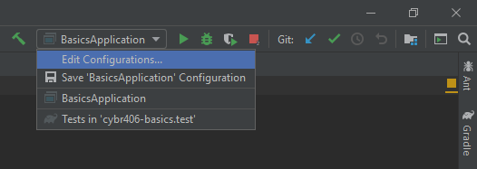
Select a Profile In IntelliJ

Slide 20
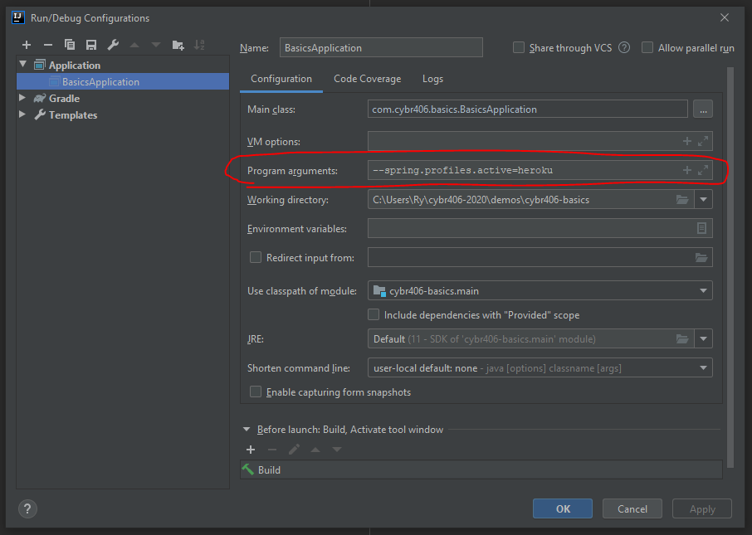
Select a Profile In IntelliJ

Slide 21
That’s a lot of annotations! Don’t worry, there are EVEN MORE! But let’s stop there for now.

Slide 22
Let’s start digging into POST requests.

Slide 23
POST: What Content Type Should I Use?
How about application/x-www-form-urlencoded?
How about multipart/form-data

Slide 24
Remember: We want to build an API.
API: Application Programming Interface
We are interested in empowering PROGRAMMERS and other MACHINES to create their own software using our service.
application/x-www-form-urlencoded?
Could work but is most often used with HTML forms.
multipart/form-data
Probably only needed when files are being uploaded.

Slide 25
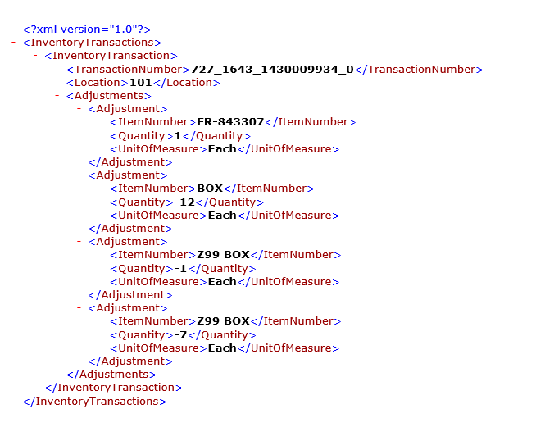
What about XML?
Too verbose and ugly! That’s so 2000 (or whatever year it was fashionable in)!

Slide 26
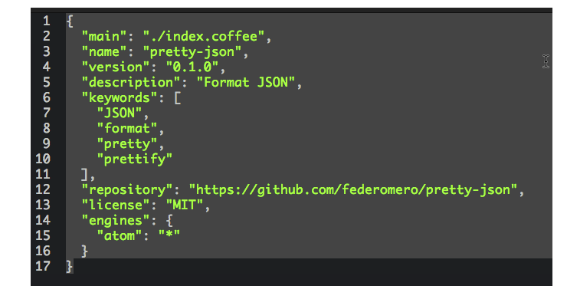
Let’s use JSON
Less verbose, more fashionable.
Practically everyone is using it, so let’s join the bandwagon.

Slide 27
Yes, We Can POST JSON!
It’s a matter of setting the right headers to the right values.
Content-Type: application/json
Good news: Postman has a dropdown to make this easy.

Slide 28
What Should We POST?
Any kind of data that changes the state of the server.
This could be many, many different things.
A user registers for a website (name and password stored to database).
A user updates their password (password updated in the database).
An new TODO item is added to a TODO list (new item appended to the end).

Slide 29
Considerations
POST data often includes more than one field, and they are often bundled together.
A login includes a “username” and “password” in one package.
Fields often need to be validated.
Username is required, but first and last name are not.
You expect a date in a particular format.

Slide 30
Let’s start by collecting data into some kind of bundle with a Java method and @PostMapping.

Slide 31
Critical Parts
@PostMapping annotation on the method
Return type
ResponseEntity<> lets you return an arbitrary object paired with a response code.
A method argument with the container type of your choosing (custom class, map, etc.) annotated with…
@RequestBody
Java Doc: Annotation indicating a method parameter should be bound to the body of the web request.
@Valid if you want the data to be validated.

Slide 32
Map<String, Object>
No planning necessary, perhaps useful for rapid prototyping.
It’s flexible, but not very customizable.

Slide 33
Java Class
Methods can be added to include useful functionality.
Class, fields, and methods can be annotated to control validation.
Better solution in the long run.

Slide 34
Validation
You have 2 main options.
Implement the Validator interface.
Annotate your classes with JSR-303 annotations.

Slide 35
Validator Interface
Very simple: just implement the interface.
ValidationUtils class helps with common validation errors.
Register it in your implementation in a controller using @InitBinder.
Pitfalls
After you register a validator within a controller, it may validate more than you intended it to.
The problem can be worked around, but it is not well documented.

Slide 36
JSR-303 Annotations
Spring docs: “JSR-303 standardizes validation constraint declaration and metadata for the Java platform.”
Very streamlined
Validation rules are readable in the class being validated.
Custom constraints can be created fairly easily if you have some familiarity with creating annotations.
No need for @InitBinder in controller classes.

Slide 37
Validation Recommendation Prefer JSR-303 annotations over Validator interface.

Slide 38
Dependency Injection

Slide 39
What is Dependency Injection
When one class depends on another class to complete its work, dependency injection supplies the dependent class.
Encourages code reuse (DRY principle).
A single class can be injected (shared) by many other classes, which can reduce memory usage.
Spring has a class called ApplicationContext that contains dependencies.
It’s a giant bag full of tools.

Slide 40
@Component
Javadoc: Indicates that an annotated class is a "component". Such classes are considered as candidates for auto-detection when using annotation-based configuration and classpath scanning.
Spring will automatically search for and load the annotated class and add it to the ApplicationContext.
Indicates the annotated class can be use by other classes and automatically injected when used with @Autowired.
Variations: @Repository, @Service, and more.
The variations sometimes imply some additional behavior.
Puts a tool in your tool bag.

Slide 41
@Autowired
Javadoc: Marks a constructor, field, setter method, or config method as to be autowired by Spring's dependency injection facilities.
Marks a location where you want to use a tool from the tool bag.

Slide 42
@Configuration
Javadoc: Indicates that a class declares one or more @Bean methods and may be processed by the Spring container to generate bean definitions and service requests for those beans at runtime.
A class that creates tools and configures tools.

Slide 43
Testing

Slide 44
Spring Boot & Testing
You can use dependency injection in tests.
Tools for testing requests & responses pretty easily.
Imagine a Postman request, only it’s configured in Java code.

Slide 45
Testing Annotations
@SpringBootTest
Enable Spring dependency injection and other features in you tests.
@AutoConfigureMockMvc
Automatically configure a MockMvc class to test your API.
@ActiveProfiles("test")
Run a test with a particular profile active.
Yes, this ties in with application.properties
For example, application-test.properties could be loaded.
@Test
Marks methods that perform tests.

