Slide 1
Databases

Slide 2
SQL Resources
SQL Tutorial Knowing how to use SQL to create, select, insert, update, and delete will be helpful. This tutorial covers many of the commands, though they may need to be slightly adapted from database to database.
H2 Homepage, Data Types, Commands, SQL Grammar H2 is the database we will use most extensively in class. These pages may come in handy as a reference.

Slide 3
Embedded vs Persisted Databases
Embedded Databases
Persisted Databases
Data is lost when app restarts
Built into the app, no separate install needed
Examples
H2
HSQLDB
Data remains when app restarts
Separate from the application, requires installation
Examples
MySQL
PostgreSQL
MariaDB

Slide 4
Why Use Embedded?
Rapid prototyping
Makes automated testing easy
Tests do not pollute database with test data over time
Easy for others to clone your project and run it
Easy participation makes contributions to your project more likely
Someone can try your application without having to install a database
Demos

Slide 5
Using H2 In Your Application

Slide 6
Get Started
H2 is an embedded database with a browser-based UI.
To start using it, you need to add a new dependency to your project’s build.gradle file.
dependencies { … runtime('com.h2database:h2’)
… }

Slide 7
Using the GUI
Enable H2’s console in application.properties
Start your app and visit http://localhost:8080/h2-console
spring.h2.console.enabled = true

Slide 8
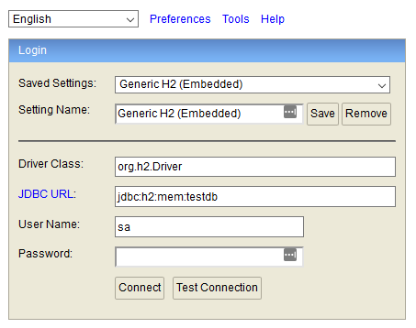
Using the GUI
Connect using the settings below:
Setting | Value
Driver Class | org.h2.Driver
JDBC URL | jdbc:h2:mem:testdb
User Name | sa
Password | (leave blank)

Slide 9
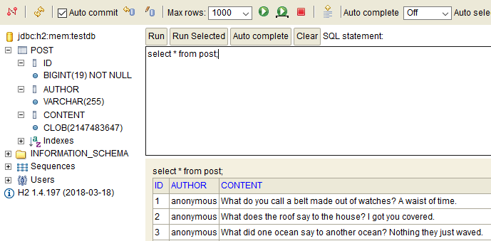
Using the GUI
Use the UI to explore and edit your data

Slide 10
Demo: Using the GUI
See how to connect and get around.

Slide 11
Bootstrapping
Initialize your database with tables and data

Slide 12
Database Bootstrapping
When your app starts its database is empty. No tables. No rows. No structure. NOTHING!
You need to bootstrap the database to make it useful.
Create tables
Insert default data
Spring Boot supports 2 methods:
SQL files (simple)
Migrations (advanced)

Slide 13
Bootstrapping With SQL Files
You can bootstrap the database with files containing SQL statements.
Schema
Create src/main/resources/schema.sql
Write create statements for tables, indexes, etc. here.
Data
Create src/main/resources/data.sql
Write insert statements to fill the database with an initial set of data.
Notes:
Demo

Slide 14
Bootstrapping With SQL Files
Advantages
Disadvantages
Easy if you are comfortable with SQL.
Fast and simple to add to your project.
Works well with embedded databases.
Not very portable from database to database.
data.sql can be tricky when using a persisted database and can lead to accidentally duplicating data.

Slide 15
Supporting Multiple Databases
SQL Files can support multiple databases, with some effort.
Use the “spring.datasource.platform” property to identify which database you are using.
Create data-{platform}.sql and schema-{platform}.sql files.
Read Section 10.3. Initialize a Database for details.

Slide 16
Demo: Bootstrapping Databases
See how data.sql and schema.sql work in practice.
Notes:
Demo part2-basic-sql-scripts
SQL Scripts initialize the embedded database
Demo part3-broken-mysql
SQL scripts were written for H2, don’t work with mysql.
Demo part4-mysql-support
Database platform can be switched.
Supports both embedded and persisted.
Note the data duplication after restarting the app.

Slide 17
Accessing Data from Java

Slide 18
JDBC and JPA
JDBC: Java Database Connectivity A basic API for communicating with databases from Java.
Write your own SQL statements.
Easy prepared statements.
JPA: Java Persistence API Another API offering more advanced functionality.
Automatically generate tables from a class definition.
No need to write SQL except in special circumstances.

Slide 19
Using JDBC
JdbcTemplate JavaDoc: Executes core JDBC workflow, leaving application code to provide SQL and extract results.
Write SQL and use the results in Java.
Use lambdas to transform database records into Java objects.

Slide 20
Configuring JdbcTemplate
@Configuration public class BookDemoConfiguration { @Bean JdbcTemplate jdbcTemplate(DataSource dataSource) { return new JdbcTemplate(dataSource); } }

Slide 21
Insert
@PostMapping("/authors") public ResponseEntity<Author> createAuthor(@RequestBody Author author) { // KeyHolder is used to capture newly generated IDs. KeyHolder keyHolder = new GeneratedKeyHolder(); jdbcTemplate.update(con -> { // Prepared statements guard again SQL injection attacks. // The "?" characters are place holders for real values. PreparedStatement ps = con.prepareStatement( "insert into author (username, name, bio) values (?, ?, ?)", Statement.RETURN_GENERATED_KEYS); // Provide the actual values for each place holder. // The first argument is the place holder position. // The second argument is the actual value. ps.setString(1, author.getUsername()); ps.setString(2, author.getName()); ps.setString(3, author.getBio()); return ps; }, keyHolder); // Extract the generated id. author.setId((long) keyHolder.getKey()); return new ResponseEntity<>(author, HttpStatus.CREATED); }

Slide 22
Select a List
@GetMapping("/authors") public List<Author> findAuthors() { return jdbcTemplate.query( "select * from author", (resultSet, rowNum) -> { // This row mapper is written as a lambda and converts // raw database results into Java objects. Author author = new Author(); author.setId(resultSet.getLong("id")); author.setUsername(resultSet.getString("username")); author.setName(resultSet.getString("name")); author.setBio(resultSet.getString("bio")); return author; }); }

Slide 23
Select an Individual Record
@GetMapping("/authors/{id}") public ResponseEntity<Author> findAuthor(@PathVariable Long id) { Author result = jdbcTemplate.queryForObject( "select * from author where id = ?", (resultSet, rowNum) -> { Author author = new Author(); author.setId(resultSet.getLong("id")); author.setUsername(resultSet.getString("username")); author.setName(resultSet.getString("name")); author.setBio(resultSet.getString("bio")); return author; }, id); // This id will be used in the place holder. return result == null ? new ResponseEntity<>(HttpStatus.NOT_FOUND)
: new ResponseEntity<>(result, HttpStatus.OK); }

Slide 24
Prepared Statements & SQL Injection
https://xkcd.com/327/
Prepared statements help prevent malicious SQL.
Use the “?” placeholder for values instead of raw strings.
NEVER use string concatenation in a SQL statement.

Slide 25
JDBC & JdbcTemplate
Advantages
Disadvantages
Complete control over the SQL that is executed by the database.
Write complex queries with total control over how their results are mapped to java objects.
PreparedStatement helps keep you safe from SQL injection.
JdbcTemplate has many methods. It can be hard to know which is best to use.
Verbose code with lots of boilerplate.

Slide 26
JPA
Short for Java Persistence API, JPA adds a layer between your Java application and your database. It maps Java objects to tables in a database.
Reduces the amount of SQL you need to write by generating it for you.
Good for rapid prototyping when using an embedded database.

Slide 27
Entities
JPA has the concept of entities.
Entities are Java classes that are stored in the database and managed by JPA.

