Slide 1
Databases

Slide 2
SQL Resources
SQL Tutorial Knowing how to use SQL to create, select, insert, update, and delete will be helpful. This tutorial covers many of the commands, though they may need to be slightly adapted from database to database.
H2 Homepage, Data Types, Commands, SQL Grammar H2 is the database we will use most extensively in class. These pages may come in handy as a reference.

Slide 3
Embedded vs Persisted Databases
Embedded Databases
Persisted Databases
Data is lost when app restarts
Built into the app, no separate install needed
Examples
H2
HSQLDB
Data remains when app restarts
Separate from the application, requires installation
Examples
MySQL
PostgreSQL
MariaDB

Slide 4
Why Use Embedded?
Rapid prototyping
Makes automated testing easy
Tests do not pollute database with test data over time
Easy for others to clone your project and run it
Easy participation makes contributions to your project more likely
Someone can try your application without having to install a database
Demos

Slide 5
Using H2 In Your Application

Slide 6
Get Started
H2 is an embedded database with a browser-based UI.
To start using it, you need to add a new dependency to your project’s build.gradle file.
dependencies { … runtime('com.h2database:h2’)
… }

Slide 7
Using the GUI
Enable H2’s console in application.properties
Start your app and visit http://localhost:8080/h2-console
spring.h2.console.enabled = true

Slide 8
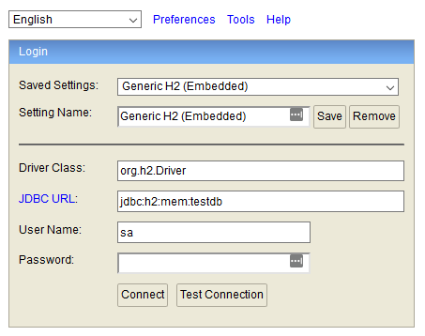
Using the GUI
Connect using the settings below:
Setting | Value
Driver Class | org.h2.Driver
JDBC URL | jdbc:h2:mem:testdb
User Name | sa
Password | (leave blank)

Slide 9
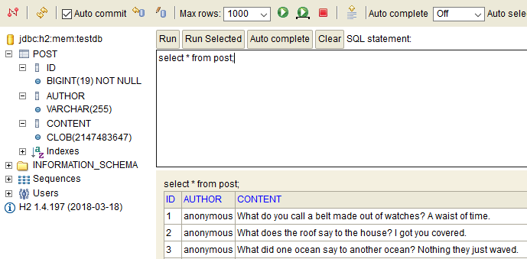
Using the GUI
Use the UI to explore and edit your data

Slide 10
Demo: Using the GUI
See how to connect and get around.

Slide 11
Bootstrapping
Initialize your database with tables and data

Slide 12
Database Bootstrapping
When your app starts its database is empty. No tables. No rows. No structure. NOTHING!
You need to bootstrap the database to make it useful.
Create tables
Insert default data
Spring Boot supports 2 methods:
SQL files (simple)
Migrations (advanced)

Slide 13
Bootstrapping With SQL Files
You can bootstrap the database with files containing SQL statements.
Schema
Create src/main/resources/schema.sql
Write create statements for tables, indexes, etc. here.
Data
Create src/main/resources/data.sql
Write insert statements to fill the database with an initial set of data.
Notes:
Demo

Slide 14
Bootstrapping With SQL Files
Advantages
Disadvantages
Easy if you are comfortable with SQL.
Fast and simple to add to your project.
Works well with embedded databases.
Not very portable from database to database.
data.sql can be tricky when using a persisted database and can lead to accidentally duplicating data.

Slide 15
Supporting Multiple Databases
SQL Files can support multiple databases, with some effort.
Use the “spring.datasource.platform” property to identify which database you are using.
Create data-{platform}.sql and schema-{platform}.sql files.
Read Section 10.3. Initialize a Database for details.

Slide 16
Demo: Bootstrapping Databases
See how data.sql and schema.sql work in practice.
Notes:
Demo part2-basic-sql-scripts
SQL Scripts initialize the embedded database
Demo part3-broken-mysql
SQL scripts were written for H2, don’t work with mysql.
Demo part4-mysql-support
Database platform can be switched.
Supports both embedded and persisted.
Note the data duplication after restarting the app.

Slide 17
Accessing Data from Java

Slide 18
JDBC and JPA
JDBC: Java Database Connectivity A basic API for communicating with databases from Java.
Write your own SQL statements.
Easy prepared statements.
JPA: Java Persistence API Another API offering more advanced functionality.
Automatically generate tables from a class definition.
No need to write SQL except in special circumstances.

Slide 19
Using JDBC
JdbcTemplate JavaDoc: Executes core JDBC workflow, leaving application code to provide SQL and extract results.
Write SQL and use the results in Java.
Use lambdas to transform database records into Java objects.

Slide 20
Configuring JdbcTemplate
@Configuration public class BookDemoConfiguration { @Bean JdbcTemplate jdbcTemplate(DataSource dataSource) { return new JdbcTemplate(dataSource); } }

Slide 21
Insert
@PostMapping("/authors") public ResponseEntity<Author> createAuthor(@RequestBody Author author) { // KeyHolder is used to capture newly generated IDs. KeyHolder keyHolder = new GeneratedKeyHolder(); jdbcTemplate.update(con -> { // Prepared statements guard again SQL injection attacks. // The "?" characters are place holders for real values. PreparedStatement ps = con.prepareStatement( "insert into author (username, name, bio) values (?, ?, ?)", Statement.RETURN_GENERATED_KEYS); // Provide the actual values for each place holder. // The first argument is the place holder position. // The second argument is the actual value. ps.setString(1, author.getUsername()); ps.setString(2, author.getName()); ps.setString(3, author.getBio()); return ps; }, keyHolder); // Extract the generated id. author.setId((long) keyHolder.getKey()); return new ResponseEntity<>(author, HttpStatus.CREATED); }

Slide 22
Select a List
@GetMapping("/authors") public List<Author> findAuthors() { return jdbcTemplate.query( "select * from author", (resultSet, rowNum) -> { // This row mapper is written as a lambda and converts // raw database results into Java objects. Author author = new Author(); author.setId(resultSet.getLong("id")); author.setUsername(resultSet.getString("username")); author.setName(resultSet.getString("name")); author.setBio(resultSet.getString("bio")); return author; }); }

Slide 23
Select an Individual Record
@GetMapping("/authors/{id}") public ResponseEntity<Author> findAuthor(@PathVariable Long id) { Author result = jdbcTemplate.queryForObject( "select * from author where id = ?", (resultSet, rowNum) -> { Author author = new Author(); author.setId(resultSet.getLong("id")); author.setUsername(resultSet.getString("username")); author.setName(resultSet.getString("name")); author.setBio(resultSet.getString("bio")); return author; }, id); // This id will be used in the place holder. return result == null ? new ResponseEntity<>(HttpStatus.NOT_FOUND)
: new ResponseEntity<>(result, HttpStatus.OK); }

Slide 24
JDBC & JdbcTemplate
Advantages
Disadvantages
Complete control over the SQL that is executed by the database.
Write complex queries with total control over how their results are mapped to java objects.
PreparedStatement helps keep you safe from SQL injection.
JdbcTemplate has many methods. It can be hard to know which is best to use.
Verbose code with lots of boilerplate.

Slide 25
Using JPA
Relies heavily on annotations
Generates most of your SQL for you
Maps Java objects to database tables

Slide 26
@Entity
Identifies the object as a class to be saved to the database.

Slide 27
@Id
Annotates the property that uniquely identifies the object
Becomes the primary key in the table generated for the class.

Slide 28
@GeneratedValue
Used in conjunction with @Id
Indicates the database should generate this value. The strategy parameter indicates how to generate the value. Use IDENTITY to create unique, auto-incrementing numbers.

Slide 29
@Lob
Use this annotation on a String to store large chunks of data into large object (LOB)

Slide 30
Relationships
Describe how classes relate to one another.
@OneToMany, @ManyToOne
@ManyToMany

Slide 31
Controlling JPA Bootstraping
spring.jpa.hibernate.ddl-auto={value}
Value | Description
create | Create tables on application startup. Does not drop them during shutdown.
create-drop | Create on startup, drop on shutdown. Similar to using an embedded database.
update | Update tables in needed.
validate | Validate that tables match your Java classes.
none | Do nothing at all.

Slide 32
JPA Repositories
Access and manage your data.

Slide 33
Repositories
Manage data
Expose basic CRUD operations (Create, Retrieve, Update, Delete)
Create search methods using naming conventions

Slide 34
Search
You can define queries using method naming convention
SQL will automatically be generated for you.
Some examples:
findByLastnameAndFirstname
findByFirstnameLike
findByStartDateBetween

Slide 35
Pagination
Use the Pageable interface as a method argument to capture:
Page number
Page size
Sort
Return Page<T> from a Repository to display a subset of a large result set.
Contains useful information about the number of results.

Slide 36
@Query
It may be difficult to write a method name that describes your search.
For certain cases, writing SQL may still be easier.
Supports JPQL, which is portable between databases.
Supports native SQL, which may or may not be portable.

Slide 37
Debugging
Add these to application.properties. They can help you solve problems by revealing the SQL statements JPA generates.
# Generated SQL statements will be logged. # This is a good starting point that won't overwhelm your logs with information. spring.jpa.show-sql = true # This has the same outcome as the property shown above. logging.level.org.hibernate.SQL = DEBUG # This property will log the values being bound to SQL prepared statements # without dumping out an overwhelming amount of information. logging.level.org.hibernate.type.descriptor.sql.BasicBinder = TRACE # This property will reveal even more information about bindings and values. # Expect a large amount of logging in your console. logging.level.org.hibernate.type = TRACE

Slide 38
JPA Summary
Advantages
Disadvantages
Greatly reduces boilerplate.
Extensive knowledge of SQL not needed (it still helps greatly, though).
Rapid prototyping with classes.
Not always obvious what queries will be generated.
Sometimes difficult to map Java object models to database tables. Polymorphism can be challenging.
Multi-column primary keys can be very difficult to work with.

