Slide 1
Working With Git & GitHub

Slide 2
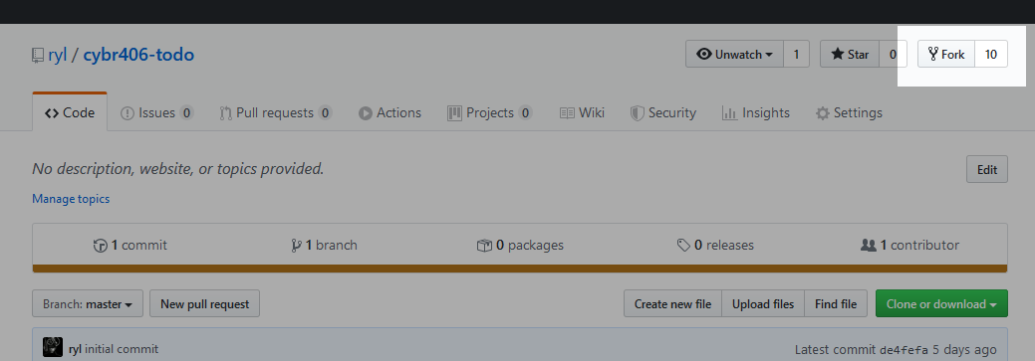
Fork a Class Project
A fork is a copy of a repository in your own account.
Use the “Fork” button in the top right corner.
Read about forks on GitHub

Slide 3
Clone Your Copy
After you fork the class repository, clone it locally.
Using HTTP git clone https://github.com/username/project.git
Using SSH git clone git@github.com:username/project.git
Read about cloning on GitHub

Slide 4
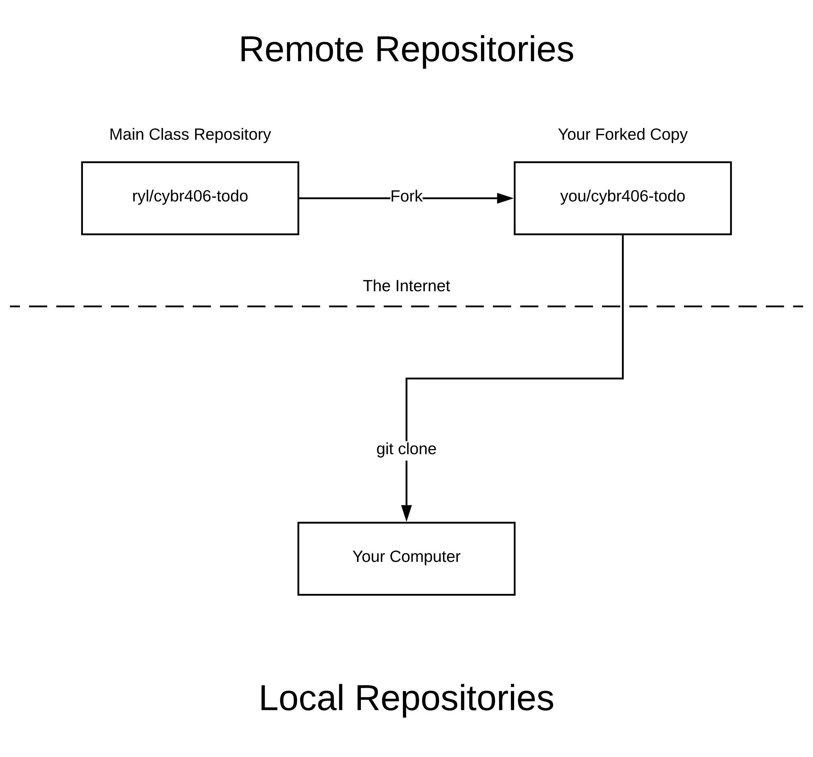

Slide 5
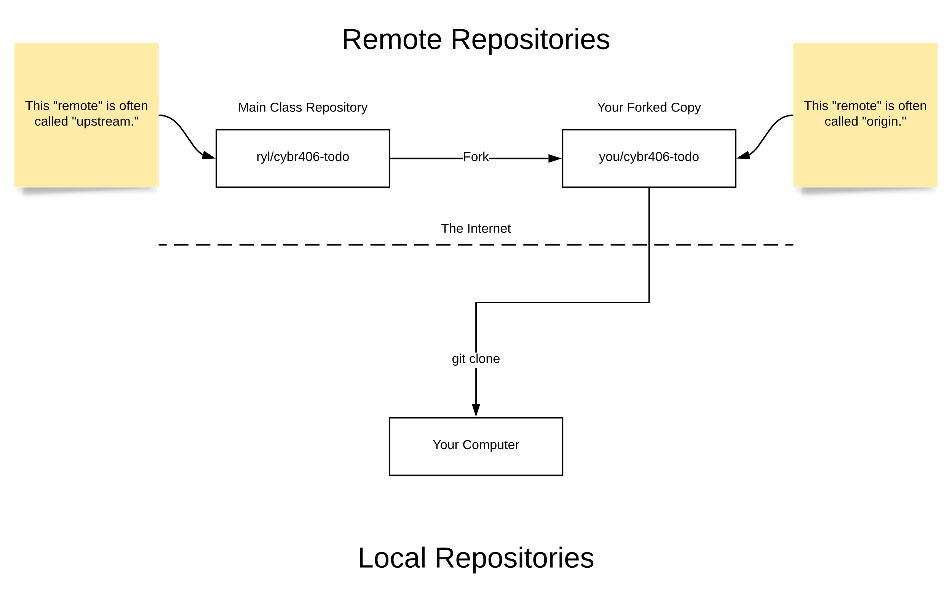

Slide 6
List Remote Repositories
Use “git remote -v” to list remote repositories your local repository is linked to.
$ git remote -v
origin git@github.com:ryl/cybr406-2020.git (fetch)
origin git@github.com:ryl/cybr406-2020.git (push)
The name of the
remote repository
The location of the
remote repository.

Slide 7
Committing Local Changes
Git stores the entire history of your project.
Your local repository is a complete copy of the entire history of the remote repository.
When you make changes locally you must push them back to the remote repository.
This is how code gets shared with others!

Slide 8
Committing Local Changes
Use “git status” for an overview of changes.
Use “git add” to prepare the changes you want to commit.
Use “git commit” to save the prepared changes to Git’s history.

Slide 9
Over-Simplification
Red = Not Ready
$ git status
On branch master
Your branch is up-to-date with 'origin/master'.
Changes not staged for commit:
(use "git add <file>..." to update what will be committed)
(use "git checkout -- <file>..." to discard changes in working directory)
modified: index.md
Untracked files:
(use "git add <file>..." to include in what will be committed)
files/working-with-git-github.pptx
images/git-1.svg
images/github-fork.png
no changes added to commit (use "git add" and/or "git commit -a")
Read about untracked, unstaged, and staged changes.
A change to an existing file that is not recorded in Git’s history.
New files that are not yet recorded in Git’s history.

Slide 10
“git add” lets you select which changes you would like to commit. The dot on the end reads as “all changes.”
$ git add .
$ git status
On branch master
Your branch is up-to-date with 'origin/master'.
Changes to be committed:
(use "git reset HEAD <file>..." to unstage)
new file: files/working-with-git-github.pptx
new file: images/git-1.svg
new file: images/github-fork.png
modified: index.md
“git status” now shows changes in green, meaning they are ready to commit.
Over-Simplification
Green = Good 2 Go

Slide 11
“git commit” saves the staged (green) changes to its history.
Use the “-m” argument to write a short message that will appear in the history.
$ git commit -m "Added a new presentation and updated index.md"
[master 4232352] Added a new presentation and updated index.md
4 files changed, 2 insertions(+)
create mode 100644 files/working-with-git-github.pptx
create mode 100644 images/git-1.svg
create mode 100644 images/github-fork.png
$ git status
On branch master
Your branch is ahead of 'origin/master' by 1 commit.
(use "git push" to publish your local commits)
nothing to commit, working tree clean
“git status” now reports the local repository is ahead of the remote repository named “origin” by 1 commit.

Slide 12
“git log” lets you view the history of the project
$ git log
commit 030b3aa0e55c3ab97f3983bc246a3a9a4922ec75 (HEAD -> master)
Author: Ry Lowry <rylowry@gmail.com>
Date: Tue Feb 4 01:08:01 2020 -0600
Added a new presentation and updated index.md
commit c219eee14934c63d3a05d87182e65b15290aca84 (origin/master, origin/HEAD)
Author: Ry Lowry <rylowry@gmail.com>
Date: Thu Jan 30 00:31:07 2020 -0600
Prepare git fork notes.
commit e9dfc377a3578135ad5469e51532cd45e9f1cd66
Author: Ry Lowry <rylowry@gmail.com>
Date: Thu Jan 30 00:00:46 2020 -0600
Added ide tips & a reference page for annotations and classes.
commit 7fc967ca01be6bc8277b25636ff43201fb7c7ce0
Author: Ry Lowry <rylowry@gmail.com>
Date: Tue Jan 28 03:19:04 2020 -0600
Updated presentation and homepage.
Navigation
Up Arrow: Scroll Up
Down Arrow: Scroll Down
Q: Quit viewing logs

Slide 13
Push Local Changes to GitHub
You have committed changes locally, nice job!
They only exist on your computer, though.
You need to “push” your changes to share them with the world.
“git push” will send all the local commits to the remote repository.
$ git push
Counting objects: 14, done.
Delta compression using up to 8 threads.
Compressing objects: 100% (14/14), done.
Writing objects: 100% (14/14), 205.45 KiB | 3.48 MiB/s, done.
Total 14 (delta 8), reused 0 (delta 0)
remote: Resolving deltas: 100% (8/8), completed with 3 local objects.
To github.com:ryl/cybr406-2020.git
54ee24c..b21d2fc master -> master

Slide 14
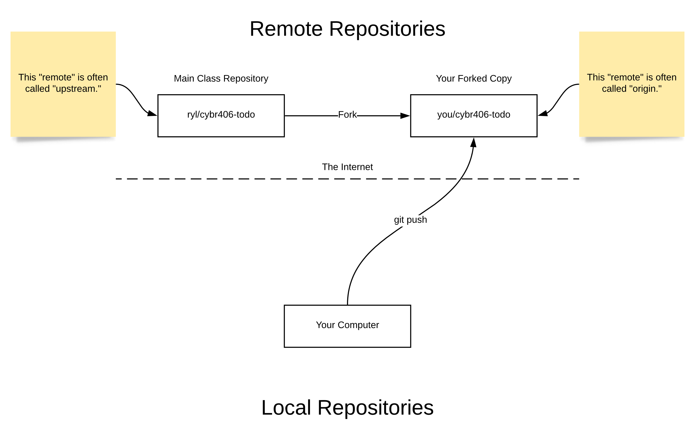

Slide 15
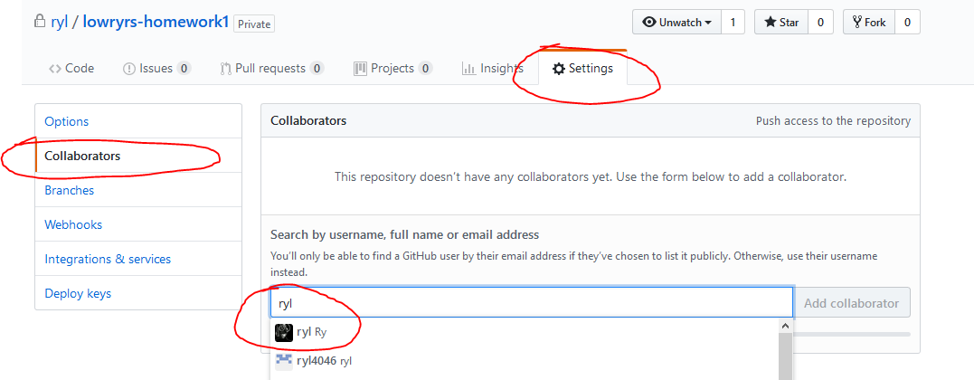
Add a Collaborator

Slide 16
Basic Homework Recipe
git clone (paste your repository URL copied from GitHub here)
Write code
git status
git add .
git commit -m "A short, descriptive message“
git push
Add “ryl” as a collaborator.

