Slide 1
Middle Georgia AWS Meetup
06-08-2021

Slide 2
Install SDK
https://boto3.amazonaws.com/v1/documentation/api/latest/guide/quickstart.html
pip install boto3
“aws configure” command to configure credentials file located at ~/.aws/credentials

Slide 3
Capture and parse VPC flow logs
Capture IP traffic going through your interfaces to assist with network troubleshooting or for security analysis.
VPC Flow Logs, Subnet Flow Logs, Elastic Network Interface Flow Logs
Download file with process and search

Slide 4
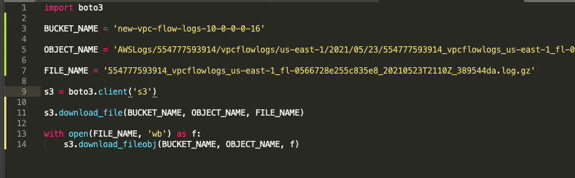
Simple Code to download flow log from S3

Slide 5
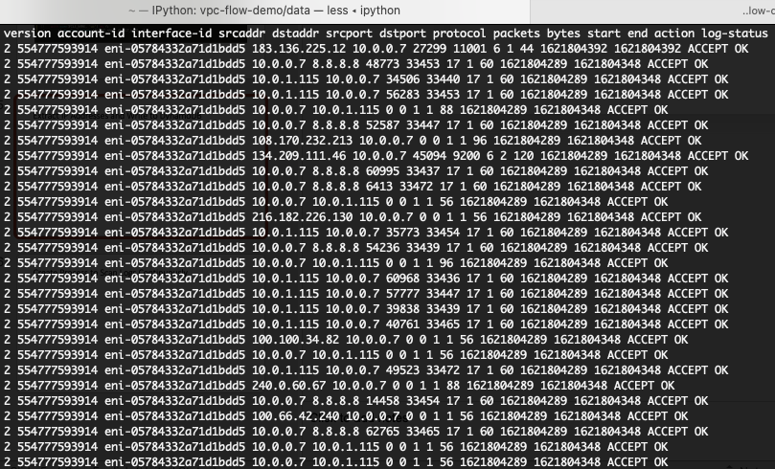
Raw log after extracting

Slide 6
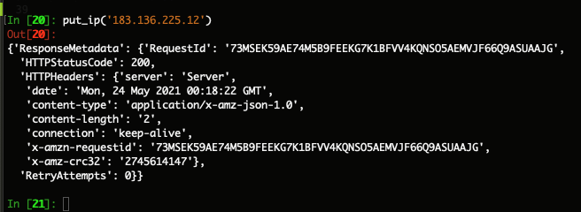
Extract IP Addresses and Write to DynamoDB

Slide 7
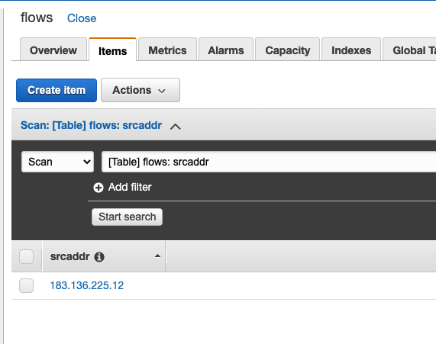
Extract IP Addresses and Write to DynamoDB

Slide 8
Create Process to Scan Logs Continuously

