Slide 1
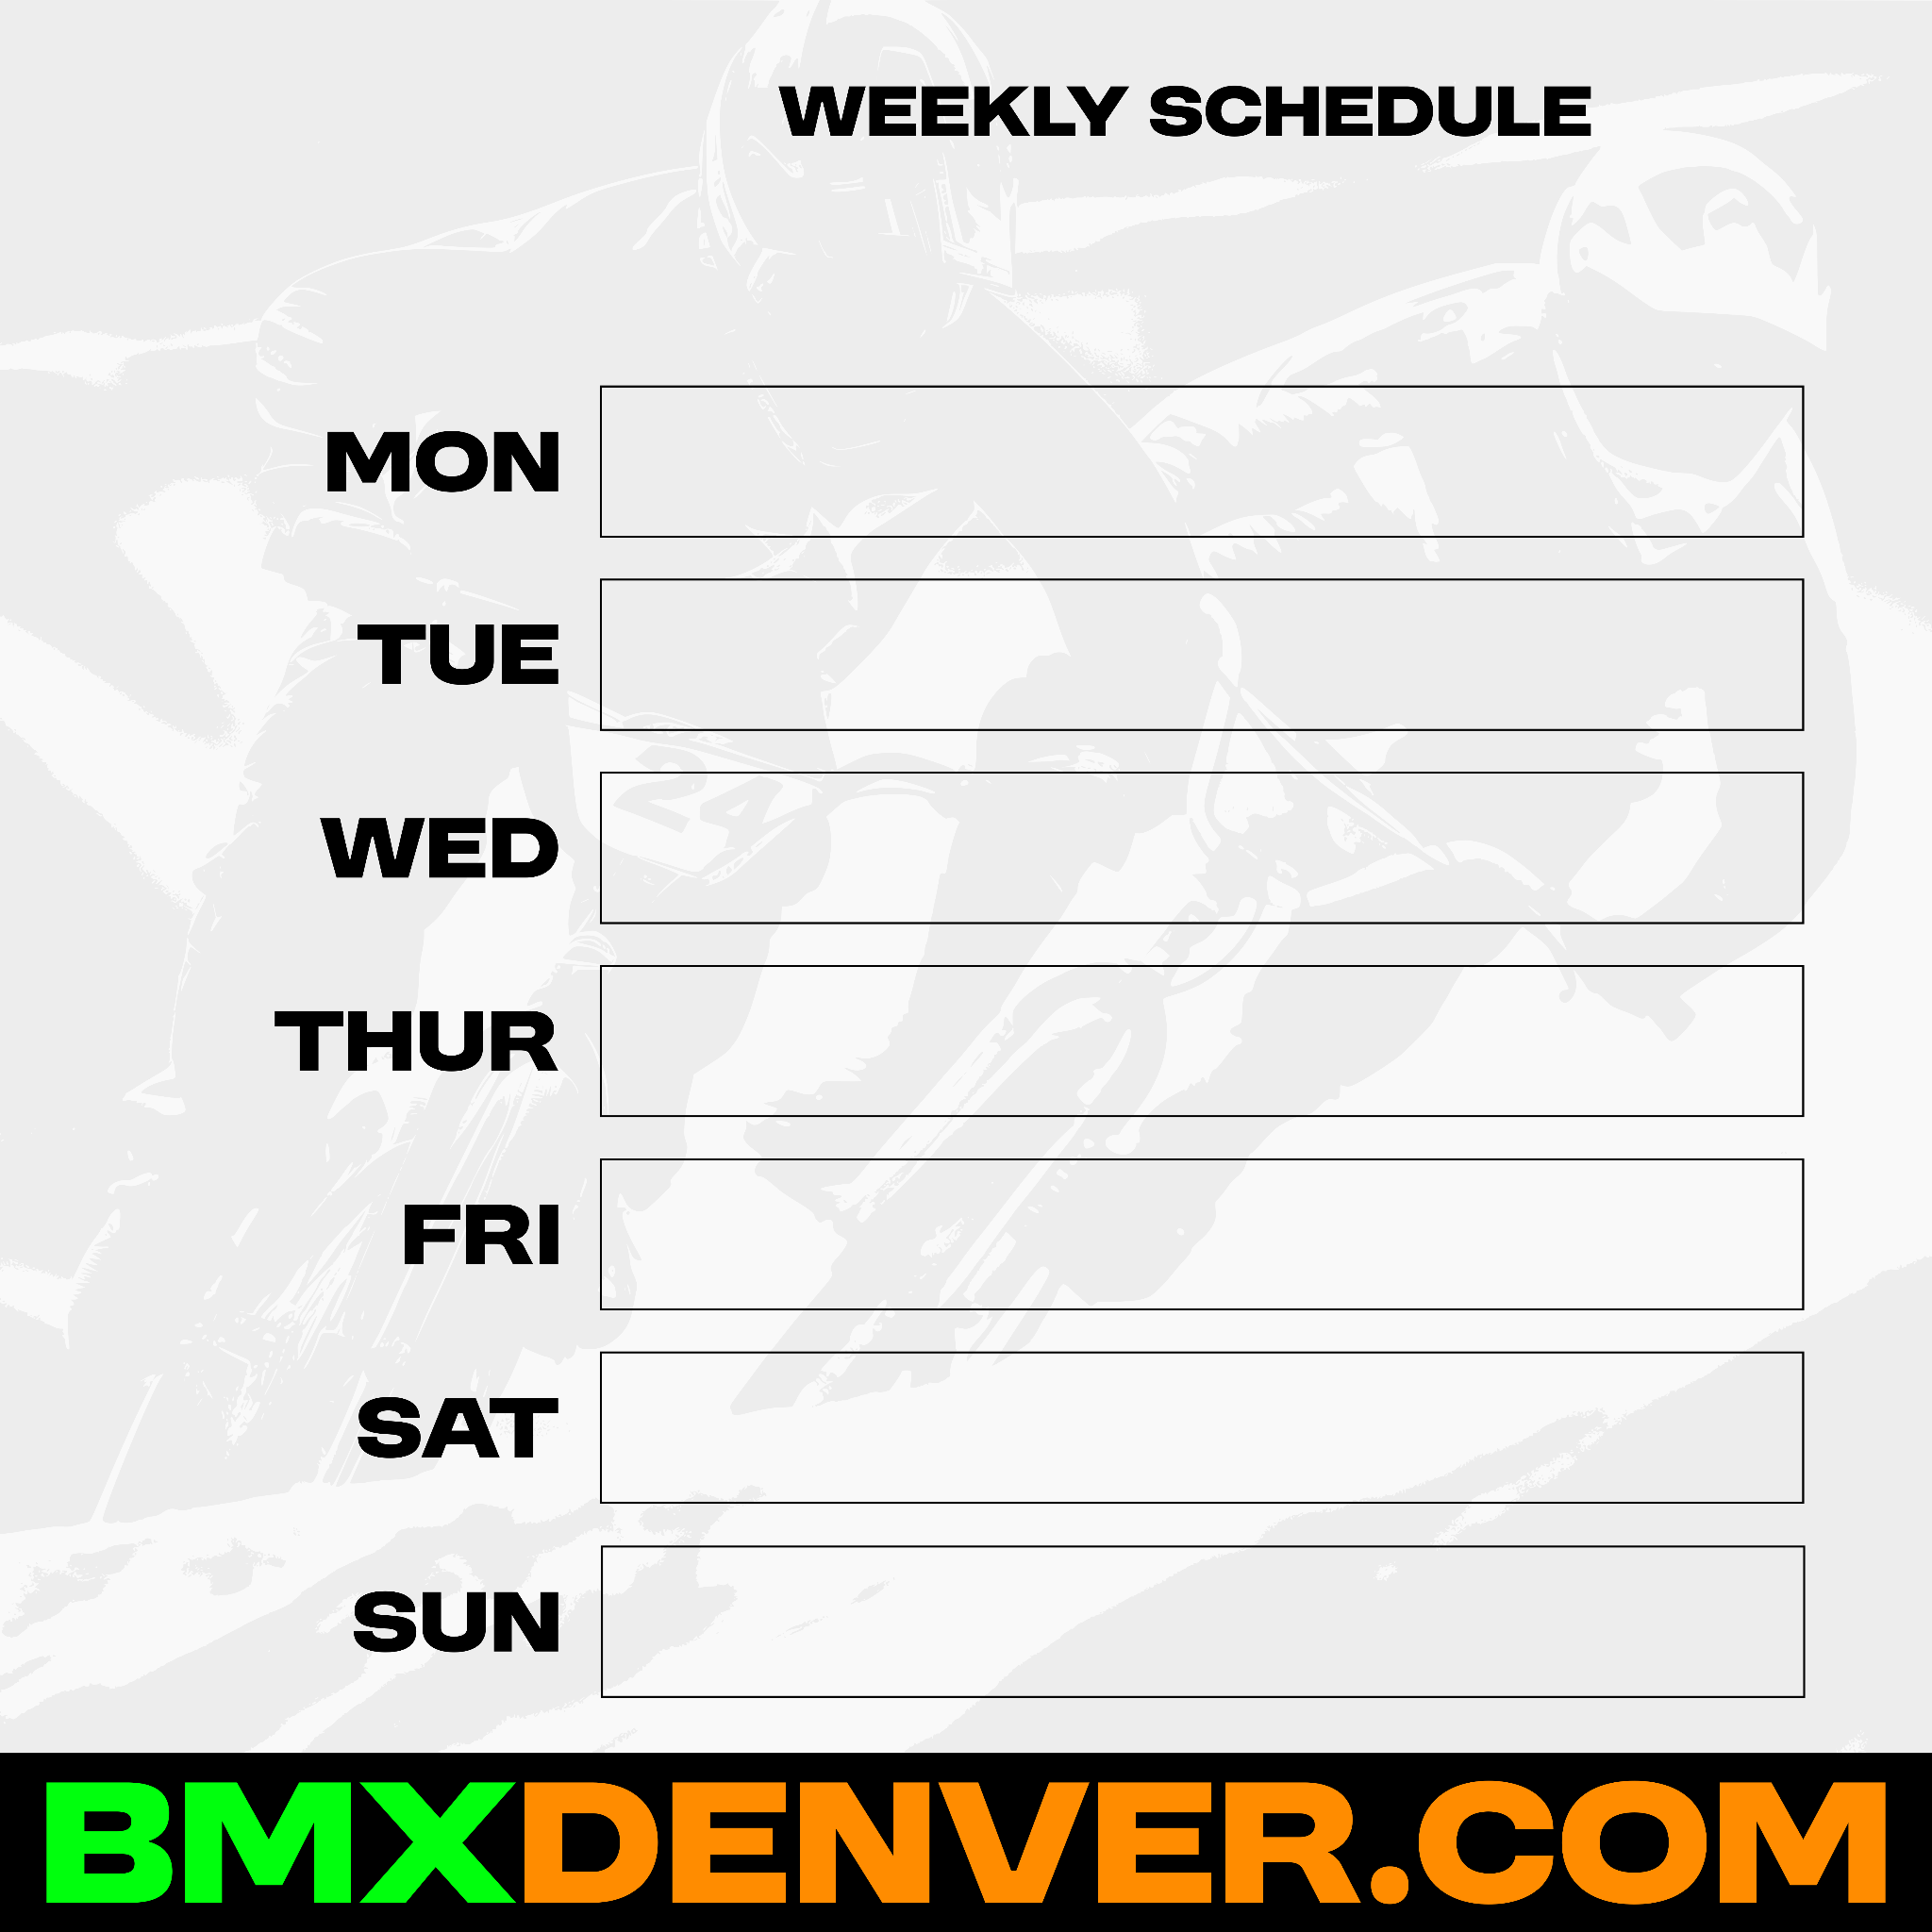

Social:
FB
Dim:
Square
Content:
Weekly
Schedule
Directions:
Fill out template and copy/paste
11/3-11/9
VOLUNTEER MAINTENANCE NIGHT!
Free pizza and riding after 530-630pm
6-8pm practice ($5 or D-pass)
No scheduled events
6-8pm practice & race ($10 or D-pass)
No scheduled events
VOLUNTEER MAINTENANCE NIGHT!
Free pizza and riding after
2-4pm practice & race ($15 or D-pass)

Slide 2
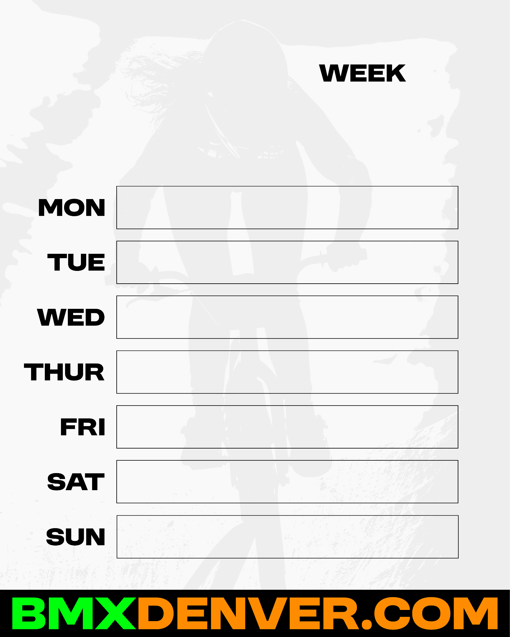
Social:
FB/Insta
Dim:
Vertical (Mobile)
Content:
Weekly
Schedule
Directions:
Fill out template and copy/paste
11/3-11/9
6-8pm practice ($5 or D-pass)
No scheduled events
6-8pm practice & race ($10 or D-pass)
No scheduled events
VOLUNTEER WORK NIGHT!
PARTY
RACE DAY

