Slide 1
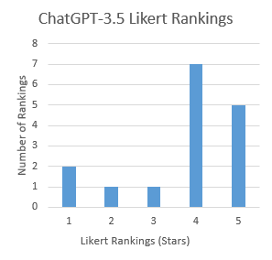
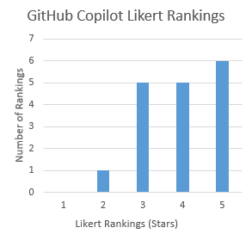
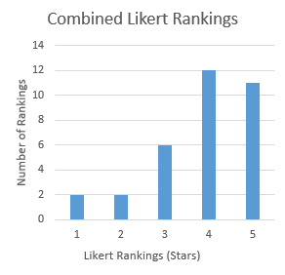
Comparing the Abilities of AI Assistants in Web Development
Using OpenAI ChatGPT-3.5 and GitHub Copilot
Grand Canyon
University
Rylan Casanova
College of Engineering and Technology
ABSTRACT
This study investigates the comparative capabilities of GPT-3.5 and GitHub Copilot in coding assistance and communication within the context of Scrum and Agile methodologies. Drawing upon a review of peer-reviewed literature, which emphasizes effective Scrum Master roles, management techniques in Agile methodologies, and considerations of AI assistant capabilities and limitations, this research employs a mixed-methods approach to analyze Likert scores and qualitative observations. Results suggest GitHub Copilot's superior communication effectiveness and proficiency in handling tasks across multiple files, while GPT-3.5 exhibits a slight edge in smaller, more specific tasks, with both assistants demonstrating comparable debugging accuracy. These findings contribute to a deeper understanding of AI-powered coding tools and their potential in optimizing productivity and efficiency in software development processes, thereby providing valuable insights for developers and researchers alike.
REFERENCES
[1] Paasivaara, M. (2021, May 1). Teaching the Scrum Master Role using Professional Agile Coaches and Communities of Practice. IEEE Xplore.
[2] Hidayati, A., Budiardjo, E. K., & Purwandari, B. (2020). Hard and Soft Skills for Scrum Global Software Development Teams. Proceedings of the 3rd International Conference on Software Engineering and Information Management.
[3] Hayat, F., Rehman, A., Arif, K., Wahab, K., & Abbas, M. (n.d.). The Influence of Agile Methodology (Scrum) on Software Project Management. IEEE Computer Society.
[4] Tokdemir, G., & Uguz, S. (2022). Research Trends in Agile Software Development. 2022 International Conference on Emerging Trends in Computing and Engineering Applications (ETCEA).
[5] Alexander, F., Abdiwijaya, E. A., Pherry, F., Gunawan, A. A. S., & Anderies. (2022). Systematic Literature Review on Solving Competitive Programming Problem with Artificial Intelligence (AI). 2022 1st International Conference on Software Engineering and Information Technology (ICoSEIT).
[6] Nghiem, K., Nguyen, A. M., & Bui, N. D. Q. (2024). Envisioning the Next-Generation AI Coding Assistants: Insights & Proposals.
[7] Zhang, D., Mohd, & Yamaguchi, S. (2022). Human-AI Pair Programming by Data Stream and Its Application Example. 2022 IEEE International Conference on Consumer Electronics-Asia (ICCE-Asia).
[8] Johari, D., Samaddar, S., & Kumar, S. (n.d.). AI based WebApp development using Application Programming Interface (API). IEEE Xplore; 2022 2nd International Conference on Advance Computing and Innovative Technologies in Engineering (ICACITE).
‌
RESEARCH HYPOTHESES/ OBJECTIVES
H₀ There is a significant difference in the coding ability between GPT-3.5 and GitHub Copilot
H₁ The debugging accuracy of GPT-3.5 significantly differs from the debugging accuracy of GitHub Copilot
H₂ There is a significant difference in the effectiveness of communication between GPT-3.5 and GitHub Copilot
LITERATURE
In my review of peer-reviewed articles, I researched several new methodologies related to AI assistants in code development and Scrum or Agile in coding classes.
The literature reviewed gave insight on how to be an effective Scrum Master [1], fully utilizing my Scrum development team [2] of AI assistants through proper communication practices. Furthermore, Scrum and Agile emphasize management techniques for time, scope, quality, risk, human (or AI assistant, in this case) resource management [3], and proper execution of the Software Development Process (SDP) [4].
It was also important to consider the capabilities and limitations [5] the AI assistants may encounter throughout my research. The literature review was critical to reviewing and implementing proper communication practices [6] throughout my research. Multiple of the articles reviewed demonstrated how AI assistants can be effective in code generation [7] and web app development [8].
METHODOLOGY
Mixed Methods Research Framework
Quantitative Data: Likert scores, keywords
Qualitative Data: Observations, notes, overall trends and themes
Partially Structured Observations
AI tests are conducted “equally” among both assistants
Prompts are open-ended and collected observations are examined for patterns
Analysis for similarities, differences, trends
Experimental Design
Follow a set of procedures for recording and grading observations (Likert)
DATA &
ANALYSIS
Recorded 32 table entries (prompts, results, notes, and scores for each AI assistant)
ChatGPT-3.5 Likert Analysis
Mean: 3.75 stars
Median: 4 stars
Mode: 4 stars
GitHub Copilot Likert Analysis
Mean: 4.00 stars
Median: 4 stars
Mode: 5 stars
Key Analysis + Themes
Copilot never scored below a 2
Both AIs gave a functioning response a majority (>50%) of the time
Copilot’s Likert data having a mode of 5 stars demonstrates its high level of communication
Copilot is better than ChatGPT with tasks that require modification of multiple files
ChatGPT has a slight edge over Copilot with tasks that are smaller and more specific
CONCLUSION
In conclusion, the research findings reveal nuanced differences in the capabilities of GPT-3.5 and GitHub Copilot in coding assistance and communication. While GitHub Copilot demonstrates superiority in communication effectiveness in context and handling tasks across multiple files, GPT-3.5 shows a slight advantage in smaller, more specific tasks. Copilot’s ability to use context and give a working response in a significantly lower average amount of prompts demonstrates its effectiveness of communication. However, both assistants exhibit comparable performance in debugging accuracy. These insights contribute to a better understanding of AI-powered coding tools and can guide developers and researchers in leveraging these technologies to enhance productivity and efficiency in software development workflows.

