Slide 1

PRODUCT STORY • JUNE 2026
Draft night, built to feel shared.
DraftHQ combines a reliable multiplayer draft room with the league workspace that surrounds it.
CURRENT STATE + ROADMAP
A presentation-ready tour of what exists today—and what comes next.

Slide 2
THE IDEA
One product, two moments
DraftHQ starts with the highest-pressure league moment—the live draft—and grows outward into the league’s operating home.
153
32
5
70
unit tests passing
application routes
provider paths
database migrations
Reliable multiplayer draft room first
Then ownership, imports, commissioner tools, mobile, history, and the fun stuff.
02

Slide 3
EXPERIENCE MAP
The league journey is already visible
01
02
03
04
05
06
Create
Organize
Configure
Gather
Draft
Remember
Start a persistent league
Members, teams, owners
Order, rounds, timer
Lobby and chat
Realtime picks + recovery
History and archives
LIVE
LIVE
LIVE
LIVE
LIVE
PLANNED
The core journey now reaches a completed draft. The next chapter is everything that happens after it.
03

Slide 4
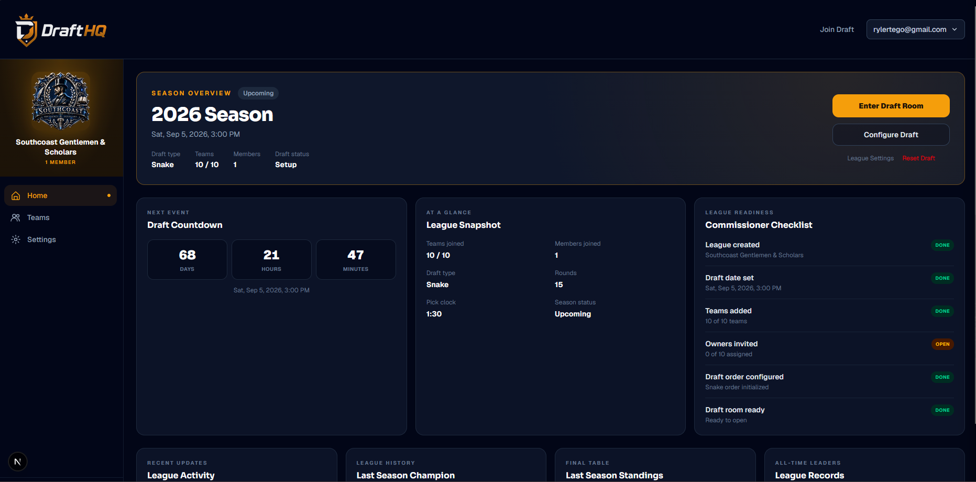
PRODUCT 1 OF 7
Current state: dashboard
The front door
Authenticated users see every league workspace, draft status, and next action in one place.
SHIPPED
• Persistent accounts
• League status
• Create or join
• Direct workspace entry
04

Slide 5
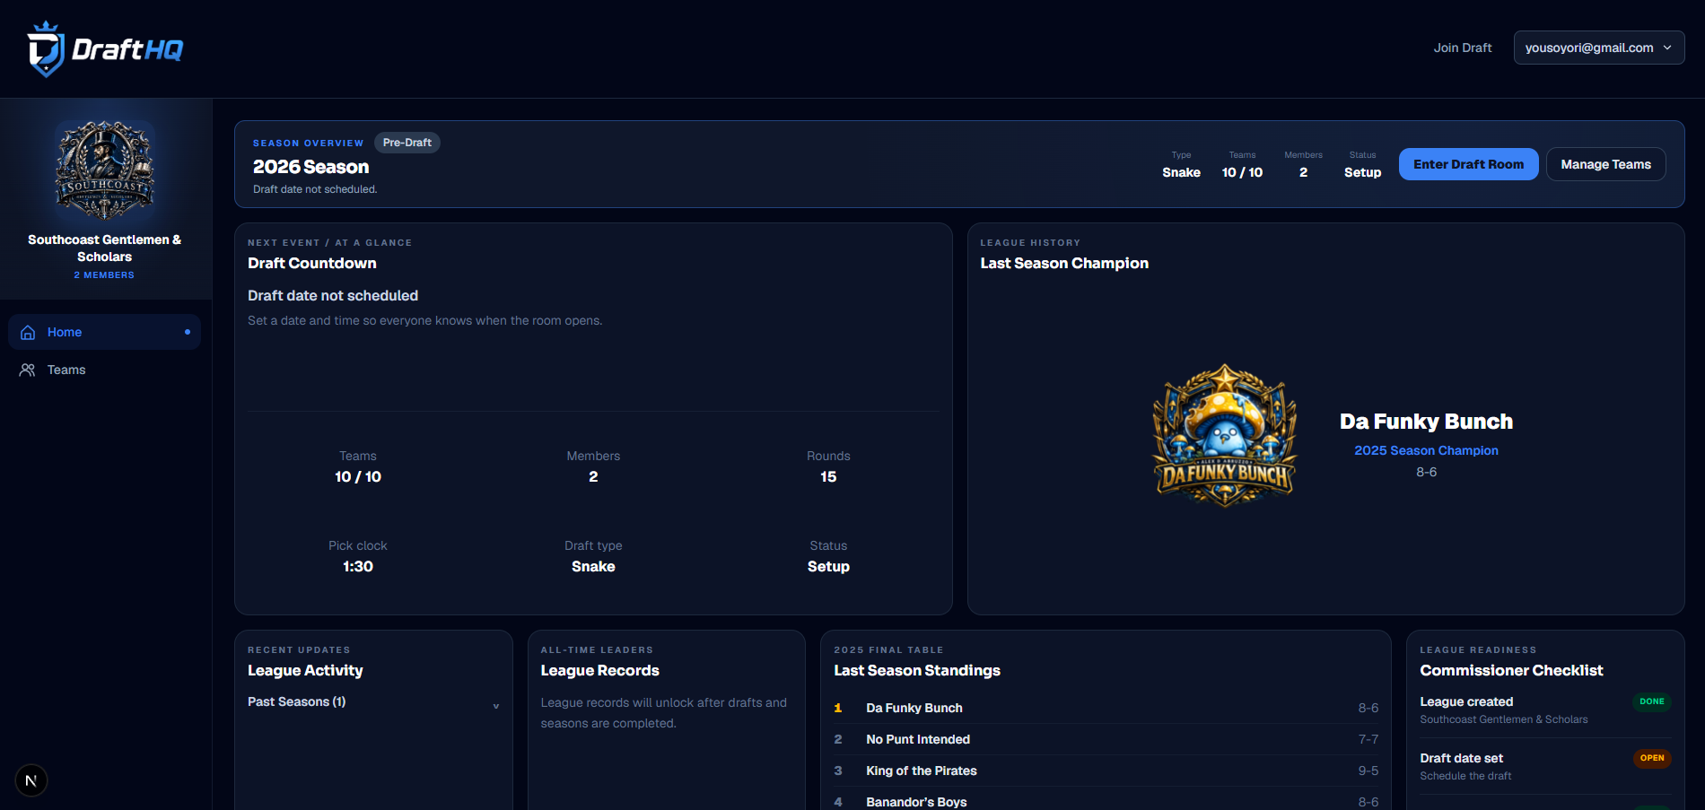
PRODUCT 2 OF 7
Current state: league workspace
The operating home
Branding, membership, teams, seasons, and draft access are now organized around a persistent league identity.
SHIPPED
05

Slide 6
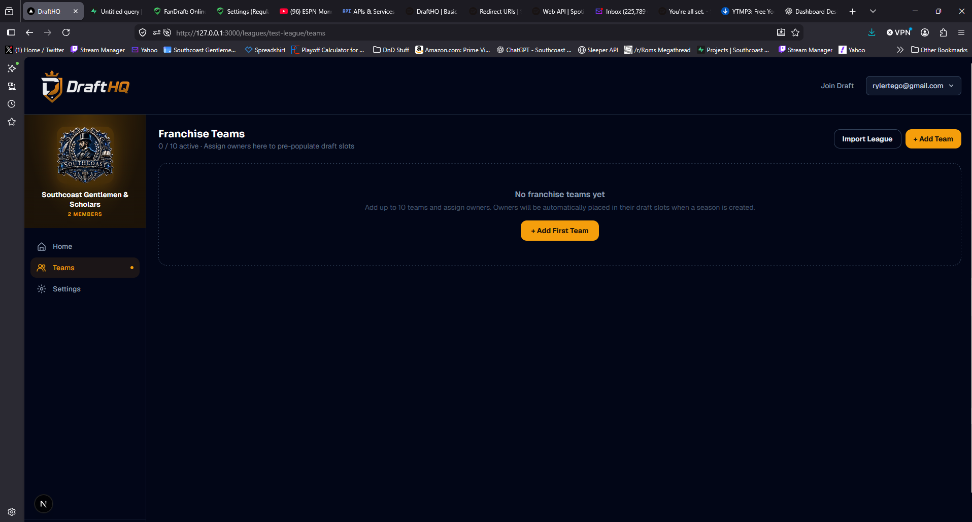
PRODUCT 3 OF 7
Current state: teams and ownership
Ownership is durable
Commissioners manage franchises and assign owners once. Those assignments materialize into setup-phase draft slots automatically.
Less draft-night admin. Fewer wrong-owner mistakes.
06

Slide 7
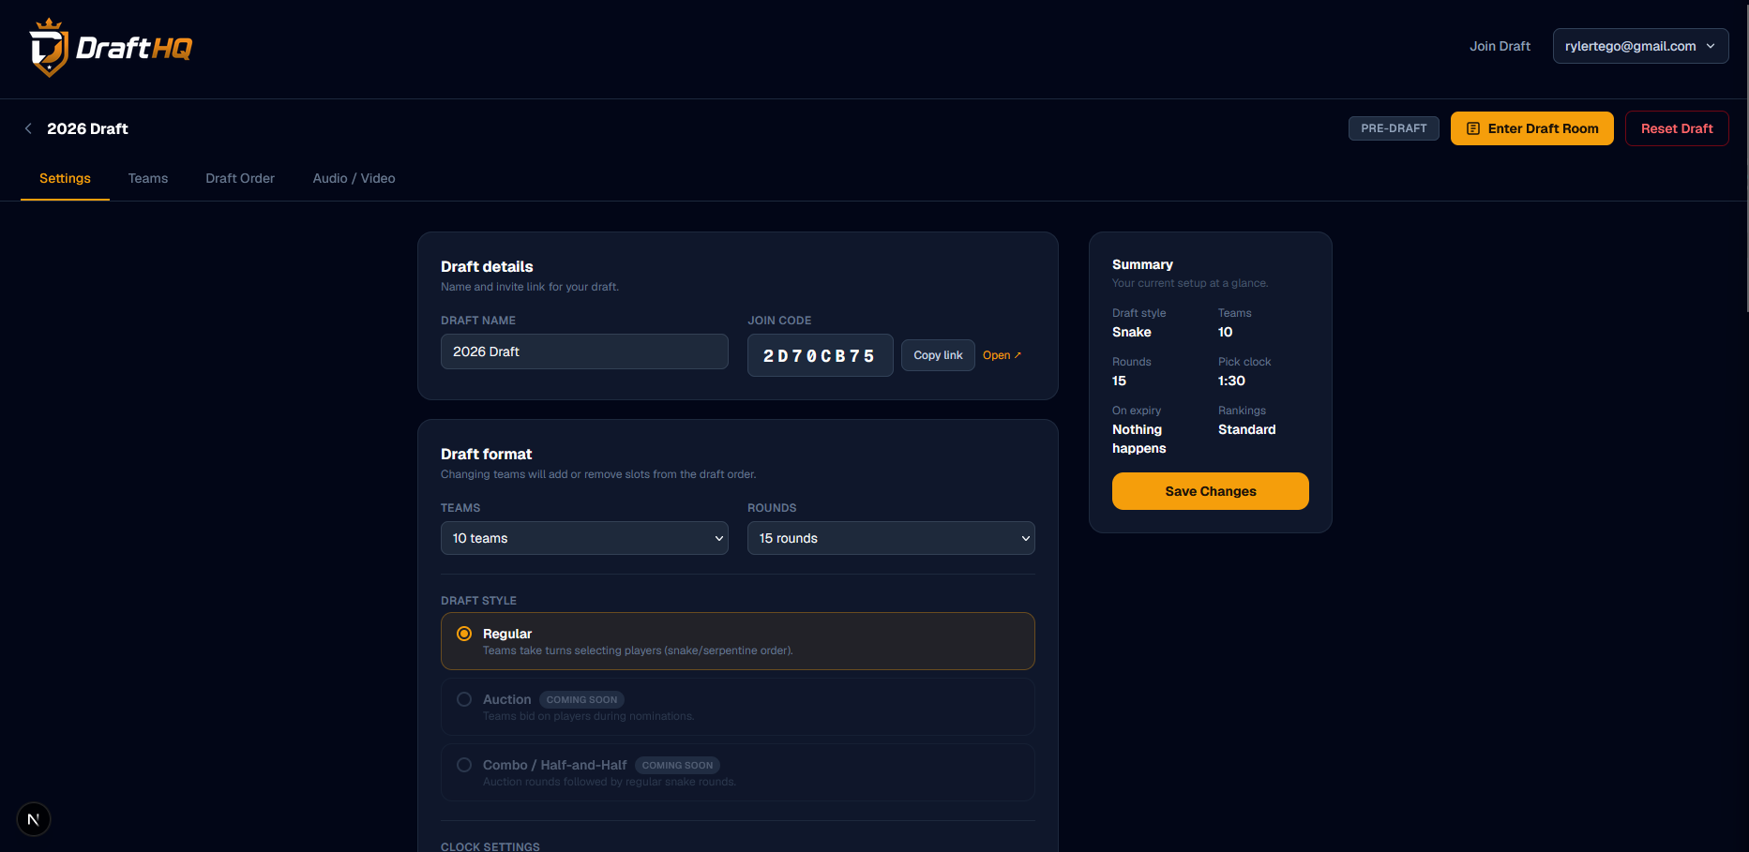
PRODUCT 4 OF 7
Current state: draft setup
One control surface
Timer behavior, scoring, schedule, roster positions, team profiles, invitations, and draft order live together.
Stabilization focus
Move every setup write behind atomic, commissioner-authorized database operations.
07

Slide 8
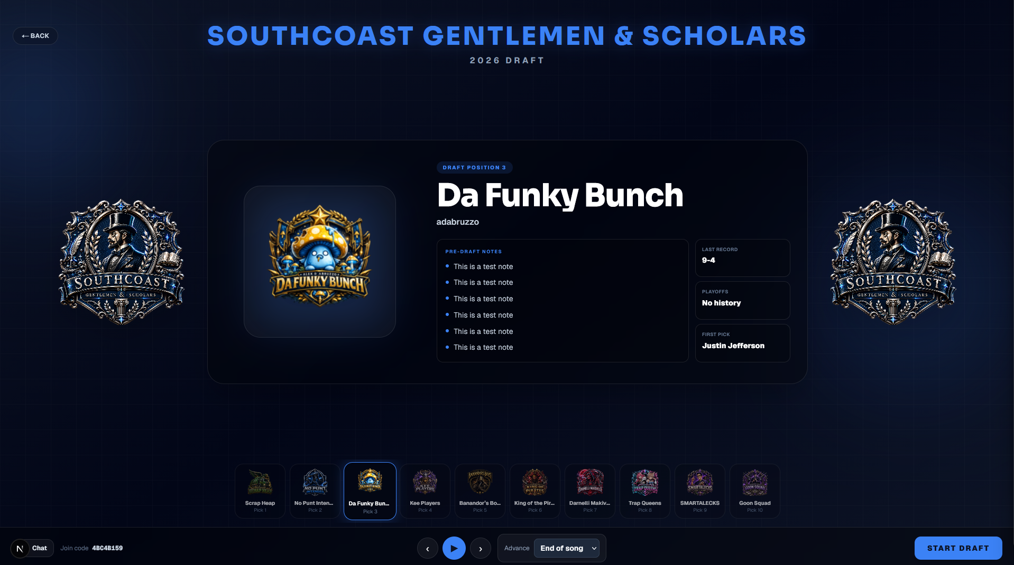
PRODUCT 5 OF 7
Current state: pre-draft lobby
A calmer start
Presence, team ownership, countdown, and realtime chat give commissioners confidence before the first pick.
REALTIME
08

Slide 9
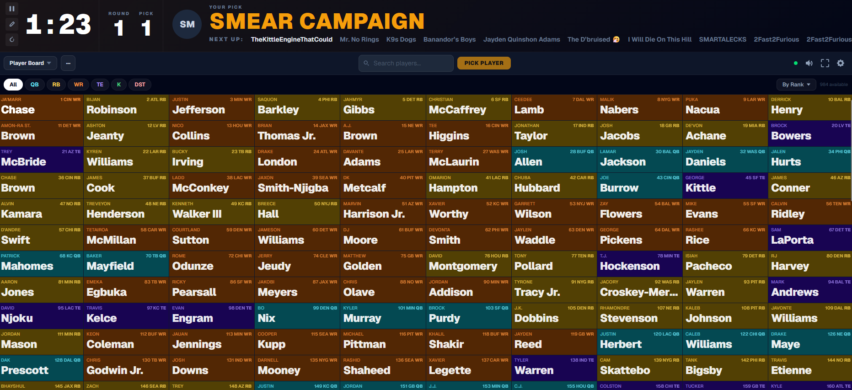
PRODUCT 6 OF 7
Current state: live draft room
The core product
Atomic picks, wrong-owner protection, synchronized timer, pause/resume, undo, commissioner recovery, and reconnect reconciliation.
MULTIPLAYER
09

Slide 10
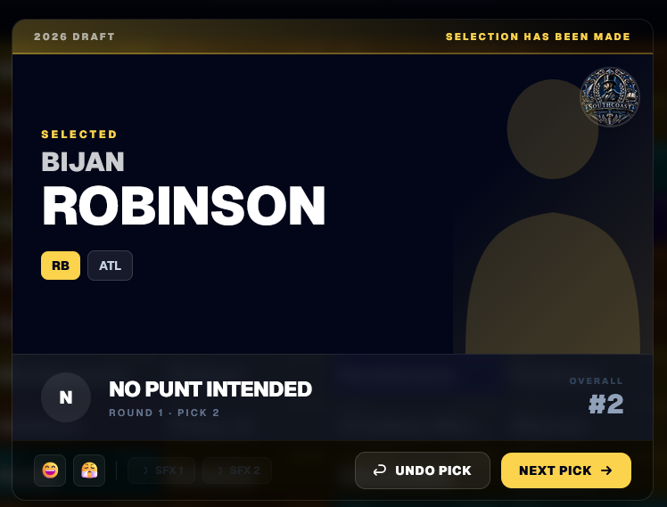
PRODUCT 7 OF 7
Current state: pick reveal
Every pick gets a shared moment
01
Announce the selection
02
Show the player and team
03
Move everyone to the next clock
A polished reveal turns database state into draft-night theater.
10

Slide 11
CAPABILITY MAP
What has shipped so far
Multiplayer core
Ownership
Commissioner
League platform
Realtime room updates
Invite and join flows
All-team visibility
Dashboard + workspaces
Atomic picks
Persistent league members
Participant recovery
Seasons and draft creation
Reconnect recovery
Franchise team owners
Edit a pick
League branding
Synchronized timer
Auto-assigned draft slots
Reset and clock controls
Chat and lobby
Pause / resume / undo
Owner profile controls
Team and league settings
Sleeper + provider previews
The important part: this is no longer a static draft board. It is a connected, role-aware league workflow.
11

Slide 12
READINESS
A lot works—and the next job is trust
PASS
153 / 153
0
NEXT
Production build
Focused unit tests
TypeScript errors
End-to-end hardening
The product has moved faster than its verification layer.
The right next move is a stabilization sprint: atomic setup operations, secured elevated routes, green lint, and realistic multiplayer regression coverage.
BUILD CONFIDENCE BEFORE MORE SURFACE AREA
12

Slide 13
ROADMAP
Planned sequence from here
NOW
NEXT
THEN
LATER
Stabilize
Finish release core
League continuity
Advanced experience
• Setup correctness
• Security + lint
• DB / E2E gates
• Ownership edge cases
• Timer confidence
• Real-device mobile
• Season archive
• Member archive
• League history
• Rankings polish
• Landmine mode
• Walk-up songs
Guiding rule
Reliable multiplayer first. Every new feature earns its place by making draft night—or the league around it—meaningfully better.
13

Slide 14
THE CONVERSATION
DraftHQ is becoming the place a league runs—not only the screen it drafts on.
What would make you trust this on your own draft night?
• Which screen feels most valuable?
• What would you need before inviting your league?
• Which future feature would actually keep you coming back?
Thanks

