Slide 1
Graphs & Digraph
KC A. CACAYURAN
Instructor

Slide 2
Introduction
binary tree data structure
provides a useful way of storing data for efficient searching
All tree structures are hierarchical.
each node can only have one parent node
Trees can be used to store data which has a definite hierarchy; for example a family tree or a computer file system.

Slide 3
Graph: Definition
Some data need to have connections between items which do not fit into a hierarchy like this.
Graph data structures can be useful in these situations.
A graph consists of a number of data items, each of which is called a vertex.
Any vertex may be connected to any other, and these connections are called edges.

Slide 4
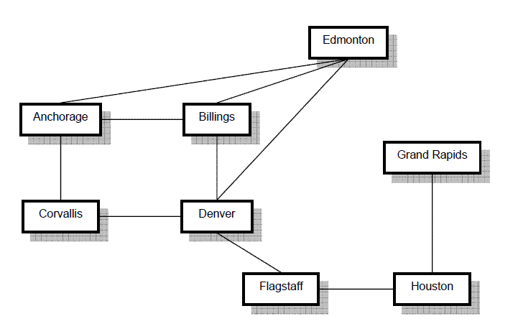
A Graph: An Illustration

Slide 5
Kinds of Graph
Undirected Graph
Directed Graph

Slide 6
Undirected Graph
An undirected graph is complete if it has as many edges as possible – in other words, if every vertex is joined to every other vertex.
For a complete graph with n vertices, the number of edges is n(n – 1)/2.
A graph with 6 vertices needs 15 edges to be complete.

Slide 7
Undirected Graph
Two vertices in a graph are adjacent if they form an edge.
For example, Anchorage and Corvallis are adjacent, while Anchorage and Denver are not. (refer to the figure)
Adjacent vertices are called neighbors.

Slide 8
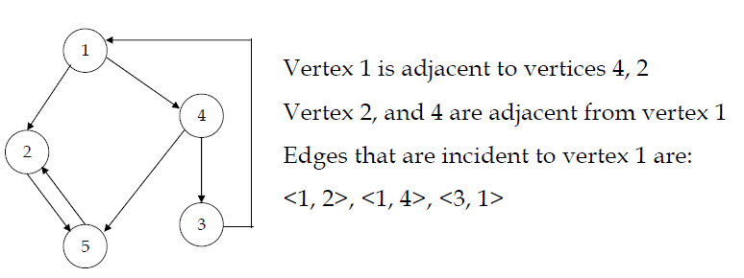
Adjacent and Incidents

Slide 9
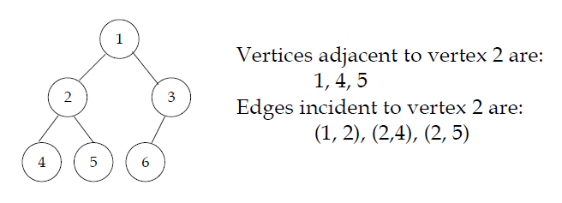
Adjacent and Incidents

Slide 10
Terms and Terminologies
A path is a sequence of vertices in which each successive pair is an edge.
For example: Anchorage-Billings-Denver-Edmonton-Anchorage (refer to figure)
A cycle is a path in which the first and last vertices are the same and there are no repeated edges.
For example: Anchorage-Billings-Denver-Flagstaff (refer to figure)

Slide 11
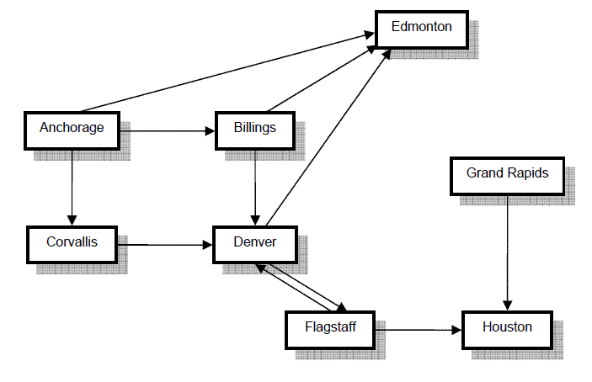
Directed Graph
each edge is an ordered pair of vertices – it has a direction defined

Slide 12
Concepts
A path in a directed graph must follow the direction of the arrows.
The following is a path in this graph:
Billings-Denver-Flagstaff
while the following is not, because there is no edge from Denver to Billings:
Flagstaff-Billings-Denver

Slide 13
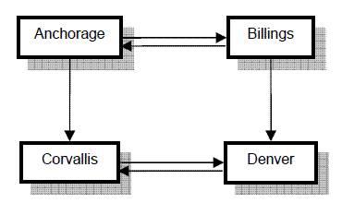
Concepts
A directed graph is connected if, for any pair of vertices, there is a path between them.
The following example graph is not connected – can you see why? What single edge could you change to make it connected?

Slide 14
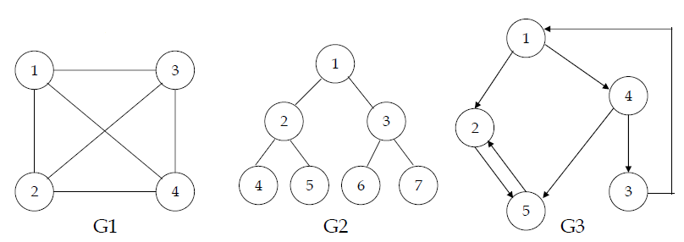
Graph Examples

Slide 15
Traversing a Graph
Traversal is the facility to move through a structure visiting each of the vertices once.
We looked previously at the ways in which a binary tree can be traversed.
Two possible traversal methods for a graph are breadth-first and depth-first.

Slide 16
Breadth-First Traversal
This method visits all the vertices, beginning with a specified start vertex.
It can be described roughly as “neighbors-first”.
No vertex is visited more than once, and vertices are only visited if they can be reached – that is, if there is a path from the start vertex.

Slide 17
Breadth-First Traversal
Breadth-first traversal makes use of a queue data structure.
The queue holds a list of vertices which have not been visited yet but which should be visited soon.
Since a queue is a first-in first-out structure, vertices are visited in the order in which they are added to the queue.

Slide 18
Breadth-First Traversal
Visiting a vertex involves, for example, outputting the data stored in that vertex, and also adding its neighbors to the queue.
Neighbors are not added to the queue if they are already in the queue, or have already been visited.

Slide 19
Depth-First Traversal
A depth-first traversal works in a similar way, except that the neighbors of each visited vertex are added to a stack data structure.
Vertices are visited in the order in which they are popped from the stack, i.e. last-in, first-out.

Slide 20
Graph Implementation
Internal representation:
Vertices are stored as keys in a Map structure – this means a vertex can be quickly looked up. This Map is known as the adjacency map.
Edges starting from each vertex are stored as a List of the adjacent vertices. This List is stored as the value associated with the appropriate key in the Map.

Slide 21
Internal Representation
For example, the representation of the graph used in the example would consist of a Map with the following entry representing Anchorage:
Key: “Anchorage”
Value: [“Billings”, “Corvallis”, “Edmonton”]

Slide 22
Networks
Sometimes the edges in a graph have numbers, or weights, associated with them.
Weights in the example below could be based on, for example, costs of flights, or on WAN bandwidth.
A graph like this is called a weighted graph, or a network.

Slide 23
Dijkstra’s Algorithm
similar to the breadth first traversal, except that it uses a special kind of queue data structure called a priority queue.
In the priority queue, items are removed in order of value rather than in order of being added to the queue.
When the target vertex is removed from the priority queue, the shortest path has been found.

Slide 24
Digraphs
A directed graph or (digraph) is a set of vertices and collection of directed edges that each connects an ordered pair of vertices. We say that a directed edge points from the first vertex in the pair and points to the second vertex in the pair. We use the name 0 through V-1 for the vertices in a V-vertex graph.

Slide 25
Example of Digraphs
0
6
7
8
1
2
9
10
3
4
5
11
12

Slide 26
Digraphs
Here are some definitions that we use.
Self-loop is an edge that connects a vertex to itself
Two edges are parallel if they connect the same ordered pair of vertices
The outdegree of a vertex is the number of edge pointing from it. The indegree of a vertex is the number of edges pointing to it.

Slide 27
Digraphs
A subgraph is a subset of a diagraph’s edges (and associated vertices) that constitute a diagraph.
A directed path in a diagraph is a sequence of vertices in which there is a (directed) edge pointing from each vertex in the sequence to its successor in the sequence. A simple cycle is a cycle with no repeated edges or vertices (except the requisite repetition of the first and last vertices)
A directed cycle is a directed path (with at least one edge) whose first and last vertices are the same. A simple cycle is a cycle with no repeated edges or vertices ( except the requisite repetition of the first and last vertices.)

Slide 28
End of Lecture: Graph and Digraphs

