Slide 1
Pump Training

Slide 2
Overview
Check seals

Slide 3
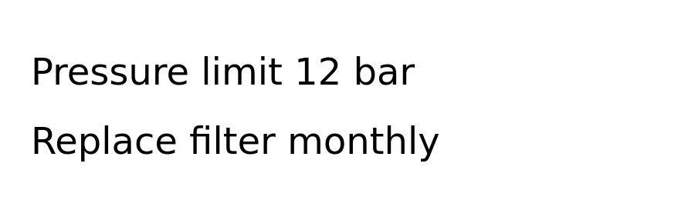
Label
Label

