Slide 1

CONTACTLESS PAYMENTS ON STELLAR
Noir Wallet
Tap. Pay. Done.
A wallet you never open. Payments that just happen. Tap any RFID sticker, NFC card, or wearable to pay instantly — no app, no unlock, no confirmation.
TAP · PAY · DONE
Presented by: Richie Christian De Guzman
Noir Wallet

Slide 2
Paying Is Still Full of Friction
Contactless was supposed to be instant. In reality, every payment still demands attention — unlock the phone, open the app, authenticate, confirm. Crypto is even harder to spend: you need a cold wallet or a phone app just to pay for anything. Behind it all, merchants surrender percentage fees to card rails and wait days for settlement — and high-throughput venues can't afford either.
10–30s
2–3%
T+2
Per Checkout Interaction
Card Rail Fees
Days to Settle
Unlock, open, authenticate,
confirm — every single time
What merchants surrender
on every sale
Before merchants actually
see their money
The principle: crypto gets adopted when people can use it daily. Remove the friction from everyday purchases, and spending crypto becomes as natural as tapping a card — that's what turns holders into users.
Noir Wallet

Slide 3
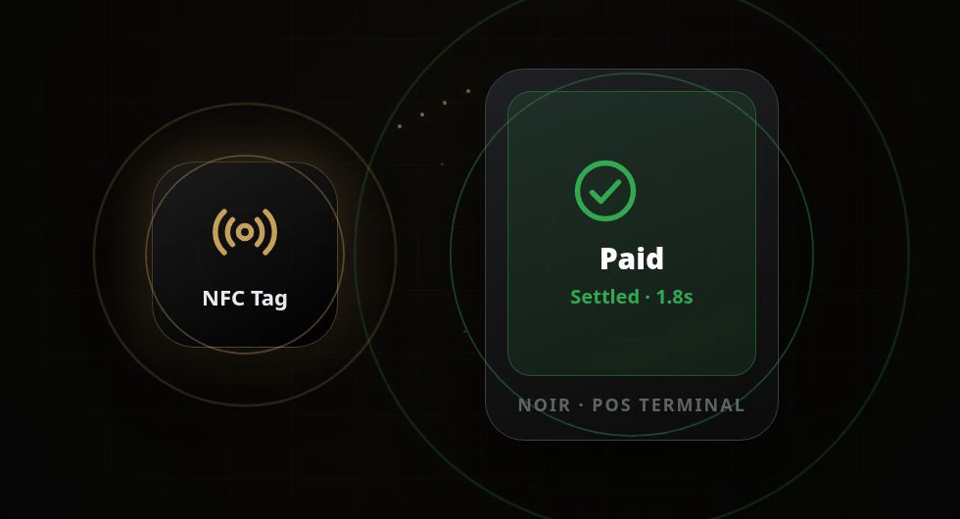
Checkout Should Never Be
the Bottleneck
What Traditional Payments
Demand
Unlock your phone and open an app for every purchase
Confirm each transaction on-device
2–3% fees on closed card networks
Multi-day settlement before funds arrive
Speed should not cost you custody. Even “tap to pay” cards ride closed networks with percentage fees and day-long settlement.
Noir Wallet

Slide 4
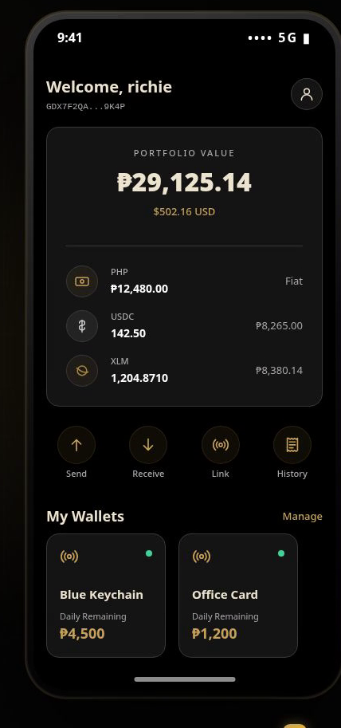
OUR SOLUTION
Introducing Noir Wallet
Zero interaction. Instant settlement.
Tap-First Identity
Any RFID sticker, NFC card, or wearable links to your Stellar wallet — the tag is the login
x402 Protocol
Debited the moment your tag touches the terminal — no unlock, no app, no confirmation
x402 Agents
Each device gets its own funded agent wallet with a daily limit — your main funds stay untouched
Soroban Registry
The device_registry smart contract maps hardware to wallets on-chain — auditable and revocable

Slide 5
Why Stellar?
Stellar provides everything needed for pay-by-tap at machine speed and near-zero cost.
Near-Zero Fees
Fast Finality
Soroban Contracts
~$0.00001 per operation — viable for ₱20 canteen meals
3–5 second confirmations — faster than a receipt prints
WASM smart contracts for the on-chain device registry
Fee Channels
Real Assets
PDAX Fiat Bridge
Sponsored transactions absorb costs — users never buy XLM first
XLM, USDC, and issuer assets — spend and settle in stable value
Licensed PHP on/off-ramp — merchants cash out in pesos
Architecture Principle
Only hashed device references and payment operations go on-chain. The terminal reads a tag UID, Soroban resolves the linked wallet, and Stellar settles the transfer — with PDAX converting to PHP for merchants who want pesos, not crypto.
~$0.00001
< 2s
Per transaction
Tap to “Paid”
Noir Wallet

Slide 6
How It Works
One tap sets off the whole pipeline — the user never sees any of it.
1 · Tap Terminal reads the tag UID over NFC/RFID
2 · Hash & Resolve UID is SHA-256 hashed; device_registry resolves the wallet
3 · Debit the Agent The device's x402 agent wallet signs within its daily limit
4 · Settle & Cash Out Stellar finalizes in 3–5s; PDAX bridges to PHP
The gateway returns 202 Accepted instantly and settles asynchronously — under two seconds from tap to “Paid” — with an offline queue that batches transactions when the network drops.
Noir Wallet

Slide 7
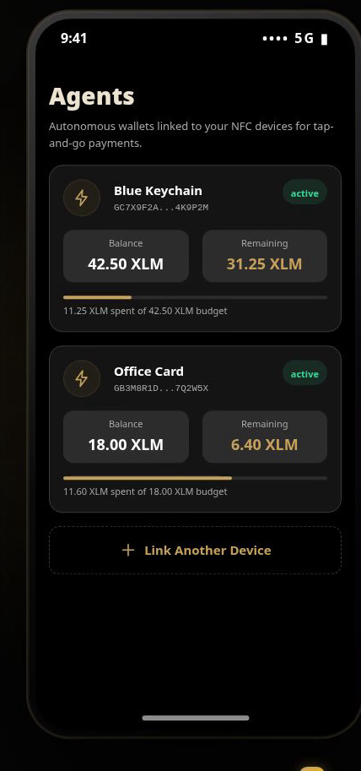
System Architecture
Three Core Layers
device_registry · Soroban
Hardware-to-wallet mapping with terminal whitelisting and per-device replay protection on-chain
Payment Gateway · Rust + actix-web
Async payment queue, fee channels, daily-limit enforcement, and idempotent transaction records in PostgreSQL
PDAX Fiat Bridge
Licensed Philippine exchange integration — auto-liquidation webhooks convert merchant USDC to PHP
Only SHA-256 device hashes touch the chain. Raw card UIDs never leave the terminal, and no custodial server ever holds user funds.
Noir Wallet

Slide 8
Security-First Design
✓
Hashed Device Identity
Tag UIDs are SHA-256 hashed at the terminal — the raw UID is never stored or transmitted
✓
Terminal Authentication
Only whitelisted POS terminals can initiate payments, via API keys and signed challenges
🔒
✓
Replay Protection
Every tap carries a signed nonce; 500ms anti-double-tap rate limiting per device
Blast-Radius Limits
DEFENSE IN DEPTH
✓
Per-device daily limits and isolated x402 agent wallets — a lost tag never exposes main funds
✓
Encrypted Key Custody
Fee-channel and agent keys sealed with envelope encryption (KMS-backed KeyManager)
Noir Wallet

Slide 9
Market Opportunity & Competitive Advantage
Target Venues
How We Compare
Transit
Campus Canteens
Feature | EMV Tap | Apple Pay | Noir Wallet
No phone unlock needed | ✓ | — | ✓
Self-custody of funds | — | — | ✓
Sub-cent transaction fees | — | — | ✓
Settlement in seconds | — | — | ✓
Stickers & wearables | — | — | ✓
Per-device spend limits | — | — | ✓
Open smart contracts | — | — | ✓
Turnstile-speed fares,
no queue pileups
Lunch-rush throughput
with student ID stickers
Event Gates
Retail Checkout
Wristband entry
and cashless concessions
Sub-cent fees instead
of 2–3% card rails
₱100B+ QR/contactless volume in PH alone. Every cashless venue that hates checkout queues is a Noir venue.
Noir Wallet

Slide 10
Business Model & Roadmap
Revenue Streams
Roadmap
Merchant Transaction Fees
Q3 2026
A fraction of card-rail pricing — volume over margin
PDAX production integration, terminal authentication, mainnet pilot with first venues
Device & Tag Sales
Q4 2026
Branded NFC cards, stickers, and wearables for venues
Offline queue + batch settlement, merchant dashboard, spending analytics
PDAX Conversion Spread
2027
Small margin on automated USDC → PHP liquidation
Transit & campus partnerships, wearable product line, multi-asset auto-conversion
Enterprise & Developer APIs
Future
White-label tap-to-pay for transit operators and campuses
Cross-chain agents, x402 ecosystem APIs, machine-to-machine payments
Noir Wallet

Slide 11
Tap the future.
Zero-interaction payments, settled on Stellar in under two seconds.
x402 Protocol
Soroban
Stellar
PDAX Bridge
Noir Wallet · Tap. Pay. Done.
Noir Wallet

