Slide 1

Information and Communication Technologies (TIC) and Related Technologies :
Made by : Benaissa Rym
Team :
Salhine rachid
Nadji Ines
Abed Bouchra
Delhoum Lyna
Section : C
Groupe : 85

Slide 2
TABLE OF CONTENTS :
Information and Communication Technologies :
01
04
Integration of TIC in Business
02
Key Components of TIC
05
Future Trends and Innovations
03
06
Conclusion
Technologies Related to TIC

Slide 3

Information and Communication Technologies :

Slide 4
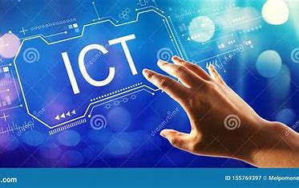
Information and Communication Technologies (ICT) encompass the use of technology for gathering, storing, processing, and transmitting information through electronic devices like computers, smartphones, networks, and internet applications. ICT's evolution from basic computing to today's interconnected digital landscape was marked by key milestones such as personal computers, widespread internet usage, networking technologies, and mobile devices, revolutionizing communication and societal operations. ICT's profound impact on society spans education, healthcare, governance, and societal interactions by revolutionizing learning methods, enhancing healthcare delivery through remote monitoring and telemedicine, promoting transparent and responsive governance, and connecting people globally, reshaping traditional structures, and empowering individuals and communities across various facets of daily life.

Slide 5

2. Key Components of TIC :

Slide 6
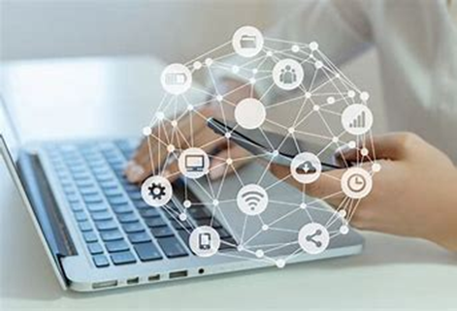
2.1 Hardware and software : Hardware and software are foundational in Information and Communication Technologies (ICT), shaping the digital landscape. Hardware, including servers and computers, is vital for data processing and communication, directly impacting ICT efficiency. Meanwhile, software, like operating systems, manages resources, enabling specific functions. This symbiotic relationship drives advancements and innovation within ICT, mirroring an engine powering dynamic functionalities and influencing societal sectors. 2.2 Network architecture : Network architecture in Information and Communication Technologies (ICT) facilitates seamless connectivity, supporting an intricate network of devices and users. Using standardized protocols, ICT networks enable smooth information exchange globally while ensuring security with measures like encryption. Integrating technologies from industry leaders and collaborative tools enriches this ecosystem, shaping digital connectivity across the expanding technological landscape.

Slide 7
2.3 Cloud computing : Cloud computing transforms ICT infrastructure by revolutionizing resource management and delivery of computing services over the internet. Its scalability allows flexible resource adjustments, optimizing efficiency and accessibility, enabling remote access and collaboration. The inherent flexibility empowers adaptation to changing needs, freeing organizations from traditional constraints. This pivotal technology fosters innovation and agility within modern ICT infrastructure. 2.4 Cybersecurity and Privacy : In the dynamic ICT landscape, cybersecurity and privacy are top concerns due to the interconnected systems facing diverse cyber threats. Constantly evolving risks demand advanced security measures like encryption and multi-factor authentication, while stringent data protection regulations tackle privacy concerns. Cloud computing adds complexity, necessitating robust security for cloud-stored data. A comprehensive approach includes collaboration, education, and leveraging artificial intelligence for threat detection in ensuring cybersecurity and privacy within ICT frameworks.

Slide 8
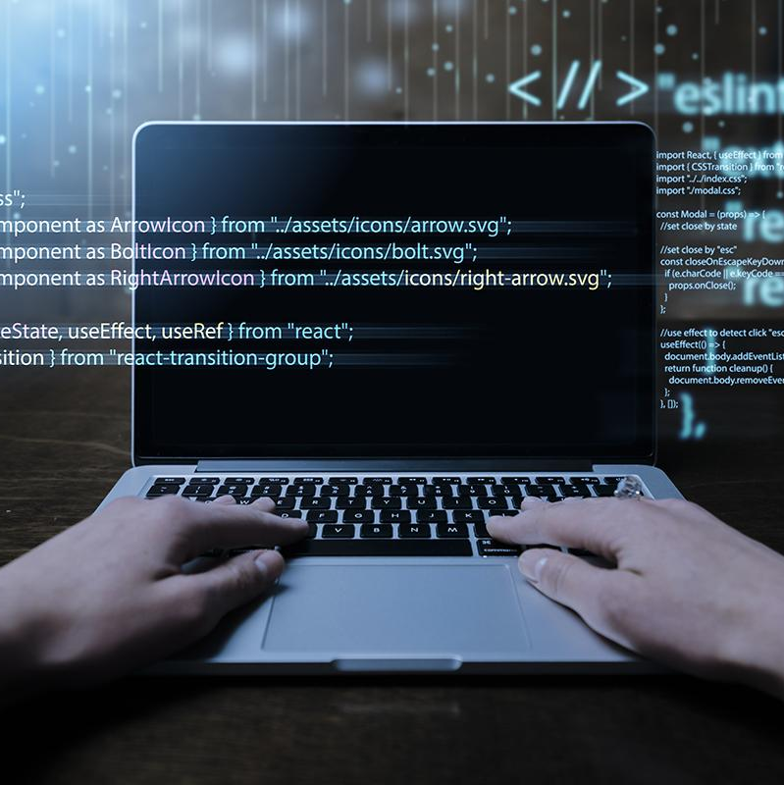
3. Technologies Related to TIC :

Slide 9
Technologies Related to TIC :
Google services :
Microsoft tools :
Git and GitHub :
01
02
03
Gmail
Google Drive
Google Workspace
Microsoft 365
Microsoft Azure
Version Control with Git
Collaboration with GitHub

Slide 10

4. Integration of TIC in Business

Slide 11
4.1 Digital Transformation Businesses harness Information and Communication Technologies (ICT) to drive digital transformation, reshaping operations and promoting innovation. ICT provides tools that streamline processes, enhance connectivity, and offer real-time insights, powered by cloud computing, data analytics, and artificial intelligence. Collaboration tools foster seamless connectivity, encouraging innovation across teams globally. Leveraging ICT automates tasks, optimizes workflows, and enhances customer experiences, securing a competitive edge in evolving markets. This strategic ICT adoption not only boosts efficiency but also enables adaptability, fostering sustained growth and innovation in the dynamic business landscape. 4.2 E-Government and E-Services : Information and Communication Technologies (ICT) drive public administration modernization globally. Governments utilize ICT to streamline processes, boost transparency, and establish efficient digital infrastructures. Digital platforms enable online access to government services, reducing paperwork and wait times. ICT enables e-governance initiatives like online tax filing and digital communication with agencies. Additionally, ICT-driven data analytics supports evidence-based policymaking and resource optimization, enhancing citizen experiences and tailoring services to modern digital society's evolving needs. 4.3 Impact on Various Sectors : Information and Communication Technologies (ICT) drive transformative changes in finance, healthcare, and education. ICT modernizes banking with online services and innovative fintech solutions in finance. Healthcare benefits from electronic records, telemedicine, and health apps, improving patient care and access. In education, ICT revolutionizes learning with online platforms, virtual classrooms, and personalized tools, enhancing educational effectiveness. Overall, ICT's pivotal role in these sectors enhances efficiency, innovation, and service delivery.

Slide 12

5. Future Trends and Innovations :

Slide 13
5.1 Artificial Intelligence and Machine Learning : Artificial Intelligence (AI) and Machine Learning (ML) are reshaping the future of Information and Communication Technologies (ICT). Their integration promises to revolutionize data processing, decision-making, and automation within ICT systems. AI swiftly analyzes vast datasets, predicting trends and extracting insights, leading to efficient, self-optimizing systems in ICT. ML allows systems to learn and adapt, offering personalized experiences and real-time problem-solving, reducing human intervention. The advancement and integration of AI and ML in ICT herald a future of smart, adaptive, and data-driven systems, shaping digital communication and information management. 5.2 Internet of Things (IoT) : The Internet of Things (IoT) expands Information and Communication Technologies (ICT), creating a more interconnected digital ecosystem. IoT involves internet-connected sensors and devices, enhancing information flow across various domains. Industries benefit from smart processes and real-time monitoring, while healthcare sees improved patient care via remote monitoring. Smart cities optimize services, and smart homes offer automation. Despite data security concerns, IoT's impact on ICT is undeniable, revolutionizing daily life, work, and communication in an interconnected and intelligent digital landscape. 5.3 Blockchain Technology : Blockchain technology holds significant potential in Information and Communication Technologies (ICT), particularly in enhancing data security and transparency. Its decentralized and immutable nature makes it robust for securing sensitive information, revolutionizing data storage and transmission. Blockchain ensures data integrity and verifiability, employing smart contracts to automate and secure processes. Its distributed ledger minimizes single-point failures, enhancing resilience against cyber threats. Blockchain's transparency fosters trust by allowing users to track data origins and modifications. As ICT advances, integrating blockchain promises a more secure, transparent, and resilient digital infrastructure.

Slide 14
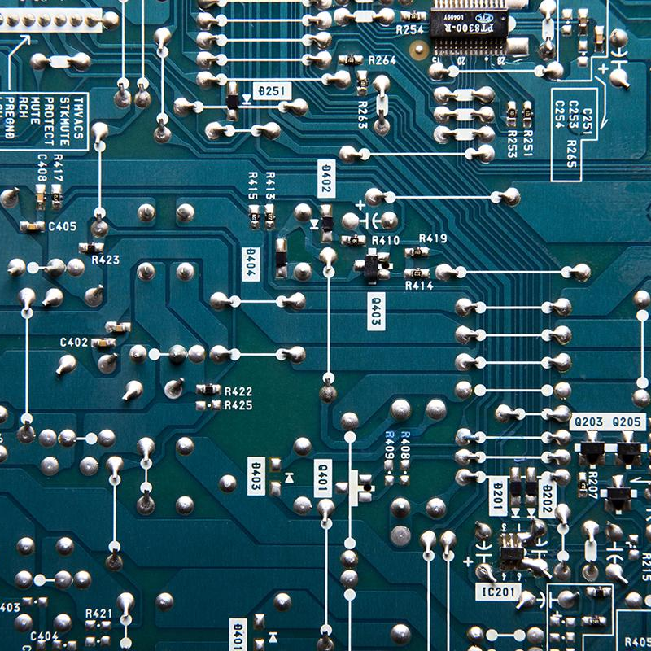
6. Conclusion : Absolutely! Information and Communication Technologies (ICT) and associated technologies drive transformative changes in communication and information processing. ICT breaks barriers, fostering global connectivity and real-time collaboration through platforms like GitHub and cloud services. Advanced analytics, machine learning, and IoT elevate information processing, creating a networked ecosystem. ICT isn't just a tool; it catalyzes progress, reshaping communication and enabling innovative collaboration. The future envisions a TIC-driven world with instant communication, borderless collaboration, and intelligent, interconnected information processing, paving the way for limitless innovation.

