Slide 1
Standardizing Hybrid Automata: From Theoretical Foundations to Real-World Implementation Frameworks

Slide 2
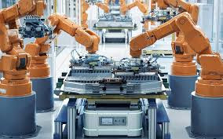
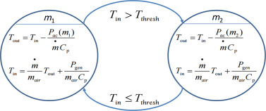
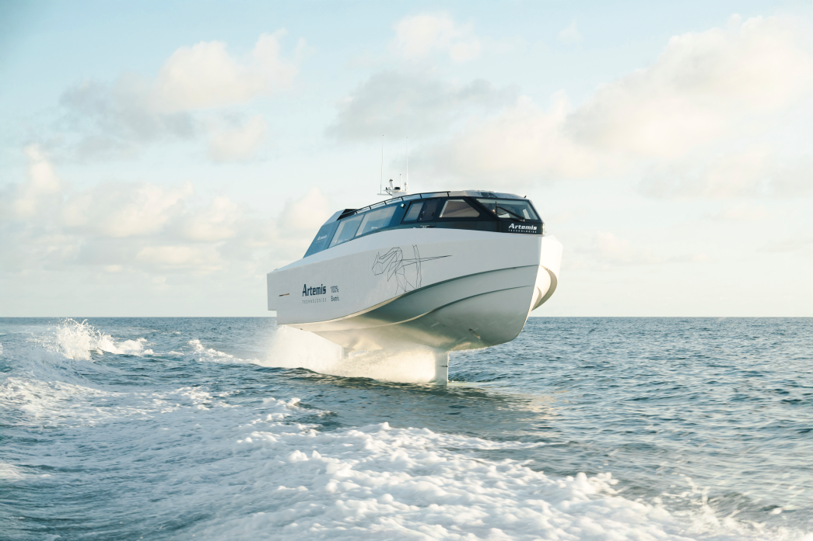
What Are Hybrid Automata?
Hybrid Automata Image: https://www.sciencedirect.com/topics/computer-science/hybrid-automaton
Robot Arm Image: https://www.lgt.com/li-en/market-assessments/insights/investment-strategies/the-transformative-force-of-industrial-automation-251896
Artemis EF12: https://www.artemistechnologies.co.uk/
Formal Models for dynamical systems that combine discrete modes with continuous dynamics
Extends the Functionality of the common Finite State Machine allowing us to solve real world physical problems with discrete control modes of operations which are transitioned by defined conditions
Widely used within research and industry with 100s of papers every single year being produced on it with conferences like HSCC (Hybrid Systems: Computation and Control dedicated to it.
for defining high level control of industrial robotics, autonomous navigation and embedded systems control.
It provides a model for modelling complex behaviours in a interpretable way as an alternative to commonly used AI deep learning methods which are essentially black boxeswhich are hard to regulate because of potentatial of emergent undefined dangerous bbehaviours occurring.

Slide 3
Why do we care about Hybrid Automata?

Slide 4
Current bottlenecks in the industry and research
Although tools exist for reachability analysis of defined automtaton, these are quite difficult to use most of the time and don’t always have very good documentation,
Therefore we discusss the importance of creating a unified framework .

Slide 5
Work
Hybrid automaton framework in python, and a automaton modelling language that developers can use to convert there theoretical definitions of automaton into real world usable and testable applications.

Slide 6
Conclusions

Slide 7
References
j

