Slide 1

FORD MOTOR COMPANY RESEARCH PROJECT
Business Intelligence and Data Analytics Capstone – Option 1
Ryan Meyers
Colorado State University Global
MIS581: Capstone – Business Intelligence and Data Analytics
Dr. Justin Bateh
December 5, 2021
Notes:
Hello my name is Ryan Meyers and this presentation will cover the research project completed on the automobile industry. The background on the Ford Motor Company will be covered, in addition to, the research conducted, the findings, and the recommendations to Ford on the utilization of the analysis.

Slide 2

Objectives of the research
Identify Trends in the Automobile Industry
Present and Future State of the Industry – Gas Mileage Ratings and Vehicle Types
Comparisons of Ford Motor Company and the Industry
Areas of Future Growth
New Technologies and Trend Analysis
Provide Models and Analysis for a Competitive Advantage
4 key objectives to improve productivity and customer experience. Call Centre Helper. (2021). Retrieved December 1, 2021, from https://www.callcentrehelper.com/customer-service-objectives-157605.htm.
Notes:
The main objective of the research project is to identify trends in the automobile industry. The automobile industry is a constantly changing environment where the change in market demand is produced both by the consumer and by government regulatory actions. The products offered in this market must adapt to the changing environment in a robust manner that can be difficult for some companies to reliably maintain in their manufacturing ecosystem. The researcher will focus on two areas of the consistent change in the industry which is the gas mileage ratings of vehicles and the production shares of common vehicle types. The dataset used in the study will present an overview of the trends in the industry and these trends will be compared to Ford Motor Company’s current product offerings.
The research project will also explore the trends in new technologies such as electric and hybrid cars. The analysis will also provide details on the impact that different technologies such as drivetrains and engine types have the observed response variable of gas mileage ratings.
The deliverable for the research project is to generate descriptive and predictive analytics that can be used by Ford Motor Company to create a competitive advantage. The changing market will require a robust model for predicting the future trends in the industry to maintain competitively viable products. The research models will provide a framework and understanding of the possibilities of data analysis using common data in the automobile industry.

Slide 3
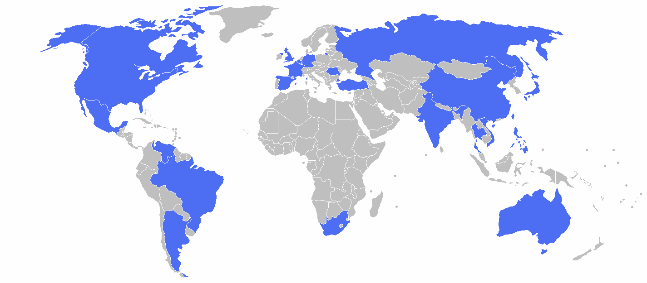
Ford motor company background
Founded in 1903 and headquartered in Dearborn, Michigan (“Ford Motor Company Incorporated”, 2009)
125 Locations and 186,000 Employees Globally (88,000 U.S. Employees)
Largest U.S. Based Automobile Manufacturer
4th Largest Automobile Manufacturer in the World
$127.1 Billion Annual Revenue in 2021 (“Ford Motor: 2021 Fortune 500”, 2021)
Product Offerings
Ford, Lincoln, and Troller
Notes:
Ford Motor Company was founded in the year 1903 and is currently headquartered in Dearborn Michigan. The company has seen an expansion from the meek beginnings in the Michigan automaker plants expanding to over 125 locations globally. The outreach of the organization has been due to many technological improvements in the manufacturing industry such as the creation of the first moving assembly line and popular vehicles for the middle class such as the Model T. Ford now employs around 186,000 employees globally with 88,000 of those workers being in the United States. This footprint awards Ford Motor Company with being titled the largest U.S. based automobile manufacturer and the 4th largest automobile manufacturer in the world. These statistics makes Ford a prime selection for the research project that has been conducted in this presentation and the research report.
Ford’s annual revenues in 2021 reach $127.1 billion which marks the company on the Fortune 500 list of organizations. The company offers automobiles now under the titles of Ford, Lincoln, and Troller with offerings including trucks, sedans, etc. Ford also has a financial division for financing and loans.

Slide 4

Dataset description
Environmental Protection Agency (EPA) Trends Database
Data from 1975 to Current Completed Year (2020)
Variables
Model Year, Vehicle Type, Production Share, Real-World MPG, CO2 Emissions, etc.
Supplementary Datasets
Department of Energy Sources
Top Vehicle Manufacturers
The Global Electric Car Market
U.S. Environmental Protection Agency (EPA). U.S. Agency for International Development. (2020, April 28). Retrieved December 2, 2021, from https://www.usaid.gov/node/175451.
Notes:
The Environmental Protection Agency (EPA) is one of the largest regulatory bodies in the United States. The agency is responsible for monitoring the effects that organizations and factors have the environment as a whole which ties closely to automobile manufacturers. Automobiles are a large portion of the environmental effects such as C02 and greenhouse emissions in the United States. This is one of reasons that the EPA has been collecting and storing regulatory data in, what the agency titled, “The Automobile Trends Database”. The database contains various information on automobiles from the year 1975 to the current completed year which is 2020 for the time this research was conducted.
The dataset contains multiple variables such as model year, vehicle type, and environmental variables such as C02 emissions. The prime objective of this report wants to analysis which of these variables in the dataset have the largest (or any) impact on the real-world miles per gallon variable on automobiles. This dataset was stored on the EPA website in a comma separated values (csv) file with different variables optionally added to the exported dataset.
The supplementary datasets are not used for the predictive model building of the analysis but rather used for the descriptive statistical understanding of the industry and the possible future trends. These dataset are supplied by the Department of Energy and stored on the Knoema.com website. This analysis will be supplemental to the main objective and research hypothesis analysis.

Slide 5
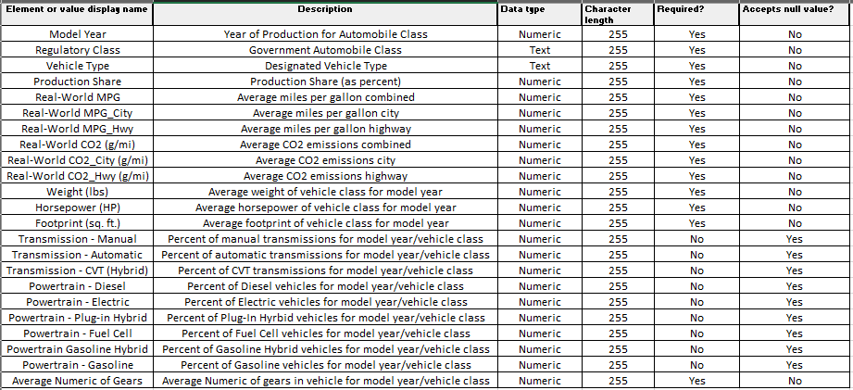
Data dictionary
Notes:
The visual representation of the dataset is displayed in the data dictionary. This table highlights the different variables found within the EPA dataset and the possible variables that could impact the outcome of Real-World miles per gallon. The metadata on the variables also provides inputs to how these data points are handled in the analysis and provide insights into how the data should be treated if Ford Motor Company does future analysis of the dataset.

Slide 6
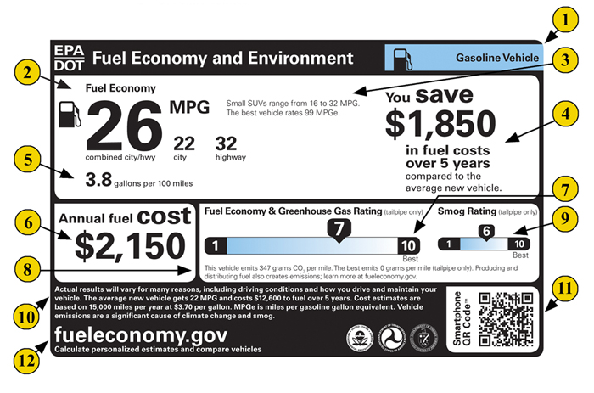
Study overview
Evaluate the Current and Future State of the Automobile Market
Environmental Health and Economic Factors
Gas Mileage Ratings
Descriptive and Predictive Statistical Modeling
Research Hypothesis
“What factors have statistically significant impacts on the real-world miles per gallon values for automobiles?”
Focus and Resource Allocation
Gasoline vehicles: learn more about the label. www.fueleconomy.gov - the official government source for fuel economy information. (2021). Retrieved December 1, 2021, from https://www.fueleconomy.gov/feg/label/learn-more-gasoline-label.shtml.
Notes:
The research study being completed has prime objectives of analyzing the current and future states of the automobile market. The automobile industry has seen changes in the market due to an increase in responses to environmental health and economic factors. Regulatory agencies such as the EPA and National Highway Traffic Safety Administration (NHTSA) have released documentation on the fuel economy and greenhouse emissions requirements for the automobile industry in recent years. This has pushed automobile manufacturers to provide vehicles that comply or risk being heavily penalized with fines. There has been a plethora of research articles that have explored the impact of these new standards such as “Vehicle efficiency and tractive work: rate of change for the past decade and accelerated progress required for U.S. fuel economy and CO2 regulations” by John Thomas in 2016 and “The Macroeconomic Effects of 2017 through 2025 Federal Fuel Economy and Greenhouse Gas Emissions Standards” by Carley et al. in 2019. The primary drivers of the this research are that regulatory agencies are requiring the market to change to meet environmental and economic issues such as C02 emission and rising gas prices.
The research study will utilize descriptive and predictive statistical modeling to assist in reaching the research objectives. The presentation will go into further detail on which models will be leveraged in the analysis but the goal of the models is to provide a holistic view of the industry in regards to the identified environmental and economic factors. The predictive models will further provide the ability to predict the future state of these factors in the industry.
The research hypothesis is stated to be “What factors have statistically significant impacts on the real-world miles per gallon values for automobiles?”. The research will leverage the EPA dataset to generate statistical models to determine these factors, if they do exist, in the data. This identification of factors will assist Ford Motor Company in focusing resources and product development to the areas of highest impact on the gas mileage ratings of their automobiles.

Slide 7

Research design
Derived Data – EPA Dataset
Testing of Null Hypotheses
Statistically Significant Relationship Between EPA Variables and Real-World MPG
Data Exploration – Python
Predictive Models – R
Multi-Linear Regression and Times Series Forecasting (ARIMA)
Hiremath, S. (2018, September 24). Statistical modelling, model fitting and bic for dummies. NephJC. Retrieved December 1, 2021, from http://www.nephjc.com/news/modelling.
Notes:
The research design of the project generates the framework that was used for the research data analysis. The data used in the research project was derived data which is defined as compiled or historical data that is used to generate new information through processes such as model development (“Data Module #1: What is research data?”, 2021). The data used in the EPA and Department of Energy uses historically aggregated data for the research analysis.
The research will focus on testing of the null hypotheses in the dataset. This hypotheses can be stated in total as “there is no statistically significant relationship between the variables in the EPA dataset and real-world miles per gallon values” with the alternate hypothesis stating that there is a statistically significant relationship. The basis of the research is that the null hypothesis will be rejected in favor of the alternate hypothesis meaning that there are variables that can be identified for impacting real-world miles per gallon.
The descriptive and data exploration of the dataset was conducted in the Python coding language. The researcher used the Jupyter notebook distribution of Python for the analysis and creation of distribution models, measures of central tendency, and the overall nature of the dataset. The Pandas, Numpy, and Matplotlib libraries were used for the analysis referencing the Python for Data Analysis by Wes McKinney book. This data exploration and models allowed for data understanding to generate the predictive models.
The predictive statistical models were built in the R programming language using the R Studio distribution. The main models used for the analysis were the Multi-Linear Regression and Time Series Forecasting model called the Auto-regressive Moving Average (ARIMA) model. These models will be the basis for determining the future values of the real-world miles per gallon values and whether to reject or approve the research null hypotheses.

Slide 8
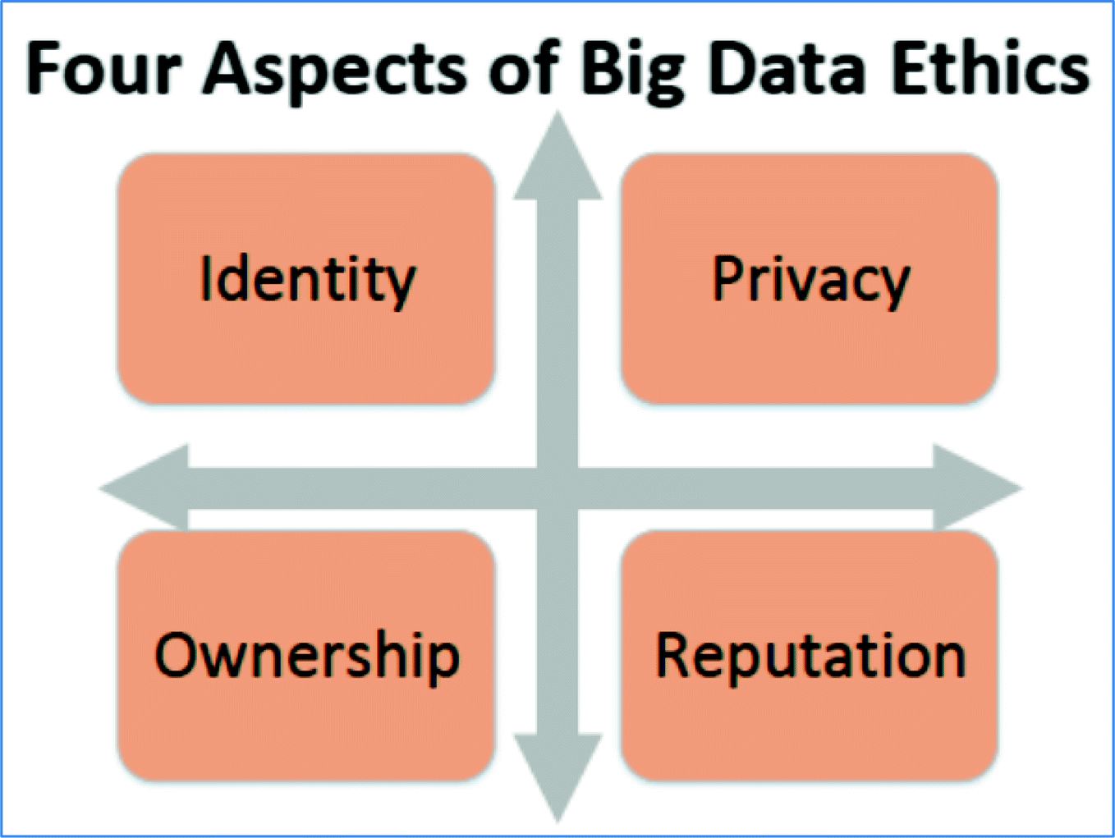
Limitations and ethical considerations
Current Available Dataset: EPA Trends Database
Publicly Available Data
Internal Data to Ford Motor Company
Four Elements of Data Ethics: Identity, Privacy, Reputation, and Ownership (Davis & Patterson, 2012)
Federal Database - Regulations
Aggregated Data
Notes:
The research limitations stem from the data available to the researcher. The primary dataset that was used was a publicly available dataset from the EPA for model creation. A more robust model could be built using Ford’s internal databases, however, the framework established in this report could be expanded if Ford decides to input their own data in a later stage. The data provided by the Department of Energy and EPA is also lacking the areas of future technologies so the models are limited in speculating future growth from the data that could be obtained in the research project.
The four elements of data ethics: Identity, Privacy, Reputation, and Ownership (Davis & Patterson, 2012) should also be mentioned in regards to the research. Data analysis can become gray in the area of data ethics with the copious amounts of data that has been and is being generated on a daily basis. This means that an organization must protect the individuals from any negative effects that could be due to the analysis of the data (O’Leary, 2016). The EPA dataset used for the analysis alleviates many concerns by being an aggregated dataset which does not link data to the individual person(s). The dataset is also a publicly available and federally regulated dataset which mitigates risks in the area of ownership and privacy. The dataset is compliant with the elements of data ethics but any future analysis should be aware of these four areas for proper handling of data analysis (Gahi et al., 2016).
The groundwork for the research project is completed and the researcher will now begin to share the data analysis conducted and the findings.

Slide 9
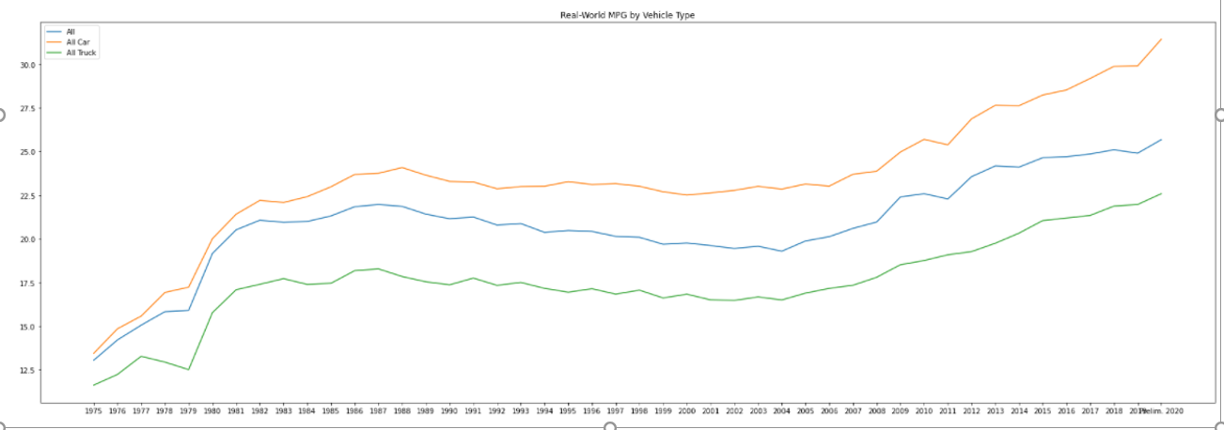
Data analysis and findings (descriptive/exploration)
Data Exploration
Trend of Real-World MPG by Vehicles
Notes:
The data exploration stages of any data analysis project are highly important for understanding the nature of the data (Kaur et al., 2018). The first area of exploration was in determining the trend of the response variable: Real-World MPG in the dataset. The graphical depiction of the values of the miles per gallon variable show that for all vehicle types the miles per gallon values are increasing over time. This highlights that in the predictive model the researcher should notice predictions that increase in comparison to the historical data and model predictors that have a positive effect on the response variable.

Slide 10
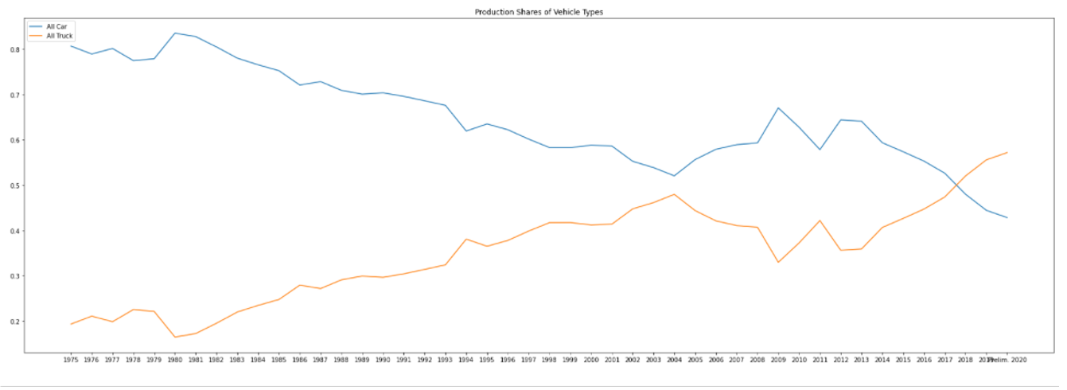
Data analysis and findings (descriptive/exploration)
Trend of Production Share of Vehicle Types
Notes:
The increase in the real-world miles per gallon values for both cars and trucks further is explored in the production shares of these vehicle types. The automobile market is constantly changing, as stated in the previous research sections, so the ability to identify which of the product offerings is most impactful in the market provides an advantage. This graphic shows that between the years 2017 and 2018 the production shares in trucks outpaces cars for the first time in historical record. This information is highly useful in assessing Ford’s product line and future focus on product development. This information will also be useful in putting the predictive models outcomes in reference to his recent change in automobiles.

Slide 11

Data analysis and findings (predictive models)
Predictive Model Building and Outputs
All Vehicle Types
Response – Real-World Miles Per Gallon
Inputs – All Numeric Variables in the EPA Dataset
Models
Multi-Linear Regression
Time-Series Forecasting (ARIMA)
Evaluation
Gains Chart and Prediction Value Comparisons
Assumptions
Normally Distributed Variables
Predictive modeling: Types of predictive modeling methods. EDUCBA. (2021, October 6). Retrieved December 1, 2021, from https://www.educba.com/predictive-modeling/.
Notes:
The exploratory and descriptive statistical tests provide inputs into the building of the predictive models. The response variable for the models will be the Real-World Miles Per Gallon variable in the EPA dataset with all the numeric variables being the input variables. The dataset was filtered and subset to remove the categorical variables from the analysis. The dataset was also filtered to only focus on the aggregate or all vehicle types with the ability to conduct an analysis on the car or truck subsets if required in future analyzes. The models that are used are the Multi-Linear Regression model and times-series forecasting (ARIMA) model. The evaluation of the models will be conducted using a gains chart and prediction value comparisons between the two predictive models.
The predictive models assume normally distributed variables especially in the response variable. This assumption was tested in the descriptive statistical analysis which can be found in the research report.

Slide 12
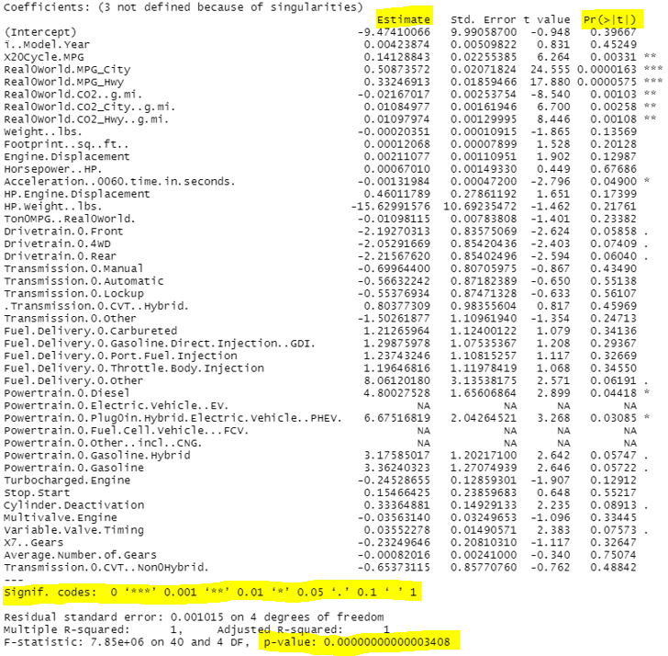
Multi-Linear Regression Model
Regression Model is Statistically Significant
Estimate Values – Impact on Real-World MPG
Multiple Significant Variables at Research Confidence Interval
Reject the Research Null Hypothesis
Notes:
The multi-linear regression model built used all the input variables from the EPA dataset to predict the output values of the Real-World miles per gallon variable. The overall model was statistically significant with a p-value less than the 0.05 threshold for the research’s 95% confidence interval. The output provides the p-values for all the variables in the dataset with the legend showing the variables’ significance values. The inclusion of variables such as acceleration and plug-in hybrid powertrains being statistically significant allows the null hypothesis to be rejected in favor of the alternate hypothesis. This means that there is evidence that variables in the EPA dataset have a statistically significant relationship with the real-world MPG variable. The estimate values in the regression output can be used to create a linear equations where an increase in one unit of the variable would result in the increase or decrease of the real-world miles per gallon value. For example, a one unit increase in acceleration would decrease the real-world miles per gallon value by 0.0013 MPG. This model can be used for predicting future miles per gallon values which is shown on the next slide.

Slide 13
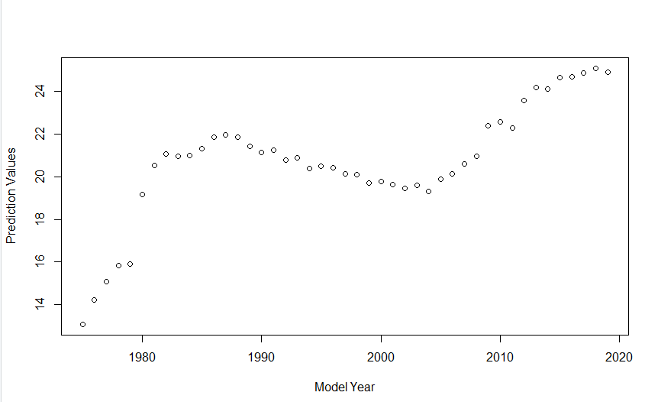
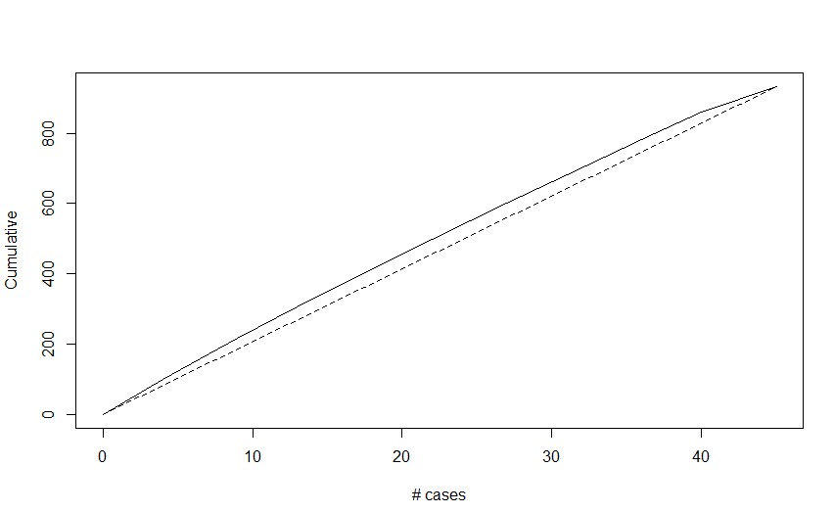
Regression model – prediction values and performance
Prediction Values Chart
Gains Chart - Evaluation
Notes:
The multi-linear regression model can be used to generate predicted values for the current dataset and future values. The visual shows that there is a dip in real-world miles per gallon values but overall the trend is increasing which matches the findings in the descriptive statistical tests. The models shows that the current values and short-term values will be around the 24 miles per gallon value ratings.
The gains chart is used to compare the linear regression model with a naïve or random guessing approach. The top line shows that the model outperforms random guessing for all cases and is a good predictive model for future values based on the current dataset.

Slide 14
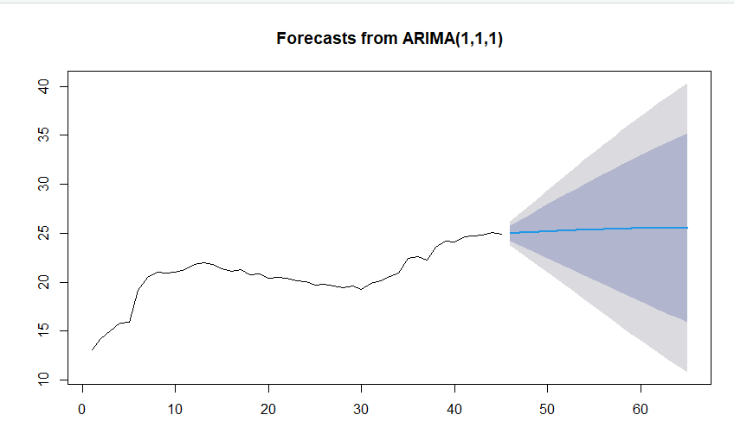
Time-Series forecasting model (ARIMA)
Statistically Significant Model
Similar Results to the Regression Model
Blue Line – Most Likely Trajectory of Future Values
Notes:
The time-series forecasting model that was built was the auto-regressive moving average (ARIMA) model. The model was statistically significant with the given EPA dataset with results very similar to the linear regression model. This outcome ensures the research project delivers accurate results with two models having similar value outcomes. The blue line in the visual shows the area of most likely values with the cones showing the possibility of increase or decrease given the data in the dataset (Singh, 2019). The time-series model will be highly useful if Ford Motor Company wishes to predict future values on a larger time scale compared to the linear regression model previously shown in this presentation.

Slide 15
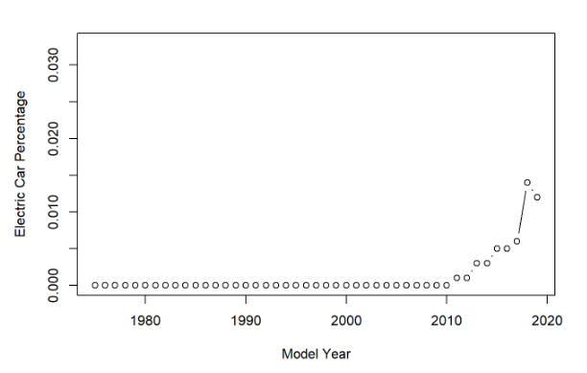

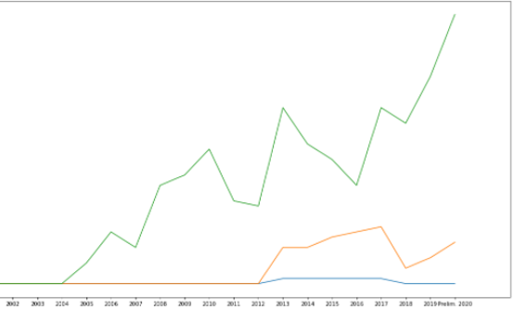
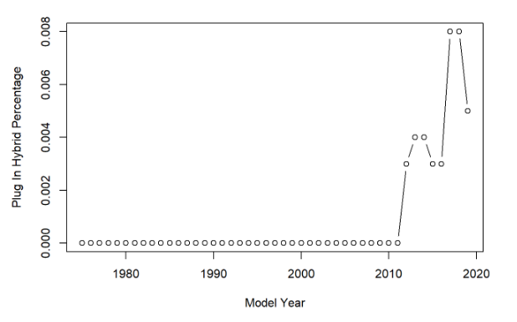
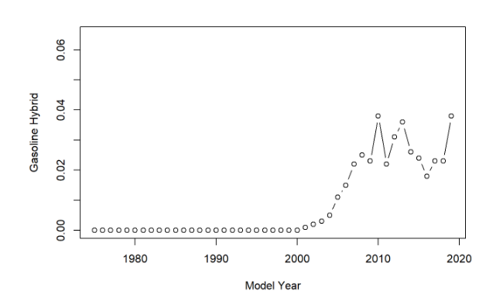
Future trends – hybrid and electric vehicles
Ford Production
Production %
Notes:
The research project also completed analysis on the future trends in the industry which was primarily focused on alternative fuel types in automobiles. The visuals depicted uses data from the Department of Energy and the EPA combined to explore the production shares of electric and hybrid vehicles. The charts on the left show that in recent years there has been an increase in production of hybrid and electric vehicles but with production percentages very low in comparison to other vehicle fuel types. The “Ford Production” chart displays that Ford has spent resources on producing hybrid and electric vehicles to keep in line with the production of the industry. This means that Ford will be a leader in the area as the different fuel types are poised in making a difference in miles per gallon ratings as shown in the data analysis in this research report.

Slide 16

recommendations
Models for Current and Future State
Inclusion of Internal Data
Continual Development
Framework for Data Analysis
Hoffmann, I. (2020, July 26). Recommendations. Ingo Hoffmann. Retrieved December 1, 2021, from https://ingo-hoffmann.com/recommendations/.
Notes:
The models and analysis presented in this report provide a basis for multiple recommendations by the researcher. The descriptive and predictive models built should be used for assessing the current state of the industry and where Ford Motor Company wants to fit within the automobile industry. The models should also be used for a forward-leaning approach to generate a short, medium, and long term goal in terms of product offerings and miles per gallon values. The product lineup should continually be compared to the data and analysis for a viability check.
The inclusion of internal Ford data would make the models more robust in providing a one-to-one comparison of trends and data points. The research model is only as accurate as the data inputted so any data that Ford would find valuable should be included to increase the return on the analytics.
The models should be continually developed in terms of data. The EPA dataset is updated once a year so, for example, when the data for 2021 is added the data should be added to the model and the predictive values compared to determine how well the model is performing and provide more data for the analysis.
The research project provides a framework for future analysis work that Ford can conduct with the same or different data. The tools and techniques used are universal for analyzing data and conducting a data analytics project.

Slide 17
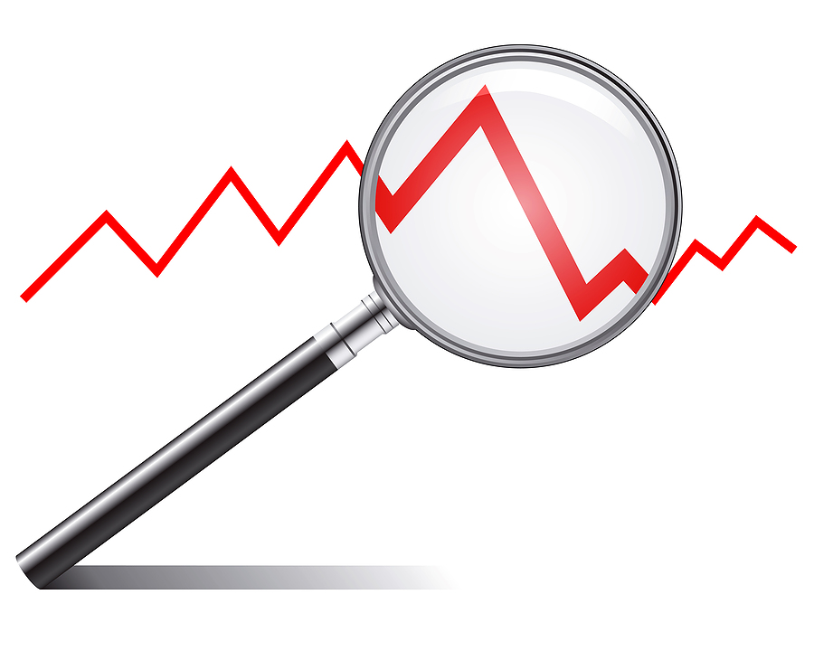
Conclusion
Research Analytics on the Trends in the Automobile Industry
Predictive Abilities
Competitive Advantage
Constantly Changing Environment – Agile Models
Corporate Services. (2017, May 9). Equipment Rental Software - trend analysis and your rental business. Corporate Services. Retrieved December 1, 2021, from https://www.corpservice.com/blog/2017/4/26/trend-analysis-and-your-rental-business.
Notes:
This research report has demonstrated that variables within the automobile industry can have a statistically significant impact on the industry issues and concerns. The descriptive statistical tests provided insights into how the industry is currently behaving and areas of interest for any organization manufacturing automobiles. The predictive models allowed for analytics to be developed for identifying and predicting trends for Ford Motor Company.
The predictive abilities of the model were found to be statistically significant in support of the research hypothesis and objectives. The variables that have the largest impact on the real-world miles per gallon ratings allow Ford to focus on these areas in their product offerings and generate a competitive advantage. The ability to leverage analytics to predict the future state in a constantly changing environment allows Ford to remain agile to the market. The models and analysis highlight areas of future technological impacts that Ford can utilize to remain the top manufacturer of automobiles in the United States.

Slide 18
references
A complete guide to stepwise regression in R. Statology. (2021, August 25). Retrieved October 30, 2021, from https://www.statology.org/stepwise-regression-r/.
A&E Television Networks. (2009, November 13). Ford Motor Company Incorporated. History.com. Retrieved October 15, 2021, from https://www.history.com/this-day-in-history/ford-motor-company-incorporated.
Carley, S., Zirogiannis, N., Duncan, D., Siddiki, S., & Graham, J. D. (2019). The Macroeconomic Effects of 2017 Through 2025 Federal Fuel Economy and Greenhouse Gas Emissions Standards. Journal of Policy Analysis & Management, 38(3), 732–763. https://doi.org/10.1002/pam.22132.
Data module #1: What is research data?: Types of research data. DeWitt Wallace Library . (2021, March 9). Retrieved October 29, 2021, from https://libguides.macalester.edu/c.php?g=527786%2F&p=3608643.
Davis, K., & Patterson, D. (2012). Ethics of Big Data: Balancing risk and innovation. O'Reilly.
Environmental Protection Agency. (2021, January). Automotive Trends Report. EPA. Retrieved October 16, 2021, from https://www.epa.gov/automotive-trends/explore-automotive-trends-data.
Ford Again Leads Automakers in U.S. Assembly, Hourly Jobs, Underscoring Commitment to American Economy. Ford Media Center. (2021, March 19). Retrieved October 16, 2021, from https://media.ford.com/content/fordmedia/fna/us/en/news/2021/03/19/ford-leads-automakers-us-assembly-vehicle-sales.html.
Ford's impact in the US. Ford Corporate. (2021). Retrieved October 16, 2021, from https://corporate.ford.com/social-impact/economic-impact.html.
Fortune. (2021, August 3). Ford Motor: 2021 Fortune 500. Fortune. Retrieved October 16, 2021, from https://fortune.com/company/ford-motor/fortune500/.
Gahi, Y., Guennoun, M., & Mouftah, H. T. (2016, June). Big data analytics: Security and privacy challenges. In 2016 IEEE Symposium on Computers and Communication (ISCC) (pp. 952-957). IEEE.

Slide 19
References (continued)
Høyer, K. G. (2008). The history of alternative fuels in transportation: The case of electric and hybrid cars. Utilities Policy, 16(2), 63-71.
Idris, N. O., Achban, A., Utiarahman, S. A., Karim, J., & Pontoiyo, F. (2020, November). Predicting the Selling Price of Cars Using Business Intelligence with the Feed-forward.
Kaur, P., Stoltzfus, J., & Yellapu, V. (2018). Descriptive statistics. International Journal of Academic Medicine, 4(1), 60.
McKinney, W. (2017). Python for Data Analysis, 2nd Edition. O'Reilly Media, Inc.
Locations. Ford Corporate. (2021). Retrieved October 16, 2021, from https://corporate.ford.com/operations/locations.html.
O'Leary, D. E. (2016). Ethics for big data and analytics. IEEE Intelligent Systems, 31(4), 81-84.
O’Leary, Z. (2021). The essential guide to doing your research project. (4th ed.). SAGE Publishing.
Patankar, N. A., Lin, J., & Patankar, T. N. (2021). Mileage efficiency of cars. Cleaner Engineering and Technology, 4, 100240.
Rietmann, N., Hügler, B., & Lieven, T. (2020). Forecasting the trajectory of electric vehicle sales and the consequences for worldwide CO2 emissions. Journal of Cleaner Production, 261, 121038.
Singh, D. (2019, July 12). Time Series Forecasting Using R. Pluralsight. Retrieved October 29, 2021, from https://www.pluralsight.com/guides/time-series-forecasting-using-r.

Slide 20
References (continued)
Thomas, J. (2016). Vehicle efficiency and tractive work: rate of change for the past decade and accelerated progress required for U.S. fuel economy and CO2 regulations. SAE International Journal of Fuels and Lubricants, 9(1), 290+. https://link.gale.com/apps/doc/A478973873/AONE?u=colstglobal&sid=bookmark-AONE&xid=aeeaf302
Timeline - History, Chronology - Ford Rouge Factory Tour. The Henry Ford. (2021). Retrieved October 15, 2021, from https://www.thehenryford.org/visit/ford-rouge-factory-tour/history-and-timeline/timeline/.
Toledo, A. H., Flikkema, R., & Toledo-Pereyra, L. H. (2011). Developing the research hypothesis. Journal of Investigative Surgery, 24(5), 191-194.
Top vehicle manufacturers in the US market, 1961-2016. Knoema. (2020, May 21). Retrieved October 16, 2021, from https://knoema.com/infographics/floslle/top-vehicle-manufacturers-in-the-us-market-1961-2016.
Wee, H. M., & Wu, S. (2009). Lean supply chain and its effect on product cost and quality: a case study on Ford Motor Company. Supply Chain Management: An International Journal.
Wu, J.-D., & Liu, J.-C. (2011). Development of a predictive system for car fuel consumption using an artificial neural network. Expert Systems with Applications, 38(5), 4967–4971. https://doi.org/10.1016/j.eswa.2010.09.155

