Slide 1
Arrowrithm

Slide 2
The Golden Circle
Why; “The Problem”
Context
Importance of data to businesses
Business adopting “the data approaches”
Opportunity
Organizations with limited resources to access “the data approaches”
Why
How
What

Slide 3
Importance of Data in Business [in case you are not already convinced]
“Information is the oil of the 21st century, and analytics is the combustion engine.” - Peter Sondergaard, Senior Vice President and Global Head of Research at Gartner, Inc.
“We are surrounded by data, but starved for insights.” - Jay Baer, marketing and customer experience expert
“Without big data analytics, companies are blind and deaf, wandering out onto the web like deer on a freeway.” - Geoffrey Moore, management consultant and author of Crossing the Chasm

Slide 4
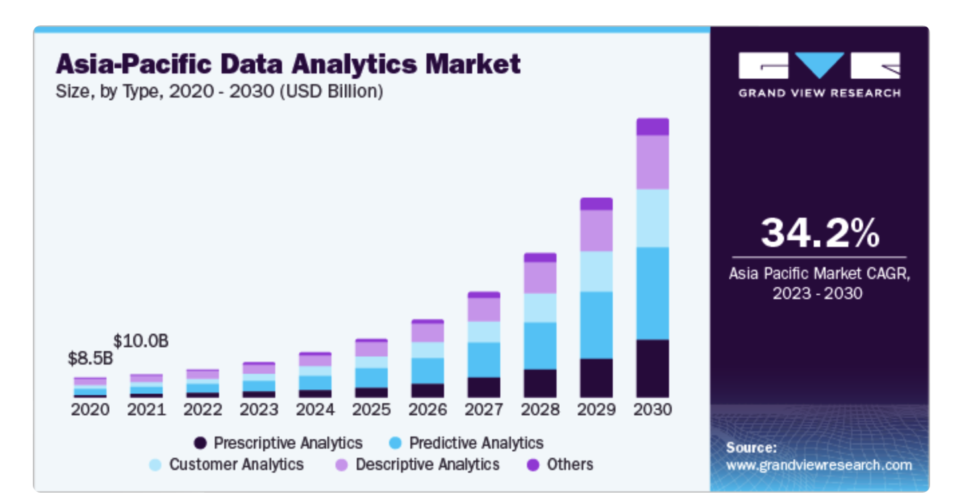
Businesses adopting Data Approaches
“The global data analytics market size was valued at USD 49.03 billion in 2022 and is projected to grow at a compound annual growth rate (CAGR) of 26.7% from 2023 to 2030. The main factors propelling the data analytics market's expansion are the growing adoption of machine learning and artificial intelligence to offer increased acceptance of social networking platforms, individualized consumer experiences, and the rise of online shopping.”
Source: https://www.grandviewresearch.com/industry-analysis/data-analytics-market-report

Slide 5
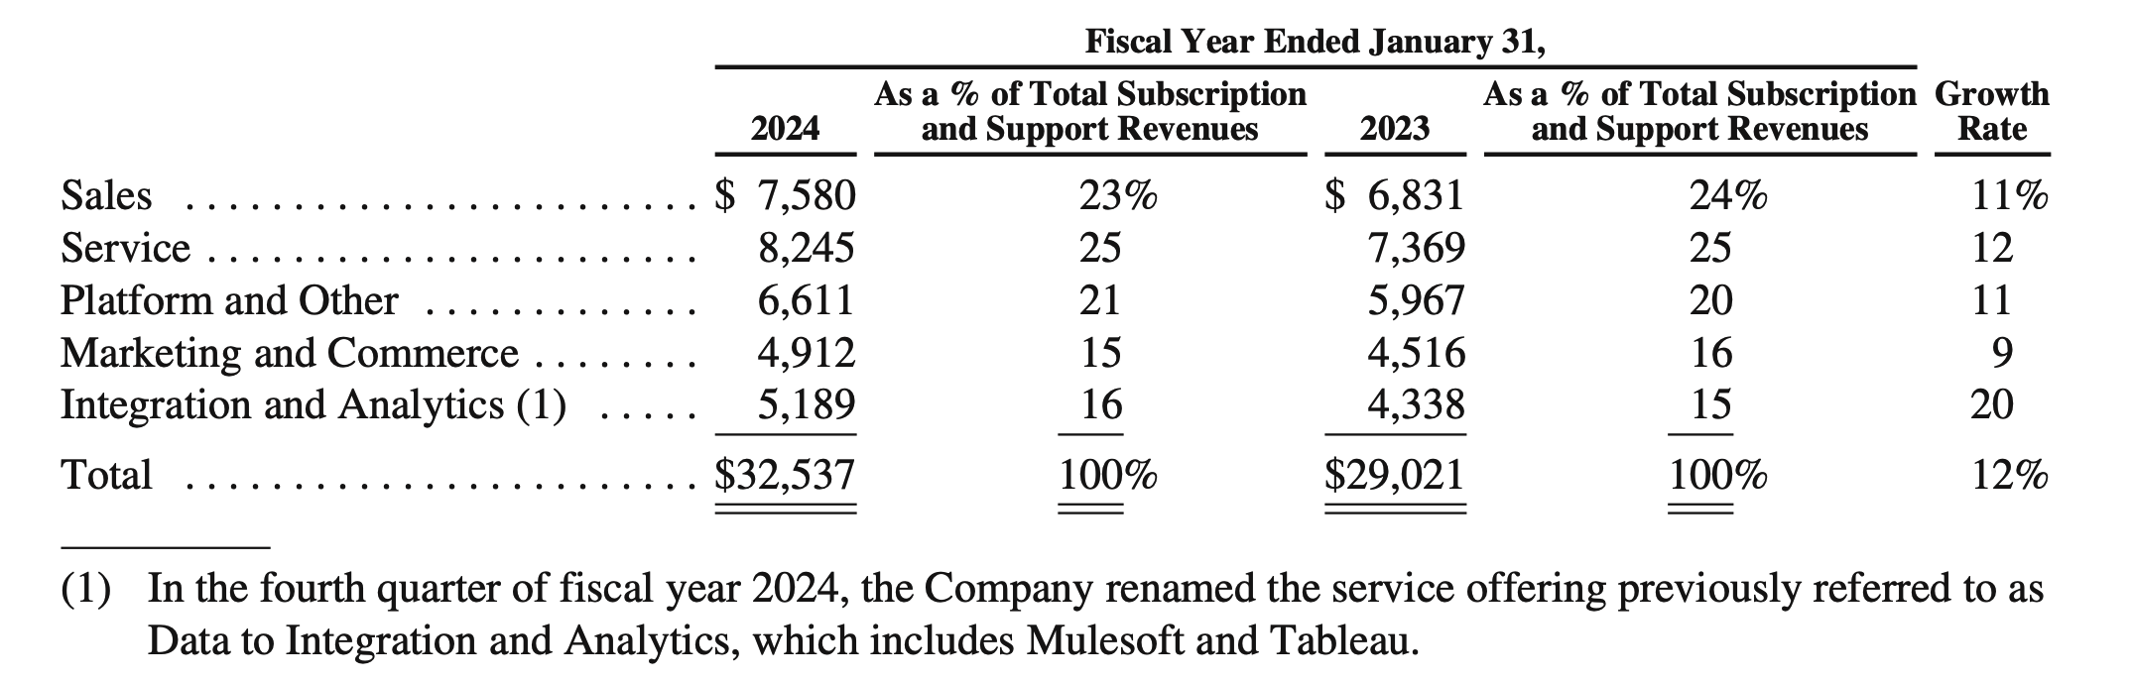
Businesses adopting Data Approaches
Salesforce Data Analytics Subscription and Support Revenue grew by 16% YoY [Up 1% from previous YoY]
Extract from Salesforce FY 2024 Annual Report
Source: https://investor.salesforce.com/financials/default.aspx;
https://s23.q4cdn.com/574569502/files/doc_financials/2024/ar/salesforce-fy24-annual-report.pdf

Slide 6
Market Validation – Need More
Competitor Sales – Tableau, PowerBi
Our Target market, purchasing power, habits of customer

Slide 7
Opportunity
Approximately 300,000 SMEs in Singapore
As of 2020, small SMEs (< 50 staff or <= 10 mil Rev) consistently make up 96% (~288,000) of the SMEs in Singapore
As of 2014, estimate of 70% (~210,000) of SMEs in Singapore are micro-SMEs (< 10 staff or <= 1 mil Rev)
If percentage remains, assume targeting businesses with revenue between 1 mil and 10 mil : Approximately 78,000 business fall in scope of our Solution
Denotes a business with a Data team
Denotes a business with limited resource looking to get into data
Resources
# Businesses
Source:
https://www.straitstimes.com/business/budget-2024-s-pore-businesses-workers-and-families-want-help-to-defray-costs-stay-productive
https://www.singstat.gov.sg/-/media/files/publications/industry/ssn222-pg9-12.ashx#:~:text=In%202020%2C%20there%20were%20211%2C400,in%20value%2Dadded%20in%202020.
https://www.straitstimes.com/singapore/some-micro-smes-gradually-restructuring#:~:text=Spring%20estimates%20that%20about%2070,parts%20of%20their%20business%20processes.

Slide 8
Market Size
Number of SMEs in Singapore
Continual Expansion – New companies spawn rate

Slide 9
The Golden Circle
How; “The solution”
Bridge the Gap for SMEs by using AI to build business intelligence dashboards for data analysis hence reducing the cost of entry
Why
How
What

Slide 10
The Golden Circle
What: “The product”
A commercialized platform that enables users to generate their own business intelligence dashboards for data analysis
Why
How
What

Slide 11
Product

Slide 12
Business Model Slide

Slide 13
Market Adoption

Slide 14
Competitor Slide
What Competition does well, not so well, Startup bridges the gap
Tableau Pulse – AI generated analysis
Tableau – Data visualization tool

Slide 15
Team

Slide 16
Financial Model
The financial model slide shows how your product creates revenue. For example, if your product is a subscription-based service, has premium features, or other horizontal integration, you’ll explain that model on these slides. Potential investors should walk away from your presentation knowing exactly how your startup creates revenue and understand any plans to ensure a steady stream of income.

Slide 17
https://www.hubspot.com/startups/resources/startup-pitch-decks

