Slide 1
Arrowrithm

Slide 2
The Golden Circle
Why are we doing this? (“The Problem”)
Context: Businesses are beginning to recognize the value of data:
360 view of the business
Realtime updates
New opportunities for revenue growth
New opportunities for cost reduction
“Problem”:
Cost of getting started – Hiring, Training, Tools, Administrative overheads, etc.
Uncertain results – Despite the investment, there is no guarantee of results.
Problem is exacerbated for smaller organizations because of limited resources.
Why
How
What

Slide 3
Importance of Data in Business [in case you are not already convinced]
“Information is the oil of the 21st century, and analytics is the combustion engine.” - Peter Sondergaard, Senior Vice President and Global Head of Research at Gartner, Inc.
“We are surrounded by data, but starved for insights.” - Jay Baer, marketing and customer experience expert
“Without big data analytics, companies are blind and deaf, wandering out onto the web like deer on a freeway.” - Geoffrey Moore, management consultant and author of Crossing the Chasm

Slide 4
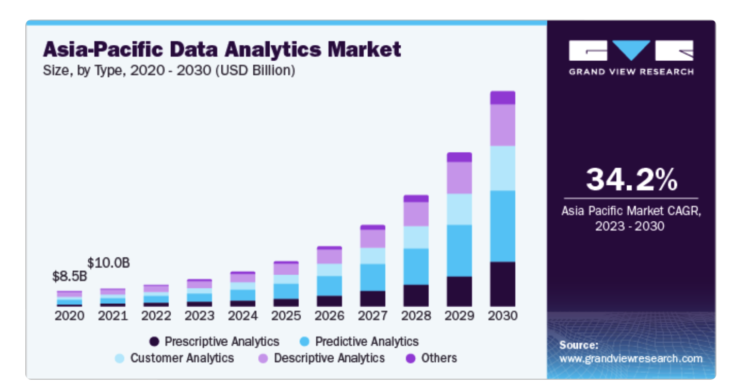
Growing Market Demand
“The global data analytics market size was valued at USD 49.03 billion in 2022 and is projected to grow at a compound annual growth rate (CAGR) of 26.7% from 2023 to 2030. The main factors propelling the data analytics market's expansion are the growing adoption of machine learning and artificial intelligence to offer increased acceptance of social networking platforms, individualized consumer experiences, and the rise of online shopping.”
Source: https://www.grandviewresearch.com/industry-analysis/data-analytics-market-report

Slide 5
The Golden Circle
Why are we doing this? (“The Problem”)
Context: Businesses are beginning to recognize the value of data:
360 view of the business
Realtime updates
New opportunities for revenue growth
New opportunities for cost reduction
“Problem”:
Cost of getting started – Hiring, Training, Tools, Administrative overheads, etc.
Uncertain results – Despite the investment, there is no guarantee of results.
Problem is exacerbated for smaller organizations because of limited resources.
Why
How
What

Slide 6
The Golden Circle
Why are we doing this? (“The Problem”)
Context: Businesses are beginning to recognize the value of data:
360 view of the business
Realtime updates
New opportunities for revenue growth
New opportunities for cost reduction
“Problem”:
Cost of getting started – Hiring, Training, Tools, Administrative overheads, etc.
Uncertain results – Despite the investment, there is no guarantee of results.
Problem is exacerbated for smaller organizations because of limited resources.
Why
How
What

Slide 7
The Golden Circle
How do we solve this?
By providing Business Intelligence and Analytics to businesses in an Impactful and Cost-efficient manner.
What is the product?
A commercialized platform that harnesses the power of A.I. (trained with data engineering and analytics best practices); effectively providing business with an experienced data analyst at a faction of the cost.
Why
How
What

Slide 8
Product – MVP01

Slide 9
Opportunity – Target Personas by Data Adoption Stages
Early Adopter [Business with Established Data Teams and Infrastructure]
Supplementary tool for Non-technical Personal to query data on the fly for insights.
Majority [Business on the data journey]
Exploratory tool for businesses to engage their data
Supplementary tool for Non-technical Personal to query data on the fly for insights.
Laggers [Business with no data emphasis]
Future Targets – to collaborate with data training organizations to educate and inform on data opportunity
Early Adopter
Majority
Laggers
Data Adoption
Small
SMEs
(26%)
Micro-SMEs (70%)
# of Businesses
Approximately 300,000 SMEs in Singapore
Source:
https://www.straitstimes.com/business/budget-2024-s-pore-businesses-workers-and-families-want-help-to-defray-costs-stay-productive
https://www.singstat.gov.sg/-/media/files/publications/industry/ssn222-pg9-12.ashx#:~:text=In%202020%2C%20there%20were%20211%2C400,in%20value%2Dadded%20in%202020.
https://www.straitstimes.com/singapore/some-micro-smes-gradually-restructuring#:~:text=Spring%20estimates%20that%20about%2070,parts%20of%20their%20business%20processes.

Slide 10
Execution Plan
Pilot Program
Cashflow Analytics for Decision Makers
Staff Analytics for Human Resource

Slide 11
Business Model Slide

Slide 12
Market Adoption

Slide 13
Competitor Slide
What Competition does well, not so well, Startup bridges the gap
Tableau Pulse – AI generated analysis
Tableau – Data visualization tool

Slide 14
Team

Slide 15
Financial Model
The financial model slide shows how your product creates revenue. For example, if your product is a subscription-based service, has premium features, or other horizontal integration, you’ll explain that model on these slides. Potential investors should walk away from your presentation knowing exactly how your startup creates revenue and understand any plans to ensure a steady stream of income.

Slide 16
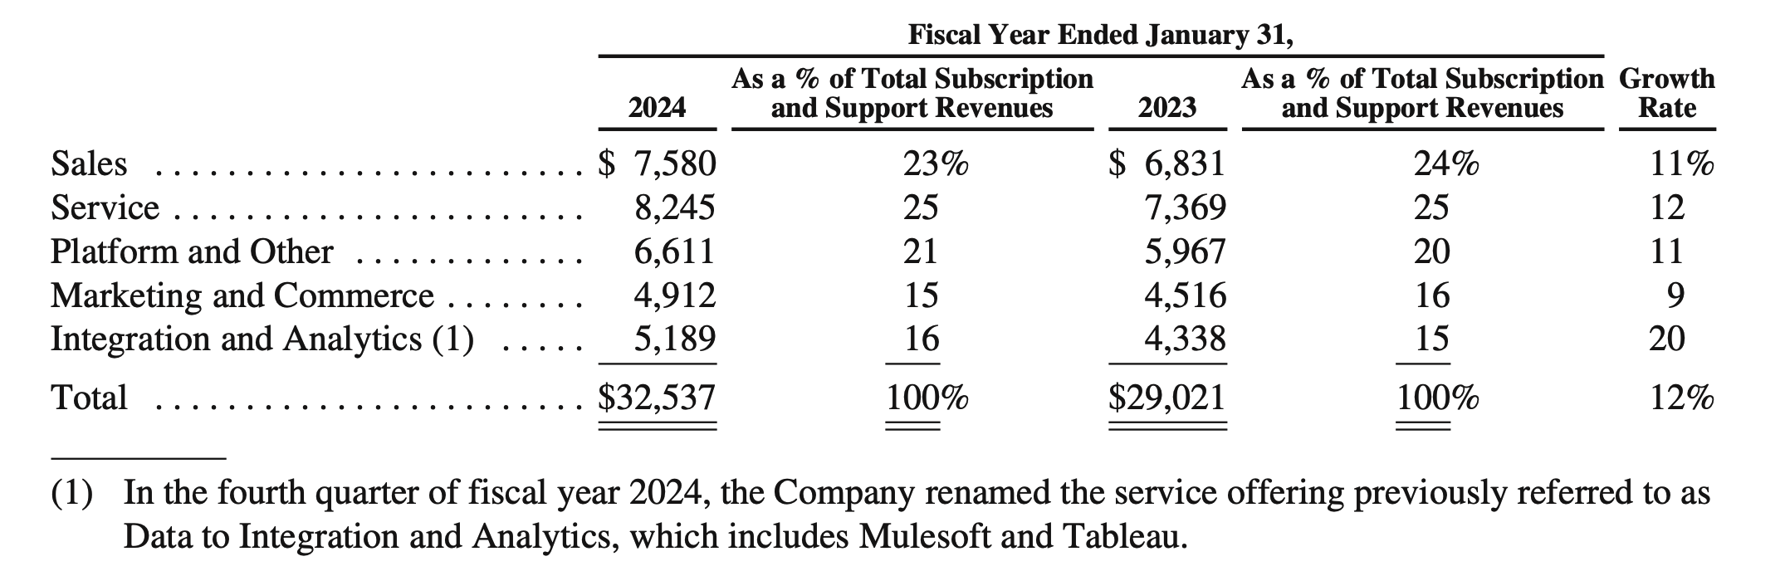
Businesses adopting Data Approaches
Salesforce Data Analytics Subscription and Support Revenue grew by 16% YoY [Up 1% from previous YoY]
Extract from Salesforce FY 2024 Annual Report
Source: https://investor.salesforce.com/financials/default.aspx;
https://s23.q4cdn.com/574569502/files/doc_financials/2024/ar/salesforce-fy24-annual-report.pdf

Slide 17
Opportunity – Market Size
Approximately 300,000 SMEs in Singapore
As of 2020, small SMEs (< 50 staff or <= 10 mil Rev) consistently make up 96% (~288,000) of the SMEs in Singapore
As of 2014, estimate of 70% (~210,000) of SMEs in Singapore are micro-SMEs (< 10 staff or <= 1 mil Rev)
If percentage remains, assume targeting businesses with revenue between 1 mil and 10 mil : Approximately 78,000 business fall in scope of our Solution
Business with Data
Resources
# Businesses
Source:
https://www.straitstimes.com/business/budget-2024-s-pore-businesses-workers-and-families-want-help-to-defray-costs-stay-productive
https://www.singstat.gov.sg/-/media/files/publications/industry/ssn222-pg9-12.ashx#:~:text=In%202020%2C%20there%20were%20211%2C400,in%20value%2Dadded%20in%202020.
https://www.straitstimes.com/singapore/some-micro-smes-gradually-restructuring#:~:text=Spring%20estimates%20that%20about%2070,parts%20of%20their%20business%20processes.

Slide 18
Product
Cloud-based Application
Data Engineering
Natural Language
Processing
Data
1. Upload
Data Cleansing
A.I. Module
Human Association
A.I. Module
Schema Building
Data Question

Slide 19
Market Validation – Need More
Competitor Sales – Tableau, PowerBi
Our Target market, purchasing power, habits of customer

Slide 20
Getting Started
Free service for analysis and train model

Slide 21
Market Size
Number of SMEs in Singapore
Continual Expansion – New companies spawn rate

Slide 22
https://www.hubspot.com/startups/resources/startup-pitch-decks

