Slide 1
Pitch deck
Arrowrithm
20 Aug 2024

Slide 2
Arrowrithm Driving Data decision-making for every business
Mission
To maximize the data potential of every business to achieve greater success

Slide 3
Arrowrithm Driving Data decision-making for every business
Problem
Data Enablement is currently a luxury afforded only to businesses with substantial resources to make the necessary investments in this area.
60,000 SGD
Approx. annual cost for a Fresh Graduate Data Analyst (glassdoor.sg)
72,000 SGD
Approx. annual cost for a Fresh Graduate Data Engineer (glassdoor.sg)
210,000 SMEs
(70%) have under 1mil SGD yearly revenue (Straitstimes)
78,000 SMEs
(26%) have under 1mil – 10mil SGD yearly revenue (Straitstimes)
Excl. Cost of Infrastructure, Administration, Training

Slide 4
AI.LeaN
Arrowrithm Driving Data decision-making for every business
Value Proposition - AI.lean
AI.lean is an Artificial Intelligence (AI) platform that functions as a “Robotic” Data Analyst and Engineer. She is trained to harness years of Data Analytics and Visualization methodologist to produced Industry Standard Business Intelligence Dashboards.
As AI.lean evolves, she will go beyond Business Intelligence to produce data actionable insights to facilitate business growth and cost reduction.
AI.lean IS a Data Analyst & Engineer at less than a faction of the cost
“Robotic” Data Analyst & Engineer
Utilizes Artificial Intelligence (AI) to generate impactful visualizations based on industry standards
Evolves to produce Actionable Insights for business growth and cost reduction

Slide 5
Arrowrithm Driving Data decision-making for every business
We are a tool built for the Business!
Hard
Power BI
Business Intelligence Software
Qlik Sense
Visualization Software
Tableau
Visualization Software
Tableau Pulse
AI assisted Charting
AI.lean
AI Data Analyst
Zero
Technical Barrier to
Entry

Slide 6
Arrowrithm Driving Data decision-making for every business
Revenue through a SaaS model
30,000
10% SME Market Captured
$30 SGD
Subscription Fee/Month
$10.8M SGD
Projected Revenue by 2030

Slide 7
Arrowrithm Driving Data decision-making for every business
Go-to-market Plan
Ideal Customer
A business with tremendous amount of data available with a high appetite to utilize data to expand the business.
A tool for all
While AI.lean’s primary audience are businesses with limited resources and hence, unlikely to be data enabled, due to AI.lean being a tool “build for the business”, it is complementary with businesses who are data enabled. AI.lean may serve as a supplementary tool for decision makers to perform fast, hassle free queries into their data for instant analytical results.
Data Appetite
Data Availability
Legend
Ideal Customer

Slide 8
Arrowrithm Driving Data decision-making for every business
Go-to-market Plan
Acquisition
Multiple channels will be utilized. The first of which is a collaborative efforts with businesses in the space of Data Education. The second means will be though Business Networks focusing on understanding other businesses pain-points and providing data solutions.
Scale
The scaling strategy will be primarily though word-of-mouth.
2024 (December)
Release of Minimum Viable Product
2024 (Beyond December)
Domain training and improvement of Model
2024 (Beyond December)
Targeted User growth by specific industries
Notes:
Improved accurary – Productivities = Industry stand result” – news ways to look existing data.

Slide 9

Arrowrithm Driving Data decision-making for every business
Team
Ryan Chia
Founder
Ryan started his career as a software engineer before progressing into the field of Data where he developed across all domains of the field. He combines business thinking and technology know-how which shapes his approach to how he handles and overcomes challenges.

Slide 10
Arrowrithm Driving Data decision-making for every business
Acquisition Projections and Key Metrics
Marketing
16 Business Pitches per month
New Acquisition: 4 business per month
Conversion Rate: 25%
AI.lean Platform
Conversion rate (trail to paid): 20%
Retention rate: 90%
Revenue
Customer Lifetime: 13 months
Customer Lifetime Value: $360 (12 x 30 - incl trial)
Forecast based on:
- 10% growth per month through word-of-month
- 4 newly acquired businesses per month

Slide 11
Arrowrithm Driving Data decision-making for every business
Status Update & Use of Funding
AI.lean
Built the foundation for the classification model
Midst of training and refining the model
Building charting for queries based on data context
Pilot Program
Collaborating with ‘Friends and Family’ businesses
Use of funds
1 Headcount to accelerate development of charting
Outsourcing of development for User-interface platform

Slide 12
Arrowrithm Driving Data decision-making for every business
Thank You

Slide 13
Differentiation from Competition
We are a tool built for the Business!
Hard
Power BI
Business Intelligence Software
Qlik Sense
Visualization Software
Tableau
Visualization Software
Tableau Pulse
AI assisted Charting
AI.lean
AI Data Analyst
Zero
Technical Barrier to
Entry

Slide 14
Market Size – Personas by Data Maturity
Illustration of Data Maturity of SMEs in Singapore
Not Started
Early Stages
Matured
Represents an SME surveyed
Micro-SMEs (70%)
Small SMEs (26%)
Data Adoption of SMEs in Singapore
Approximately 300,000 SMEs in Singapore
Source:
https://www.straitstimes.com/business/budget-2024-s-pore-businesses-workers-and-families-want-help-to-defray-costs-stay-productive
https://www.singstat.gov.sg/-/media/files/publications/industry/ssn222-pg9-12.ashx#:~:text=In%202020%2C%20there%20were%20211%2C400,in%20value%2Dadded%20in%202020.
https://www.straitstimes.com/singapore/some-micro-smes-gradually-restructuring#:~:text=Spring%20estimates%20that%20about%2070,parts%20of%20their%20business%20processes.

Slide 15
Market Size – Personas by Data Maturity
Illustration of Data Maturity of SMEs in Singapore
Matured
[Business with Established Data Teams and Infrastructure]
Supplementary tool for Non-technical Personal to query data on the fly for insights.
Micro-SMEs (70%)
Small SMEs (26%)
Data Adoption of SMEs in Singapore
Approximately 300,000 SMEs in Singapore
Source:
https://www.straitstimes.com/business/budget-2024-s-pore-businesses-workers-and-families-want-help-to-defray-costs-stay-productive
https://www.singstat.gov.sg/-/media/files/publications/industry/ssn222-pg9-12.ashx#:~:text=In%202020%2C%20there%20were%20211%2C400,in%20value%2Dadded%20in%202020.
https://www.straitstimes.com/singapore/some-micro-smes-gradually-restructuring#:~:text=Spring%20estimates%20that%20about%2070,parts%20of%20their%20business%20processes.

Slide 16
Market Size – Personas by Data Maturity
Illustration of Data Maturity of SMEs in Singapore
Early Stages
[Business on the data journey]
Exploratory tool for businesses to engage their data
Supplementary tool for Non-technical Personal to query data on the fly for insights
Micro-SMEs (70%)
Small SMEs (26%)
Data Adoption of SMEs in Singapore
Approximately 300,000 SMEs in Singapore
Source:
https://www.straitstimes.com/business/budget-2024-s-pore-businesses-workers-and-families-want-help-to-defray-costs-stay-productive
https://www.singstat.gov.sg/-/media/files/publications/industry/ssn222-pg9-12.ashx#:~:text=In%202020%2C%20there%20were%20211%2C400,in%20value%2Dadded%20in%202020.
https://www.straitstimes.com/singapore/some-micro-smes-gradually-restructuring#:~:text=Spring%20estimates%20that%20about%2070,parts%20of%20their%20business%20processes.

Slide 17
Market Size – Personas by Data Maturity
Illustration of Data Maturity of SMEs in Singapore
Not Started
[Business with no data emphasis]
Tool to get Started
Opportunity to collaborate with data training organizations to educate and inform on data opportunity
Micro-SMEs (70%)
Small SMEs (26%)
Data Adoption of SMEs in Singapore
Approximately 300,000 SMEs in Singapore
Source:
https://www.straitstimes.com/business/budget-2024-s-pore-businesses-workers-and-families-want-help-to-defray-costs-stay-productive
https://www.singstat.gov.sg/-/media/files/publications/industry/ssn222-pg9-12.ashx#:~:text=In%202020%2C%20there%20were%20211%2C400,in%20value%2Dadded%20in%202020.
https://www.straitstimes.com/singapore/some-micro-smes-gradually-restructuring#:~:text=Spring%20estimates%20that%20about%2070,parts%20of%20their%20business%20processes.

Slide 18
Execution Plan
Pilot Program
API Cashflow Analytics for Decision Makers
Staff Analytics for Human Resource

Slide 19
Team

Slide 20
Market Adoption – Target Personas by Data Appetite and Availability
Early Adopters [Business with High Data Appetite]
A1: Businesses that has data ready to be engaged
A2: Businesses that may require assistance
Majority [Businesses with High Data Availability]
Require spark to ignite Data Appetite
Potentially cautious about over committing to Data Strategy
Laggers [Business with Low Data Appetite]
Far from seeing the value in their data
Requires outreach to get started and moved into target market
Target Market
A2
Data Appetite
A1
Data Availability
Legend
Early Adopter
Majority
Laggers
Notes:
Improved accurary – Productivities = Industry stand result” – news ways to look existing data.

Slide 21
Value to CEOs (Pnl, Cost Savings)
Salary (FreshGrad) - https://www.knowledgehut.com/blog/big-data/data-analyst-salary-singapore#

Slide 22
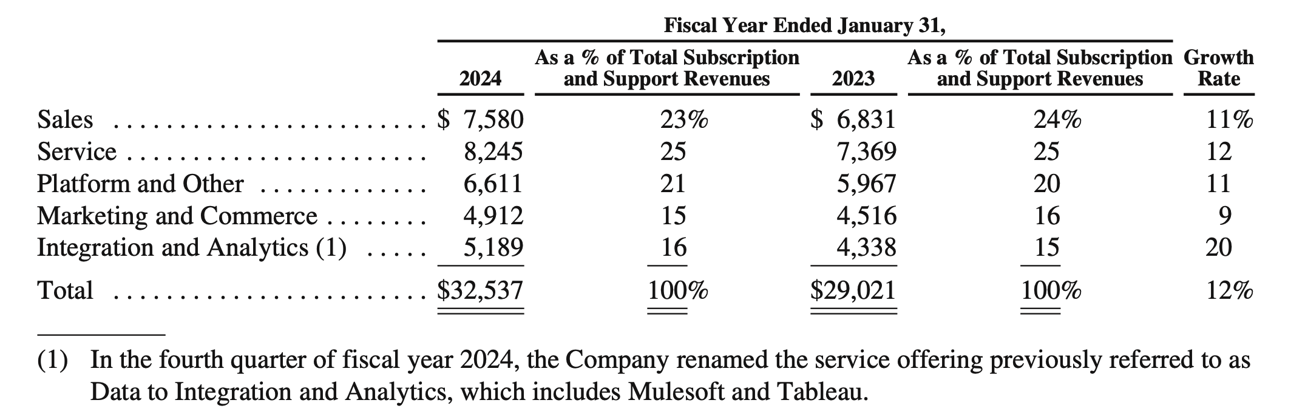
Businesses adopting Data Approaches
Salesforce Data Analytics Subscription and Support Revenue grew by 16% YoY [Up 1% from previous YoY]
Extract from Salesforce FY 2024 Annual Report
Source: https://investor.salesforce.com/financials/default.aspx;
https://s23.q4cdn.com/574569502/files/doc_financials/2024/ar/salesforce-fy24-annual-report.pdf

Slide 23
The Golden Circle
Why are we doing this? (“The Problem”)
Context: Businesses are beginning to recognize the value of data:
360 view of the business
Realtime updates
New opportunities for revenue growth
New opportunities for cost reduction
“Problem”:
Cost of getting started – Hiring, Training, Tools, Administrative overheads, etc.
Uncertain results – Despite the investment, there is no guarantee of results.
Problem is exacerbated for smaller organizations because of limited resources.
Why
How
What

Slide 24
Importance of Data in Business [in case you are not already convinced]
“Information is the oil of the 21st century, and analytics is the combustion engine.” - Peter Sondergaard, Senior Vice President and Global Head of Research at Gartner, Inc.
“We are surrounded by data, but starved for insights.” - Jay Baer, marketing and customer experience expert
“Without big data analytics, companies are blind and deaf, wandering out onto the web like deer on a freeway.” - Geoffrey Moore, management consultant and author of Crossing the Chasm

Slide 25
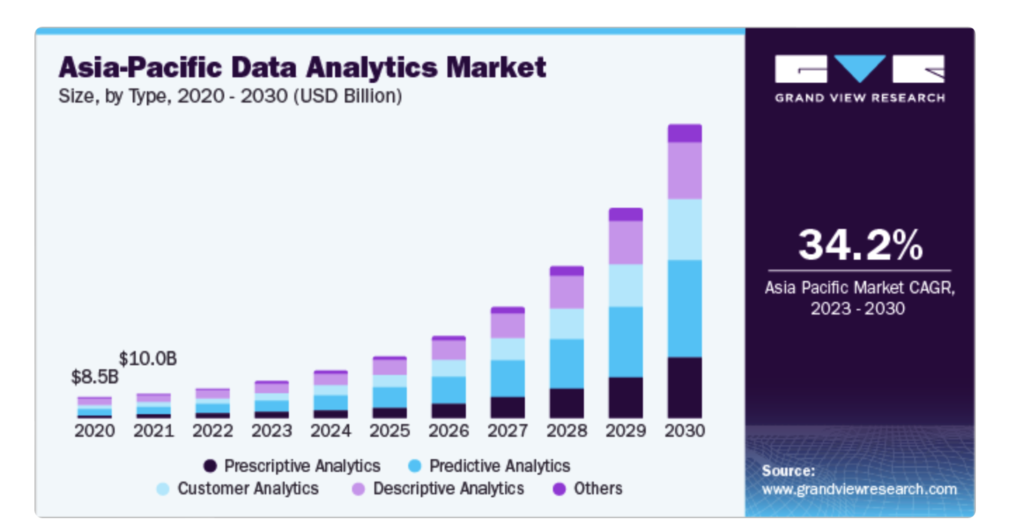
Growing Market Demand
“The global data analytics market size was valued at USD 49.03 billion in 2022 and is projected to grow at a compound annual growth rate (CAGR) of 26.7% from 2023 to 2030. The main factors propelling the data analytics market's expansion are the growing adoption of machine learning and artificial intelligence to offer increased acceptance of social networking platforms, individualized consumer experiences, and the rise of online shopping.”
Source: https://www.grandviewresearch.com/industry-analysis/data-analytics-market-report

Slide 26
The Golden Circle
Why are we doing this? (“The Problem”)
Context: Businesses are beginning to recognize the value of data:
360 view of the business
Realtime updates
New opportunities for revenue growth
New opportunities for cost reduction
“Problem”:
Cost of getting started – Hiring, Training, Tools, Administrative overheads, etc.
Uncertain results – Despite the investment, there is no guarantee of results.
Problem is exacerbated for smaller organizations because of limited resources.
Why
How
What

Slide 27
The Golden Circle
Why are we doing this? (“The Problem”)
Context: Businesses are beginning to recognize the value of data:
360 view of the business
Realtime updates
New opportunities for revenue growth
New opportunities for cost reduction
“Problem”:
Cost of getting started – Hiring, Training, Tools, Administrative overheads, etc.
Uncertain results – Despite the investment, there is no guarantee of results.
Problem is exacerbated for smaller organizations because of limited resources.
Why
How
What

Slide 28
The Golden Circle
How do we solve this?
By providing Business Intelligence and Analytics to businesses in an Impactful and Cost-efficient manner.
What is the product?
A commercialized platform that harnesses the power of A.I. (trained with data engineering and analytics best practices); effectively providing business with an experienced data analyst at a faction of the cost.
Why
How
What

Slide 29
Financial Model
The financial model slide shows how your product creates revenue. For example, if your product is a subscription-based service, has premium features, or other horizontal integration, you’ll explain that model on these slides. Potential investors should walk away from your presentation knowing exactly how your startup creates revenue and understand any plans to ensure a steady stream of income.

Slide 30
Opportunity – Market Size
Approximately 300,000 SMEs in Singapore
As of 2020, small SMEs (< 50 staff or <= 10 mil Rev) consistently make up 96% (~288,000) of the SMEs in Singapore
As of 2014, estimate of 70% (~210,000) of SMEs in Singapore are micro-SMEs (< 10 staff or <= 1 mil Rev)
If percentage remains, assume targeting businesses with revenue between 1 mil and 10 mil : Approximately 78,000 business fall in scope of our Solution
Business with Data
Resources
# Businesses
Source:
https://www.straitstimes.com/business/budget-2024-s-pore-businesses-workers-and-families-want-help-to-defray-costs-stay-productive
https://www.singstat.gov.sg/-/media/files/publications/industry/ssn222-pg9-12.ashx#:~:text=In%202020%2C%20there%20were%20211%2C400,in%20value%2Dadded%20in%202020.
https://www.straitstimes.com/singapore/some-micro-smes-gradually-restructuring#:~:text=Spring%20estimates%20that%20about%2070,parts%20of%20their%20business%20processes.

Slide 31
Product
Cloud-based Application
Data Engineering
Natural Language
Processing
Data
1. Upload
Data Cleansing
A.I. Module
Human Association
A.I. Module
Schema Building
Data Question

Slide 32
Market Adoption – Target Personas by Data Adoption Stages
Early Adopter [Business with Established Data Teams and Infrastructure]
Supplementary tool for Non-technical Personal to query data on the fly for insights.
Majority [Business on the data journey]
Exploratory tool for businesses to engage their data
Supplementary tool for Non-technical Personal to query data on the fly for insights.
Laggers [Business with no data emphasis]
Future Targets – to collaborate with data training organizations to educate and inform on data opportunity
Early Adopter
Majority
Laggers
Data Adoption
Small
SMEs
(26%)
Micro-SMEs (70%)
# of Businesses
Approximately 300,000 SMEs in Singapore
Source:
https://www.straitstimes.com/business/budget-2024-s-pore-businesses-workers-and-families-want-help-to-defray-costs-stay-productive
https://www.singstat.gov.sg/-/media/files/publications/industry/ssn222-pg9-12.ashx#:~:text=In%202020%2C%20there%20were%20211%2C400,in%20value%2Dadded%20in%202020.
https://www.straitstimes.com/singapore/some-micro-smes-gradually-restructuring#:~:text=Spring%20estimates%20that%20about%2070,parts%20of%20their%20business%20processes.

Slide 33
Market Size – Personas by Data Maturity
Illustration of Data Maturity of SMEs in Singapore
Not Started - Early Stage
Journey
Matured
Sampled SME current stage of data adoption
Micro-SMEs (70%)
Small SMEs (26%)
Revenue
Data Adoption of SMEs in Singapore
Approximately 300,000 SMEs in Singapore
Source:
https://www.straitstimes.com/business/budget-2024-s-pore-businesses-workers-and-families-want-help-to-defray-costs-stay-productive
https://www.singstat.gov.sg/-/media/files/publications/industry/ssn222-pg9-12.ashx#:~:text=In%202020%2C%20there%20were%20211%2C400,in%20value%2Dadded%20in%202020.
https://www.straitstimes.com/singapore/some-micro-smes-gradually-restructuring#:~:text=Spring%20estimates%20that%20about%2070,parts%20of%20their%20business%20processes.

Slide 34
Market Size – Personas by Data Adoption Stages
Illustration of Data Adoption of SMEs in Singapore relative to each other
Laggers
Late Majority
Early Majority
Early Adopters
Early Adopter
[Business with Established Data Teams and Infrastructure]
Supplementary tool for Non-technical Personal to query data on the fly for insights.
Micro-SMEs (70%)
Small SMEs (26%)
Revenue
Data Adoption of SMEs in Singapore
Approximately 300,000 SMEs in Singapore
Source:
https://www.straitstimes.com/business/budget-2024-s-pore-businesses-workers-and-families-want-help-to-defray-costs-stay-productive
https://www.singstat.gov.sg/-/media/files/publications/industry/ssn222-pg9-12.ashx#:~:text=In%202020%2C%20there%20were%20211%2C400,in%20value%2Dadded%20in%202020.
https://www.straitstimes.com/singapore/some-micro-smes-gradually-restructuring#:~:text=Spring%20estimates%20that%20about%2070,parts%20of%20their%20business%20processes.

Slide 35
Market Size – Personas by Data Adoption Stages
Illustration of Data Adoption of SMEs in Singapore relative to each other
Laggers
Late Majority
Early Majority
Early Adopters
Majority
[Business on the data journey]
Exploratory tool for businesses to engage their data
Supplementary tool for Non-technical Personal to query data on the fly for insights.
Micro-SMEs (70%)
Small SMEs (26%)
Revenue
Data Adoption of SMEs in Singapore
Approximately 300,000 SMEs in Singapore
Source:
https://www.straitstimes.com/business/budget-2024-s-pore-businesses-workers-and-families-want-help-to-defray-costs-stay-productive
https://www.singstat.gov.sg/-/media/files/publications/industry/ssn222-pg9-12.ashx#:~:text=In%202020%2C%20there%20were%20211%2C400,in%20value%2Dadded%20in%202020.
https://www.straitstimes.com/singapore/some-micro-smes-gradually-restructuring#:~:text=Spring%20estimates%20that%20about%2070,parts%20of%20their%20business%20processes.

Slide 36
Market Size – Personas by Data Adoption Stages
Illustration of Data Adoption of SMEs in Singapore relative to each other
Laggers
Late Majority
Early Majority
Early Adopters
Laggers
[Business with no data emphasis]
Future Targets – to collaborate with data training organizations to educate and inform on data opportunity
Micro-SMEs (70%)
Small SMEs (26%)
Revenue
Data Adoption of SMEs in Singapore
Approximately 300,000 SMEs in Singapore
Source:
https://www.straitstimes.com/business/budget-2024-s-pore-businesses-workers-and-families-want-help-to-defray-costs-stay-productive
https://www.singstat.gov.sg/-/media/files/publications/industry/ssn222-pg9-12.ashx#:~:text=In%202020%2C%20there%20were%20211%2C400,in%20value%2Dadded%20in%202020.
https://www.straitstimes.com/singapore/some-micro-smes-gradually-restructuring#:~:text=Spring%20estimates%20that%20about%2070,parts%20of%20their%20business%20processes.

Slide 37
Market Size – Personas by Data Adoption Stages
Illustration of Data Adoption of SMEs in Singapore
Laggers
Late Majority
Early Majority
Early Adopters
Early Adopter
[Business with Established Data Teams and Infrastructure]
Supplementary tool for Non-technical Personal to query data on the fly for insights.
Majority
[Business on the data journey]
Exploratory tool for businesses to engage their data
Supplementary tool for Non-technical Personal to query data on the fly for insights.
Laggers
[Business with no data emphasis]
Future Targets – to collaborate with data training organizations to educate and inform on data opportunity
Micro-SMEs (70%)
Small SMEs (26%)
Data Adoption of SMEs in Singapore
Approximately 300,000 SMEs in Singapore
Source:
https://www.straitstimes.com/business/budget-2024-s-pore-businesses-workers-and-families-want-help-to-defray-costs-stay-productive
https://www.singstat.gov.sg/-/media/files/publications/industry/ssn222-pg9-12.ashx#:~:text=In%202020%2C%20there%20were%20211%2C400,in%20value%2Dadded%20in%202020.
https://www.straitstimes.com/singapore/some-micro-smes-gradually-restructuring#:~:text=Spring%20estimates%20that%20about%2070,parts%20of%20their%20business%20processes.

Slide 38
Market Adoption – Target Personas by Data Appetite and Availability
Early Adopter [Business with High Data Appetite]
AI.lean aims to make an immediate impact to these businesses by providing a/an:
exploratory tool for them to engage their data [A1]
consulting services and exploratory tool for them to engage their data [A2]
Majority [Businesses with High Data Availability]
These businesses are believed to follow suit once the benefits of
Future Explor.
Laggers [Business with Low Data Appetite]
Future Targets – to collaborate with data training organizations to educate and inform on data opportunity
Target Market
A2
A1
Data Appetite
Data Availability
Legend
Source:
https://www.straitstimes.com/business/budget-2024-s-pore-businesses-workers-and-families-want-help-to-defray-costs-stay-productive
https://www.singstat.gov.sg/-/media/files/publications/industry/ssn222-pg9-12.ashx#:~:text=In%202020%2C%20there%20were%20211%2C400,in%20value%2Dadded%20in%202020.
https://www.straitstimes.com/singapore/some-micro-smes-gradually-restructuring#:~:text=Spring%20estimates%20that%20about%2070,parts%20of%20their%20business%20processes.
Early Adopter
Majority
Laggers

Slide 39
Market Validation – Need More
Competitor Sales – Tableau, PowerBi
Our Target market, purchasing power, habits of customer

Slide 40
Getting Started
Free service for analysis and train model

Slide 41
Market Size
Number of SMEs in Singapore
Continual Expansion – New companies spawn rate

Slide 42
Competitor Slide
We are a tool built for the Business!
Tableau Pulse (AI assisted Charting) – Built for the Data Analyst
Tableau (Data visualization software) – Built for the Data Analyst
Qlik Sense
Power BI – “Technology build for Techie” Problem

Slide 43
Competitor Slide
We are a tool built for the Business!
Tableau Pulse
AI assisted Charting
Data Analyst
Data Engineer
Qlik Sense
Visualization Software
Tableau
Visualization Software
Power BI
Business Intelligence Software
Business Decision
Maker

Slide 44
https://www.hubspot.com/startups/resources/startup-pitch-decks

