Slide 1
Pitch deck
Arrowrithm
22 Aug 2024

Slide 2
Arrowrithm Driving Data decision-making for every business
Mission
To maximize the data potential of every business to achieve greater success

Slide 3
Arrowrithm Driving Data decision-making for every business
Problem
Data Enablement is currently a luxury afforded only to businesses with substantial resources to make the necessary investments in this area.
60,000 SGD
Approx. annual cost for a Fresh Graduate Data Analyst (glassdoor.sg)
72,000 SGD
Approx. annual cost for a Fresh Graduate Data Engineer (glassdoor.sg)
210,000 SMEs
(70%) have under 1mil SGD yearly revenue (Straitstimes)
78,000 SMEs
(26%) have under 1mil – 10mil SGD yearly revenue (Straitstimes)
Excl. Cost of Infrastructure, Administration, Training

Slide 4
AI.LeaN
Arrowrithm Driving Data decision-making for every business
Value Proposition - AI.lean
AI.lean is an Artificial Intelligence (AI) platform that functions as a “Robotic” Data Analyst and Engineer. She is trained to harness years of Data Analytics and Visualization methodologist to produced Industry Standard Business Intelligence Dashboards.
As AI.lean evolves, she will go beyond Business Intelligence to produce data actionable insights to facilitate business growth and cost reduction.
AI.lean IS a Data Analyst & Engineer at less than a faction of the cost
“Robotic” Data Analyst & Engineer
Utilizes Artificial Intelligence (AI) to generate impactful visualizations based on industry standards
Evolves to produce Actionable Insights for business growth and cost reduction

Slide 5
Arrowrithm Driving Data decision-making for every business
We are a tool built for the Business!
Hard
Power BI
Business Intelligence Software
Qlik Sense
Visualization Software
Tableau
Visualization Software
Tableau Pulse
AI assisted Charting
AI.lean
AI Data Analyst
Zero
Technical Barrier to
Entry

Slide 6
Arrowrithm Driving Data decision-making for every business
Revenue through a SaaS model
30,000
10% SME Market Captured
$30 SGD
Subscription Fee/Month
$10.8M SGD
Projected Revenue by 2030

Slide 7
Arrowrithm Driving Data decision-making for every business
Go-to-market Plan
Ideal Customer
A business with tremendous amount of data available with a high appetite to utilize data to expand the business.
A tool for all
While AI.lean’s primary audience are businesses with limited resources and hence, unlikely to be data enabled, due to AI.lean being a tool “build for the business”, it is complementary with businesses who are data enabled. AI.lean may serve as a supplementary tool for decision makers to perform fast, hassle free queries into their data for instant analytical results.
Data Appetite
Data Availability
Legend
Ideal Customer

Slide 8
Arrowrithm Driving Data decision-making for every business
Go-to-market Plan
Acquisition
Multiple channels will be utilized. The first of which is a collaborative efforts with businesses in the space of Data Education. The second means will be though Business Networks focusing on understanding other businesses pain-points and providing data solutions.
Scale
The scaling strategy will be primarily though word-of-mouth.
2024 (December)
Release of Minimum Viable Product
2024 (Beyond December)
Domain training and improvement of Model
2024 (Beyond December)
Targeted User growth by specific industries
Notes:
Improved accurary – Productivities = Industry stand result” – news ways to look existing data.

Slide 9
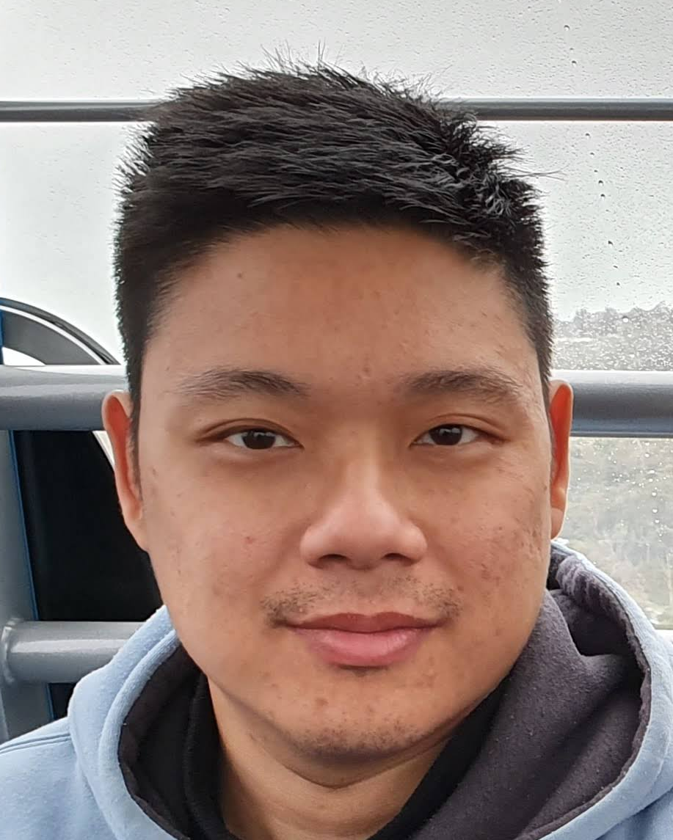
Arrowrithm Driving Data decision-making for every business
Team
Ryan Chia
Founder
Ryan started his career as a software engineer before progressing into the field of Data where he developed across all domains of the field. He combines business thinking and technology know-how which shapes his approach to how he handles and overcomes challenges.

Slide 10
Arrowrithm Driving Data decision-making for every business
Acquisition Projections and Key Metrics
Marketing
16 Business Pitches per month
New Acquisition: 4 business per month
Conversion Rate: 25%
AI.lean Platform
Conversion rate (trail to paid): 20%
Retention rate: 90%
Revenue
Customer Lifetime: 13 months
Customer Lifetime Value: $360 (12 x 30 - incl trial)
Forecast based on:
- 10% growth per month through word-of-month
- 4 newly acquired businesses per month

Slide 11
Arrowrithm Driving Data decision-making for every business
Status Update & Use of Funding
AI.lean
Built the foundation for the classification model
Midst of training and refining the model
Building charting for queries based on data context
Pilot Program
Collaborating with ‘Friends and Family’ businesses
Use of funds
1 Headcount to accelerate development of charting
Outsourcing of development for User-interface platform

Slide 12
Arrowrithm Driving Data decision-making for every business
Thank You

