Slide 1
Predicting House Prices using Linear Regression
In “4” “easy” steps!

Slide 2
Objective
Learn/practice model development
Train a linear regression model that predicts the price of a house
The model should be predictive (accurate)
A user should be able to input details about any given house, and predict a single price for it

Slide 3
Data
Sample dataset created for beginner data science projects
Ames Housing Dataset by Dean de Cock (Kaggle)
Sale prices of several houses, along with ~80 data points about each house (size, condition, location, year built/year sold, etc.)
Combination of train data (train.csv — includes sale prices) and test data (test.csv — does not include sale prices)
Notebook is based on multiple tutorials:
House Prices Prediction using TensorFlow Decision Forests by Gusthema (Kaggle)
House Price Prediction in Python - Full Machine Learning Project by NeuralNine (YouTube)

Slide 4
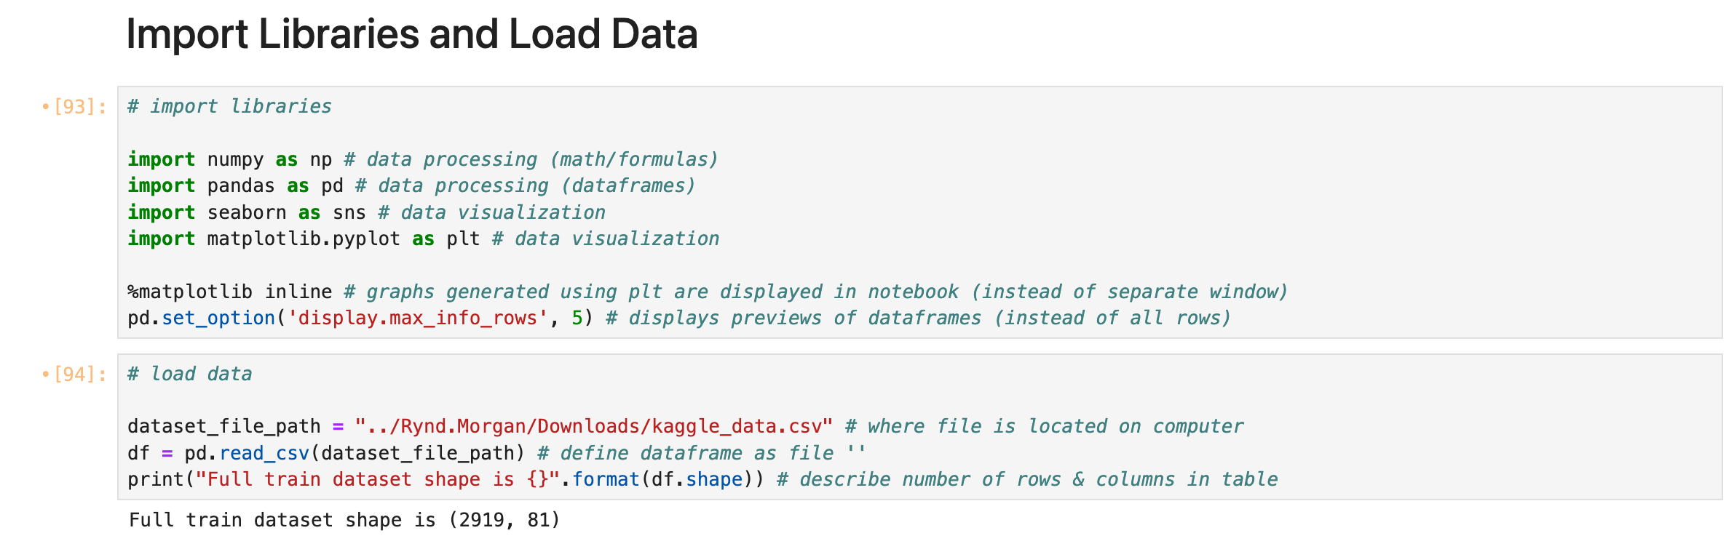
Step 0: Import Libraries and Load Data

Slide 5
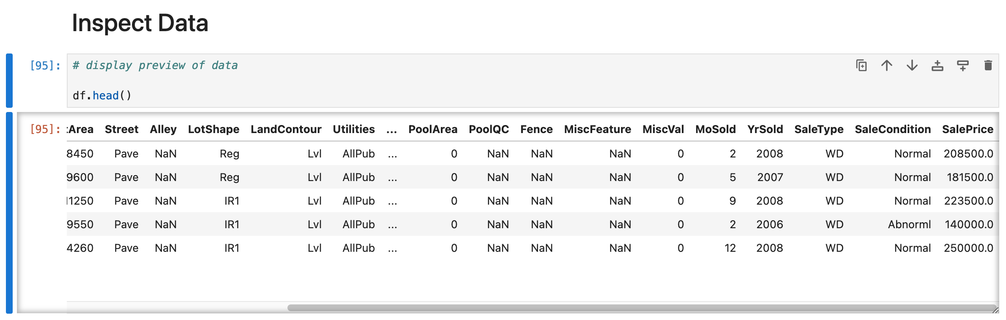

Step 1: Inspect Data

Slide 6
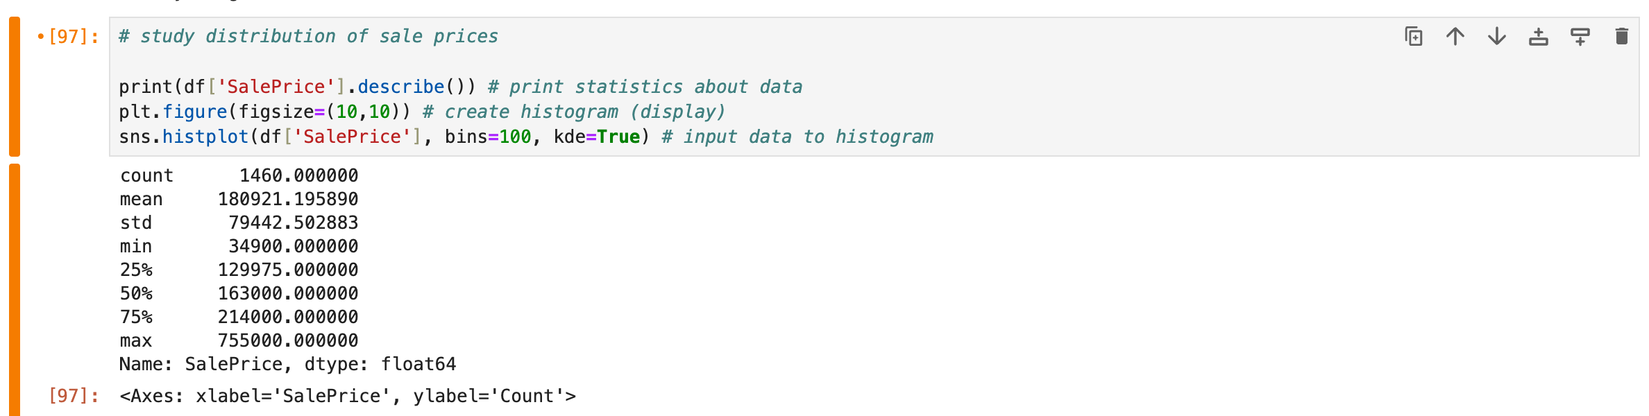


Step 1: Inspect Data
Original # of rows: 2919
Only 1460 had sale price (train.csv)

Slide 7
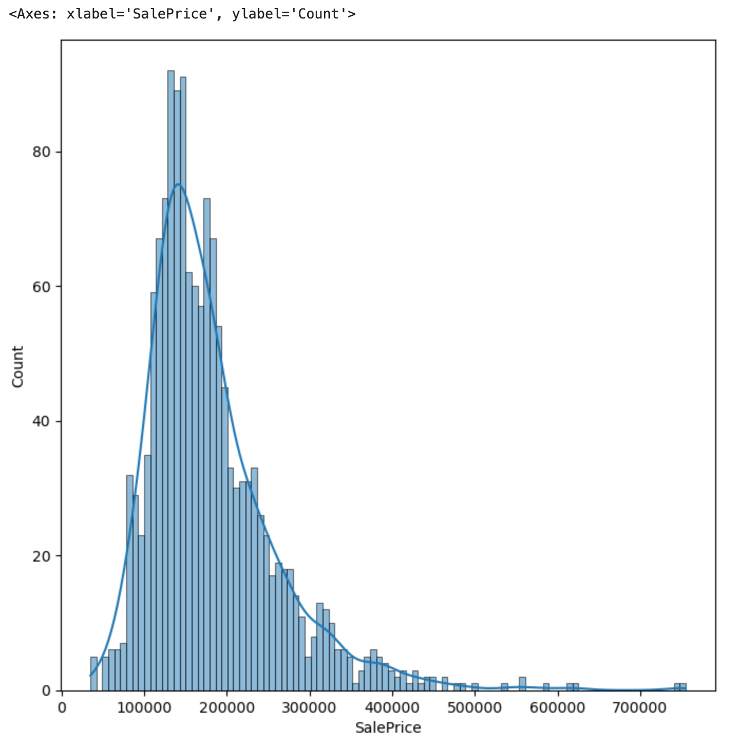
Home sale prices typically do not have normal distribution.

Slide 8
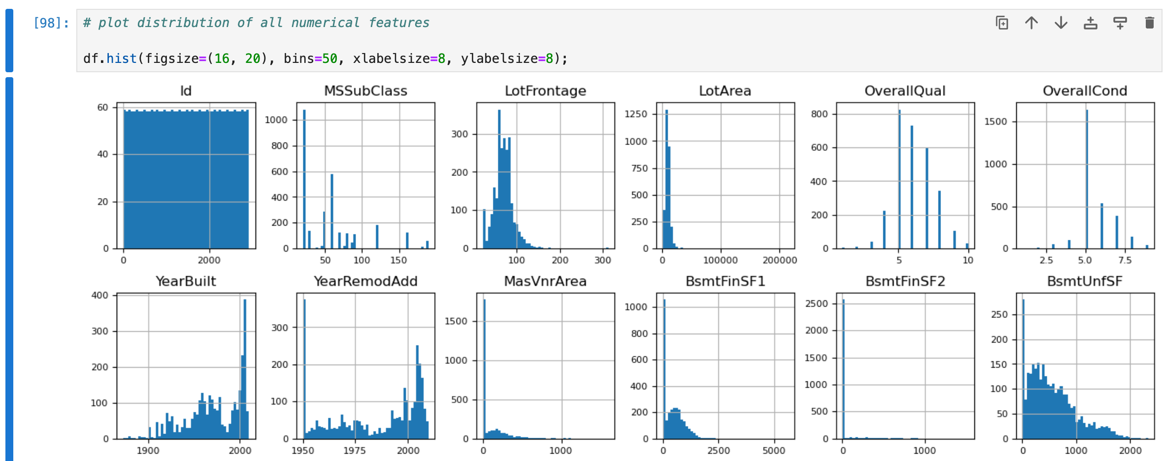


Step 1: Inspect Data

Slide 9
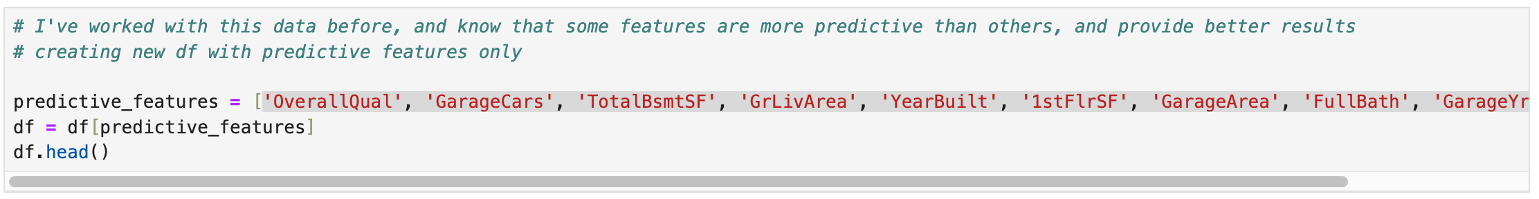
Step 2: Data Cleaning

Slide 10
Step 2: Data Cleaning
The first time I did this project, I followed a tutorial (using TensorFlow Decision Forests), which involved a feature importance step after training a random forest model
Later in this notebook, I ended up dropping more columns (features)

Slide 11
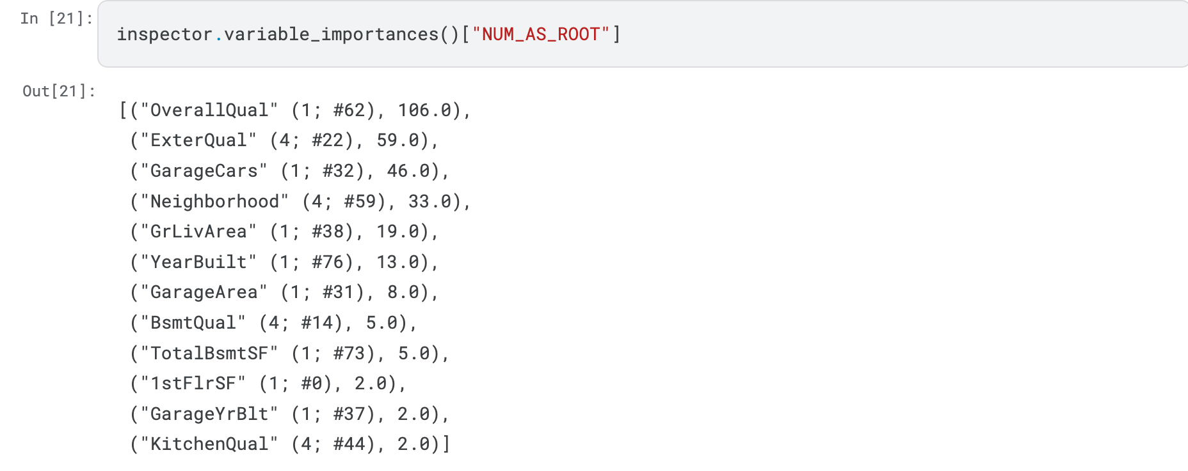
Step ???: Get Feature Importances

Slide 12
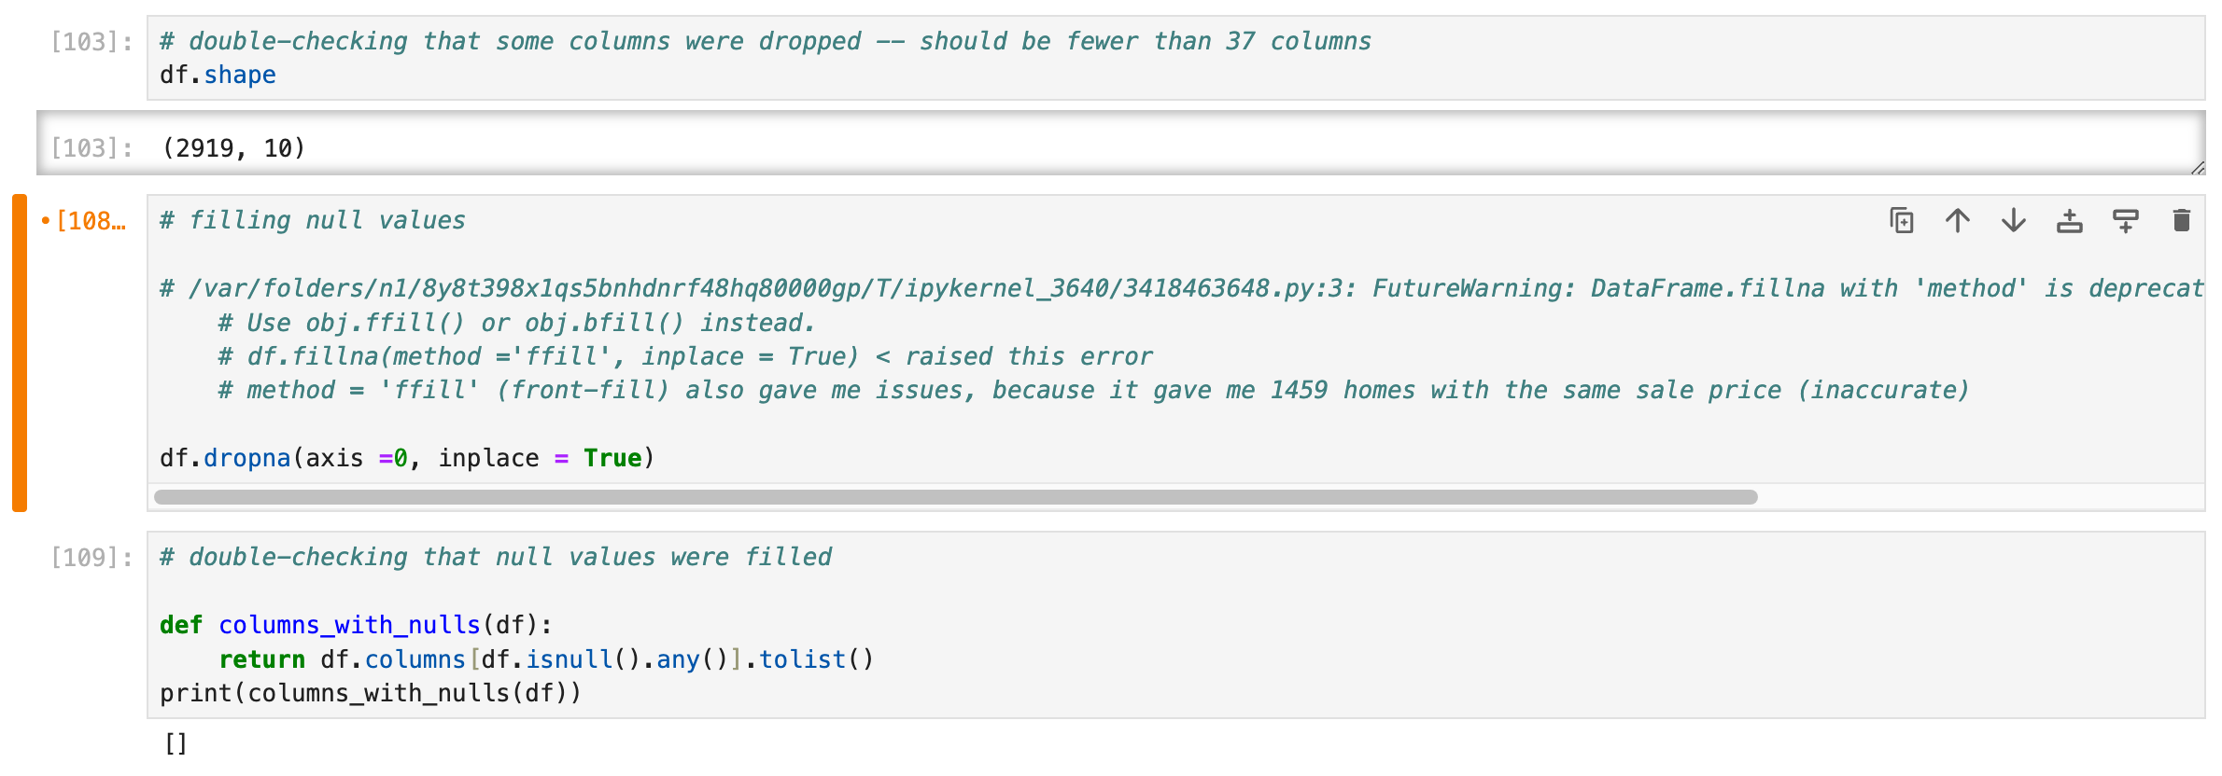
Step 2: Data Cleaning

Slide 13
Step 2: What if this were real-world data?
This is real-world data, but pre-cleaned and designed for beginners to work with
Potential data-cleaning for real-world data:
Adjusting prices for inflation (data starts from 1940s)
Transforming ‘objects’ to numerical data
Example: column “Neighborhood” is likely highly predictive, but the datatype for that column is an object (string) (the name of the neighborhood). If possible, it might be helpful to assign each neighborhood a code, or replace this column with ZIP code
Comparing to pre-existing research on home sale price predictions/general logic check (before importing the data)
Dropping columns with too many null values (some columns are irrelevant, and not worth filling if they will be dropped later)

Slide 14
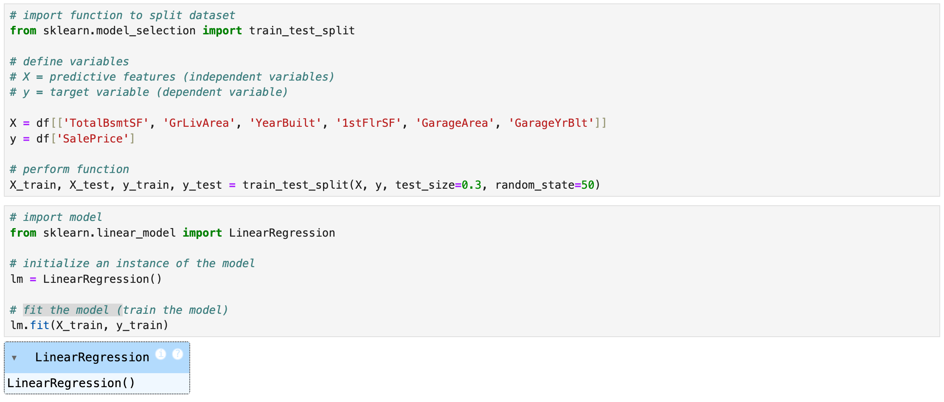


Step 3: Training the Model
dropped 3 more columns
due to next step

Slide 15
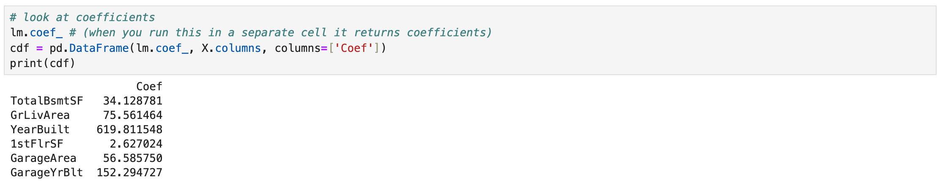
Step 3: Training the Model
Smaller coefficients = more precise predictions
I dropped 3 more columns after running this cell because the coefficients were too high (>1000)

Slide 16
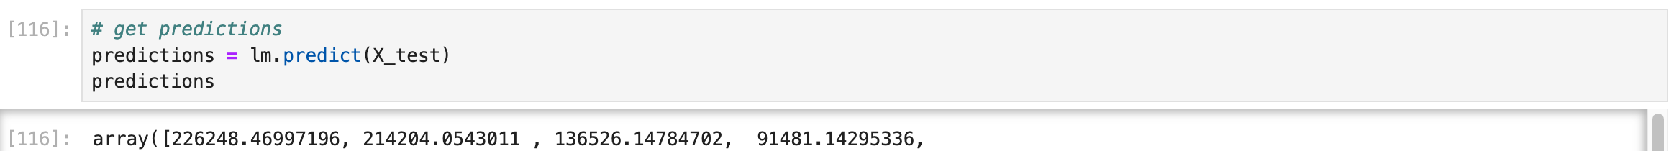
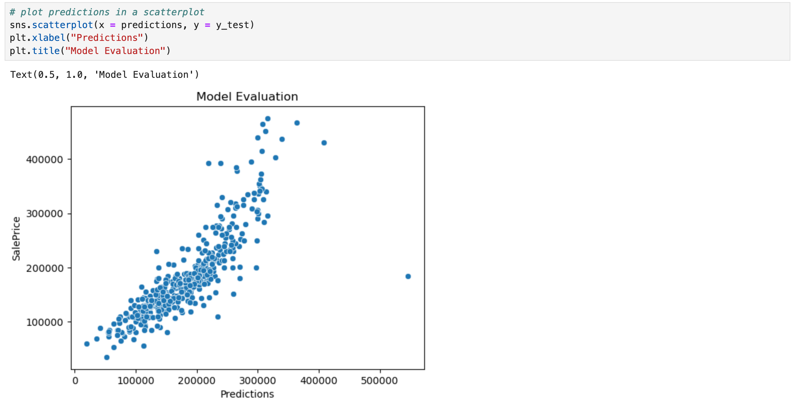
Step 3: Training the Model

Slide 17
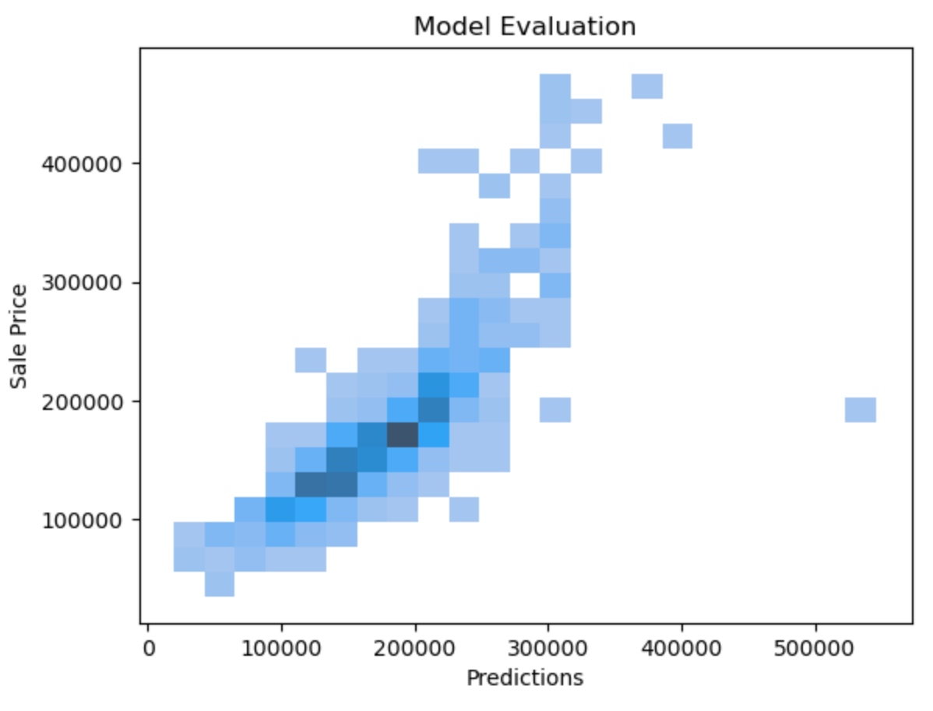
Step 3: Training the Model
Notes:
Good result! But we’re not at model evaluation yet, we’re just checking to make sure that the model did something.

Slide 18
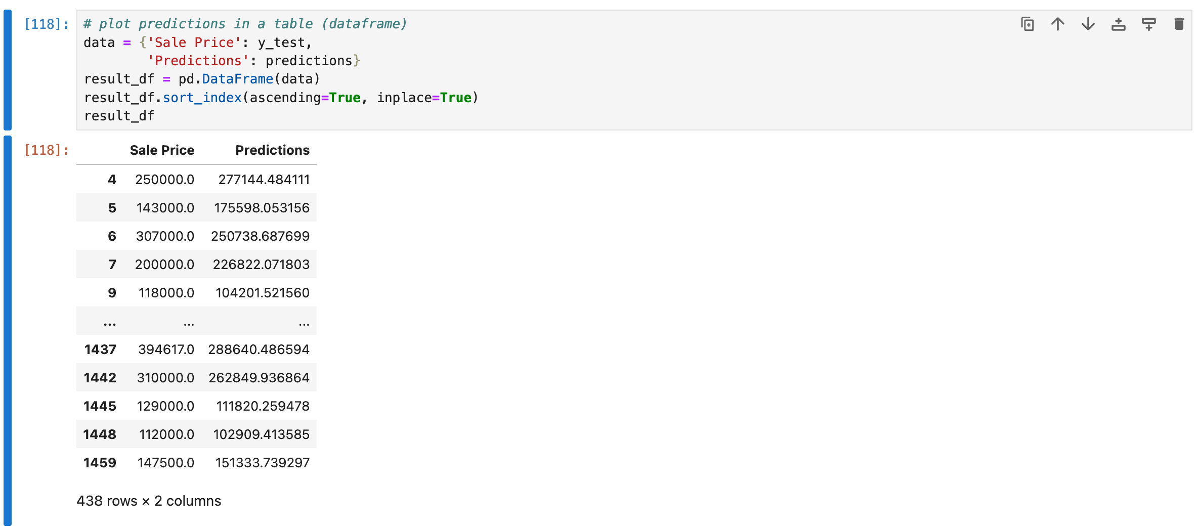
Step 4: Analysis of Model Output

Slide 19
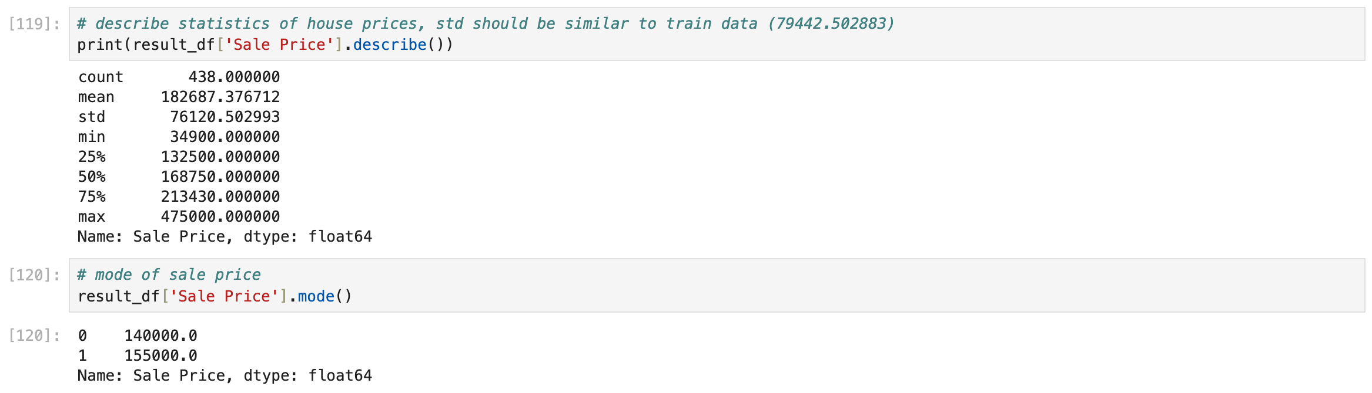
Step 4: Analysis of Model Output

Slide 20
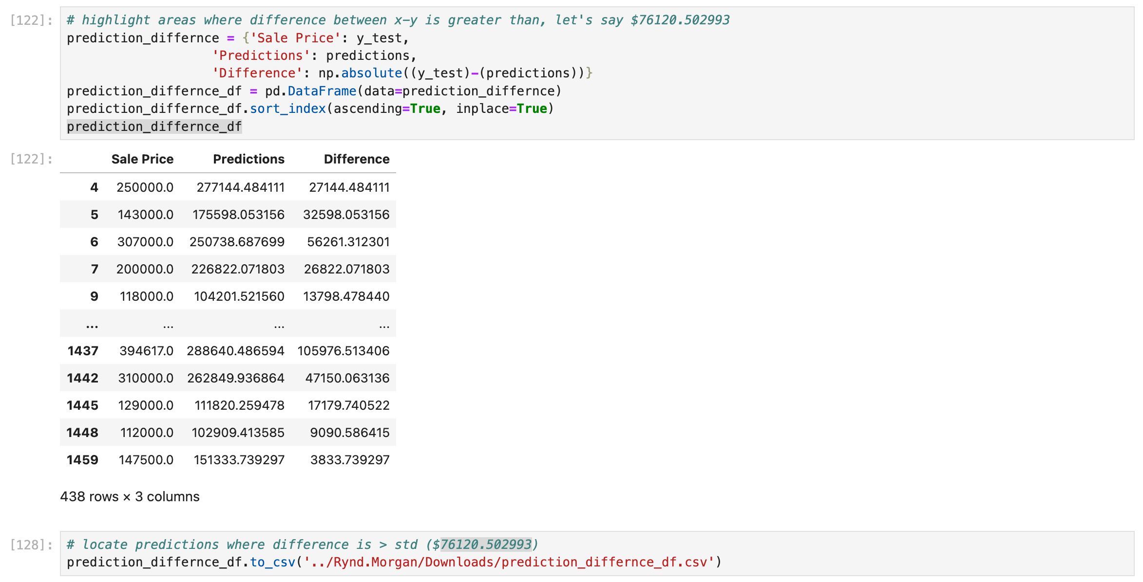
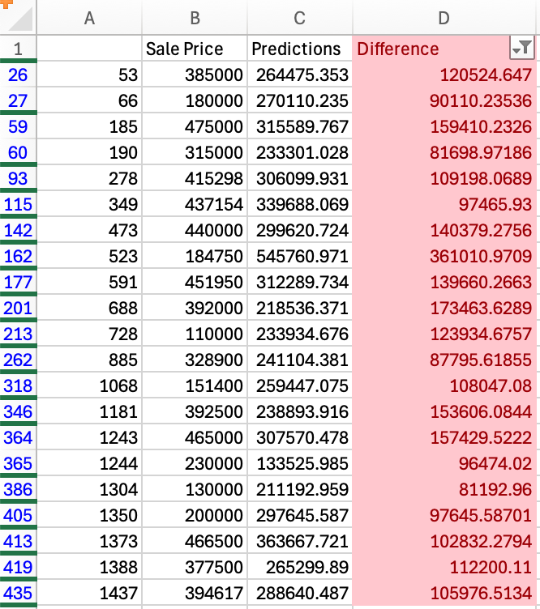
Step 4: Analysis of Model Output
Notes:
I did this wrong…needed to create analysis_df first, but this helped me learn

Slide 21
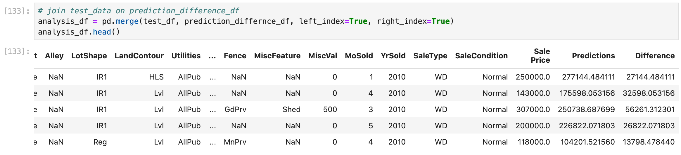
Step 4: Analysis of Model Output

Slide 22
Step 4: Analysis of Model Output
`analysis_df.to_csv`
Clean data (if necessary — Excel auto-converted predictions/prices to scientific notation, needed to convert back)
Conditional formatting — differences > 76,000
Filter on bad predictions
Hide irrelevant columns—many/all nulls, Id column, other columns known to be irrelevant
Can also do this step in notebook—drop null columns, drop non-numerical datatypes, drop other columns from analysis_df before export
This is where “actionable insights” would go if I had them

Slide 23
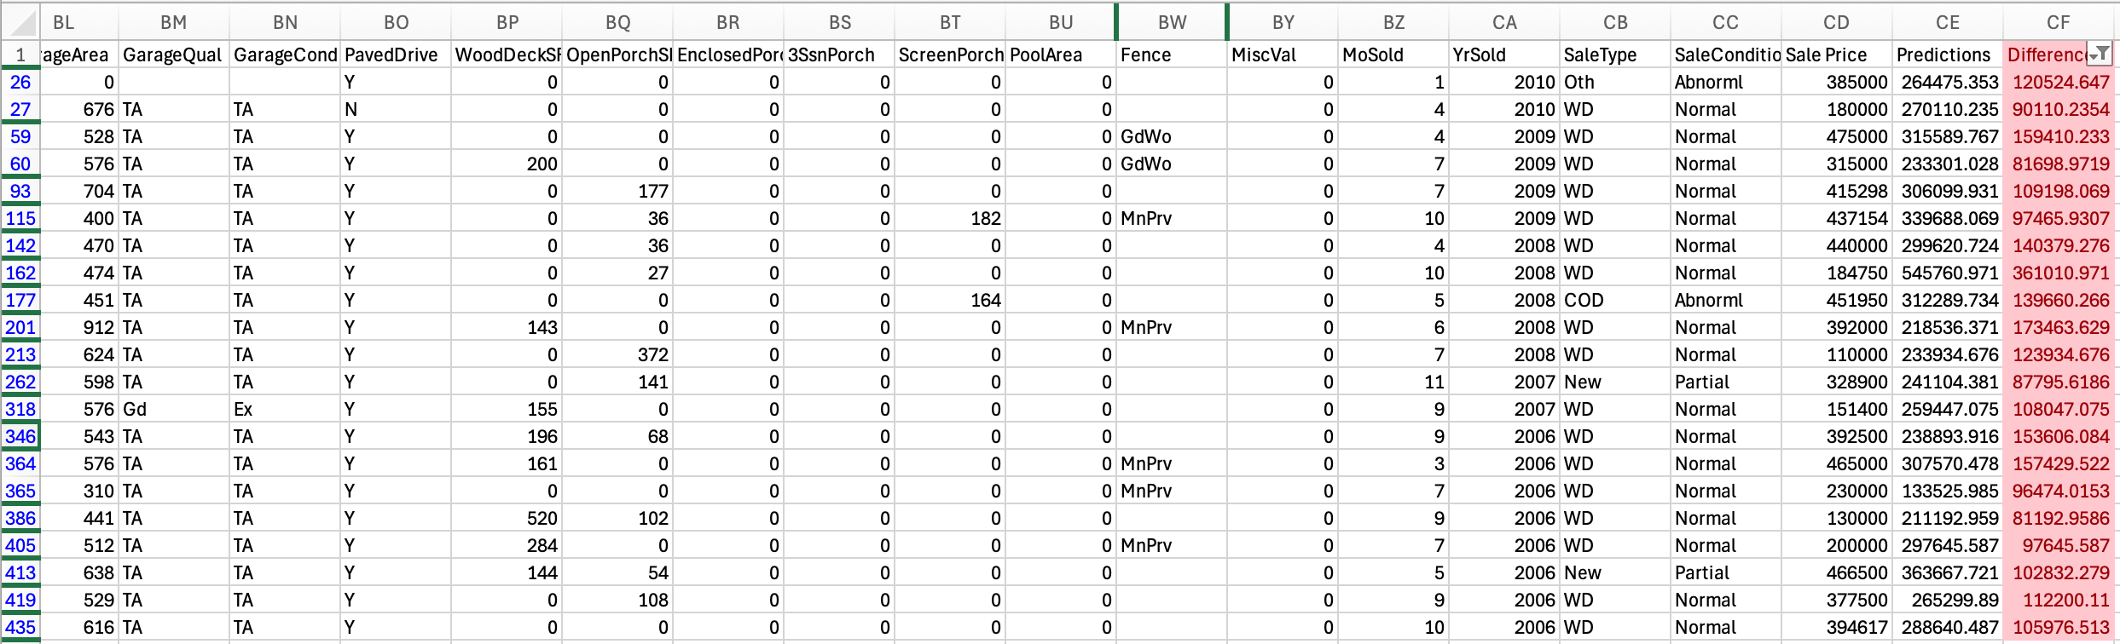
Step 4: Analysis of Model Output

Slide 24
Notes on Analysis/Actionable Insights
We have a handful of columns in this filtered table where all values are the same or similar
Paved driveway: Mostly yes
Enclosed porch, 3 season porch, pool area, misc. value: no
Year sold: 2006 – 2010 (many during 2007-2009 recession)
However, there are MANY more variables to look at in the unfiltered table, and questions to be answered
Would we benefit from converting object-values to numerical data?
Are the features that are common on “bad predictions” also common throughout the entire dataset (e.g. most homes, in general, have paved driveways)?
I filtered on “absolute difference,” but should investigate if separate features result in “over-predictions” (price too high) or “under-predictions” (price too low)

