Slide 1
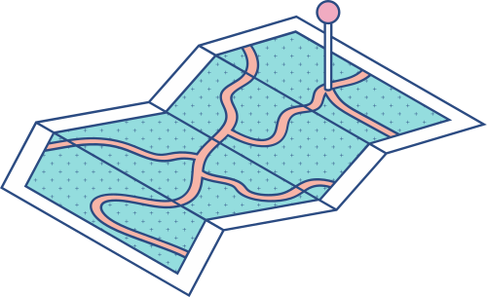




ETHERPAD
Is an online document editor primarily intended for collaborative editing in, as the site claims, “real time”. It’s an open source, highly customizable tool for online document collaboration.

Slide 2
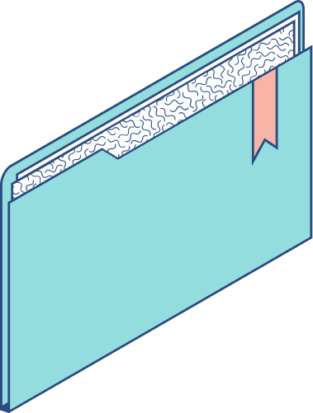
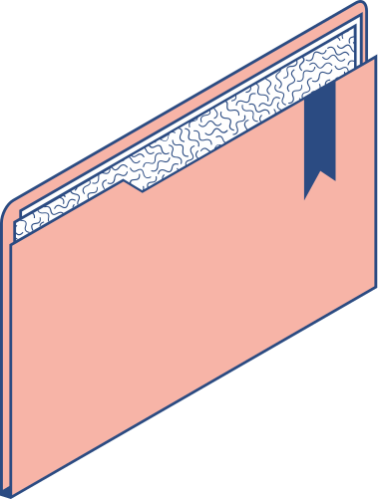

FEATURES
Real-time Collaboration Enables multiple users to edit the same document simultaneously, with changes reflected instantly to all participants. Version History Allows users to view past versions of a document, track changes over time, and revert to any previous state if needed. Chat Functionality Integrated chat box for real-time communication between collaborators without the need for third-party messaging services. Authorship Colors Distinguishes each user's contributions with different colors, making it easy to identify who has written what within the document. Import/Export Options Provides the ability to import and export documents in various formats enabling easy sharing and external usage. Access Control Controls who can view or edit each document with fine-grained permissions settings.

Slide 3
ADVANTAGES | DISADVANTAGES
Real-time Collaboration: Changes are instantly visible to all participants. User-friendly Interface: easy for anyone to use. Open Source: Free to use and can be customized. No Registration Required: allow anonymous editing. Version Control: Built-in time slider to view and revert changes. Lightweight: Doesn’t require a lot of system resources. | Limited Formatting Options: Not as feature-rich as tools like Google Docs. Security Risks: If not hosted securely, it can be vulnerable to unauthorized access. Lacks Advanced Features: No built-in chat, task management, or deep integrations. Performance Issues: Can become laggy with large documents or many users. Dependency on Internet: Requires a stable connection for real-time updates.

Slide 4
How to use Atavist/WordPress
1
2
3
STEP
STEP
STEP
Create an account on WordPress.com
Create new file or upload
Start a new project or story

Slide 5
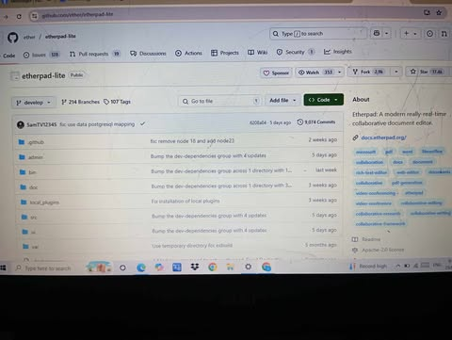
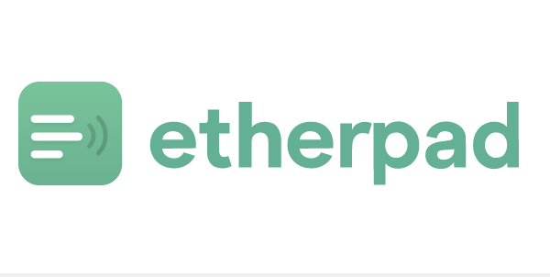
GRAPHICS

Slide 6
ATAVIST
Atavist was a digital publishing platform, it’s a drag-and-drop editor for creating beautiful online publication.

Slide 7
FEATURES
Drag-and-drop editor for ease of use. Multimedia support: Embed videos, audio, slideshows, and interactive maps. Custom design themes for visual storytelling. Publishing tools for writers, including collaboration features.

Slide 8

ADVANTAGES | DISADVANTAGES
User-friendly interface: No technical or coding knowledge required. Professional layout: Beautiful, immersive story formats. Multimedia integration: Rich, engaging storytelling. Fast publishing: Ideal for longform journalism, e-books, and portfolios. | Now defunct as a standalone service: Fully integrated into WordPress.com. Limited control compared to full web development platforms. Subscription costs (when it was active) for premium features. Dependency on the platform: No longer supported as an individual tool

Slide 9
How to use Atavist/WordPress
1
2
3
4
5
STEP
STEP
STEP
STEP
STEP
Create an account on WordPress.com
Start a new project or story
Add text box, images, video, and other media via the drag-and drop editor.
Customize layout and design using pre-et themes.
Preview and publih directly online, and
Share your wprk via social media or embed it on websites

Slide 10
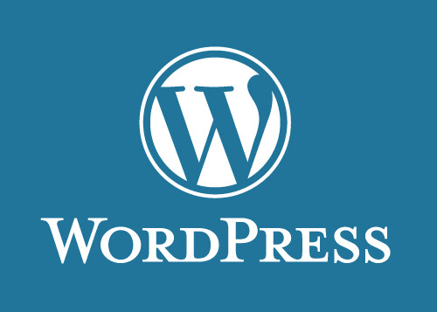
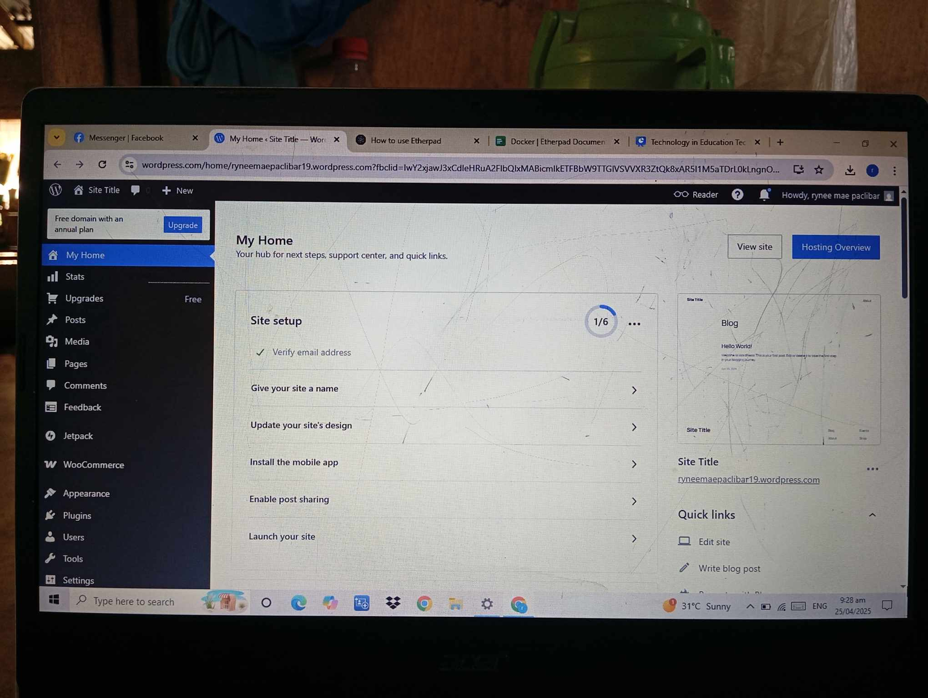
GRAPHICS

Slide 11
THANK YOU
FOR LISTENING!!

