Slide 1
COncurrency
IT 301

Slide 2
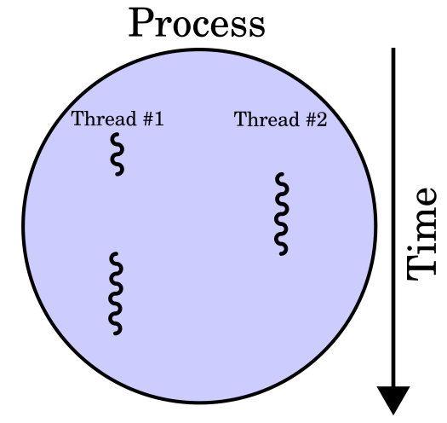
What is a thread?
A thread is a program unit that is executed concurrently with other parts of the program.
Every java program has at least one thread. main() method runs in a thread
Shares memory within a process
Notes:
Threads allow you to break up pieces of your program so that you can run them simulataneously, in parallel. It is very similar in concept to when you run different programs like microsoft word, intellij , where your os manages each program as a separate process. We will write java programs where one piece of our code is running roughly at the same time. The big difference here is a thread can easily share memory or access to the same data structures versus a separate process on your computer.

Slide 3
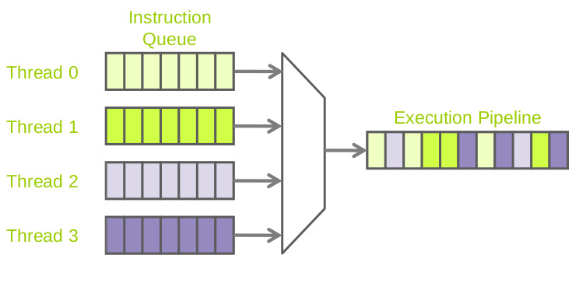
Thread scheduling
Thread scheduler
A component of the JVM
Responsible for managing the time each Thread gets to execute instructions on a CPU
Notes:
JVM provides in a java program a scheduler that helps to manage threads running on a CPU. The Thread scheduler is going to funnel these individual instructions by interleaving them in a pipeline. Muttiple pieces of our code trying to run simultaneous. This is provided for us in the JVM

Slide 4

Thread Terminology
Context switch: switching from one thread to a different thread on the CPU
All thread specific data (Java call stack, variables, program counter, …) need to be saved
Time slice (quantum): the amount of time a thread is allowed to execute instructions on a CPU
Notes:
Once a time slice has run out, a context switch occurs (a thread is interrupted, no longer runnable and put into a different state)

Slide 5
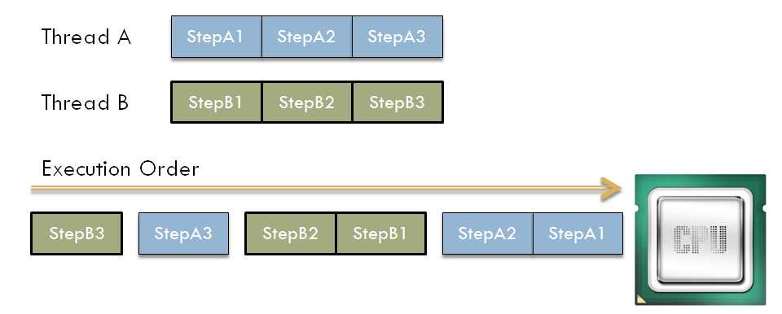
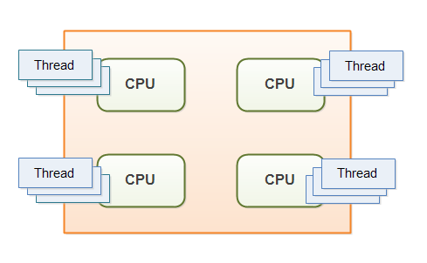
Interleaved and parallel processing
On a single processor all thread operations are interleaved
On a multi-core processor, some of the threads can run in parallel, one on each processor
Notes:
Once these steps are sent off to CPU, the steps are interleaved while to us it looks like they
Today you can have 2 pieces of code literally running at the same time
For our purposes we will study threads from the perspective of interleaving instructions on a single CPU

Slide 6
Creating Threads
Concurrency

Slide 7
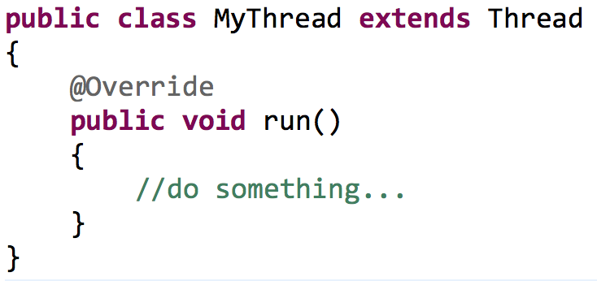
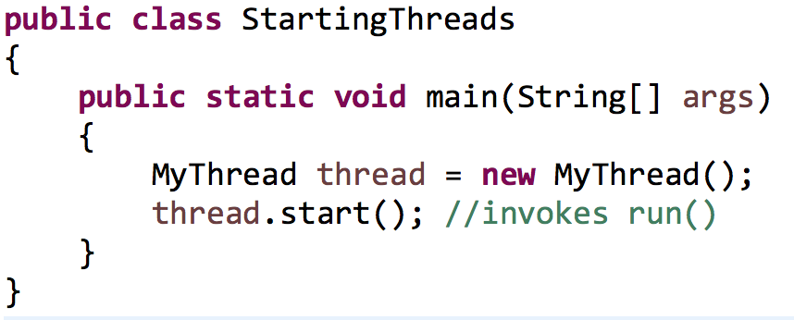
The Thread class – older way
Creating a new Thread
Define a class that extends from java.lang.Thread
Override the run() method
Starting the Thread
Call start() on an instance of your new class
Do NOT call the run() method directly as the run() method is not executed in a separate thread

Slide 8
Another Way: the Runnable interface
1) Write a class that implements java.lang.Runnable. Place the code for your task in the run() method of your class
public class MyRunnable implements Runnable {
public void run() {
// do some task
}
}
2) Create an object of your runnable class
Runnable r = new MyRunnable();
3) Construct a Thread object from the runnable object
Thread t = new Thread(r);
4) Call the start method to create the thread
t.start();

Slide 9
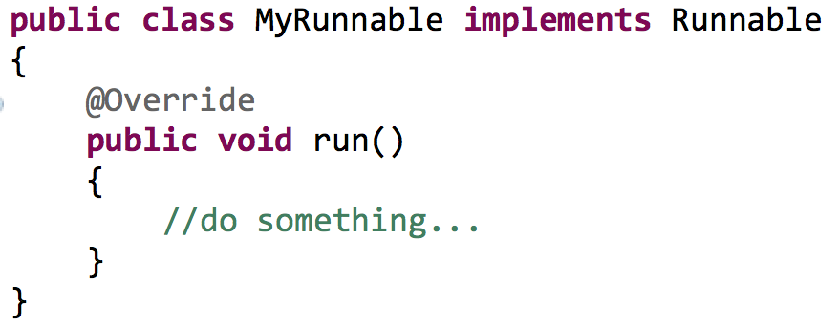
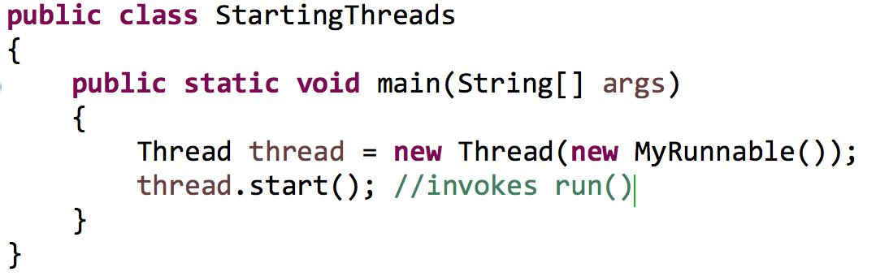
Another Way: the Runnable interface

Slide 10
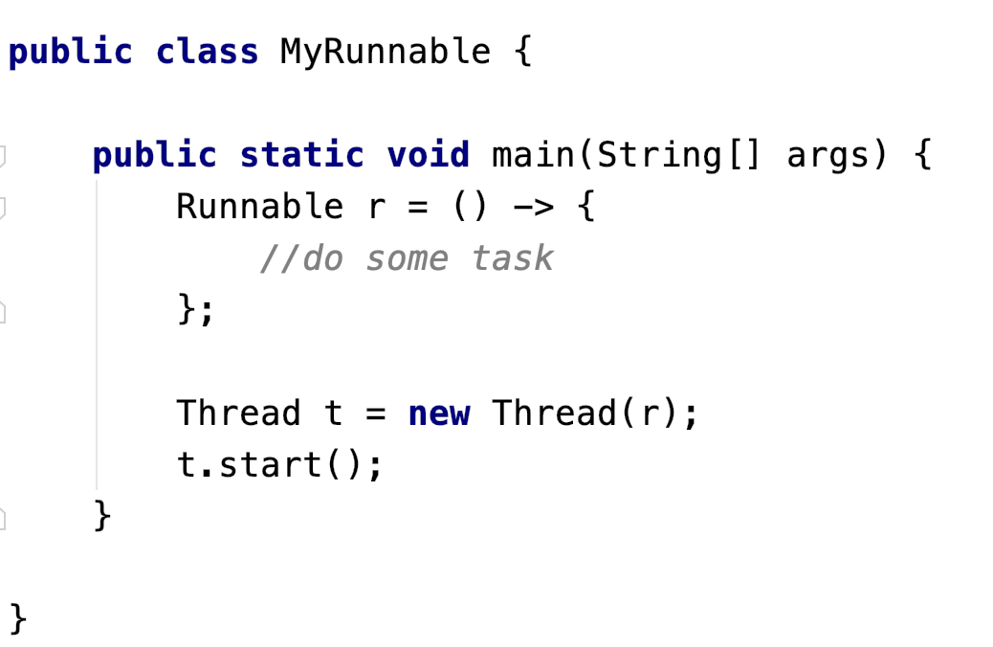
the Runnable interface with a Lambda Expression
No need to add implements Runnable here
No need to add run method

Slide 11
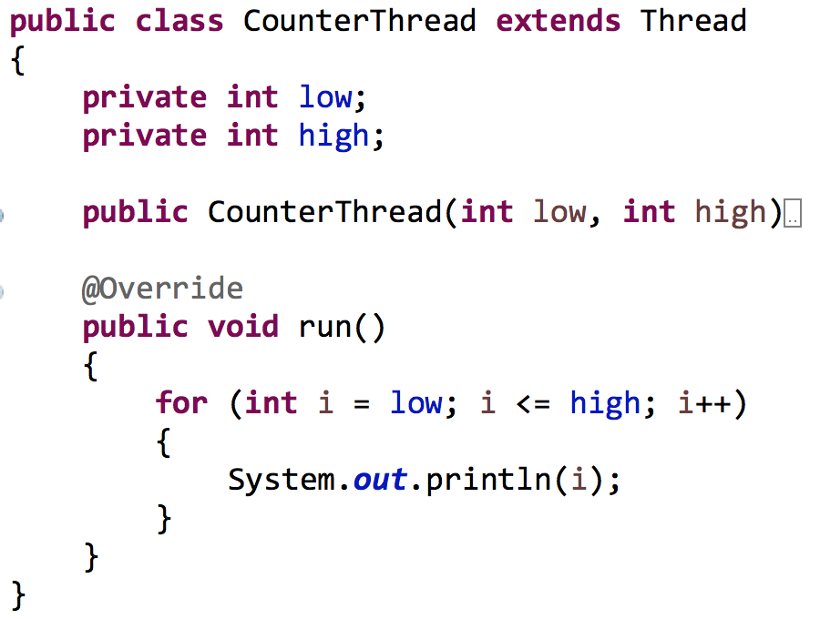
A simple thread problem
Create a thread that counts from low to high

Slide 12
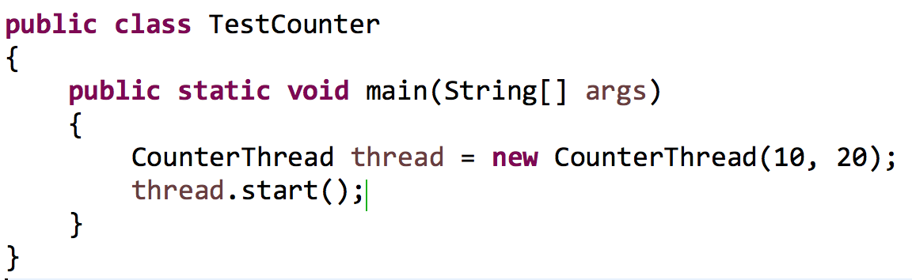
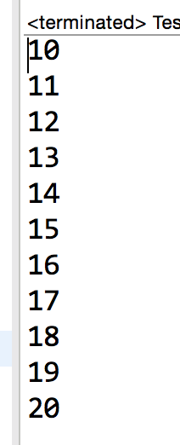
A simple thread problem
Create a thread that counts from low to high

Slide 13
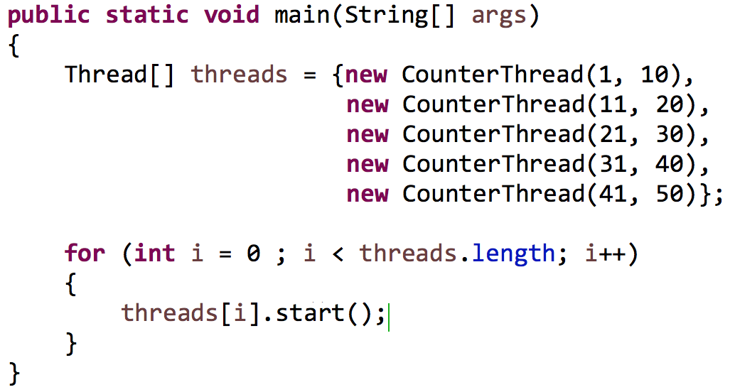
Example thread computation
Starting groups of threads

Slide 14

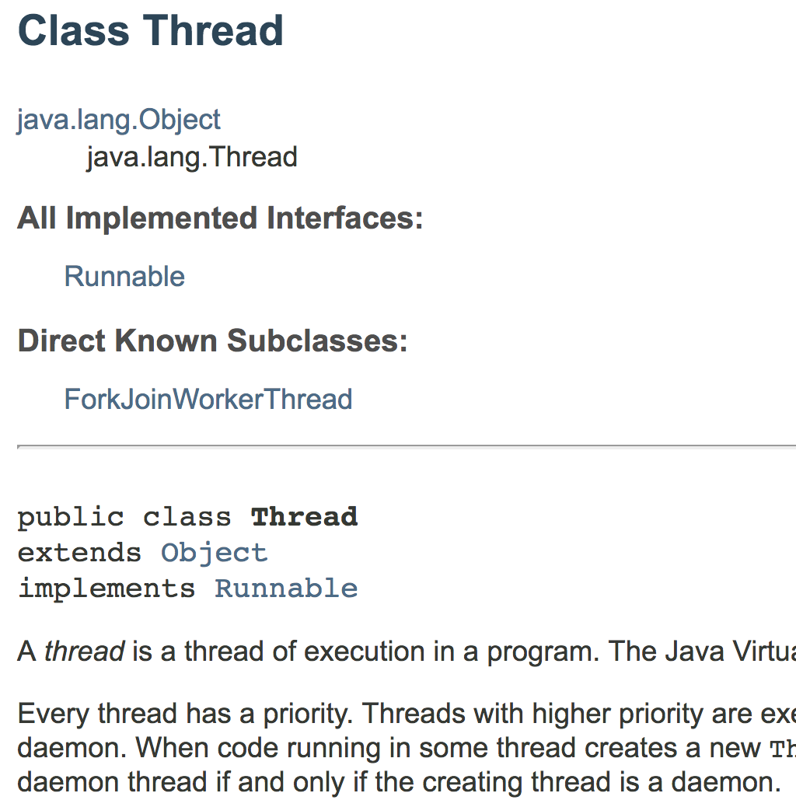
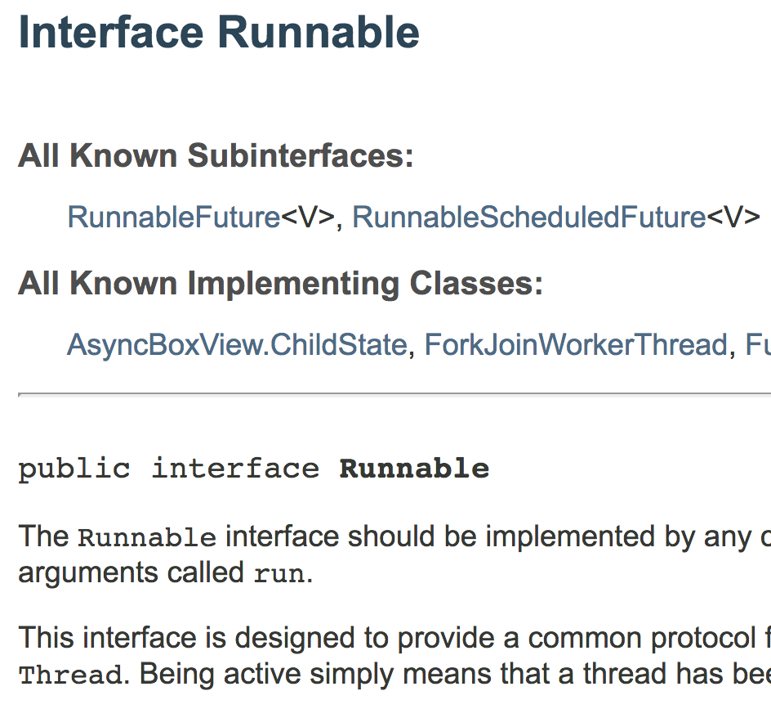
Let’s write some code Pair Program – Starting Threads

Slide 15
Capturing results
Concurrency

Slide 16
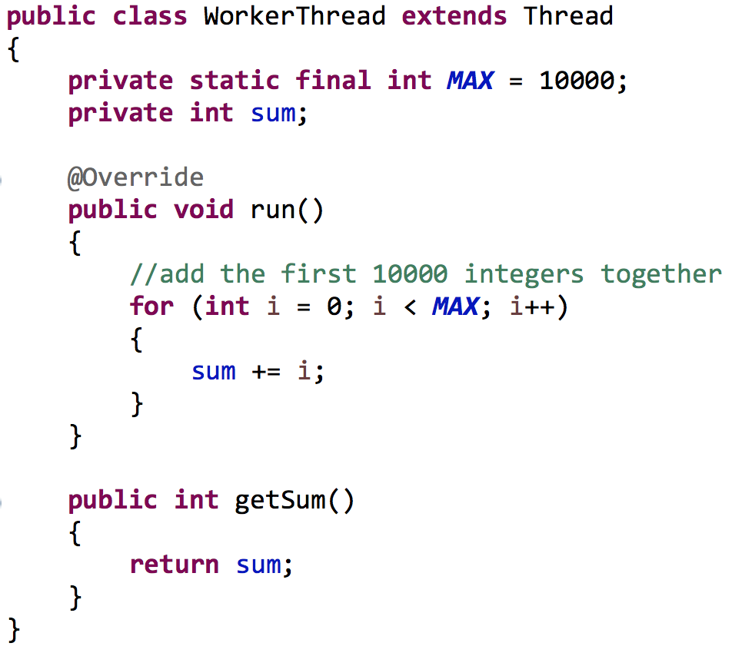
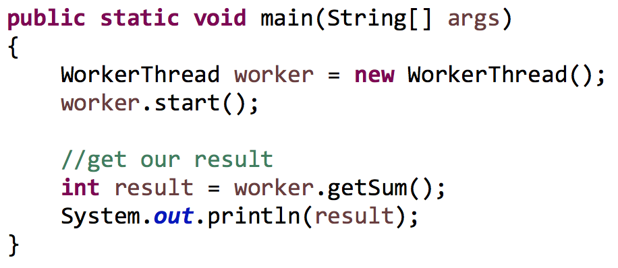
Capturing results
What is our
expected result?

Slide 17

Race conditions
Definition: A race condition occurs when the correctness of a computation depends on the relative timing or interleaving of multiple threads.

Slide 18

Concurrency
Each Java program starts with a primary thread
Any other thread that is started represents a branch in our program execution
Concurrent execution
Main thread
Computation thread

Slide 19
Concurrency
Immediate requests for results follow a consecutive mentality (rather than concurrent)
Main thread
Immediate request
for results
Computation thread
Work started
Work ended

Slide 20
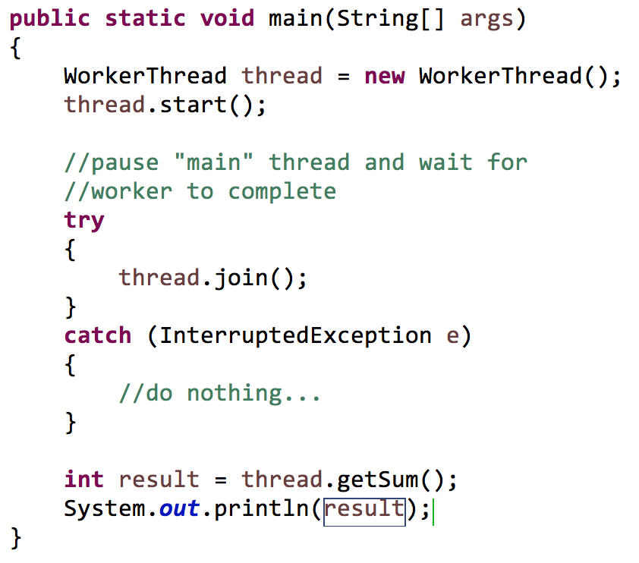
Thread.join()
Using Thread.join()
Forces the current thread into a waiting state until a secondary thread terminates
The current thread will then resume execution

Slide 21
Thread properties
Concurrency

Slide 22
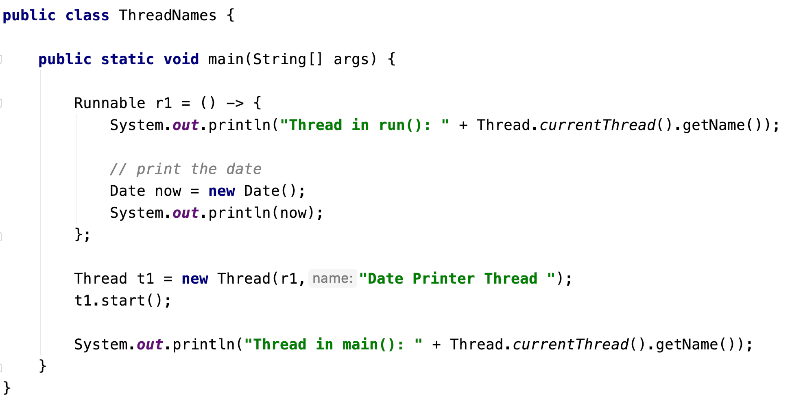

Thread names
Thread creation with a lambda
expression
Retrieving the current
thread’s name.
Setting a
Thread name
The primary thread is called ”main”

Slide 23
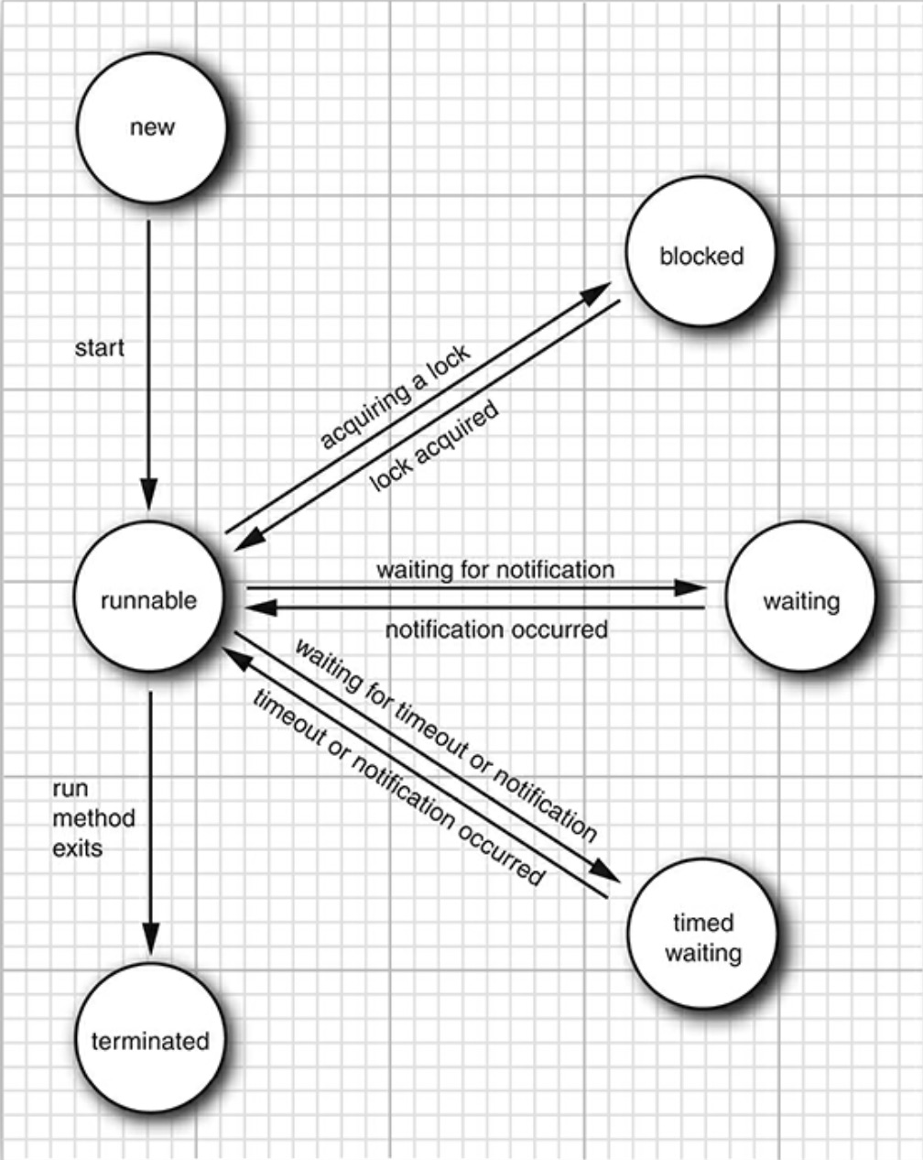
Thread states
a blocked Thread that does not execute until a necessary resource is available
a thread which has not yet started
Ready: waiting on scheduler for next chance to use CPU
Running: executing on CPU
a Thread that has completed execution
Figure 12.1 –
Core Java – Cay Horstmann

Slide 24
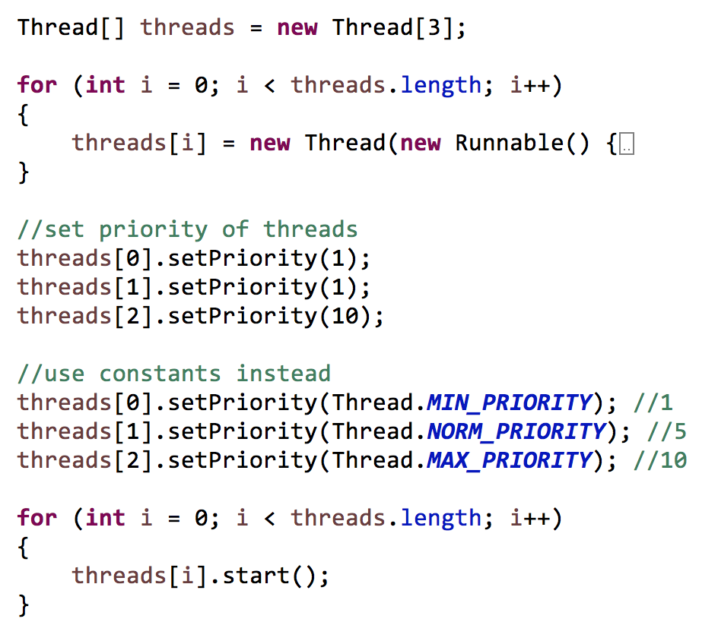
Thread priorities
Threads inherit the priority of the thread that constructed it
Higher priority threads are given more CPU time
Priorities range from [1, 10]
A priority is not guaranteed to influence the scheduler
You should not really use them

Slide 25
Pausing a thread
Thread.sleep(long millis): sleeps for the given number of milliseconds (static method)
void interrupt(): sends an interrupt request to a thread. The interrupted status of the thread is set to true. If the thread is currently blocked by a call to sleep, then an InterruptedException is thrown.
Thread.yield(): causes the currently executing thread to yield to another thread. (static method)
Scheduler chooses thread
ready
running
Scheduler suspends thread or yield()
Thread.sleep()
waiting
interrupt() or timeout elapsed

Slide 26
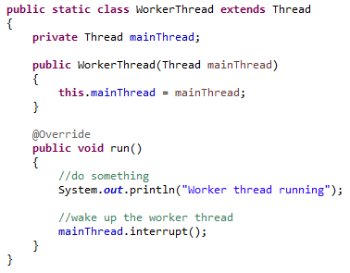
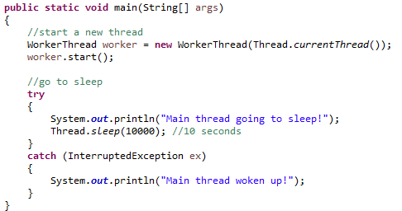
Pausing a thread
worker thread
runnable
“main” thread
runnable

Slide 27
Pausing a thread
worker thread
runnable
“main” thread
waiting

Slide 28
Pausing a thread
worker thread
runnable
“main” thread
running

Slide 29

Let’s write some code Pair Program – Thread Timing
Scheduler chooses thread
ready
running
Scheduler suspends thread or yield()
Thread.sleep()
waiting
timeout elapsed or interrupted

