Slide 1
Concurrency PART 2
IT 301

Slide 2
Thread Scheduler
The JVM has a Thread Scheduler
The Thread Schedule runs each thread for a short amount of time (time slice)
Then the scheduler activates another thread.
There will always be slight variations in running times – especially when calling Operating System services (e.g. input and output)
There is no guarantee about the order in which threads are executed.

Slide 3
Terminating Threads
A thread terminates when its run method terminates
Do not terminate a thread using the deprecated stop method.
Remember, you can notify it should terminate with:
t.interrupt();
t.interrupt() does not cause the thread to terminate immediately but rather sets a boolean variable in the thread data structure

Slide 4
Terminating Threads
The run method should occasionally check whether it has been interrupted by using the static Thread.interrupted() method
An interrupted thread should release resources, clean up, and exit.
public void run()
{
for (int i = 1;
i <= REPETITIONS && !Thread.interrupted(); i++)
{
Do work.
}
Clean up.
}

Slide 5
Terminating Threads
The sleep method throws an InterruptedException when a sleeping thread is interrupted.
You should catch the exception and terminate the thread
public void run() {
try {
for (int i = 1; i <= REPETITIONS; i++) {
Do work.
Sleep.
}
} catch (InterruptedException e) {
}
Clean up.
}

Slide 6
Terminating Threads
Java does not force a thread to terminate when it is interrupted
It is entirely up to the thread what it does when it is interrupted.
Interrupting is a general mechanism for getting the thread’s attention.

Slide 7
Race Conditions
When threads share data, then can conflict with each other causing unpredictability, lost updates, corrupted data
We will take a look at two examples:
A very simple program where multiple threads share an integer counter, all threads increment the same counter (sharedcounter.zip)
A more real world example where multiple threads manipulate a bank account. We will see two sets of threads (sharedaccount.zip)
Each thread in the first set repeatedly deposits $100
Each thread in the second set repeatedly withdraws $100

Slide 8
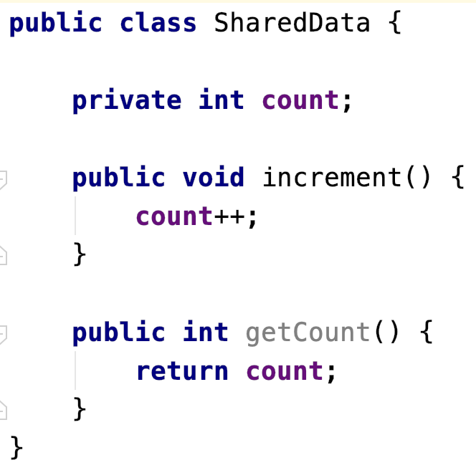
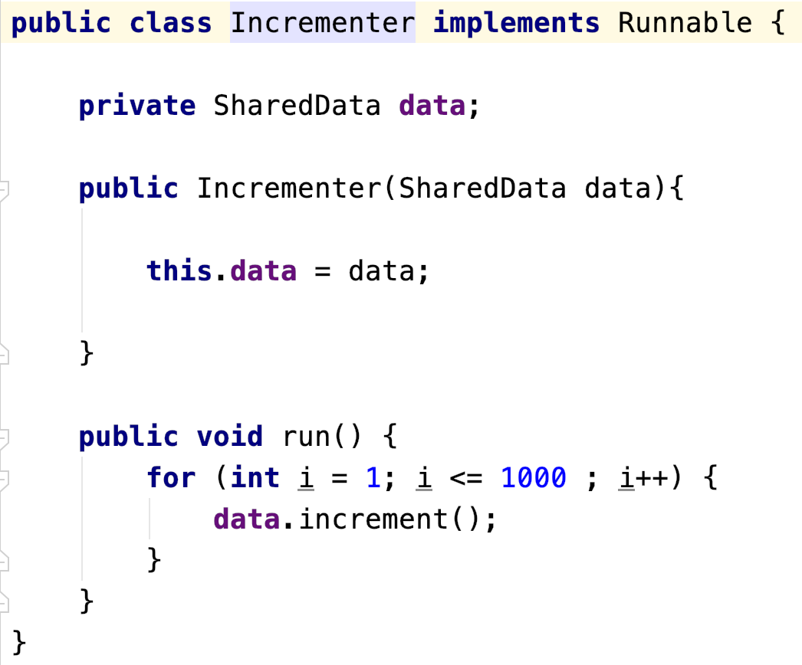
Shared data regions
Unlike processes, threads share a single memory space
Any interaction with shared memory can result in: unpredictability, corrupted data, lost updates
Shared data
Thread

Slide 9
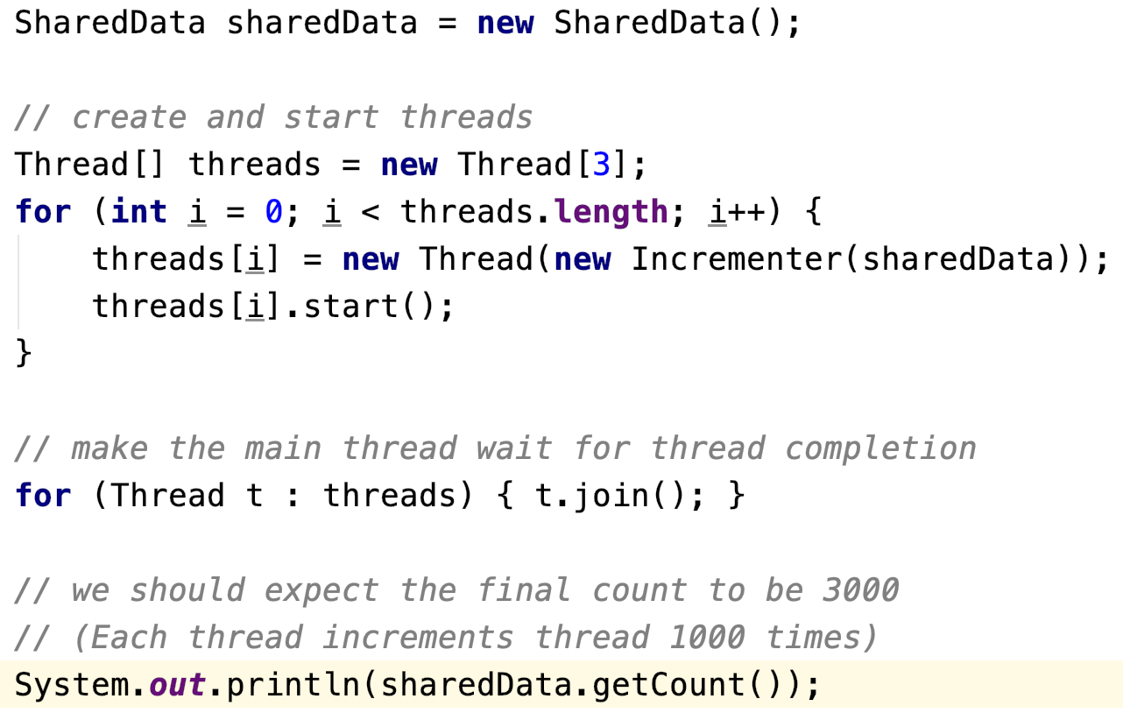
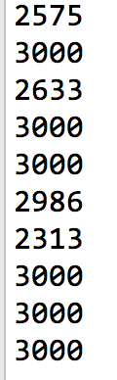
Shared data regions
Expected result?

Slide 10

Lost updates
Is increment safe?
count++; is short-hand for count = count +1;
We can easily break this Java statement into three high level steps:
Retrieve the value in count
Increment this value by 1
Assign the result to count
There are actually many more low-level steps
executed by the JVM shown on the next slide

Slide 11
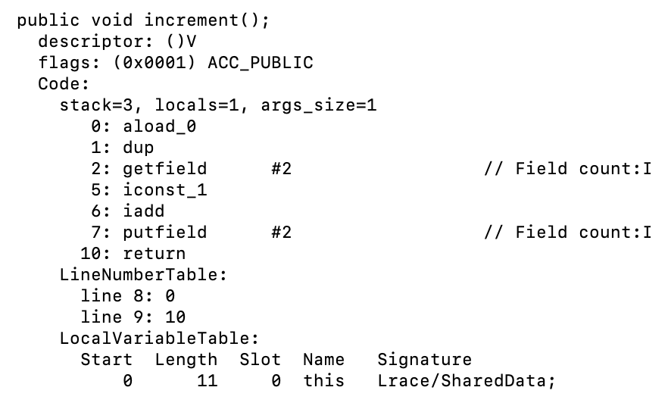
Lost updates
Here is the JVM Assembly language code for the
increment method – you can see many low-level instructions are needed to simply perform count++

Slide 12
Scenario
1.
Thread
Scheduler
Retrieve count: 3
interrupt!
ThreadA
Shared Data
count = 3
ThreadB

Slide 13
Scenario
1.
Thread
Scheduler
Retrieve count: 3
interrupt!
ThreadA
2.
Shared Data
count = 3 → 4
ThreadB
Retrieve count: 3
Increment count: 4
Reassign

Slide 14
Scenario
1.
Thread
Scheduler
Retrieve count: 3
interrupt!
ThreadA
3.
Increment count: 4
Reassign
2.
Shared Data
count = 3 → 4
count = 3 → 4
ThreadB
Retrieve count: 3
Increment count: 4
Reassign

Slide 15
BankAccount Example
run method of DepositRunnable class:
public void run()
{
try
{
for (int i = 1; i <= count; i++)
{
account.deposit(amount); Thread.sleep(1);// 1 millisecond
}
}
catch (InterruptedException exception)
{
}
}

Slide 16
BankAccount Example
run method of WithdrawalRunnable class:
public void run()
{
try
{
for (int i = 1; i <= count; i++)
{
account.withdraw(amount); Thread.sleep(1);// 1 millisecond
}
}
catch (InterruptedException exception)
{
}
}

Slide 17
BankAccount Example
deposit method in BankAccount class is accessing the shared this.balance data which can cause unpredictability
public void deposit(double amount)
{
System.out.print("Depositing " + amount);
double newBalance = this.balance + amount;
System.out.println(",new balance is"+newBalance);
this.balance = newBalance;
}
Notes:
The more Java statements we have here the more JVM assembly language instructions we produce

Slide 18
BankAccount Example
withdraw method in BankAccount class is accessing the shared this.balance data which can cause unpredictabilty
public void withdraw(double amount)
{
System.out.print("Withdrawing " + amount);
double newBalance = this.balance - amount;
System.out.println(",new balance is"+newBalance);
this.balance = newBalance;
}
Notes:
The more Java statements we have here the more JVM assembly language instructions we produce

Slide 19
BankAccount Example
Program output could look predictable like this
Depositing 100.0, new balance is 100.0
Withdrawing 100.0, new balance is 0.0
Depositing 100.0, new balance is 100.0
Depositing 100.0, new balance is 200.0
Withdrawing 100.0, new balance is 100.0
...
Withdrawing 100.0, new balance is 0.0
Program output could become unpredictable when we see the ending balance is not zero but rather negative caused by race conditions between our threads
Depositing 100.0Withdrawing 100.0, new balance is 100.0, new balance is -100.0

Slide 20
Scenario
1. A deposit thread executes the lines:
System.out.print("Depositing " + amount);
double newBalance = balance + amount;
The balance field is still 0, and the newBalance local variable is 100.
2. The deposit thread reaches the end of its time slice and a withdraw thread gains control
3. The withdraw thread calls the withdraw method which withdraws $100 from the balance variable; it is now -100
4. The withdraw thread goes to sleep
5. The deposit thread regains control and picks up where it was interrupted. It now executes:
System.out.println(", new balance is"+newBalance);
this.balance = newBalance;
The balance variable is now 100 instead of 0 because the deposit method used the old balance to computer the value of its local variable newBalance.

Slide 21
Synchronizing Access
To solve problems such as the ones just seen, use a lock object.
Lock object: used to control threads that manipulate shared resources
In Java library: Lock interface and several classes that implement the Lock interface
ReentrantLock: most commonly used lock class
Locks are a feature of Java version 5.0
Earlier versions of Java have a lower-level facility for thread synchronization
Lock
Shared data

Slide 22
Synchronizing Access
Typically, a Lock object is added to a class whose methods access shared resources, like this:
public class BankAccount
{
private Lock balanceChangeLock;
. . .
public BankAccount()
{
balanceChangeLock = new ReentrantLock();
. . .
}
. . .
}

Slide 23
Synchronizing Access
Code that manipulates shared resource is surrounded by calls to lock and unlock:
balanceChangeLock.lock();
Manipulate the shared resource. balanceChangeLock.unlock();
If code between calls to lock and unlock throws an exception, call to unlock never happens
To overcome this problem, place call to unlock into a finally clause
balanceChangeLock.lock();
try { Manipulate the shared resource. } finally { balanceChangeLock.unlock();
}

Slide 24
Visualizing Object Locks
“Like a door that guards access to a room (code segment). Only a single person (thread) can be in the room at one time. When a person leaves the room, a new person (thread) that is waiting can enter the room.”
Shared data
Thread
Thread
Thread
Thread
Thread
blocked state (ie. waiting for the lock)
runnable state (ie. owns the lock)

Slide 25
Synchronizing Access
Code for deposit method:
public void deposit(double amount)
{
balanceChangeLock.lock();
try
{
System.out.print("Depositing " + amount); double newBalance = balance + amount; System.out.println(", new balance is "+ newBalance);
balance = newBalance;
}
finally
{
balanceChangeLock.unlock();
}
}

Slide 26
Synchronizing Access
When a thread calls lock, it owns the lock until it calls unlock.
A thread that calls lock while another thread owns the lock is temporarily deactivated.
Thread scheduler periodically reactivates thread so it can try to acquire the lock.
Eventually, waiting thread can acquire the lock.

Slide 27
Check for Understanding
If you construct two BankAccount objects, how many lock objects are created?
Notes:
Answer: Two, one for each bank account object. Each lock protects a separate balance variable.

Slide 28
Check for Understanding
What happens if we omit the call unlock at the end of the deposit method?
Notes:
Answer: When a thread calls deposit, it continues to own the lock, and any other thread trying to deposit or withdraw money in the same bank account is blocked forever.

Slide 29
Avoiding Deadlocks
A deadlock occurs if no thread can proceed because each thread is waiting for another to do some work first.
public void withdraw(double amount)
{
balanceChangeLock.lock();
try
{
while (balance < amount)
Wait for the balance to grow
...
}
finally
{
balanceChangeLock.unlock();
}
}

Slide 30
Avoiding Deadlocks
How can we wait for the balance to grow?
We can’t simply call sleep inside withdraw method; thread will block all other threads that want to use balanceChangeLock.
In particular, no other thread can successfully execute deposit.
Other threads will call deposit, but will be blocked until withdraw exits.
But withdraw doesn’t exit until it has funds available.
DEADLOCK.

Slide 31
Condition Objects
To overcome problem, use a condition object.
Condition objects allow a thread to temporarily release a lock, and to regain the lock at a later time.
Each condition object belongs to a specific lock object.

Slide 32
Condition Objects
You obtain a condition object with newCondition
method of Lock interface:
public class BankAccount
{
private Lock balanceChangeLock;
private Condition sufficientFundsCondition;
. . .
public BankAccount()
{
balanceChangeLock = new ReentrantLock(); sufficientFundsCondition =
balanceChangeLock.newCondition();
. . .
}
}

Slide 33
Condition Objects
It is customary to give the condition object a name that describes condition to test; e.g. “sufficient funds”.
You need to implement an appropriate test.

Slide 34
Condition Objects
As long as test is not fulfilled, call await on the condition object:
public void withdraw(double amount) throws InterruptedException{
balanceChangeLock.lock();
try{
while (balance < amount)
{
sufficientFundsCondition.await();
}
. . .
}
finally{
balanceChangeLock.unlock();
}
}
Notes:
The await() method can throw an InteruptedException. The withdraw method throws this exception to allow the withdraw threads to decide what to do if the withdraw method is interrupted.

Slide 35
Condition Objects
Calling await:
Makes current thread wait.
Allows another thread to acquire the lock object.
To unblock, another thread must execute signalAll on the same condition object:
sufficientFundsCondition.signalAll();
signalAll unblocks all threads waiting on the condition
signal randomly picks just one thread waiting on the object and unblocks it.
signal can be more efficient, but you need to know that every waiting thread can proceed.
Recommendation: always call signalAll

Slide 36
Synchronize the BankAccount Program
Using the previous slides as a reference and your reading in Core Java, modify the BankAccount class in sharedaccount.zip so that it uses Locks and Conditions to guarantee the account balance is always predictable by removing the race conditions between the DepositRunnable and WithdrawalRunnable Threads.
Note: the only class you should have to modified is BankAccount.java

Slide 37
Check for Understanding
What is the essential difference between calling the sleep and await methods?
Notes:
Answer: A sleeping thread is reactivated when the sleep delay has passed. A waiting thread is only reactivated if another thread has called signalAll or signal.

Slide 38
Check for Understanding
Why is the sufficientFundsCondition object an instance variable of the BankAccount class and not a local variable of the withdraw and deposit methods?
Notes:
Answer: The calls to await and signal/signalAll must be made to the same object.

Slide 39
Review – Locks and Conditions
A lock protects sections of code, allowing only one thread to execute the code at a time
A lock manages threads that are trying to enter a protected code segment
A lock can have one or more associated condition objects.
Each condition object manages threads that have entered a protected code section but that cannot proceed

Slide 40
Synchronization in Java(older way)
Locks and Conditions give programmers a high degree of control over locking
However, in most situations, you don't need that control, you can use a mechanism built into Java ever since version 1.0
Every object in Java has an intrinsic lock
If a method is declared with the synchronized keyword, the object's lock protects the entire method.
To call a synchronized method, a thread must acquire the intrinsic object lock.
public synchronized void method () {
do something
}

Slide 41
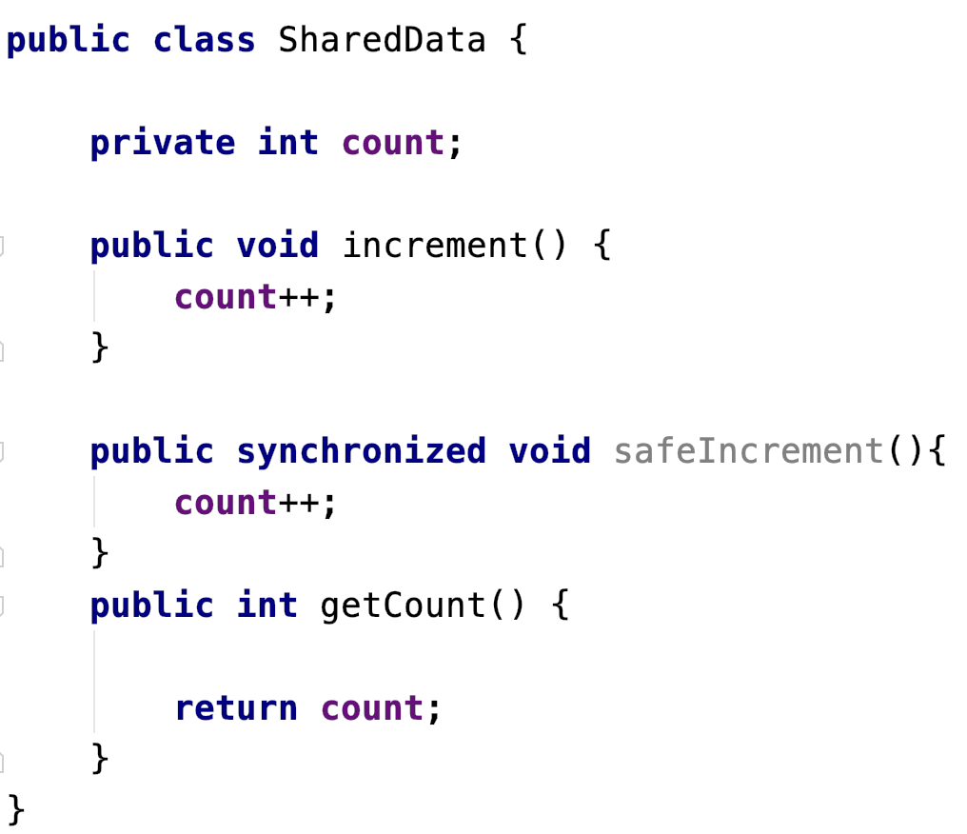
Synchronized Method(older way)
Uses the intrinsic object lock
Will complete
without interruption

Slide 42
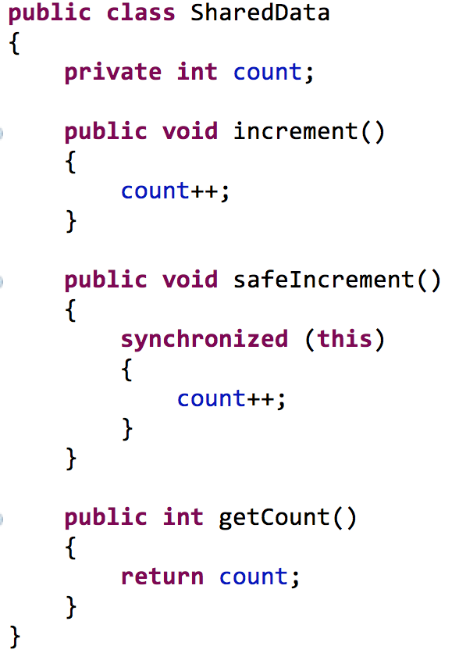
Synchronized Block (older way)
Use the SharedData object as a lock.
Mutually
exclusive
access
Will complete
without interruption

Slide 43
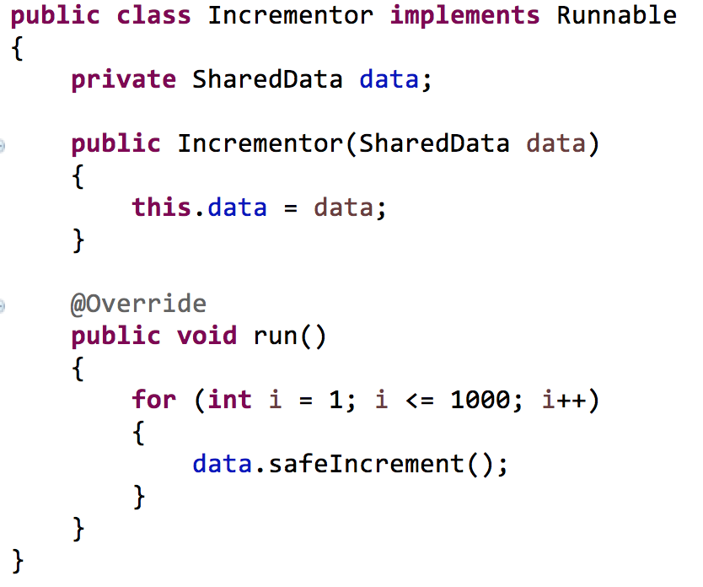

Synchronization in Java

Slide 44
Synchronize the BankAccount Program
We now will modify the BankAccount class in sharedaccount.zip so that it uses a synchronized method or block to guarantee the account balance is always predictable by removing the race conditions between the DepositRunnable and WithdrawalRunnable Threads.
Note: the only class we will have to modified is BankAccount.java

Slide 45
Thread safety
Definition: A class is thread-safe when it continues to behave correctly when accessed from multiple threads.
Question: Is Java’s ArrayList class thread-safe?
How can we know?
Java API
Test for predictable results during concurrent access

Slide 46
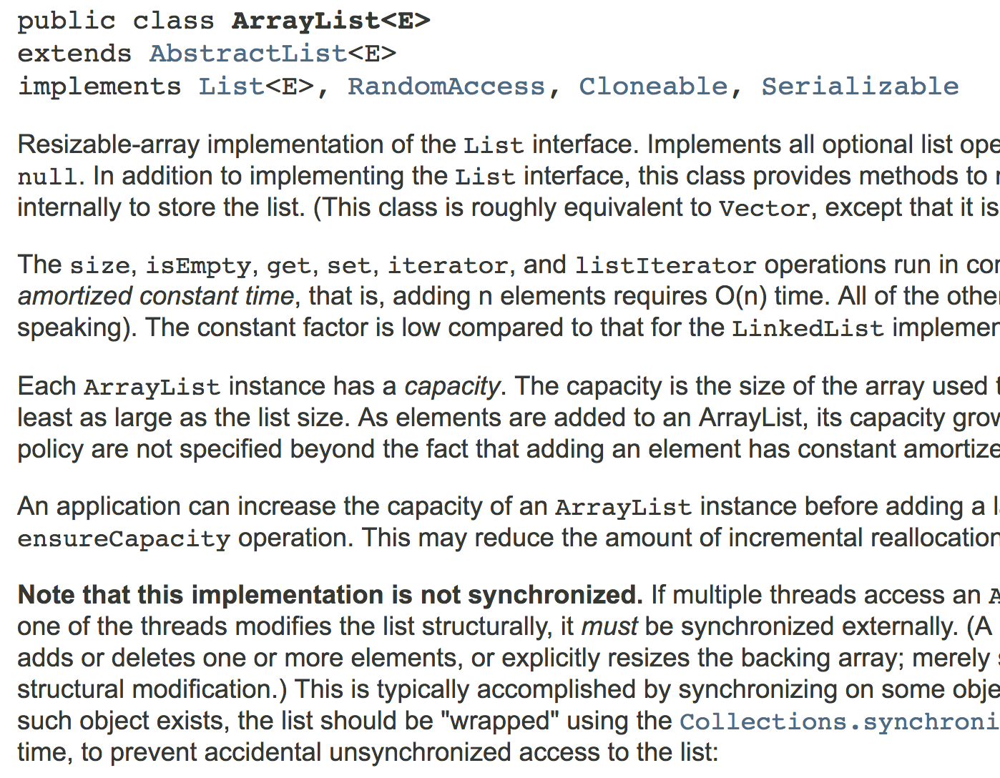
Example
What does the Java API tell us?

Slide 47
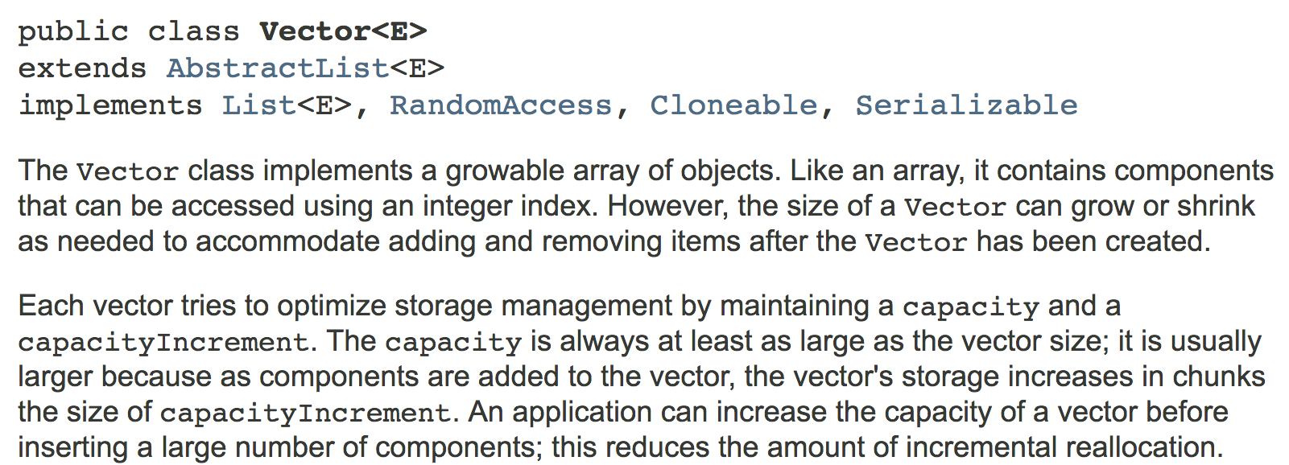
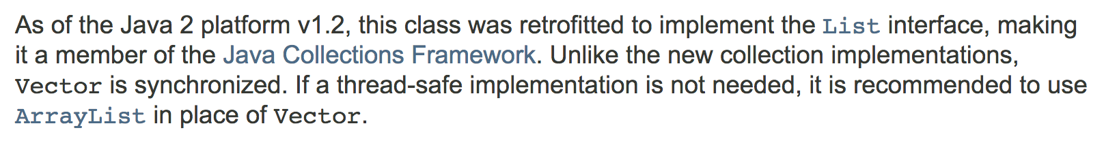
The Vector class
Alternative to the ArrayList class

Slide 48
Alternatives to synchronization
Concurrency

Slide 49

Alternatives
Volatile Fields – volatile keyword offers a lock-free mechanism for synchronizing access to an instance field provided you perform no operations other than assignment
Atomics – there are a number of classes in java.util.concurrent.atomic package that use efficient machine-level instructions to guarantee predictable updates/access without locks
Use Thread-Safe Collections
Use Thread-Safe Queue Classes

Slide 50
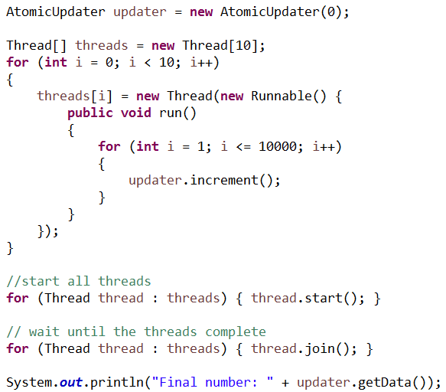
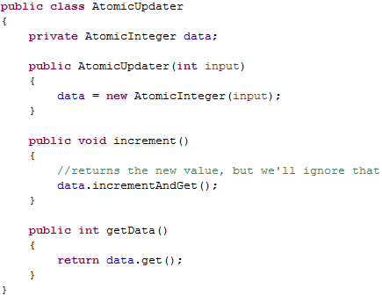
Atomics Example
Use types from java.util.concurrent.atomic

Slide 51
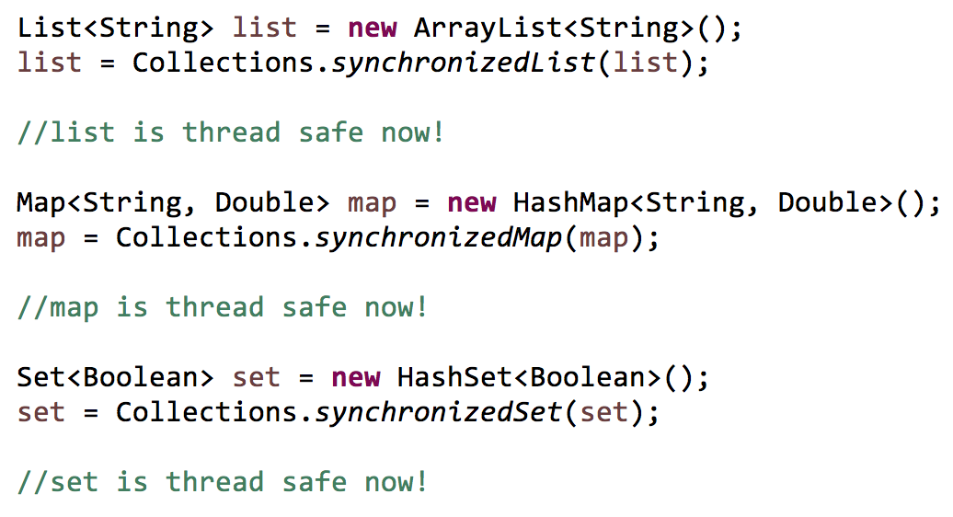
Use Thread-Safe Collections
Use methods from the Collections class

Slide 52
The producer/consumer pattern
Concurrency

Slide 53
Producers and consumers
The producer/consumer pattern is a well known solution for managing:
A queue of data
Producer threads generate data items on the blocking queue
Consumer threads remove data items from the blocking queue (for processing)
Create items
Process items
Producer
Thread
Consumer
Thread
Producer
Thread
Consumer
Thread
Producer
Thread
Consumer
Thread
Blocking Queue

Slide 54
Producers
Producer threads insert data into queue
Blocking queue causes producer thread to block when queue is full
Place orders
Producer
Thread
Producer
Thread
Producer
Thread
Blocking Queue
Register customer
Add line items
Verify addresses
Verify funds
Blocking queue allows you to safely hand data from thread to thread

Slide 55
Consumers
Blocking queue causes consumer thread to block when queue is empty
Fulfill orders
Place orders
Consumer
Thread
Producer
Thread
Producer
Thread
Consumer
Thread
Producer
Thread
Consumer
Thread
BlockingQueue
Notify customer
Generate receipt
Box items
Ship items
Consumer threads remove data from queue

Slide 56
Blocking Queues
A blocking queue causes a thread to block when you try to add an element when the queue is currently full or to remove an element when the queue is empty.
Blocking queues are often used when implementing a Producer Consumer Design Pattern

Slide 57
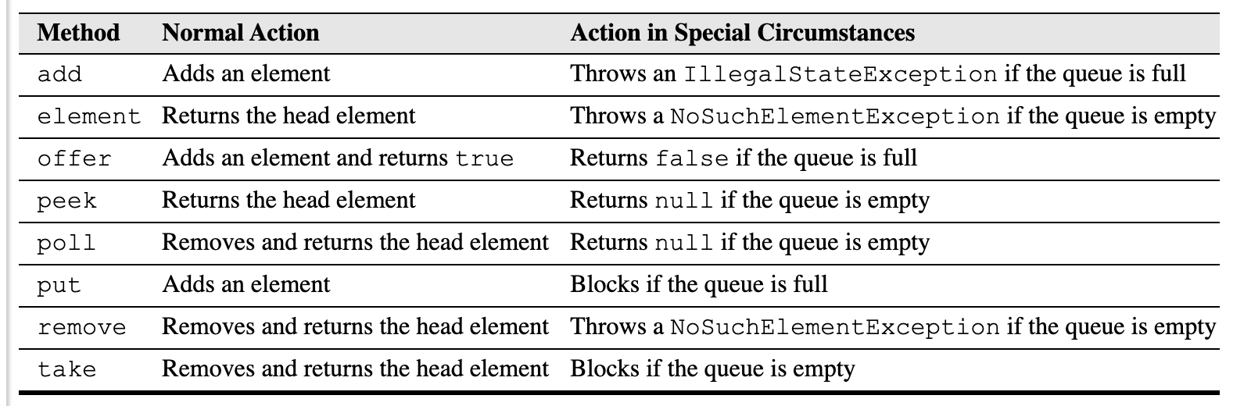
Blocking Queue Interface Methods
Table 12-1: Core Java by Cay Horstmann
Notes:
The blocking queue methods fall into three categories that differ by the action they perform when the queue is full or empty. If you use the queue as a thread management tool, use the put and take methods. The add, remove, and element operations throw exceptions so avoid. The offer poll and peek methods return with a failure indicator instead of throwing an exception if they cannot carry out the tasks.

Slide 58
Blocking Queue Class Implementations
The java.util.concurrent package offers a few classes which implement the BlockingQueue Interface
LinkedBlockingQueue – has no upper bound on it’s capacity
ArrayBlockingQueue – is constructed with a given capacity
Notes:
The blocking queue methods fall into three categories that differ by the action they perform when the queue is full or empty. If you use the queue as a thread management tool, use the put and take methods. The add, remove, and element operations throw exceptions so avoid. The offer poll and peek methods return with a failure indicator instead of throwing an exception if they cannot carry out the tasks.

Slide 59
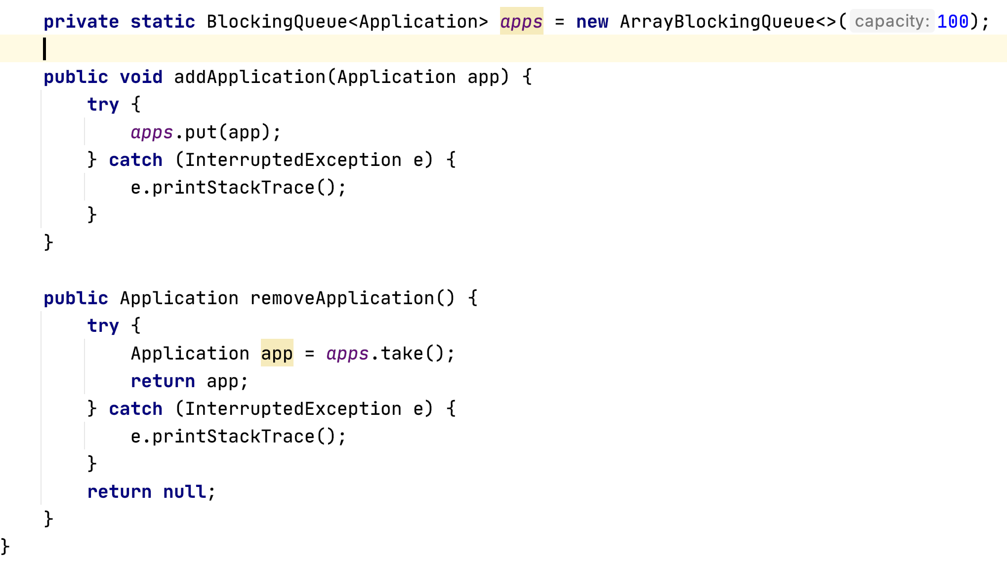
Blocking Queue Example

