Slide 1
.NET Core and Kubernetes
Glenn Condron
glenn@microsoft.com
@condrong
Brady Gaster
bradyg@microsoft.com
@bradygaster
Notes:
Brady - 2 min
Introductions

Slide 2
Introduction
Agenda
Sample app architectural overview
The new Worker Template
Configuration with Azure App Configuration Service
Messaging with Azure Service Bus Topics, Subscriptions, and Sessions
gRPC for internal-cluster APIs
Kubernetes tools used for Visual Studio and Visual Studio Code
Deployment with Azure DevOps
Notes:
Brady - 5 min
Intro the scenario, set the stage

Slide 3

Sample App - Rochambot
Rock, paper, scissors game
Humans play an army of bots
Each bot is a microservice
Some ground rules
Data is written via Topics (never direct)
Microservices don’t share databases
Minimal shared code between microservices
Notes:
Glenn – 10 mins
Talk about the rules of the road, our tenets, etc.

Slide 4
Demo: A quick look at Rochambot
Notes:
Glenn – 12 mins

Slide 5





App Flow
Azure Kubernetes Cluster
Web
Workers
Web & Workers deployed to AKS
Configured from Azure App Config
Azure App Configuration
Notes:
Brady – 13 mins

Slide 6
Code: Configuring with Azure App Configuration
Notes:
Brady – 15 min
Show the way we wire up the config
Point out that IConfiguration is being used everywhere, as if it were appsettings files
Show the settings in the portal

Slide 7

App Flow
Azure Service Bus
Web & Workers deployed to AKS
Configured from Azure App Config
Player requests a game
Player bot accepts game
Game Master sees match start
matchmaking
plays
results
Azure Kubernetes Cluster
Web
Workers
Azure App Configuration
Notes:
Glenn – 17 mins
Point out that the web posts a message to a topic
Point out how the other services have subscribed to, and respond to, the message

Slide 8
Code: A look at messaging with Azure Service Bus Topics, Subscriptions, and Sessions
Notes:
Glenn – 20 mins
Show some of the messaging code
Don’t talk about our difficulties yet – later in the talk

Slide 9


App Flow
Azure Service Bus
Web & Workers deployed to AKS
Configured from Azure App Config
Player requests a game
Player bot accepts game
Game Master sees match start
Game Master records match start
matchmaking
plays
results
Azure Kubernetes Cluster
Web
Workers
Azure App Configuration
Azure Cosmos DB
Notes:
Brady – 21 mins

Slide 10
Code: Saving data with Cosmos DB
Notes:
Brady – 25 mins
Show the data-access classes in GameMaster

Slide 11
App Flow
Azure Service Bus
Web & Workers deployed to AKS
Configured from Azure App Config
Player requests a game
Player bot accepts game
Game Master sees match start
Game Master records match
Player makes a play
Bot makes a play
Game Master sees the move
Game Master saves the move
matchmaking
plays
results
Azure Kubernetes Cluster
Web
Workers
Azure App Configuration
Azure Cosmos DB
Notes:
Glenn – next three slides end at 30 mins

Slide 12
App Flow
Azure Service Bus
Web & Workers deployed to AKS
Configured from Azure App Config
Player requests a game
Player bot accepts game
Game Master sees match start
Game Master records match
Player makes a play
Bot makes a play
Game master sees the move
Game Master saves the move
Game Master posts game results message
Player gets score
Bot gets result
Game Master saves the result
matchmaking
plays
results
Azure Kubernetes Cluster
Web
Workers
Azure App Configuration
Azure Cosmos DB
Notes:
Glenn – next two slides end at 30 mins

Slide 13

App Flow
Azure Service Bus
Web & Workers deployed to AKS
Configured from Azure App Config
Player requests a game
Player bot accepts game
Game Master sees match start
Game Master records match
Player makes a play
Bot makes a play
Game master sees the move
Game Master saves the move
Game Master posts game results message
Player gets score
Bot gets result
Game Master saves the result
UI Updated via gRPC API
matchmaking
plays
results
Azure Kubernetes Cluster
Web
Workers
Azure App Configuration
Azure Cosmos DB
Notes:
Glenn – 30 mins

Slide 14
Code: the gRPC game and leaderboard APIs
Notes:
Brady – 40 mins
Show the .csproj files and how one’s server and one’s client
Show the proto files and how they’re the same

Slide 15


Dev Publish Flow
Azure Kubernetes Cluster
Create the AKS cluster
Package code into Docker images
Notes:
Brady – end segment at 45 mins

Slide 16
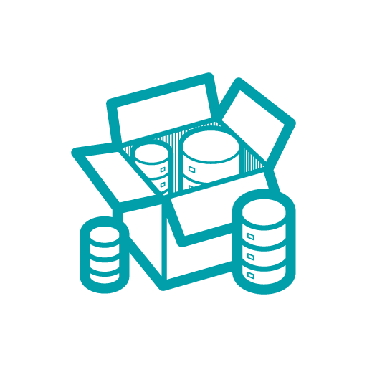
Dev Publish Flow
Azure Kubernetes Cluster
Create the AKS cluster
Package code into Docker images
Publish images to an image repository
Container Registry
Notes:
Brady – end segment at 45 mins

Slide 17
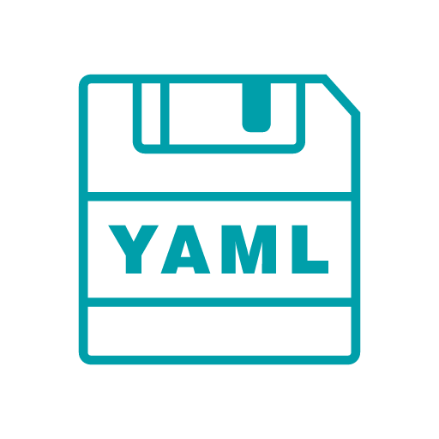
Dev Publish Flow
Azure Kubernetes Cluster
Create the AKS cluster
Package code into Docker images
Publish images to an image repository
Author Helm deployment templates
Container Registry
Notes:
Brady – end segment at 45 mins

Slide 18
Dev Publish Flow
Azure Kubernetes Cluster
Web
Workers
Create the AKS cluster
Package code into Docker images
Publish images to an image repository
Author Helm deployment templates
Apply the Helm templates to the cluster
Container Registry
Notes:
Brady – end segment at 45 mins

Slide 19
Code: Deploying with Helm and VS/VS Code
Notes:
Brady – 50 mins
Show the VS Code tools
Talk about Dev Spaces and how it enables collaborative development

Slide 20
Resources
.NET Microservices https://dotnet.microsoft.com/apps/aspnet/microservices
Using Workers as Windows Services https://devblogs.microsoft.com/aspnet/net-core-workers-as-windows-services/
Using Workers with ACI https://devblogs.microsoft.com/aspnet/dotnet-core-workers-in-azure-container-instances/
Kubernetes Tools for Visual Studio https://aka.ms/kubernetes-for-vs
Kubernetes Tools for Visual Studio Code https://code.visualstudio.com/docs/azure/kubernetes
Azure App Configuration http://aka.ms/appconfig
Health Checks https://aka.ms/dotnetcore-healthchecks
Notes:
Glenn – 60 mins
Wrap up, talk about how we’ll be open-sourcing it post-conference

Slide 21
Please use EventsXD to fill out a session evaluation.
Thank you!

